Slide 1



MANUFACTURING ANALYTICS • PYTHON FOR DATA SCIENCE
Production Efficiency, Quality & Sales
Performance Analysis
A data-driven study of AutoDrive Motors Ltd. across Passenger and Commercial Vehicle plants
Prepared by : Mohammed Abdulla | PGDM – Business Analytics, ISME Bangalore
Course : Python for Data Science | Company: AutoDrive Motors Ltd.

Slide 2





PROJECT OVERVIEW
Objective & Scope of Analysis
Business Objective
AutoDrive Motors Ltd. wants to understand how well its plants are running, how good the vehicles they build are, and how well those vehicles sell — so leadership can make smarter, data-backed decisions across Passenger (PV) and Commercial (CV) vehicle lines.
1
2
3
4
5
Data Preparation
Plant-wise Analysis
Vehicle Category
Quality Analysis
Production Trend
Load, clean, and explore the manufacturing dataset
Compare output, efficiency & cost across plants
PV vs CV: production, defects & warranty claims
Cost vs defects, inspection scores by plant
Monthly output over a two-year period
AutoDrive Motors Ltd. | Manufacturing Analytics
2

Slide 3
STEP 1
Data Preparation
1,200
15
0
0
4 Plants
vehicle production records
columns of manufacturing & sales data
missing values found
duplicate rows found
Plant A, B, C, D | 2 Vehicle Types: PV & CV
load_and_check.py
Columns Captured
df = pd.read_csv("AutoDrive_Motors_Manufacturing_Dataset_1200.csv")
print("Missing Values:")
print(df.isnull().sum())
print("Duplicate Rows:", df.duplicated().sum())
Production_ID, Date, Month, Year, Plant, Vehicle_Type, Shift, Units_Produced, Production_Cost, Defects, Defect_Rate, Inspection_Score, Warranty_Claims, Sales, Efficiency
Interpretation & Business Insight
The dataset covers 1,200 clean production records spanning 15 fields — plant, vehicle type, cost, defects, inspection score, warranty claims, and sales. With zero missing values and zero duplicates, the data is reliable and ready for analysis without any cleaning overhead, so the plant, quality, and sales comparisons ahead can be trusted at face value.
AutoDrive Motors Ltd. | Manufacturing Analytics
3

Slide 4

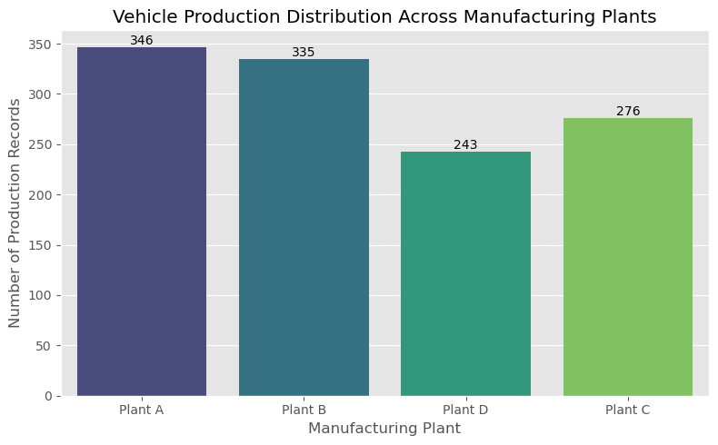
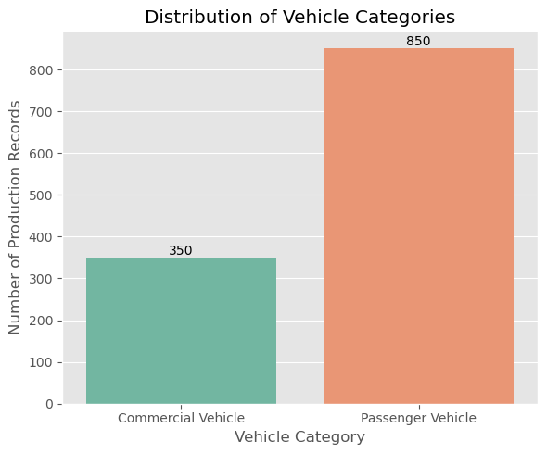
STEP 2
Exploratory Data Analysis — First Look
Chart 1: Production Records by Plant
Chart 2: Vehicle Category Split (PV vs CV)
Interpretation
Plant A holds the largest share of production records (346), followed by Plant B (335), Plant D (276) and Plant C (243). On the vehicle side, Passenger Vehicles (850 records) dominate the line-up over Commercial Vehicles (350) — so PV performance will carry more weight in the company's overall numbers.
AutoDrive Motors Ltd. | Manufacturing Analytics
4

Slide 5
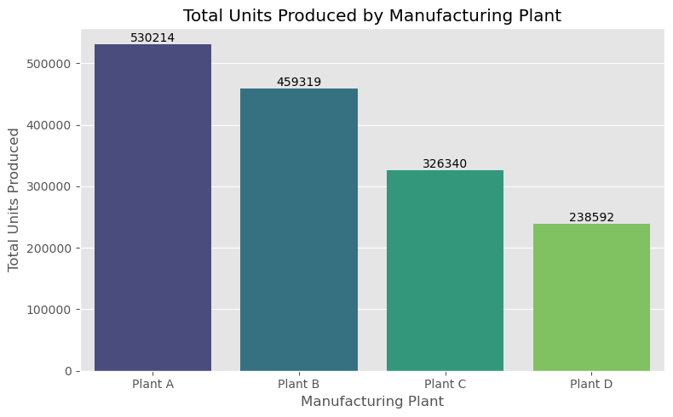
STEP 3.1
Plant-wise Production Analysis
plant_production.py
plant_production = df.groupby('Plant')['Units_Produced']\
.sum().reset_index()
sns.barplot(data=plant_production,
x='Plant', y='Units_Produced')
Interpretation
Plant A leads with 530,214 units, followed by Plant B (459,319) and Plant C (326,340). Plant D trails with 238,592 units — roughly half of Plant A's output. This points to a clear gap in manufacturing capacity or production planning between the top and bottom plants.
Total Units Produced by Manufacturing Plant
AutoDrive Motors Ltd. | Manufacturing Analytics
5

Slide 6
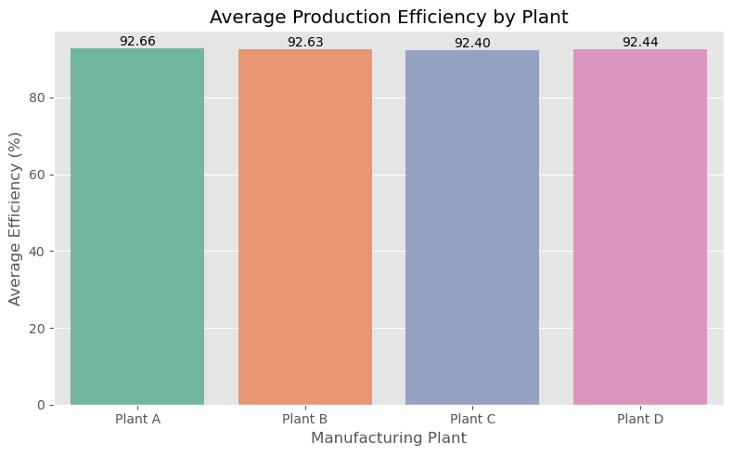
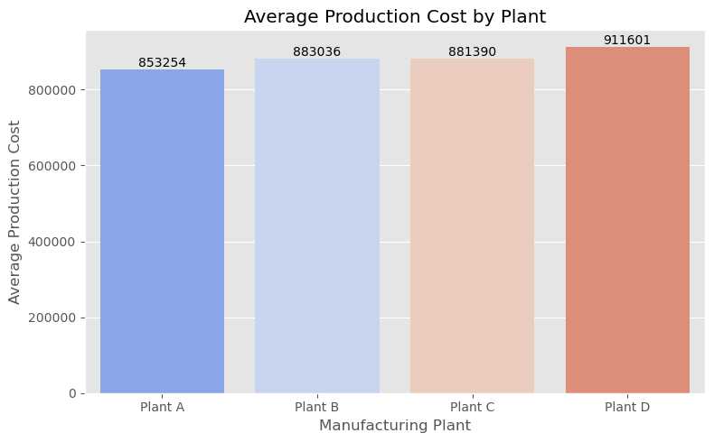
STEP 3.2
Plant Efficiency & Production Cost
Average Production Efficiency by Plant
Average Production Cost by Plant
Interpretation & Business Insight
Efficiency is close across all four plants (92.4%–92.7%), so no plant is dramatically wasting capacity. Cost tells a different story: Plant A runs the cheapest at ₹8.53 lakh average per batch, while Plant D is the costliest at ₹9.12 lakh. Since efficiency barely differs, Plant D's higher cost is likely coming from quality issues, rework, or resource use rather than genuine production complexity — a good target for cost-reduction efforts.
AutoDrive Motors Ltd. | Manufacturing Analytics
6

Slide 7

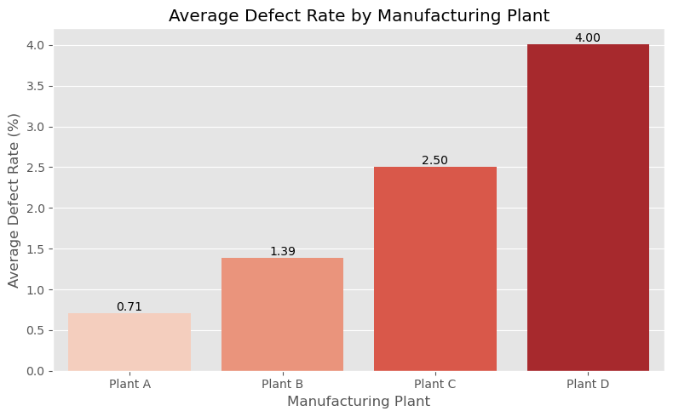

STEP 3.3
Plant Defect Rate & Best-Performing Plant
Best Manufacturing Plant: PLANT A
Highest output, lowest defect rate (0.71%), lowest cost, and top sales — the clear benchmark plant.
Interpretation
Defect rate rises sharply from Plant A (0.71%) through Plant B (1.39%) and Plant C (2.50%) to Plant D (4.00%) — nearly a six-fold jump. Combined with its lower output and higher cost, Plant D needs the most urgent attention on quality control.
Average Defect Rate by Manufacturing Plant
AutoDrive Motors Ltd. | Manufacturing Analytics
7

Slide 8


PLANT-WISE RECOMMENDATIONS
Reducing Defects & Improving Plant Efficiency
1
Roll out Plant A's production practices — its process discipline — to all other plants.
2
Reduce production costs at Plant D without cutting corners on quality.
3
Increase preventive maintenance to cut defects and improve equipment reliability.
4
Strengthen quality inspections specifically at Plant C and Plant D.
5
Track efficiency and defect rate monthly through a shared performance dashboard.
AutoDrive Motors Ltd. | Manufacturing Analytics
8

Slide 9
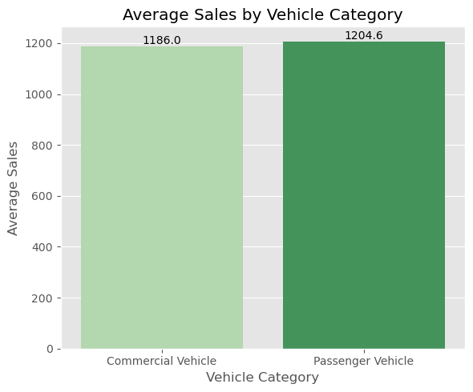
STEP 4.1
Vehicle Category Performance — PV vs CV
Metric | Commercial (CV) | Passenger (PV)
Avg. Units Produced | 1,280.16 | 1,301.66
Avg. Sales | 1,186.01 | 1,204.55
Avg. Defect Rate | 2.08% | 1.94%
Avg. Warranty Claims | 13.77 | 12.68
Avg. Efficiency | 92.58% | 92.54%
Average Sales: Passenger vs Commercial Vehicles
Interpretation
Passenger Vehicles come out ahead on almost every measure: more units produced, higher sales, a lower defect rate, and fewer warranty claims than Commercial Vehicles. Efficiency is nearly identical between the two, so the PV line isn't winning on speed — it's winning on quality and market demand.
AutoDrive Motors Ltd. | Manufacturing Analytics
9

Slide 10
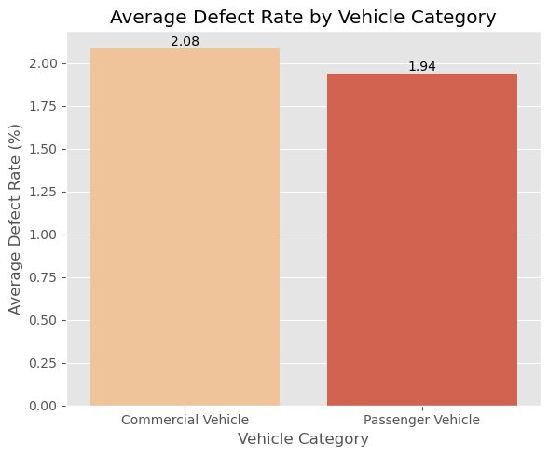
STEP 4.2
Quality Comparison & Best Vehicle Category
Best Vehicle Category: PASSENGER VEHICLES
Higher production, higher sales, and better quality outcomes overall.
Business Insight
PV vehicles produce fewer defects per unit and generate fewer warranty claims, meaning customers experience fewer post-purchase problems. Since PV also drives higher sales volume, the company should protect and expand this line while applying the same process discipline to lift CV quality.
Average Defect Rate: PV vs CV
AutoDrive Motors Ltd. | Manufacturing Analytics
10

Slide 11
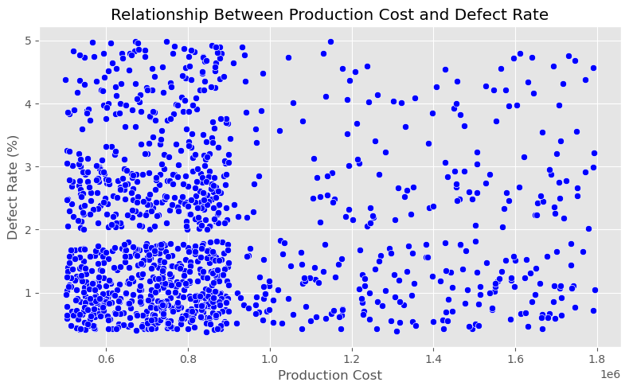
STEP 5.1
Quality Analysis — Cost vs Defect Rate
correlation_check.py
correlation = df['Production_Cost']\
.corr(df['Defect_Rate'])
print(round(correlation, 3))
# Output: 0.051
Interpretation
The correlation between production cost and defect rate is just 0.051 — essentially no relationship. Spending more per unit does not, by itself, buy fewer defects. Quality has to be fixed through process control and inspection discipline, not simply by increasing the production budget.
Production Cost vs Defect Rate (Scatter Plot)
AutoDrive Motors Ltd. | Manufacturing Analytics
11

Slide 12
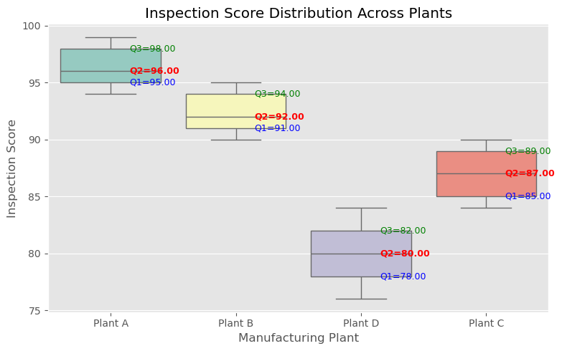
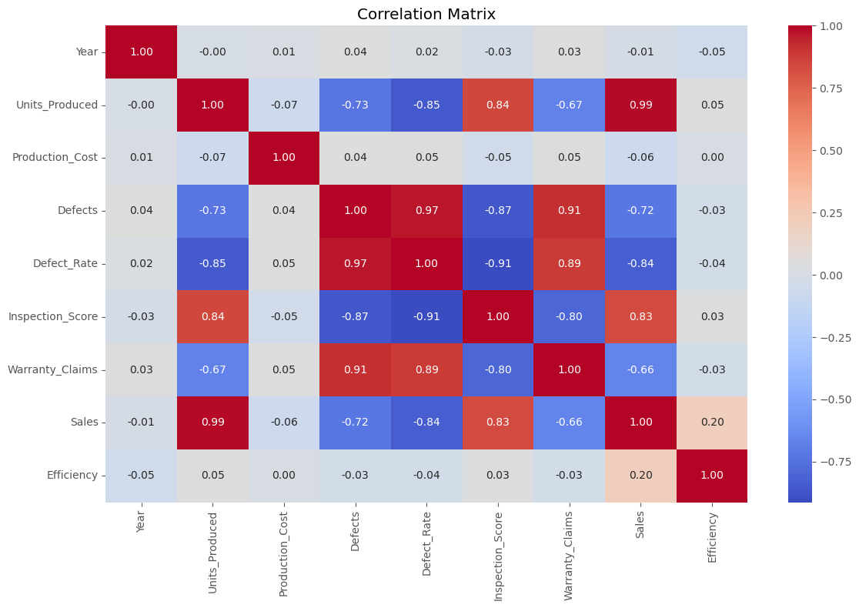
STEP 5.2
Inspection Scores & Overall Correlations
Inspection Score Distribution by Plant
Correlation Matrix — All Manufacturing Metrics
Business Insight
Inspection quality drops step by step from Plant A (median 96) to Plant D (median 80). The heatmap confirms why this matters: higher inspection scores go with lower defect rates and warranty claims (−0.91, −0.80), and Units Produced tracks Sales almost perfectly (0.99) — the company converts what it builds into what it sells.
AutoDrive Motors Ltd. | Manufacturing Analytics
12

Slide 13
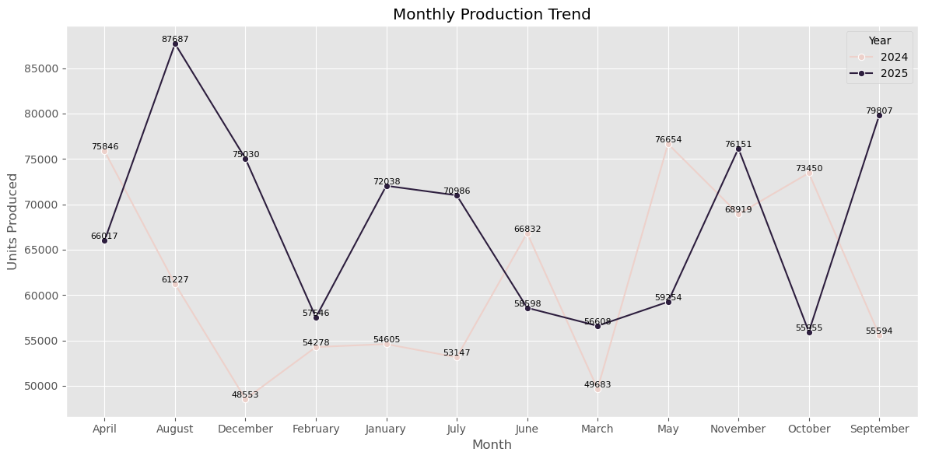
STEP 6
Monthly Production Trend (2024–2025)
monthly_trend.py
monthly = df.groupby(['Year','Month'])\
['Units_Produced'].sum()
sns.lineplot(data=monthly, x='Month',
y='Units_Produced', hue='Year')
Interpretation
Production swings across the year, with visible peaks and slower months — likely reflecting seasonal demand and planned maintenance windows rather than random variation.
Monthly Units Produced, Year over Year
AutoDrive Motors Ltd. | Manufacturing Analytics
13

Slide 14

CONCLUSION
Recommendations to Reduce Defects & Improve Efficiency
Standardize on Plant A's playbook
Tighten inspections where scores are low
Invest in preventive maintenance
Share Plant A's process discipline, maintenance routine, and inspection cadence with Plants B, C and D.
Prioritize Plant C and Plant D with more frequent, stricter quality checks.
Reduce equipment-driven defects instead of relying on higher spending alone.
Protect the PV growth engine
Monitor with a live dashboard
Plan capacity around demand
Keep investing in Passenger Vehicles while lifting CV quality to match.
Track efficiency, defect rate and inspection score monthly, by plant.
Use the monthly trend to align staffing and shifts with peak-season months.
AutoDrive Motors Ltd. | Manufacturing Analytics
14

Slide 15

CONCLUSION
Data-Driven Manufacturing Wins
This analysis covered data preparation, EDA, plant-wise performance, PV vs CV comparison, quality assessment and production trends for AutoDrive Motors Ltd. Plant A stands out as the manufacturing benchmark, and Passenger Vehicles as the stronger category — together pointing to clear, practical opportunities to cut defects, lift efficiency, and grow sales.
Thank you
Mohammed Abdulla | PGDM – Business Analytics, ISME Bangalore

