Slide 1

AI PROJECT
FRAUD DETECTION
Created by:
Abdullah Maqsood
Aqib Mahmood

Slide 2

Project IDEA:
In this project, we propose a fraud detection system that uses decision trees, a popular machine learning classification technique learned in the course. The project aims to address the real-world problem of fraud detection in financial transactions, which is a significant concern for banks and financial institutions. The system will use decision trees to analyze and classify transactions as fraudulent or non-fraudulent based on various features such as Loan Type, Income Type, Credit amount and other relevant information. The proposed system will be challenging and innovative enough to demonstrate our understanding of the concepts learned in the course.

Slide 3

Project Importance
Fraudulent transactions pose a significant threat to financial institutions and their customers. Traditional rule-based systems are not effective in detecting new fraud patterns, and manual review processes are time-consuming and prone to errors. Therefore, there is a need for an automated fraud detection system that can quickly and accurately identify fraudulent transactions.

Slide 4
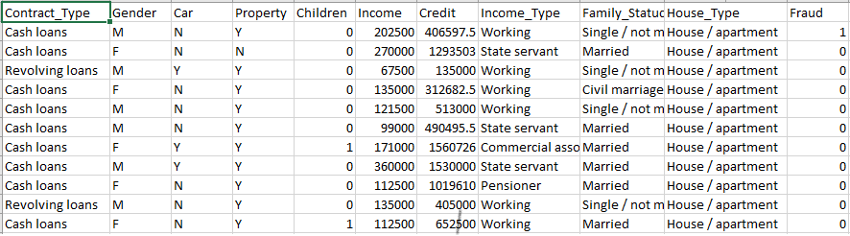
Data Collection
Data set taken from “Kaggle.com” and this is a csv file named as “Final Data.csv”
Total Records= 307,512 records
Total Attributes = 11 Attributes
Fraud is a Class Attribute

Slide 5
Data Division
Using the 1/3 data division method, we divided the original data set into two parts, one used for training and other is used for testing.
Data set used for Training contains 215,259 records in the “Final Data Training.csv” file.
Data set used for Testing contains 92,254 records in the “Final Data Testing.csv” file.

Slide 6
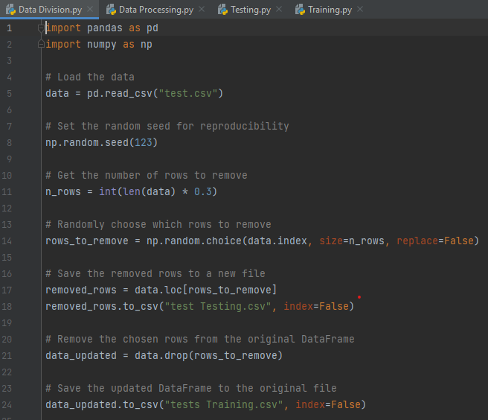
Data Division Code
We have written a code for Data Division to divide the original data into Testing and Training data.
It takes filename as input.
Read the data from original file and divide data set in two parts.
The divided data is stored in separate csv files.

Slide 7
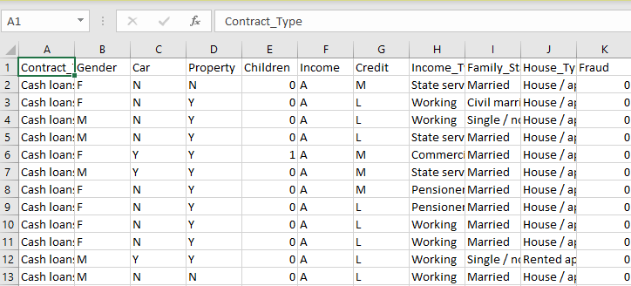
Data Processing
At this point we analyze that Income and Credit attribute have different values and when Decision Tree is made it will have a separate node for each value of Income and Credit that will increase space and time complexity of the algorithm.
We wrote a script that can assign each value in the Income and Credit attributes to their respective groups.
It will first find the max and min value of the Income or Credit column and then find difference and divide it with the number of groups.
In Income we have a set of groups {A, B, C, D, E} and in Credit we have a set of groups {L, M, N, O, P}.
This csv file is stored as ‘Final Data Trained’.
Code implemented in ‘Training.py’.

Slide 8
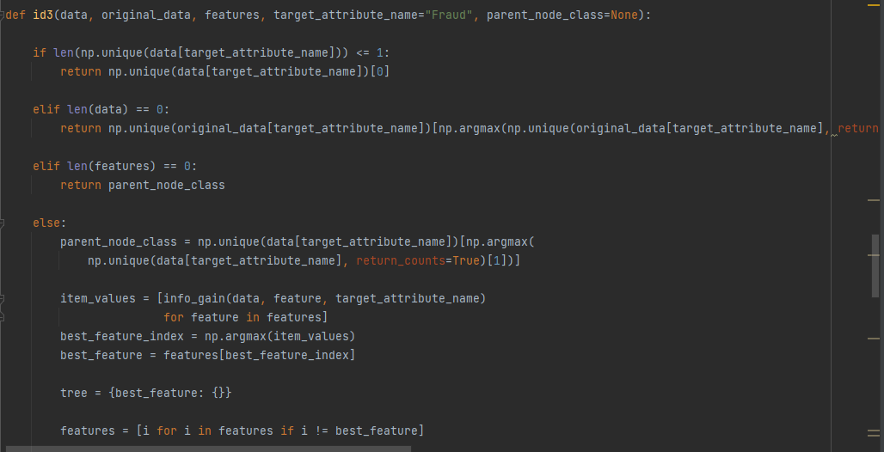
Training Our Model
We will read the data from the ‘Final Data Trained.csv’ file and then will make the decision tree.
The following function is used to create the decision Tree with the help of entropy function as well as information gain function.

Slide 9
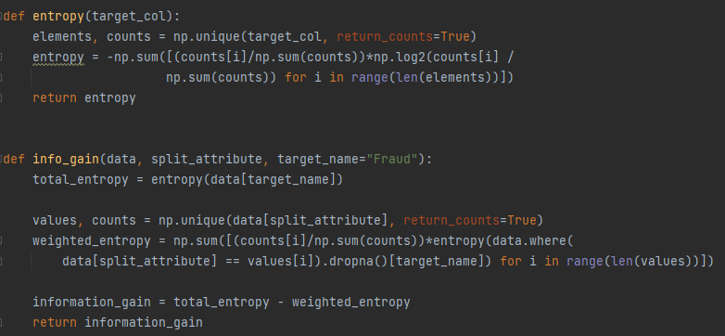
The first function is used to calculate the entropy value and the second function is used to calculate the Information gain.
After the Decision Tree is made so store in the file named as ‘decision_tree.joblib’, this is done so that Training is done is once and then testing can be done on the basis of this decision tree.

Slide 10
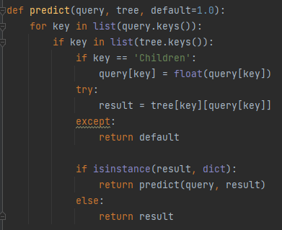
Testing Our Model
For testing we will load the decision tree from ‘decision_tree.joblib’ file and then also load the ‘Final Data Testing.csv’ file. In this csv file we contain the different integer value of attribute of Credit and Income, so we must place specific value in their relative groups.
Predict the value , after taking the input from user, using predict function.
After Prediction we are maintaining the Confusion matrix in order to find the accuracy when all the data is tested.
The accuracy on our test data is 92%.

Slide 11
Conclusion
We successfully developed and evaluated a fraud detection algorithm utilizing decision trees. The model used a dataset from Kaggle.com and partitioned it into training and testing sets. By establishing classes for income and credit attribute intervals, the model effectively identified patterns related to fraud. Trained on the 2/3 partition, the model was saved for convenient deployment. Testing on the remaining 1/3 partition resulted in a 0.92 accuracy score, as determined by the confusion matrix. This project demonstrates the efficacy of decision trees in fraud detection and lays the groundwork for future advancements and refinements.

