Slide 1

IILM UNIVERSITY
Greater Noida, Uttar Pradesh
SUMMER INTERNSHIP PRESENTATION
Machine Learning Implementation using Python
STUDENT NAME
ORGANIZATION
Abdul Haq
YuvaIntern.com
ENROLLMENT NUMBER
ROLE
CS2341391
Virtual ML Implementation Intern
PROGRAM & SEMESTER
DURATION
B.Tech CSE, 7th Semester
July 2 – August 6, 2026 (Remote)

Slide 2
OVERVIEW
What This Presentation Covers
01
Organization Profile
02
Problem Statement & Objectives
About YuvaIntern and the internship program
The challenge addressed and goals set
03
Tools & System Architecture
04
Weekly Methodology
Python stack and the ML pipeline design
How the five-week project plan unfolded
05
Outcomes & Reflection
06
Certificate of Completion
What was learned and delivered
Proof of successful completion
2

Slide 3
ORGANIZATION PROFILE
About YuvaIntern.com
YuvaIntern.com is a virtual internship platform offering structured, mentor-guided programs across Machine Learning, Data Science, Web Development, and Digital Marketing.
5 Weeks
Structured internship duration
Operates in association with Henry Harvin Education
Recognized under the National Skill Development Corporation (NSDC)
Emphasizes self-paced, project-based learning
Includes weekly virtual seminars and peer collaboration
100% Remote
Fully virtual delivery mode
NSDC
Skill development recognition
3

Slide 4
INTRODUCTION
Problem Statement
Many students who complete introductory ML coursework struggle to translate theoretical knowledge into a coherent, end-to-end project.
How can a machine learning solution be strategically planned and designed — from problem formulation and algorithm selection through experimentation, implementation, and ethical deployment — using core Python tools such as Pandas, Scikit-learn, and Matplotlib?
This internship was framed around answering this question by building the strategic and planning competencies essential for real-world ML projects — skills that are often overlooked in purely code-focused learning.
4

Slide 5
OBJECTIVES
Project Objectives
Formulate a clear problem statement and project roadmap
Research and select suitable ML algorithms
1
2
Design a robust experimental & evaluation framework
Plan a modular, maintainable Python code architecture
3
4
Develop a responsible deployment & ethics strategy
Reflect critically on the planning process
5
6
5

Slide 6
TECHNOLOGY STACK
Tools & Technologies Used
Python 3
Pandas
Scikit-learn
Core programming language for all ML concepts
Data cleaning, transformation & exploratory analysis
Algorithm reference, model design & evaluation
Matplotlib
Git
Virtual Seminars
Visualization and result interpretation
Version control for collaborative code planning
Weekly mentor guidance & peer collaboration
6

Slide 7
SYSTEM DESIGN
ML Pipeline Architecture
Data
Ingestion
→
Cleaning &
Preprocessing
→
Feature
Engineering
→
Model
Training
→
Evaluation
→
Deployment
Interface
A linear, modular pipeline was chosen for clarity, ease of debugging, and suitability for a foundational-level ML project — each stage is an independently testable component.
7

Slide 8
METHODOLOGY
Weekly Roadmap — Part 1
WEEK 1
WEEK 2
Project Planning & Strategy
Algorithm Exploration & Model Design
Defined the problem statement and hypothesis, reviewed public ML case studies for context, and outlined a methodology covering data collection, feature identification, and algorithm selection. Built a five-week timeline with an initial risk assessment.
Compared Logistic Regression, Decision Trees, and Random Forest on applicability, complexity, and robustness. Selected an ensemble (Random Forest) approach and drafted a baseline architecture with pseudocode from input to prediction.
8

Slide 9
METHODOLOGY
Weekly Roadmap — Part 2
WEEK 3
WEEK 4
Experimental Design & Metrics
Implementation Strategy
Selected accuracy, precision, recall, and F1-score to capture trade-offs beyond raw accuracy. Proposed k-fold cross-validation and an error-analysis process, with stratified sampling to mitigate data-leakage and imbalance risks.
Outlined a modular code architecture with independently testable components. Drafted pseudocode for preprocessing, training, and evaluation, and defined best practices: version control, unit testing, and PEP 8 standards.
9

Slide 10
METHODOLOGY
Weekly Roadmap — Part 3
WEEK 5
Deployment Planning, Ethics & Reflection
Proposed containerized deployment with an API layer and drift-monitoring for periodic retraining; addressed bias mitigation, transparency, and data-privacy safeguards; and closed with a reflective analysis of the internship's planning process.
Containerized Deployment
API Serving Layer
Drift Monitoring
Bias Mitigation
Data Privacy
Reflective Review
10

Slide 11
OUTCOMES
Expected Outcomes & Reflection
Complete week-by-week strategic blueprint across the ML lifecycle
Comparative understanding of multiple ML algorithms
A defined, defensible model-evaluation framework
A modular implementation strategy built for team maintainability
Awareness of ethical responsibilities in ML deployment
KEY TAKEAWAY
This internship strengthened the ability to think strategically about ML problems before implementation — and highlighted why documentation and risk-planning matter as much as code.
Next Step: implement the proposed pipeline end-to-end on a real dataset.
11

Slide 12
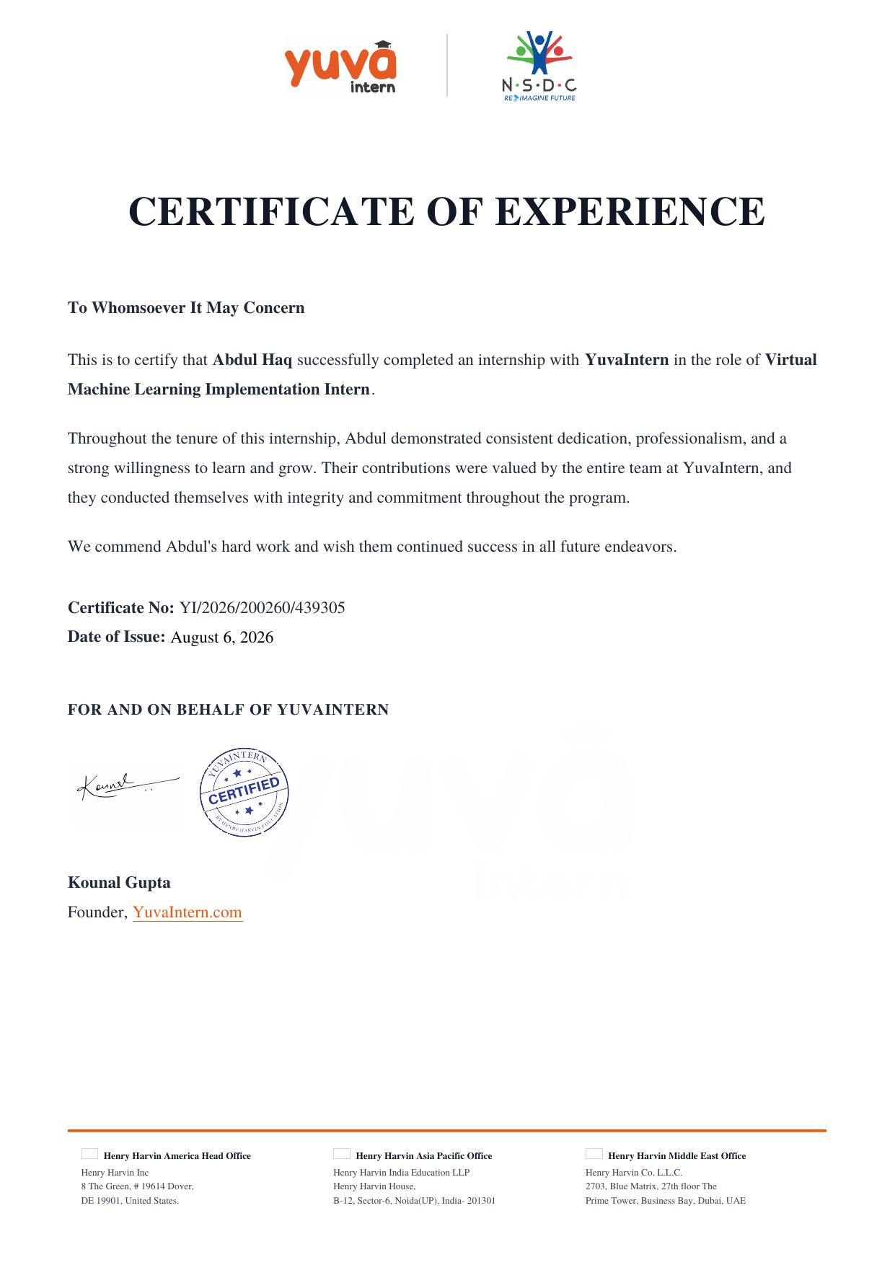
PROOF OF COMPLETION
Certificate of Experience
12

Slide 13
Thank You
Machine Learning Implementation using Python — Summer Internship at YuvaIntern.com
Abdul Haq | CS2341391 | B.Tech CSE, 7th Semester | IILM University

