Slide 1
USP Assignment- Implement Your Shell
Team Members
Abdul Khan (4NI17CS002)
Harsha Kumar (4NI17CS026)

Slide 2
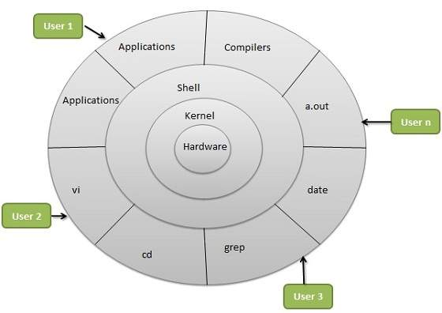
Shell Architecture

Slide 3
Shell Architecture
The architecture of a Linux System consists of the following layers −
Hardware layer − Hardware consists of all peripheral devices (RAM/ HDD/ CPU etc).
Kernel − It is the core component of Operating System, interacts directly with hardware, provides low level services to upper layer components.
Shell − An interface to kernel, hiding complexity of kernel functions from users. The shell takes commands from the user and executes kernel's functions.
Utilities − Utility programs that provide the user most of the functionalities of an operating systems.

Slide 4
Features
The following commands can be run on the shell:
cd
ls
pwd
mkdir
clear
date
help
pipe commands
exit

Slide 5
Features Added
Calculator: compute arithmetic operation
Addition : calc sum num1 num2
Subtraction : calc diff num1 num2
Multiplication : calc mult num1 num2
Division : calc div num1 num2
Owner
Time: Displays number of hours since 1-Jan-1970

Slide 6
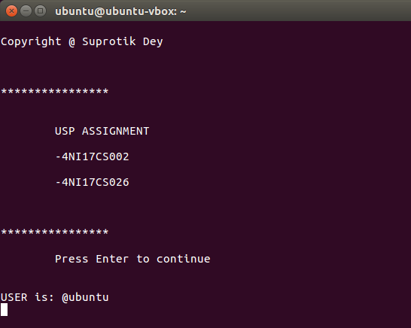
Sample Output
Command to compile and run
Output window ->

Slide 7
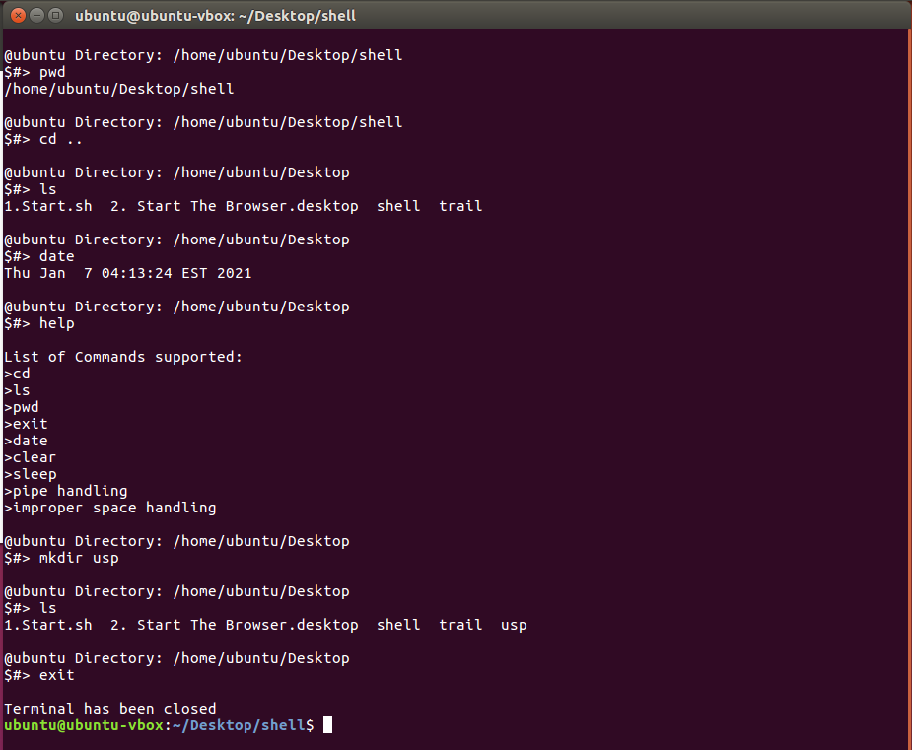
Sample Output

Slide 8
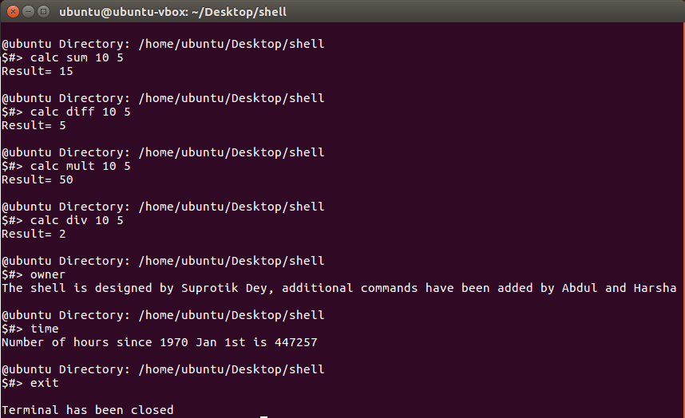
Output of Additional Features

Slide 9
Resources referred
GeeksforGeeks
https://www.geeksforgeeks.org/making-linux-shell-c/
Stack Overflow

Slide 10
Thank You

