Slide 1
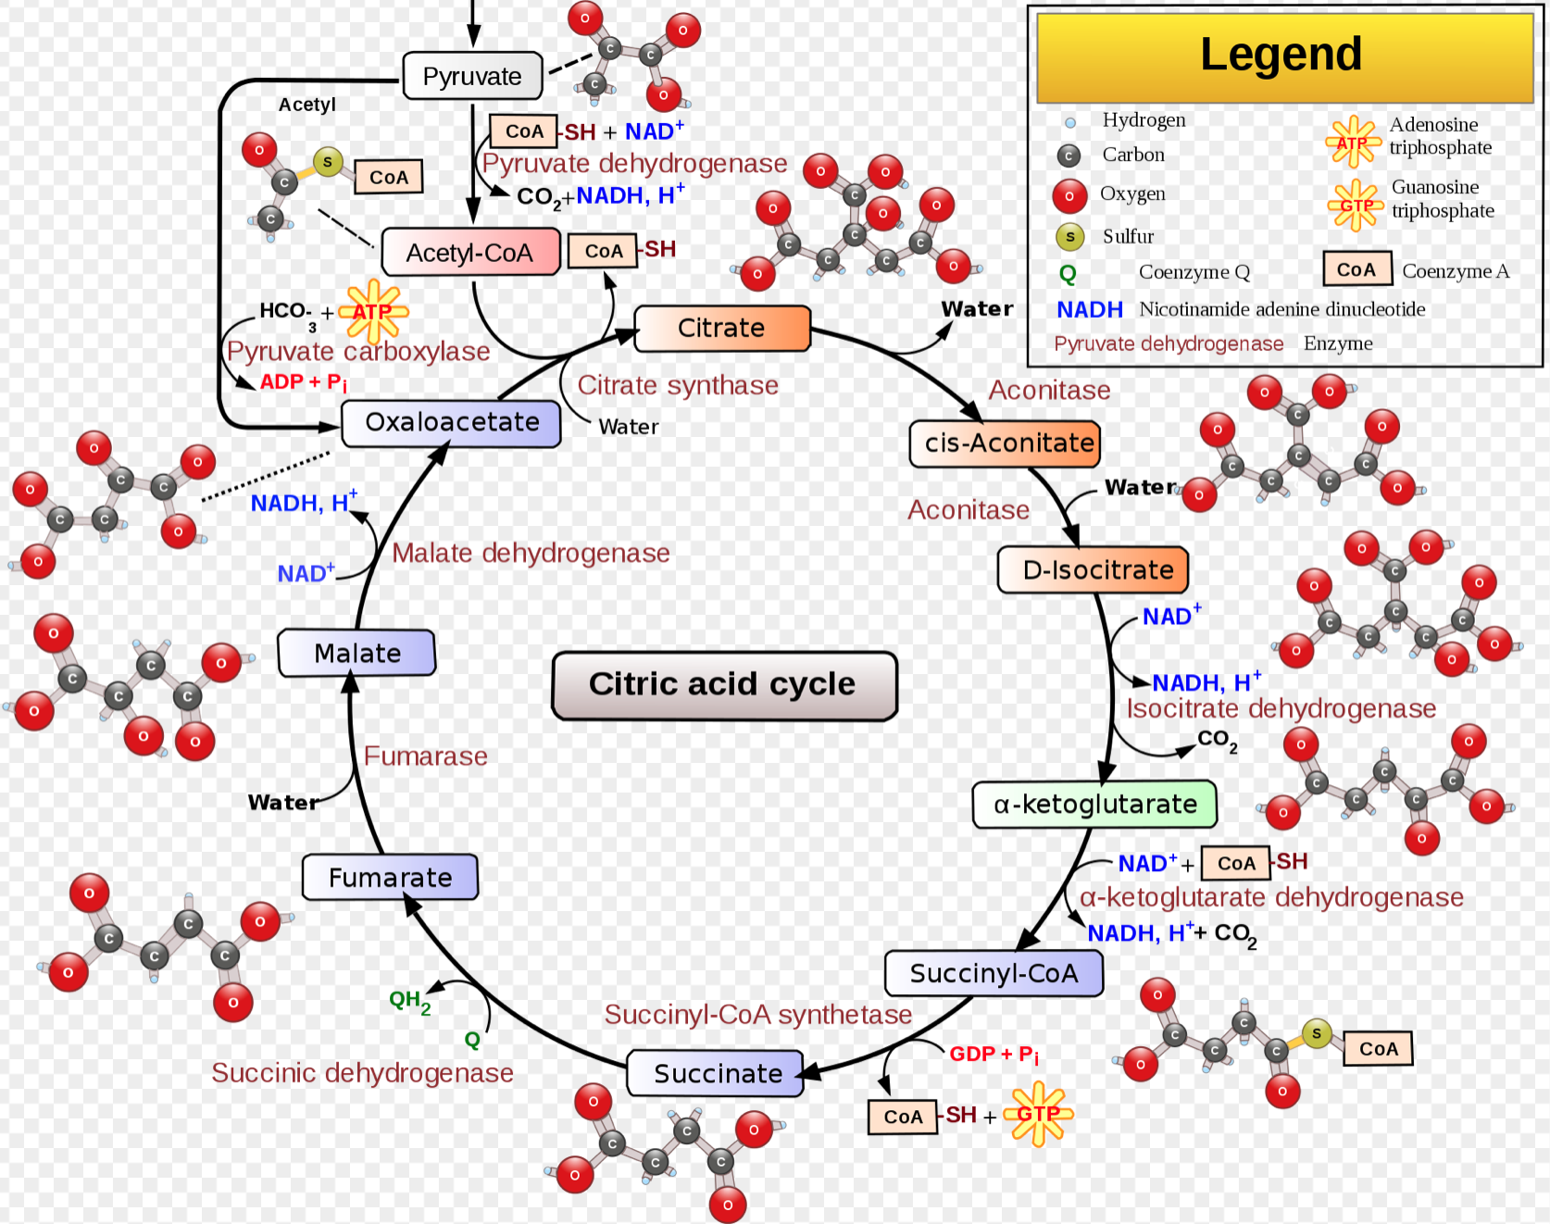
Krebs Cycle
Notice ATP, NADH and CO2 and H2O count. As these are critical molecular products that link to overall organism biochemical balance that this energy pathway relies on.

