Slide 1
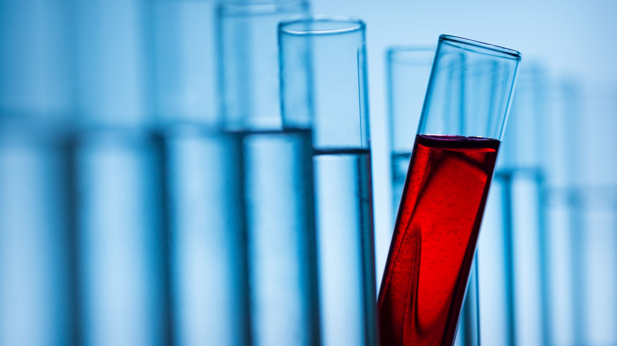
Biochemistry 101 Example
By Dr. Darrell Ross

Slide 2
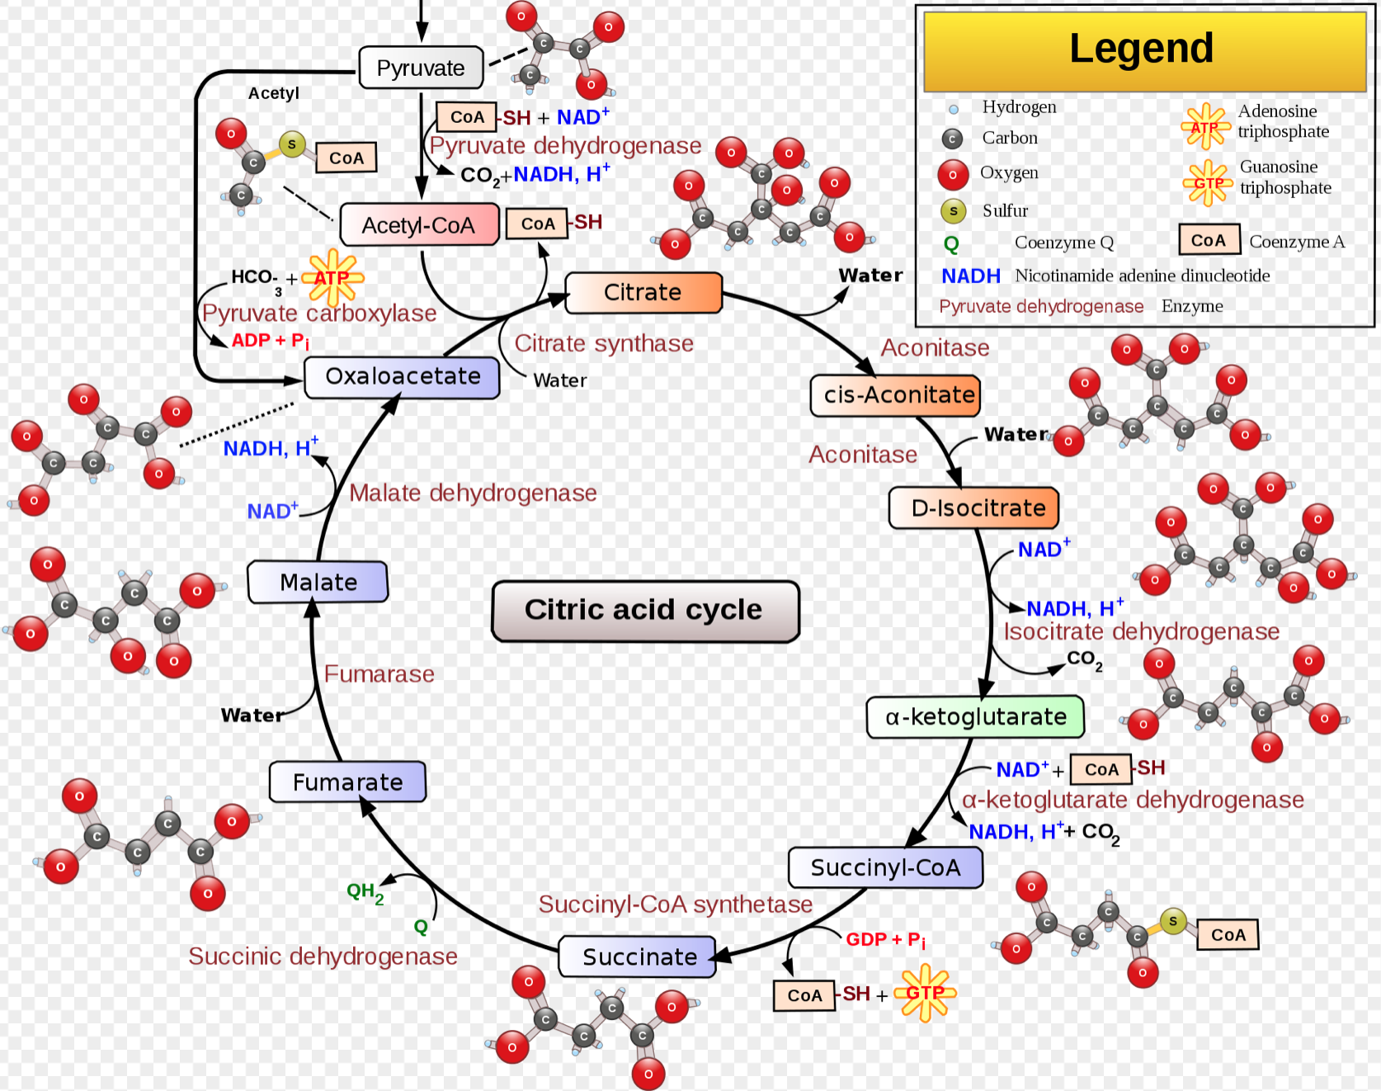
Krebs Cycle
Notice ATP, NADH and CO2 and H2O count. As these are critical molecular products that link to overall organism biochemical balance that this energy pathway relies on.

Slide 3
