Slide 1
SALES FORECASTING PROJECT
Predicting Future Retail Sales with Machine Learning
Time-Series Analysis · Feature Engineering · Regression Modeling · 30-Day Forecast
PRESENTED BY – ABDUL MAAZID
Data Science Project Report

Slide 2
Project Overview
Turning historical store transactions into an actionable 30-day sales forecast
1
Objective
2
Data Source
Forecast daily store sales using historical transaction data to support inventory and revenue planning.
Store sales transactions (2,121 records, 21 fields) spanning 2014-2017, covering orders, products, and regions.
3
Approach
4
Outcome
Aggregate to daily sales, engineer calendar and lag features, then train and compare three regression models.
A Random Forest model producing a 30-day forward sales forecast, ranked feature drivers, and model benchmarks.
Sales Forecasting Project
2

Slide 3
Dataset Overview
2,121
21
4 yrs
0
Transaction Records
Original Fields
2014 – 2017 Coverage
Missing Values
Key Fields Used
Sales Distribution
Order Date – transaction date
Sales – daily revenue (target variable)
Region / Category / Sub-Category
Customer, Product & Ship Mode fields
Metric | Value
Mean Sales | $349.83
Median Sales | $182.22
Std. Deviation | $503.18
Min / Max | $1.89 / $4,416.17
Sales Forecasting Project
3

Slide 4
Data Preparation & Cleaning
From raw transactions to a clean, continuous daily time series
1
Checked and confirmed zero missing values across all 21 fields
2
Removed duplicate transaction rows
3
Converted Order Date to a proper datetime type
4
Sorted all records chronologically by Order Date
5
Aggregated transactions into total daily sales
6
Reindexed to a continuous daily calendar, filling gap-days with 0 sales
Sales Forecasting Project
4

Slide 5
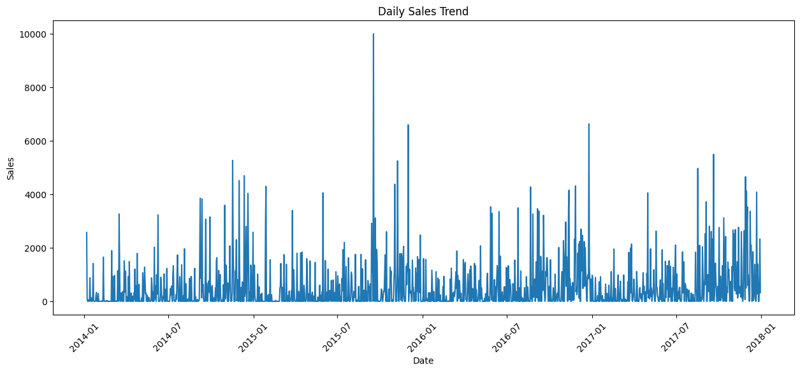
Daily Sales Trend
Raw daily sales are highly volatile — motivating monthly aggregation and lag features
Sales Forecasting Project
5

Slide 6
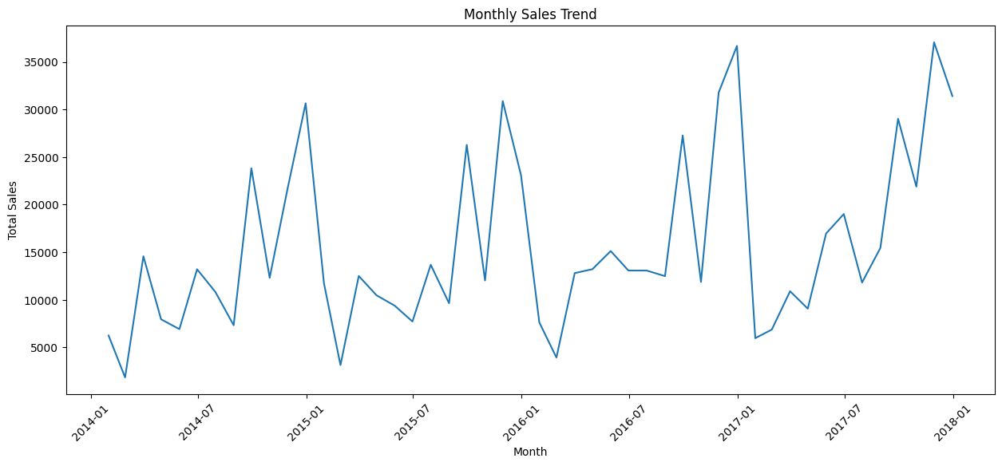
Monthly Sales Trend
Aggregating to monthly totals reveals a clearer growth pattern with seasonal peaks
Sales Forecasting Project
6

Slide 7
Feature Engineering
Two feature families give the models both calendar context and recent momentum
Calendar Features
Lag Features
Year
Previous Day Sales (t-1)
Month
Sales 7 Days Ago (t-7)
Day
Sales 30 Days Ago (t-30)
Day of Week
Gives the model short, weekly, and monthly memory of recent sales momentum. Rows with incomplete lag history were dropped.
Quarter
Captures recurring calendar-driven patterns such as weekday effects, month-end spikes, and quarterly cycles.
Sales Forecasting Project
7

Slide 8
Model Training & Comparison
80/20 chronological train-test split across three regression models
Model | MAE | RMSE | R² Score
Linear Regression | 638.96 | 938.65 | 0.059
Decision Tree | 714.77 | 1,123.43 | -0.348
Random Forest ★ Best | 617.59 | 928.08 | 0.080
Random Forest delivers the lowest error and the only positive R², making it the model used for the 30-day forecast. All three models show high error relative to typical daily sales, reflecting significant day-to-day volatility in the raw data.
MAE Average absolute prediction error, in sales dollars. RMSE Penalizes large errors more heavily. R² Share of sales variance explained by the model.
Sales Forecasting Project
8

Slide 9
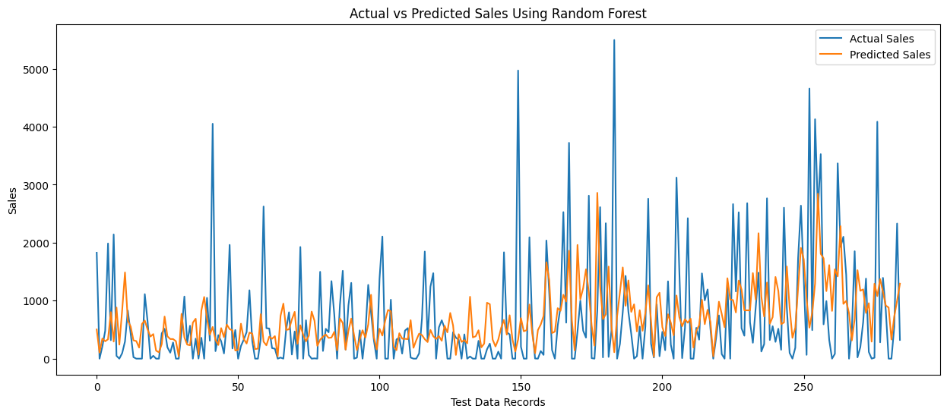
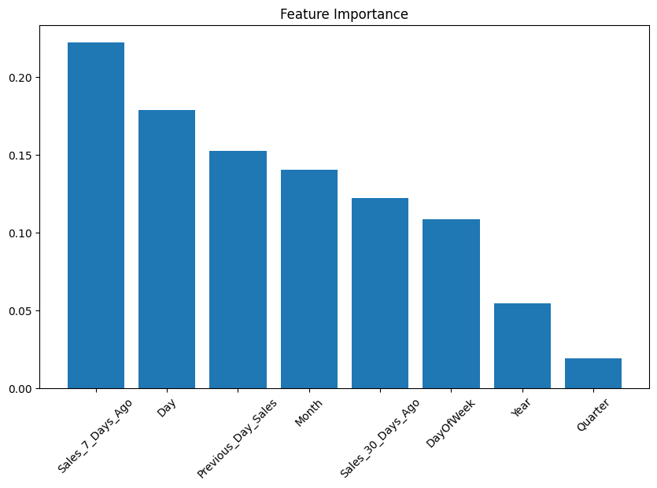
Model Performance & Feature Drivers
Actual vs Predicted Sales (Random Forest)
Feature Importance (Random Forest)
Sales from 7 days ago is the single strongest predictor, followed by day-of-month and previous-day sales — confirming that recent momentum drives near-term forecasts more than long-range calendar position.
Sales Forecasting Project
9

Slide 10
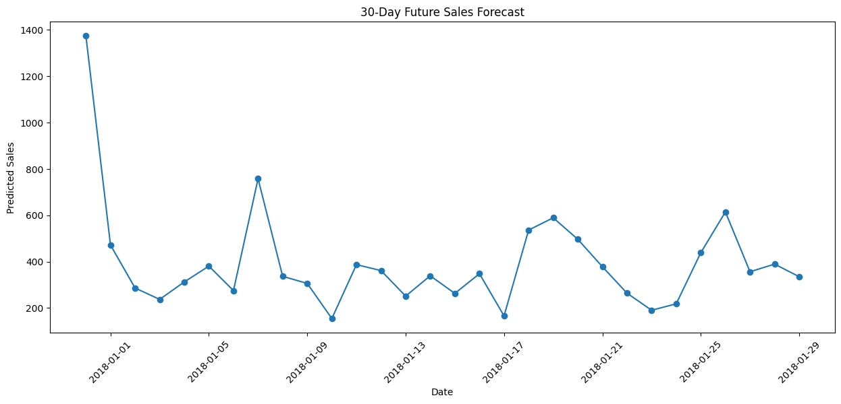
30-Day Sales Forecast & Conclusion
Key Takeaways
Random Forest projects daily sales between roughly $150 and $1,375 over the next 30 days
Recent-sales lag features (7-day, previous-day) are the dominant forecast drivers
Model accuracy is limited by high day-to-day volatility — low R² across all models
Recommended next steps: add promotional/holiday indicators, try gradient boosting, and forecast at weekly granularity to reduce noise
Sales Forecasting Project
10

