Slide 1
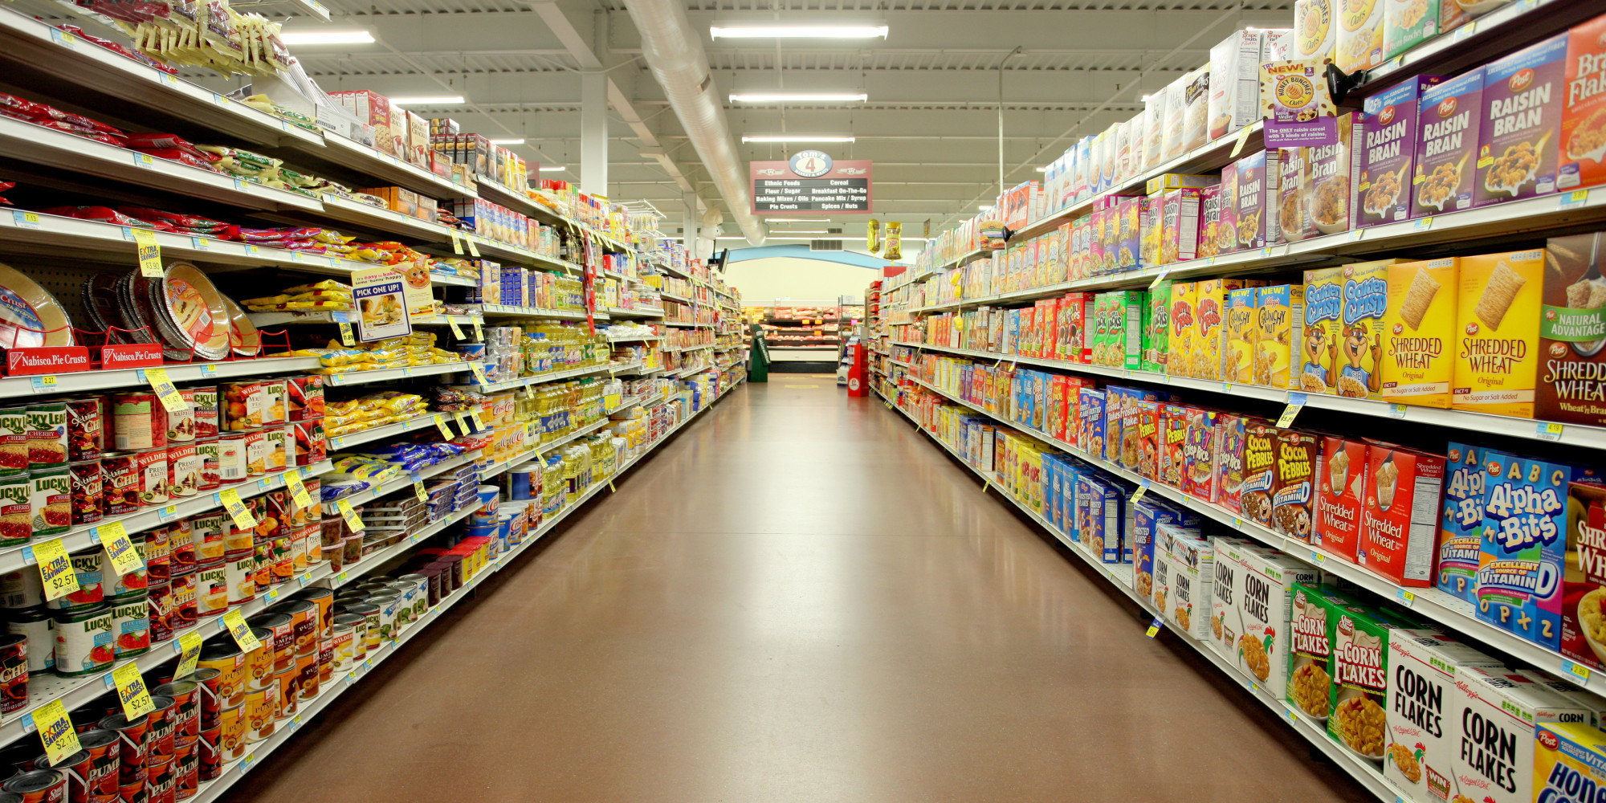

ANALYTICS ON RETAIL INDUSTRY - Sales predictor for Big Mart

Slide 2
Retail Industry
Retail is the sale of goods to end users by the purchaser. Manufacturers sell large quantities of products to retailers, and retailers attempt to sell those same quantities of products to consumers. It is basically the sale of goods and services from individuals or businesses to the end user.
RETAIL INDUSTRY
ORGANIZED
UNORGANIZED
TYPES OF RETAIL INDUSTRY
Departmental Stores
Super Markets E-Tailer Malls
General Stores

Slide 3
Role of Analytics in Retail Industry
Improved Consumer Experience
Better Strategic Decisions
Sales Prediction and Demand Forecasting
Problem Statement :
Our objective is to predict out the sales of each product at a particular store.

Slide 4
Project analysis slide 2
Project Analysis
6
1
Recommendation
Collection of Data
Objective
5
2
Prediction
Understand Problem Statement
4
3
Perform Machine
Learning Algorithms
Understand Data

Slide 5
Project analysis slide 3
Framework
Collecting Data
Data Preprocessing
Data Exploration
Model Building
Interpreting
Data sets are extracted from Analytics Vidhya
https://datahack.analyticsvidhya.com/contest/practice-problem-big-mart-sales-iii/
Imputation of Missing Data
Rectifying the irregularities
Feature Engineering
Understanding patterns
Supervised Learning Algorithms
Regression
Decision Tree
Ensemble Technique
Prediction

Slide 6
Project analysis slide 4
Retail Dataset
Product
Outlet
Display Area
Product Category
Product Price
Fat Content
Product
Weight
Outlet Type
Location
Year of Establishment
Outlet Size
Numerical
Categorical
Numerical
Categorical
Numerical
Categorical
Numerical
Categorical
Numerical

Slide 7
Project analysis slide 4
Retail Dataset
VARIABLES | DESCRIPTION
Item_Identifier | Unique Product ID
Item_Weight | Weight of product
Item_Fat_Content | Whether the product is low fat or not.
Item_Type | The category to which the product belongs.
Outlet_Identifier | Unique Store ID
Outlet_Size | The size of the store in terms of ground area covered.
Outlet_Location_Type | The type of city in which the store is located
Outlet_Type | Whether the outlet is just a grocery store or some sort of supermarket
Item_Visibility | The % of total display area of all products in a store allocated to the particular product.
Item_MRP | Maximum Retail Price of the product
Outlet_Establishment_Year | The year in which store was established.
Item_Outlet_Sales : | Sales of the product in the particular store. This is the variable to be predicted.

Slide 8
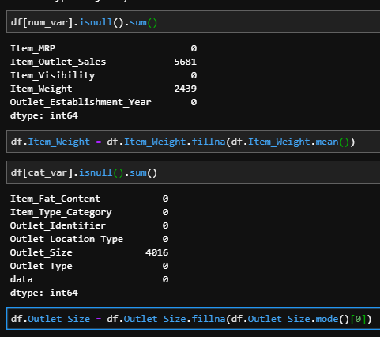
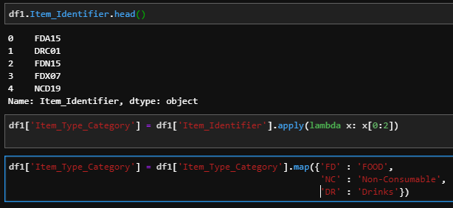
Project analysis slide 4
Data Pre-processing
Usually when ever we counter an id column, we drop it. But here we are generating a column derived from it which is useful to categorize items.
Categorical and numerical columns are separated and null values of those columns are treated with mode and mean respectively.

Slide 9
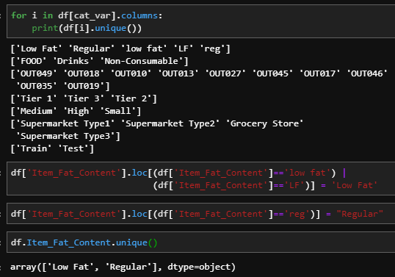
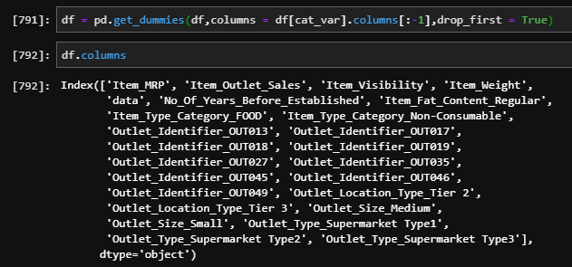
Project analysis slide 4
Data Pre-processing
There is a column in which there are different type of entries which means the same, so we are allocating one particular name to those different entries.
Converting categorical variables to dummy variables

Slide 10
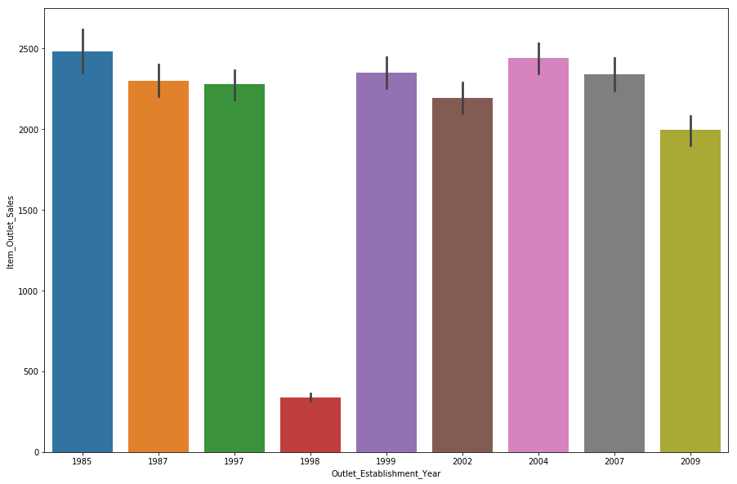
Project analysis slide 5
How Old is the Retail Outlet?
Establishment year has no significant influence on Outlet Sales

Slide 11
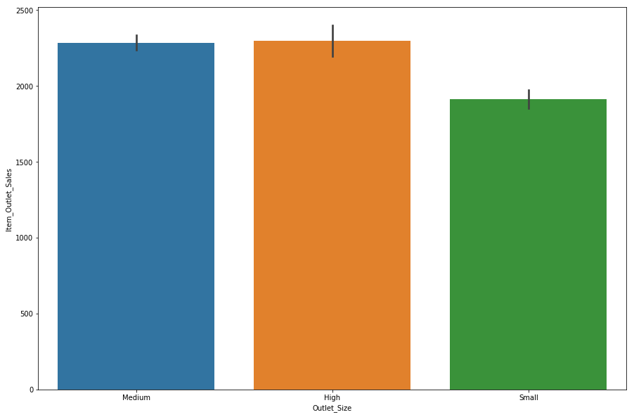
Project analysis slide 5
How does Size of Outlet influence Sales
- Size of the outlet has not significantly influenced Outlet Sales for Medium sized and High sized outlets

Slide 12
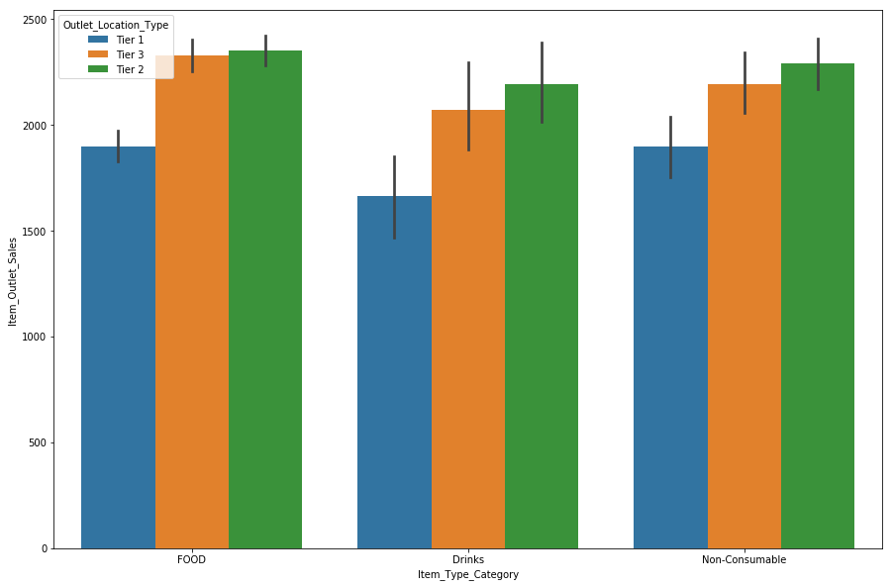
Project analysis slide 5
Consumer Purchase trends across Locations
Tier2 consumers tend to contribute to more Sales compared to Tier1 and Tier3
Consumers from all the considered locations tend to spend more on Food products

Slide 13
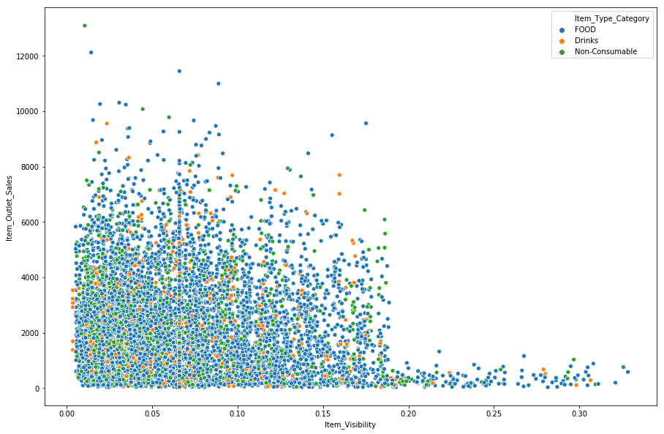
Project analysis slide 5
Products Visibility in the Retail Outlet
Food items are made easily available to customers
Item Visibility has not influenced the Sales
Increase in visibility above 0.2 has been adversely effecting Sales

Slide 14
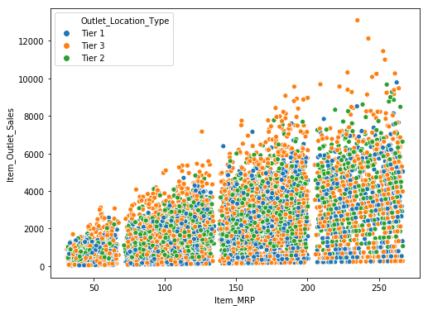
Project analysis slide 5
Products Price in the Retail Outlet
Customers in Tier3 are making more purchases irrespective of higher prices

Slide 15
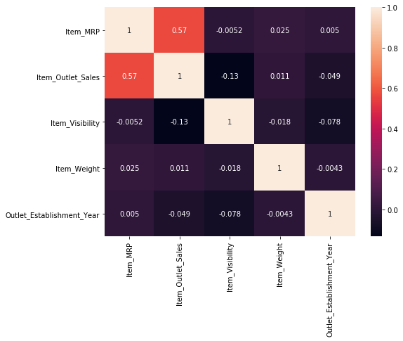
Project analysis slide 5
Understanding correlation between Numerical Factors
It is quite clear that there is no significant correlation between Sales of Outlet and between Other Attributes

Slide 16
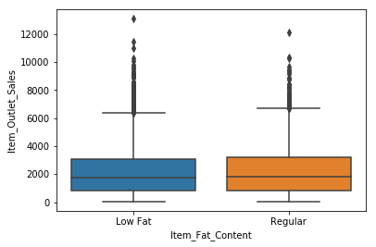
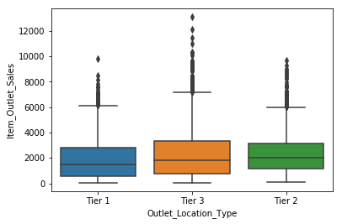
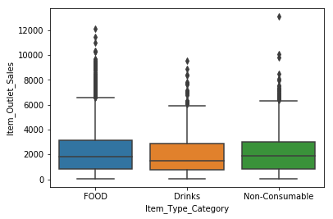
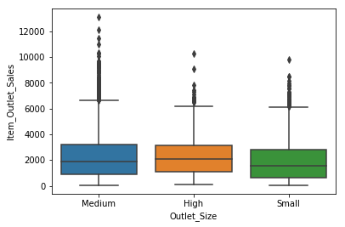
Understanding Categorical Factors

Slide 17
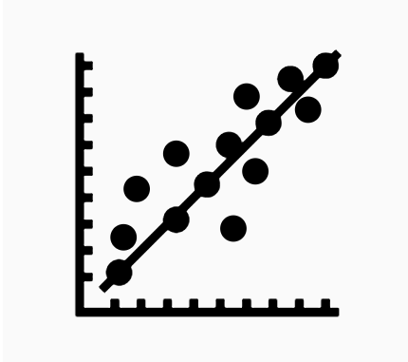
Linear Regression
Simple linear regression is useful for finding relationship between two continuous variables. One is predictor or independent variable and other is response or dependent variable.
Ridge
Lasso
Recursive Feature Elimination(RFE)

Slide 18
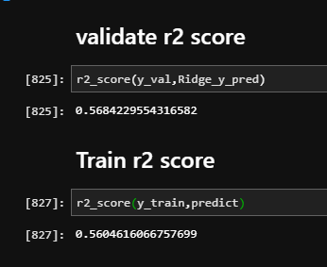
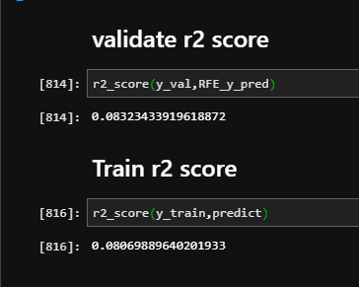
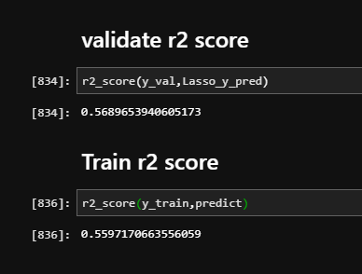
Linear Regression
RIDGE
Here the RFE validation r2 score is very less, hence we are not considering this while building our model.
RIDGE and LASSO are performing quite good compared to RFE. Hence we retain LASSO for model building.
The reason we retain only LASSO is if the β coefficients are not relevant it will set them to zero whereas RIDGE will not get rid of irrelevant features but rather minimize their impact on the trained model.
RFE
LASSO

Slide 19
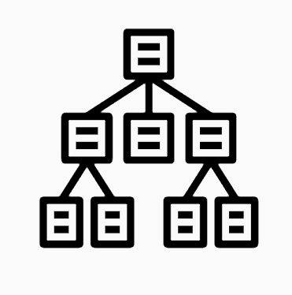
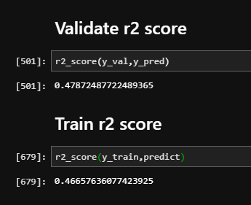
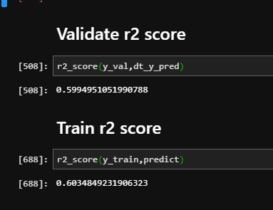
Decision Tree
Decision Tree is used to build the model.
Two models are build, one is without GridSearchCV and the other is with GridSearchCV.
AS the GridSearchCV method picks the optimal parameter from the grid search and uses it with the estimator selected by us, r2 score is high for this.
Hence we use Decision Tree along with GridSearchCV for model building.
Decision Tree
Decision Tree with GridSearchCV

Slide 20

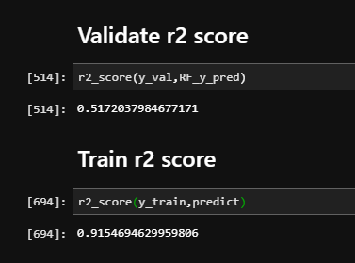
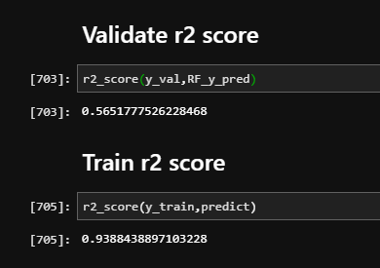
Random Forest
Random Forest is used for modelling.
Two models are build, one is without GridSearchCV and the other is with GridSearchCV.
If we observe here, the model is performing very well on train data, but it is failing to perform the same with validation data.
Such scenario is called Overfitting.
Same with the case of GridSearchCV.
Hence we wont consider Random Forest models in our model building.
Random Forest
Random Forest with GridSearchCV

Slide 21
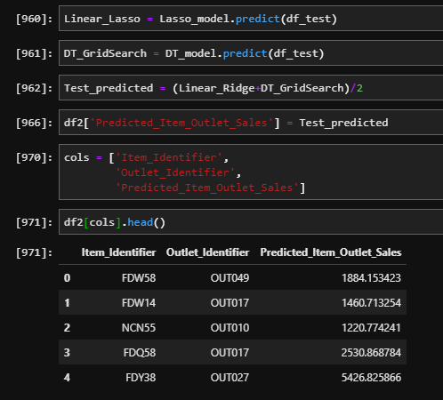
Predictions
From all the models, we choose Lasso and Decision Tree with GridSearchCV.
We will predict the sales using these models.
We will average the predicted sales that are predicted by these models and store it some variable.
We will add a column to our test dataset and feed these predicted values to that column.

Slide 22
Thank You!

