Slide 1
COURSE DESCRIPTION

Slide 2
Course title: RECOMMENDER SYSTEMS
Credit hours: 3h. Per week
Instructor: Assistant Prof. (Dr. Eihab Abdelhai)
E-mail: eaosman@bu.edu.sa
Students (send by e-mail, write full name or ID University Number)

Slide 3
Prerequisites for this course:
Data Mining
Are you know Data Mining? or
Are you studied Data Mining?

Slide 4
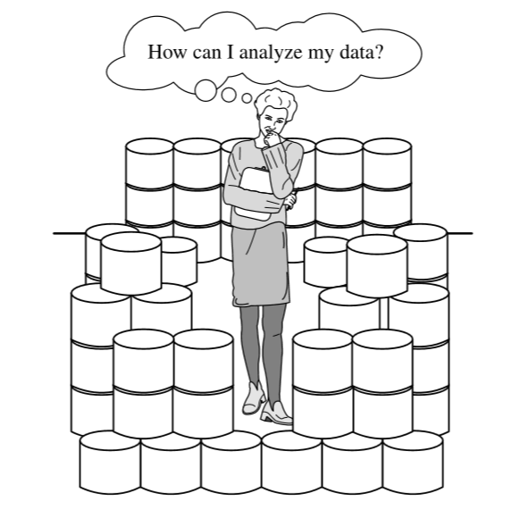
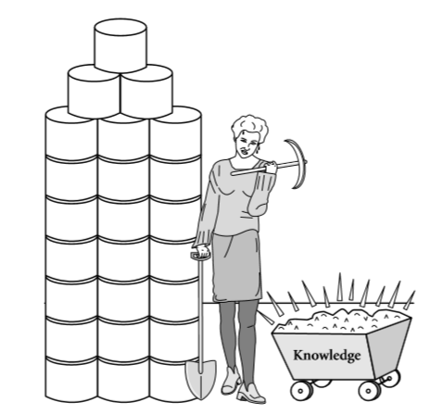
Data mining — searching for knowledge (interesting patterns) in your data.
We have data rich, but information poor.

Slide 5
Data Mining refers to extracting or “mining” knowledge from large amounts of data.

Slide 6
About this Course:
Recommender systems are a new topic of computer science.
Recommender systems have changed the way people find products, information, and even other people.
They study patterns of behavior to know what someone will prefer from among a collection of things he has never experienced.

Slide 7


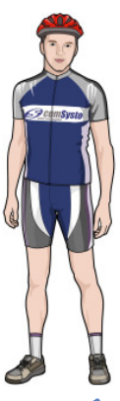



Buy
Buy
Recommend

Slide 8
The technology behind recommender systems has evolved over the past 20 years into a rich collection of tools that enable the user or researcher to develop effective recommenders.

Slide 9
We will study the most important of those tools, including:
how they work,
how to use them,
how to evaluate them, and
their strengths and weaknesses.

Slide 10
The algorithms we will study include:
content-based filtering,
user-user collaborative filtering,
item-item collaborative filtering,
and others.

Slide 11
Grading:
 | Marks | Date
Midterm 1 | 20 | Week 7 or 8
labe | 20 | Week 10 or 11
Assignments | 10 | …
Final Exam | 50 | …

Slide 12
Resources:
Electronic Materials (slides lectures - Ppt), Web Sites and etc.
Books:
“Recommender Systems: An Introduction,” by Dietmar Jannach et. al, Cambridge University Press, 2010.
“Recommender Systems Handbook,” by Francesco Ricci, Springer, 2010.

Slide 13
Basic Introduction
I want to point out some definitions

Slide 14
?
Computer System
computer system consists of two major elements: hardware and software.
Computer hardware is the collection of all the parts you can physically touch.
Computer software, on the other hand, is not something you can touch. Software is a set of instructions for a computer to perform specific operations.
You need both hardware and software for a computer system to work.

Slide 15
?
System Software
System software consists of programs that control the operations of a machine (computer, mobile, ...) and its devices.
System software serves as the interface between a user, the application software, and the computer’s hardware.
One type of system software is the operating system.
Before application software can be run, the operating system, which contains instructions that coordinate the activities among computer hardware devices, must be loaded from the hard disk into the computer’s memory.

Slide 16

Software Categories

Slide 17
Interfaces HW - user
End user
Application SW
System SW
Computer-
hardware

Slide 18
?
User Interface
Identify The Role Of The User Interface
The user interface controls how you enter data or instructions and how information displays on the computer screen.
Many of today’s software programs have a graphical user interface.
A graphical user interface (GUI) combines text, graphics, and other visual images to make software easier to use.

Slide 19
?
Software Application
Application software consists of programs designed to perform specific tasks for users.
Application software can be used as a productivity/business tool; to assist with graphics and multimedia projects; to support home, personal, and educational activities; and to facilitate communications.

Slide 20
?
Web
Application
A web application or "web app" is a software program that runs on a web server. Unlike traditional desktop applications, web apps must be accessed through a web browser.

Slide 21
?
Web apps have several advantages:
Developers do not need to develop web apps for multiple platforms. For example, a single application that runs in Chrome will work on both Windows and OS X.
Developers do not need to distribute software updates to users when the web app is updated. By updating the application on the server, all users have access to the updated version.

Slide 22
?
Mobile Application
A mobile application or "mobile app" is software that runs on a handheld device (phone, tablet, e-reader, iPod Touch, etc.) which has a “smart” operating system which supports standalone software and can connect to the internet via Wi-Fi or a wireless carrier network.
Usually people download native mobile apps from app stores such as the Apple app store or the Android Market.

Slide 23
Data Mining Methods for Recommender Systems

Slide 24
Contents
Introduction.
What is the item?
Example of Recommender System
Movielens Approach (Helping you find the right movies)
Some examples found in the Web:

Slide 25
Introduction
Recommender Systems (RS) typically apply techniques and methodologies from other neighboring areas – such as Human Computer Interaction (HCI) or Information Retrieval (IR).
However, most of these systems bear in their core an algorithm that can be understood as a particular instance of a Data Mining (DM) technique.
The process of data mining typically consists of 3 steps, carried out in succession:
Data Preprocessing , Data Analysis, and Result Interpretation (see Figure 2.1).

Slide 26
Introduction
Recommender Systems (RS) typically apply techniques and methodologies from other neighboring areas – such as Human Computer Interaction (HCI) or Information Retrieval (IR).
However, most of these systems bear in their core an algorithm that can be understood as a particular instance of a Data Mining (DM) technique.
The process of data mining typically consists of 3 steps, carried out in succession:
Data Preprocessing , Data Analysis, and Result Interpretation (see Figure 2.1).
We will analyze some of the most important methods for data preprocessing.
in Section 2.2. In particular, we will focus on sampling, dimensionality reduction,
and the use of distance functions because of their significance and their role in RS.
In Sections 2.3 through 2.5, we provide an overview introduction to the data mining
methods that are most commonly used in RS: classification, clustering and associa-

