Slide 1

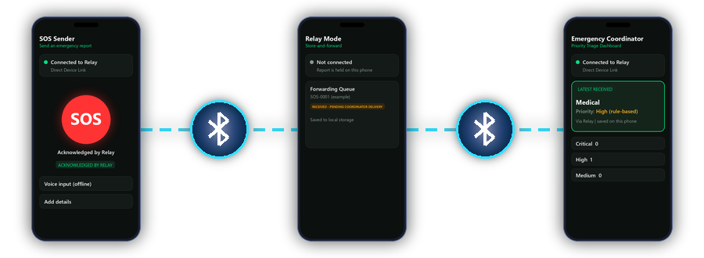
HACKATHON PRESENTATION
NO NETWORK
conventional connectivity down
SETHU
Offline Emergency Communication
& Disaster Response
Connecting emergency reports when conventional connectivity is unavailable.
Notes:
Open with the flood scenario. Sethu = Offline Emergency Communication & Disaster Response. Illustration only: the artwork is drawn, not a photograph.

Slide 2

THE PROBLEM
When networks fail, reports stall
Three people on a terrace. Water on the lower floors.
One needs a medic. One needs evacuation.
Reports may not reach a coordinator
Connectivity may be intermittent or unavailable
Delayed reports make coordination harder
Nearby phones can still talk to each other locally
SETHU | Hackathon presentation
2
Notes:
A believable scenario: a flood, three people on a terrace, one needs urgent medical help, one needs evacuation. A volunteer has a phone but the message cannot reach the response coordinator. Illustrative, not a claim about a real event.

Slide 3

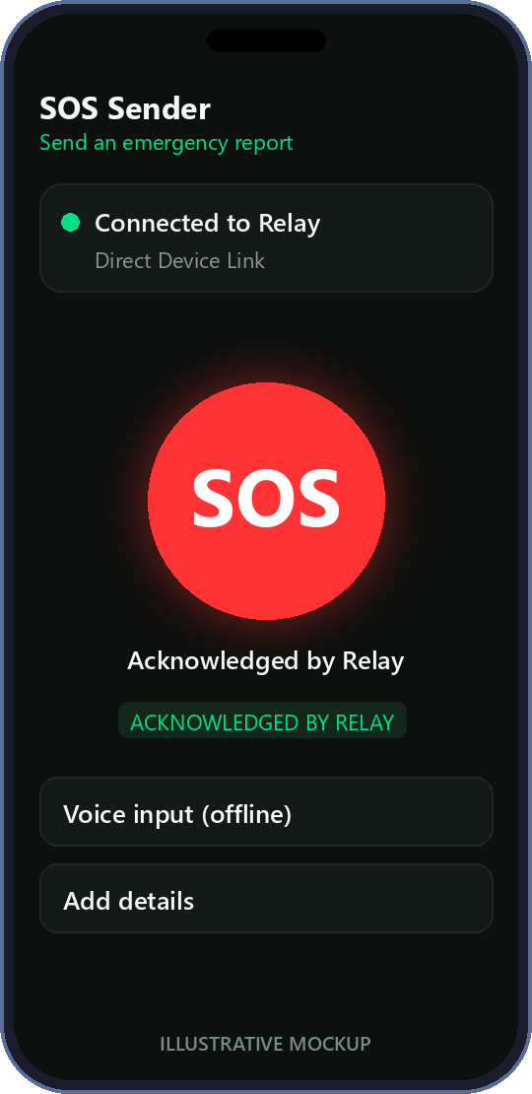
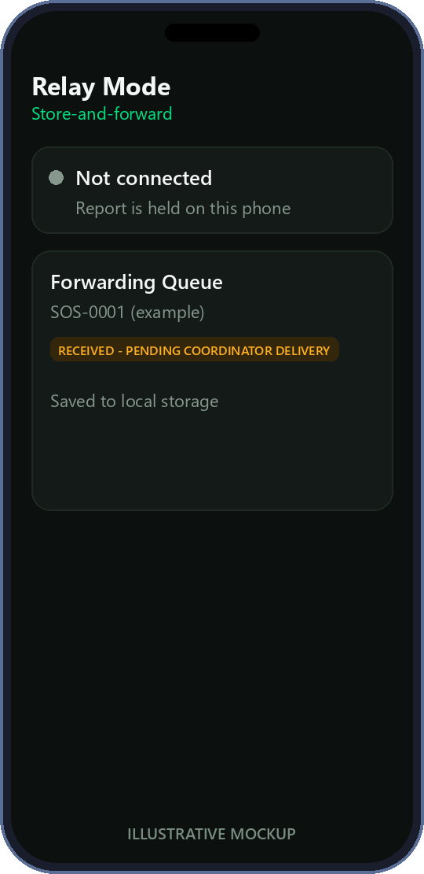
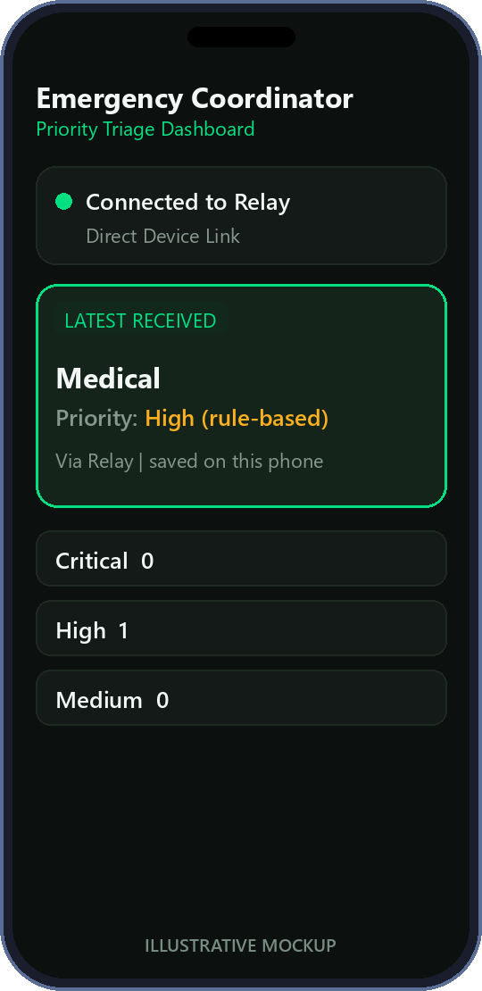

THE SOLUTION
Store on the relay. Forward when a link appears.
Person in danger
Sender phone
Relay phone
Coordinator phone
needs help
creates the SOS
stores it, then ACKs
saves and shows it
A stored report survives a temporary disconnection and goes onward when the next connection exists.
SETHU | Hackathon presentation
3
Notes:
Sethu moves an emergency report phone to phone using local Bluetooth. The Relay stores it, so a lost connection does not lose the report. Mockup phones are illustrative, not screenshots.

Slide 4

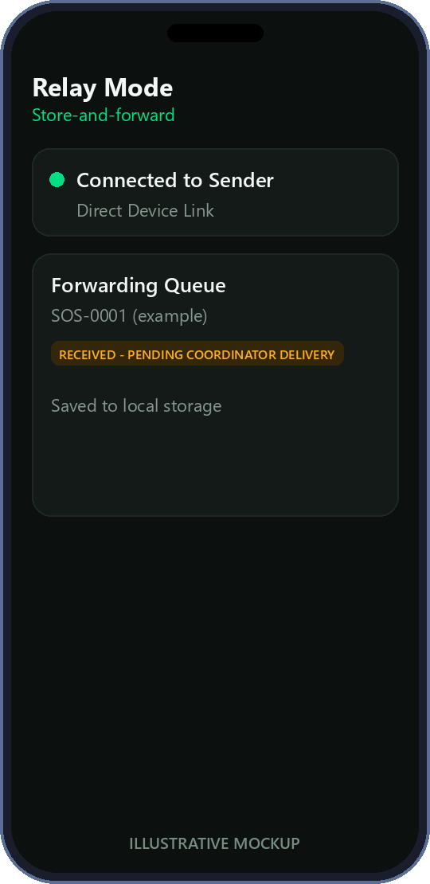


THREE-PHONE ARCHITECTURE
Illustrative mockups, not screenshots
Two stages, one active link at a time
STAGE A - iQOO <-> Vivo (manual link)
STAGE B - Vivo <-> Motorola (manual, after A ends)
iQOO 15
Vivo Y15
Motorola Edge 30 Pro
SOS Sender
Relay
Coordinator
You connect each pair manually. Forwarding of the stored SOS is automatic once Stage B is up.
SETHU | Hackathon presentation
4
Notes:
Roles are fixed by the user: iQOO 15 = Sender, Vivo Y15 = Relay, Motorola Edge 30 Pro = Coordinator. The implementation keeps ONE active Bluetooth link per phone at a time, so Stage B only starts after Stage A is ended. Connections are made by the user (Start Server, then tap the peer). Forwarding is automatic.

Slide 5

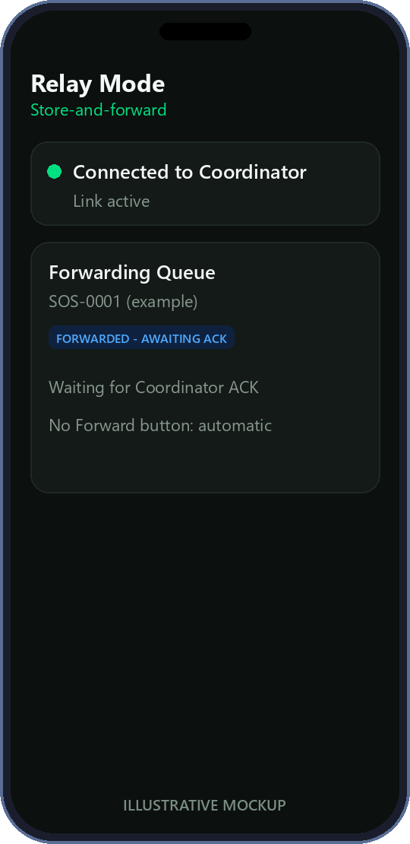
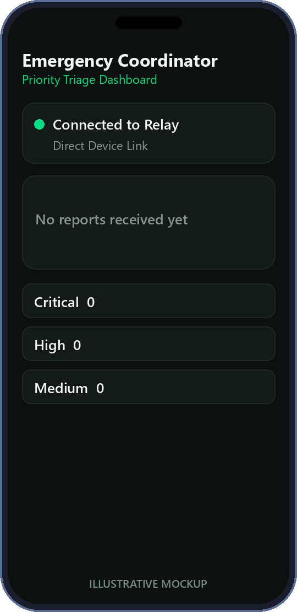
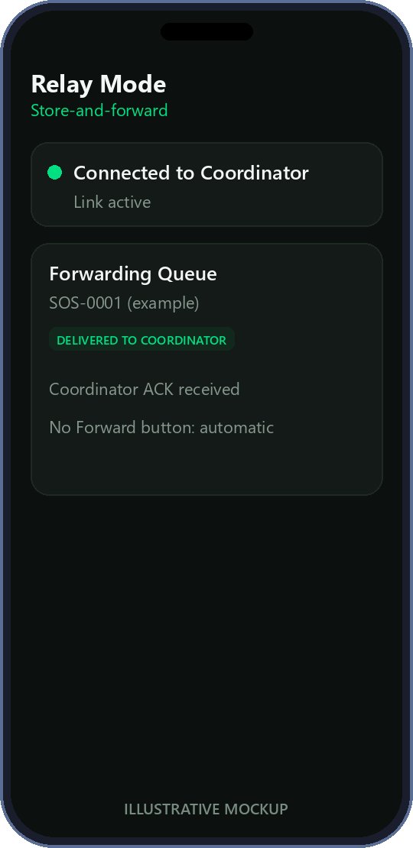
LIVE SOS WORKFLOW
Illustrative mockups, not screenshots
From first tap to a confirmed delivery
1
2
3
4
5
6
7
Create SOS
Send to Relay
Relay saves it, then ACKs
Original link ends
Connect to Coordinator (manual)
Forward automatically
Coordinator saves + ACKs
Steps 1-3
Step 4
Steps 5-6
Step 7
Sender ACKed by Relay
Relay holds the pending SOS
Auto-forward, awaiting ACK
Delivered only after ACK
SETHU | Hackathon presentation
5
Notes:
Seven steps. Steps 1-3 happen on the first manual link. Step 4 ends it (for example iQOO Bluetooth off). Step 5 is the user's second manual connection. Step 6 is automatic. Step 7: the Coordinator saves first, then acknowledges, and only then does the Relay mark delivered.

Slide 6
RELIABILITY AND DATA INTEGRITY
A report is never 'delivered' on a hunch
Durable local storage
Unique report IDs
Duplicate prevention
Written to disk before any ACK is sent
Same ID = same incident everywhere
Retransmissions do not create copies
Acknowledgement states
Pending queues
Controlled retries
Matching ID, session and stage required
Report waits on the Relay for a link
Max 3 sends per connection; no auto-dialing
RELAY DELIVERY STATES
PENDING FORWARD
FORWARDED (awaiting ACK)
DELIVERED TO COORDINATOR
FAILED: stays pending
SENDER DELIVERY STATES
PENDING
TRANSMITTED
ACKED BY RELAY
ACKED BY COORDINATOR
Socket connected or write returned is never treated as proof of delivery.
SETHU | Hackathon presentation
6
Notes:
These mechanisms exist in the code and are exercised by unit and simulated tests. DELIVERED is only recorded after the Coordinator's acknowledgement for the same report ID on the same connection.

Slide 7
OFFLINE-FIRST ENGINEERING
Everything the demo needs runs on the phone
Bluetooth Classic
On-device storage
Offline voice
Local AI assist
Offline maps
RFCOMM link between nearby phones
Atomic JSON files for every report
Vosk speech model bundled in the app
Qwen2.5-0.5B via llama.cpp; model file side-loaded
Mapsforge vector map file loaded on the device
No INTERNET permission
What this does not claim
Verified in the merged debug and release Android manifests. No cloud, analytics or telemetry dependency.
Bluetooth pairing is not app-level authentication, and Sethu adds no encryption of its own yet.
Offline-first for the intended demo workflow; this is not a security guarantee.
SETHU | Hackathon presentation
7
Notes:
Checked against the merged debug and release manifests: no INTERNET permission. The local LLM weights and the offline map file are loaded on the device (not bundled in the APK). Bluetooth pairing is not app-level authentication, and there is no app-level encryption yet.

Slide 8
INTELLIGENT EMERGENCY COORDINATION
Explainable priority, not a black box
RULE-BASED PRIORITY ENGINE
Local AI assist (optional)
CRITICAL
Explicit life-threatening wording
Qwen2.5-0.5B on-device (llama.cpp)
Proposes category and people count
Unknown stays unknown - never invented
Proposal is editable; the person confirms it
HIGH
Trapped, serious injury, fire, urgent medical
MEDIUM
Needs help, no life-threat evidence
Coordinator dashboard:
newest received report is highlighted;
a priority filter never hides a new SOS.
UNKNOWN
Too little information to classify
Highest explicitly supported level wins.
Each result carries a readable reason.
Illustrative mockup
SETHU | Hackathon presentation
8
Notes:
The priority engine is deterministic: explicit keyword rules with a stated reason, not a trained model. The local LLM only proposes structured fields that the person reviews; unknown stays unknown. No diagnosis, dispatch or tracking is claimed.

Slide 9
TECHNICAL ARCHITECTURE
Kotlin | Jetpack Compose | coroutines
What is actually in the repository
ANDROID UI - JETPACK COMPOSE
SosSenderScreen
RelayDeviceScreen
CoordinatorScreen
Direct Device Link (OfflineCommScreen)
OfflineMapScreen
ON-DEVICE INTELLIGENCE
PriorityClassifier (rules)
OfflineSpeechManager (Vosk)
OfflineAiExtractor (llama.cpp, Qwen2.5)
MapsforgeMapView (offline maps)
DELIVERY ENGINE
StoreAndForwardController (link-driven, never dials)
Role + ACK validation (Sender / Relay / Coordinator)
PROTOCOL AND DURABLE STORES
SethuMessage + SosReport (JSON lines)
SenderReportStore
RelayReportStore
CoordinatorReportStore
TRANSPORT
BluetoothRfcommTransport
RfcommAdapter -> AndroidRfcommAdapter
Android Bluetooth Classic (RFCOMM)
SETHU | Hackathon presentation
9
Notes:
Every box is a real class or library in the repository. Kotlin + Jetpack Compose. The transport is Bluetooth Classic RFCOMM through a thin adapter that the simulated tests replace with fake sockets.

Slide 10
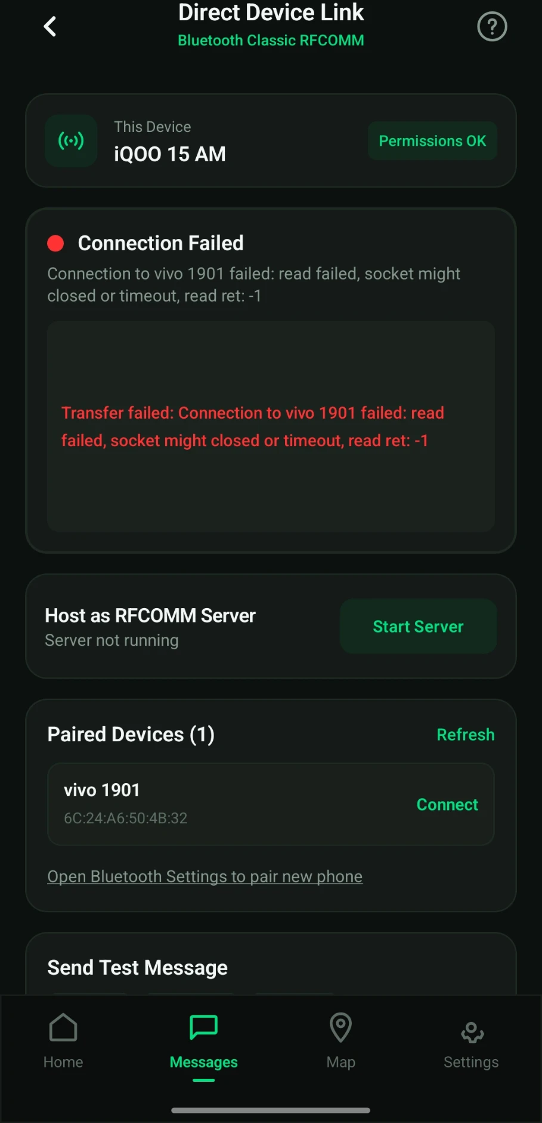
DEMONSTRATION RESULTS
What is verified - and what is not yet
Automated unit tests
Simulated end-to-end
Physical Bluetooth
VERIFIED
VERIFIED (logic)
IN PROGRESS
188 unit tests, 0 failed.
Covers stores, protocol, priority rules, ACK correlation and persistence.
Five-stage workflow on fake Bluetooth sockets.
Also lost ACKs, restarts, duplicates and connection flapping.
Three-phone run not yet verified.
First iQOO > Vivo attempt failed at the RFCOMM connect step; debugging.
Intended physical demonstration: iQOO > Vivo, send SOS, iQOO link ends,
Vivo > Motorola (manual), automatic forward, delivered after ACK.
REAL screenshot - iQOO 15
first physical attempt (failed)
Simulated tests validate application logic only, not the Bluetooth stack on the phones.
SETHU | Hackathon presentation
10
Notes:
Be explicit with the jury: unit tests and simulated end-to-end tests are verified. Physical Bluetooth validation is in progress. The screenshot on the right is a REAL screenshot of the iQOO 15 from the first physical connection attempt, which failed and is being debugged. Delete that box if you prefer not to show it, but do not claim physical success.

Slide 11
IMPACT AND FUTURE SCOPE
Where this approach could go next
FUTURE
FUTURE
FUTURE
FUTURE
Multi-hop relays
Background delivery
Authentication + encryption
Better prioritization
Reports across several relay phones
More robust delivery when the app is not open
Message-level security
Richer, evaluated triage rules
FUTURE
FUTURE
FUTURE
Sethu supports
emergency services.
It does not replace them.
More languages
Authorized integration
Field testing
Accessible, multilingual interfaces
Link to official emergency-response systems
Larger tests in disaster-like conditions
SETHU | Hackathon presentation
11
Notes:
All of these are future improvements, not current capabilities.

Slide 12

When connectivity breaks, emergency communication
should not stop at the first disconnected phone.
SETHU
Every message deserves a path.
Notes:
Close on the tagline.

