Slide 1
Sales Analysis Dashboard Summary
Data-Driven Insights | Tableau Visualization | Task 3

Slide 2
Overview of Sales Dashboard
This dashboard provides a visual analysis of sales data categorized by Segment, Category,
and Year. It offers a clear understanding of how sales evolved between 2015–2018,
Highlighting category performance and product-wise distribution trends. The insights can help businesses identify profitable areas and improvement opportunities.

Slide 3
Sales by Category and Year
Office Supplies generated the highest sales volume across all categories.
The yearly trend reveals a strong growth trajectory,
with 2018 showing the highest sales figures,
driven by both corporate and consumer segments. Technology and Furniture categories also show consistent but moderate sales performance.

Slide 4
Sales in a Year with Product
The histogram analysis highlights that the majority of product sales lie within the
lower sales bins (below ₹2K).
This indicates high transaction frequency in low-value sales, while high-value
product sales (above ₹10K) occur
infrequently but contribute significantly to overall revenue.

Slide 5
Key Insights and Observations
• Office Supplies dominate total sales volume. • Steady sales growth observed from 2015 to 2018. • Consumer Segment leads overall contribution. • Most transactions fall under low-value range (below ₹2K). • High-value transactions are fewer but have strong revenue impact. • Data supports resource optimization in high-performing categories.

Slide 6
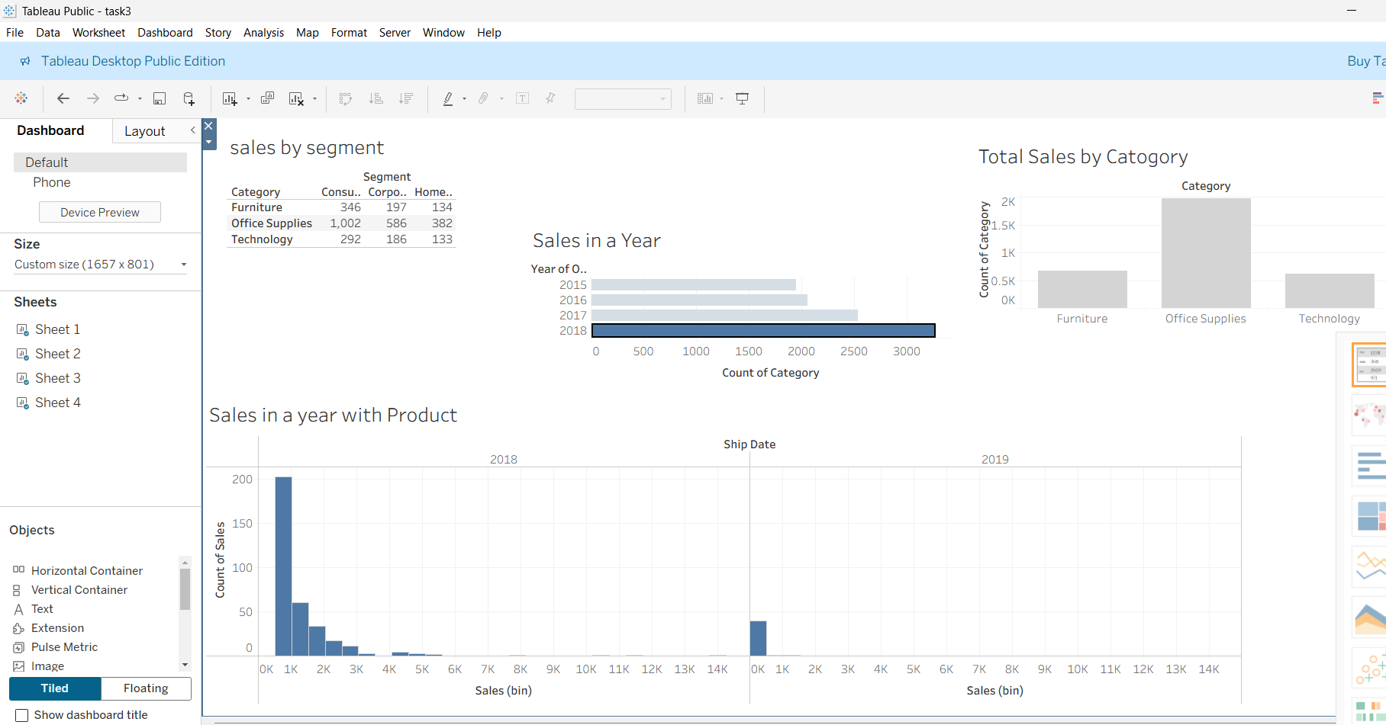
Dashboard Visualization

