Slide 1

Introduction
Management principles are important to all small businesses. Management decisions impact the success of a business, the health of its work environment and its growth. The main objective is customer's satisfaction. Management is about achieving organizational objectives through people. By engaging group of people, we can create a good business or a startup idea.

Slide 2


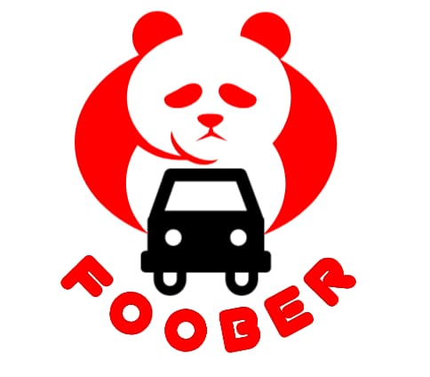
Business Model
Our business model is combining two different apps. They are foodpanda and uber. These apps work in two different aspects. Foodpanda delivers your food from specific restaurant. Uber provides you with the source of transportation. FOOBER provides you with both of these things at the same time.
This business model will work in such way that if you want to go to restaurant, you will pick the specific restaurant and order the food, in meantime the ride will be booked automatically of your choice which will take you to that restaurant if you want

Slide 3
General Problems Faced by People
No Source of Transportation
Some people have no source of transportation. Sometimes there are more people who have to go for a lunch or dinner but there is no enough space in vehicles like motorbike. They first have to book ride to go and then order food separately.
Safety Issues and High Fares
Parents are very concerned about their children's safety, especially
parents of girls so when they want to go for outing, they use public transports, due to high fares, which are not completely save.
Long Waiting Time
When you order something, you have to wait for the long time for the order to come especially in Shinwaris. It generally waste your time and delays your food.

Slide 4
FOOBER - Solution to all these Problems
Skips your Waiting Time
Your waiting time for food will be skipped or minimized. It will save your time.
Providing you both Transportation and Food
The solution to above all these problems is that we develop an app named FOOBER, which provides both transportation and food purposes. In this app, you placed your order, the driver comes and takes you to the restaurant and if you want, it will also take you back to your home.
Guaranteed Safety and Desired Fares
It will provide you with the safe means of transportation by tracking the ride and customer will be able to have its desired appropriate fare.

Slide 5
Benefits for Customers
Convenience​
​Customers can order​
food and rides from the same app, which​ is more convenient than using separate​ apps for each service.​
Time-saving
Customers can save time by ordering food and rides at the same time, rather than having to wait for one service to be completed before using the other.
Safety and Security
Customers can feel safer and more secure when using a trusted app that provides features such as real-time tracking, driver ratings, and 24/7 customer support.

Slide 6
Benefits for Restaurants
Improved efficiency ​
​Restaurants can improve their efficiency by using real-time order tracking and customer communication, for efficiency of their operations.​
​
Increased Exposure
By partnering with our app, restaurants can gain access to a larger customer base, which can lead to more orders and increased visibility.
Access to customer data
Restaurants can gain knowledge of their customers' preferences through our app's data analytics tools, which can help them make more informed
business decisions.
Marketing Opportunities ​
Our app will provide​ with marketing opportunities, like targeted advertising and special deals for users, to help them attract new customers and retain existing ones​.

Slide 7
Benefits for Drivers
Increased Earning Potential
By offering both food and ride-sharing services, our app could provide drivers with more opportunities to earn money and increase their income
Flexible Schedules
Many drivers appreciate the flexibility of working for ride-sharing and food delivery services which allows them to set their own schedules and work as much or as little as they want
Access to Larger Customer Base ​
​By partnering with your app, drivers could gain access to a larger customer base,​ which could lead to more frequent and higher-paying orders.​
​
Rewards
Our app will offer rewards to drivers who perform well, such as bonuses for completing a certain rides or deliveries, or exclusive discounts on gas and car maintenance services.

Slide 8
Marketing and Growth Strategy
We will offer a variety of payment options to cater to different customer preferences and provide real-time tracking of food to increase transparency and improve the customer experience.
We will market the convenience of
having both food and ride orders in one app, and offer promotions to encourage customers to use the app. For growth, we will expand to new cities and partner
with popular restaurants and ride-sharing
services to increase our customer base.
We will generate marketing by displaying our ads on different apps and on social media accounts, that will result in the attraction of customers.

Slide 9
Our Revenue
Data analytics
We will sell the data that our app collects on user behavior to restaurants,
ride-sharing companies, and other
businesses that want to better understand
their customers
Advertising Revenue
We will generate revenue by displaying targeted ads to our app users, which will be sold to restaurants, ride-sharing companies
and other businesses that want to reach
our audience.
Commission Fees
We will charge a
commission fee for each order placed
through your app, which will be paid by the restaurants and driver
Subscription Fees
We will offer
premium features and services to our app users for a monthly or annual subscription fee, such as access to exclusive deals and
discounts.

