Slide 1
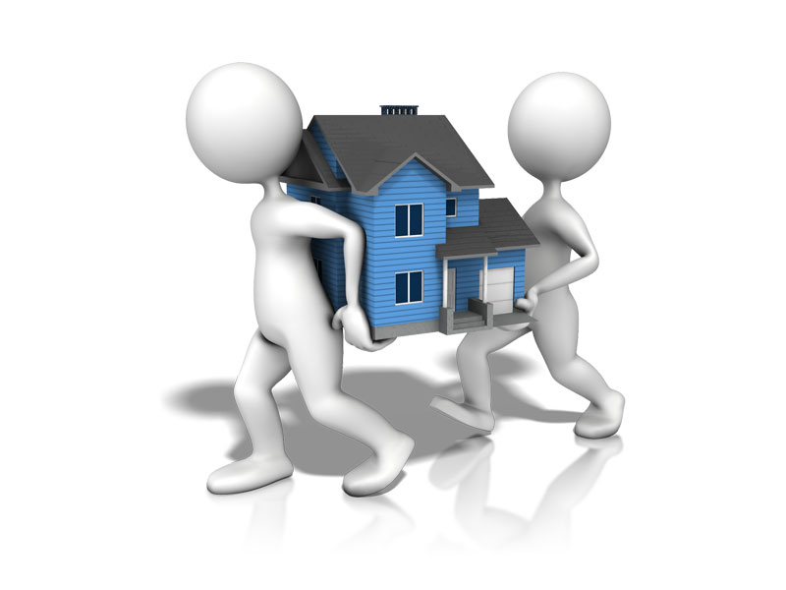
Housing Society Record Management System
FYP
1st Evaluation
Group Members:
Osama Shahid
(BSCS/F14/0105)
…………………………….
Sana Khan
(BSCS/F14/0135)
Supervisor:
Muhammed Adeel Mannan
(Asst.Professor)
Hamdard University

Slide 2
Overview
Group Introduction
ProjectDescription /Description
Scope
Project Plan
Literature Review
Tools
Use Case Diagram
Process Flow Diagram
Challenges and Problems Encountered
Current Status
Evidence of Progress
References

Slide 3
Group Introduction
Project Partners:
Osama Shahid
Sana Khan
Supervisor:
Muhammad Adeel Mannan (Asst. Professor)
M. Adeel is generous person with a very helping attitude. His knowledge is commendable not only on his field but also in general.
Relevant Experience in Business Analysis, Database, Software Project Management, SQL, SCM.
He has experience as a IT Manager and have brief knowledge in the field of Project Management.

Slide 4
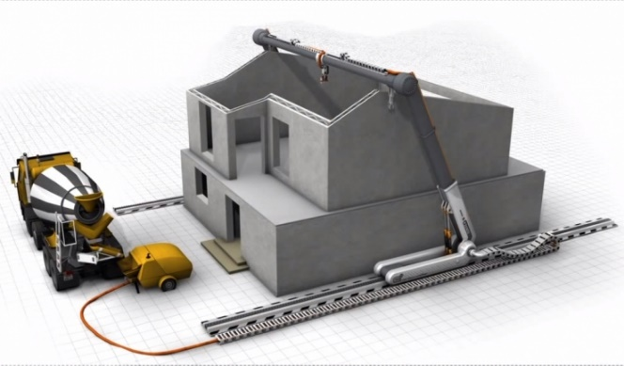
Description
Objectives:
Revolves around the following objectives:
To provide a reliable interaction between customer and dealer/Web Based using php.
Android application on React Native JS which fulfils the requirement of getting alerts of billing payment vouchers and society news updates.

Slide 5
Project Scope
System Architecture

Slide 6
Literature Review
Brings Professionalism m and Transparency to running of the Association. [1]
Online Market Understanding customer need. Understand buying cycle To know what are our compotators. [2]
The focus of this research project is basically managing housing for low income, medium and high incomes households or what is commonly known as affordable housing. [3]
Facilities include 24-hrs Security, Internet cafe, 24-hrs water supply and Electricity supply. It also serves you with the Buses, which travel from main city area. [4]
This paper presents the various methods in which we can manage the housing society by a system, which is created using, cloud. [5]

Slide 7

Literature Review
In this city we are always on the lookout for unusual alliances and for the energy that is Generated when people from entirely different disciplines and backgrounds are keen to work on. [6]
This paper focuses on the study of implementation of an Android Application for management Of Residential society functions. [7]

Slide 8
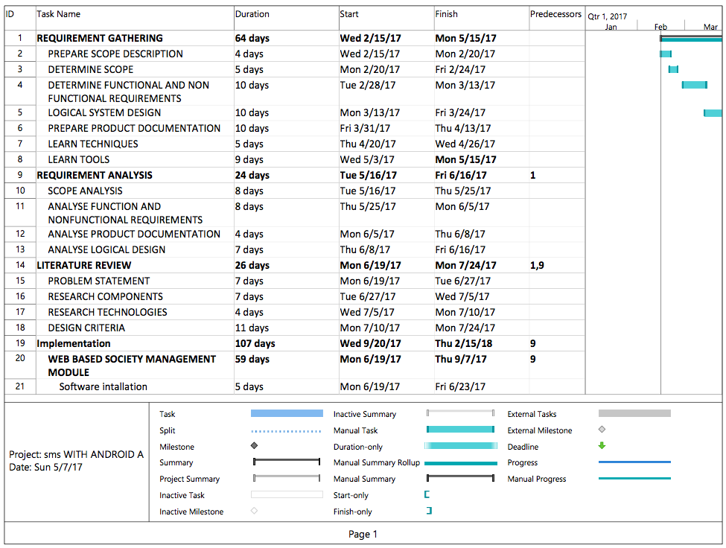
Project Plan
Gantt Chart

Slide 9



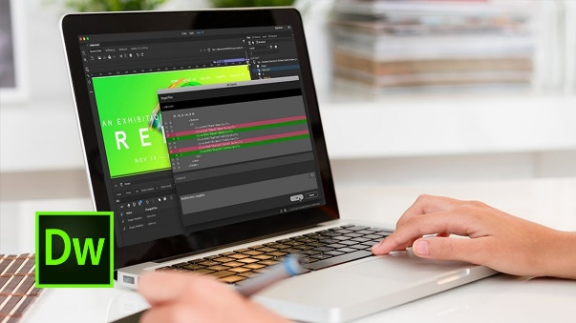
Project tools
Software:
Adobe Photoshop
Dreamweaver
Xampp Server
MySQL
Html5, CSS3
Php 7
Hardware:
PC to develop
Camera for Video Making

Slide 11
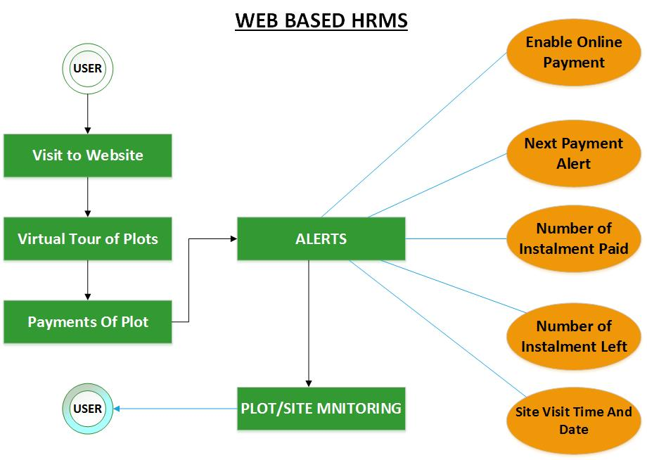
Process Flow Diagram

Slide 12
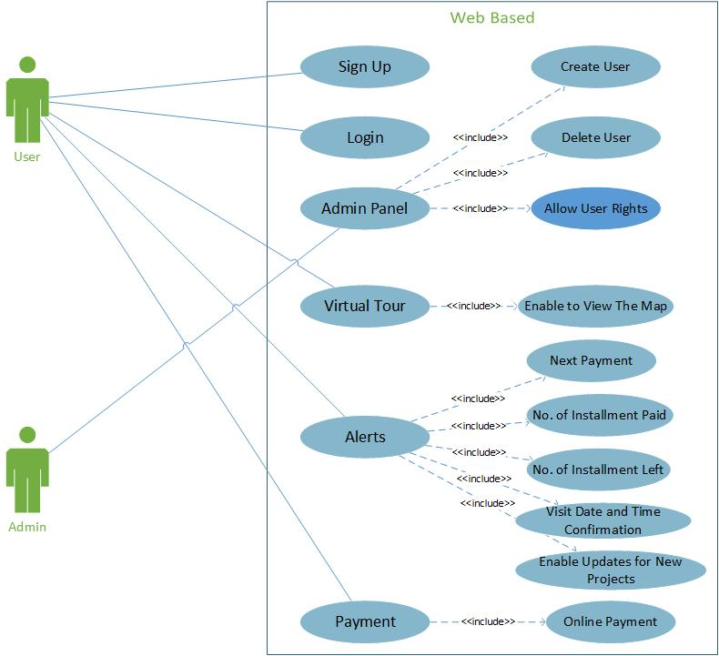
Use Case Diagram

Slide 13
Challenges And Problems Encountered
Setup environment for Web application development.
Designed the frontend of application with :
The connectivity of database.
Designed backend of application with :
The connectivity of database with frontend.

Slide 14
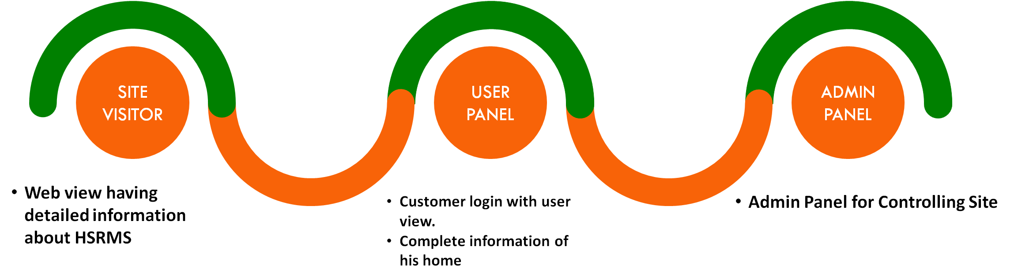
Current Status

Slide 15
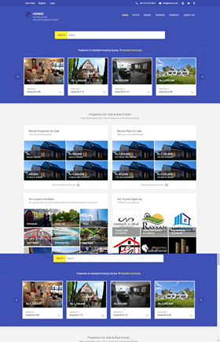
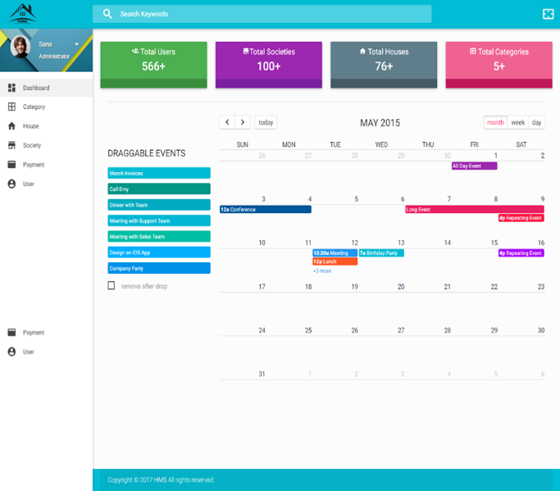

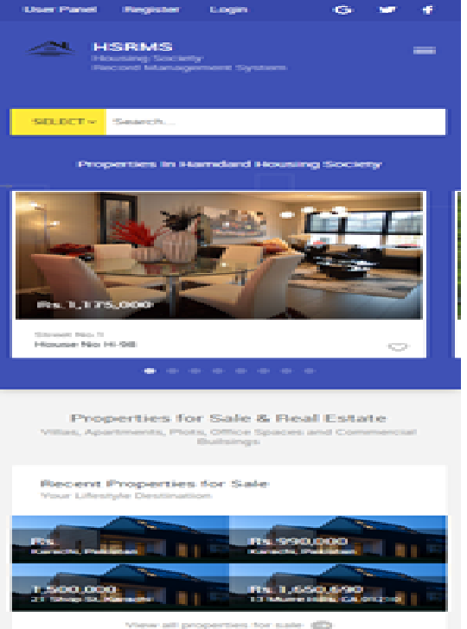
Evidence of the Progress

Slide 16
References
[1] S.Banerjee. 2008. "Adda ERP." https://apartmentadda.com/home/aboutUsPage.php.
[2] J.Odeh. 2014. "Online Real Estate Management System." https://www.slideshare.net/jazod7/online-real-estate-management-system-34844226.
[3] Henry Peter Gommans, George Mwenda Njiru , and Arphaxad Nguka Owange 2014. "Rental House Management System." International Journal of Scientific and Research Publications, 4 (II).
[4] Trainer, Project. 2015. "Green Villa Housing Society Management System." http://www.1000projects.info/visual-basic-vb-projects/green-villa-housing-society-management-system/1106.
[5] Prachi Pakhale , Shweta Shirke, Swsati Dhake,. 2016. "Online Housing Society Management System." International Journal for Research in Applied Science & Engineering Technology (IJRASET) 4 (III).
[6] Summit, S.C.C. "Envisioning And Implementation a Smart Society."
[7] Rutuja Vatharkar, Pratiksha Patil, Swati Sonar, Prof. Shivganga Gavhane 2016. "IMPLEMENTATION OF SOCIETY MANAGEMENT SYSTEM: SOCIETALES." International Journal of Science & Technology 6 (2).
[8] https://tribune.com.pk/story/129853/fraud-detected-in-telecom-housing-society/
[9] https://www.dawn.com/news/1118217

Slide 17
Thank You!

