Slide 1
Gagawa
html generator library

Slide 2
Roadmap
What is Gagawa ?
Static analysis interpretation
Assertions inserted in code
Writing test cases

Slide 3
What is Gagawa ?
HTML Generator Library written in Java
Build well-formed HTML in web and non-web apps
Uses objects to represent each HTML element or tag
Use write() on top-most element to write to HTML doc
Used especially in absence of JSPs
Build entire sites using Gagawa

Slide 4
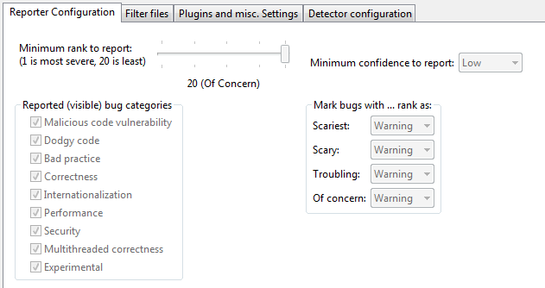
Static Analysis with FindBugs
FindBugs Configuration in Eclipse

Slide 5
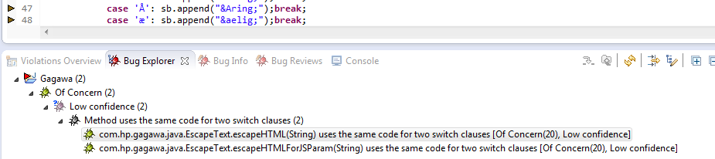
Static Analysis with FindBugs
Reported just 2 Bugs, no Scariest, Scary or Troubling kinds
Of Low Concern about ‘duplicate code’ present 2 methods in EscapeText.java class

Slide 6
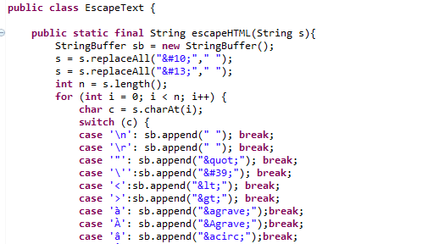
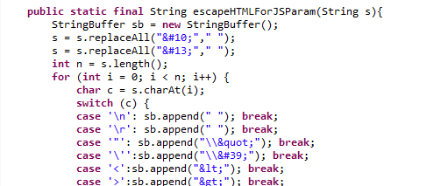
Static Analysis with FindBugs
Exact same code in the 2 methods of EscapeText class
2nd for loop with same switch statement
1st for loop with switch statement

Slide 7
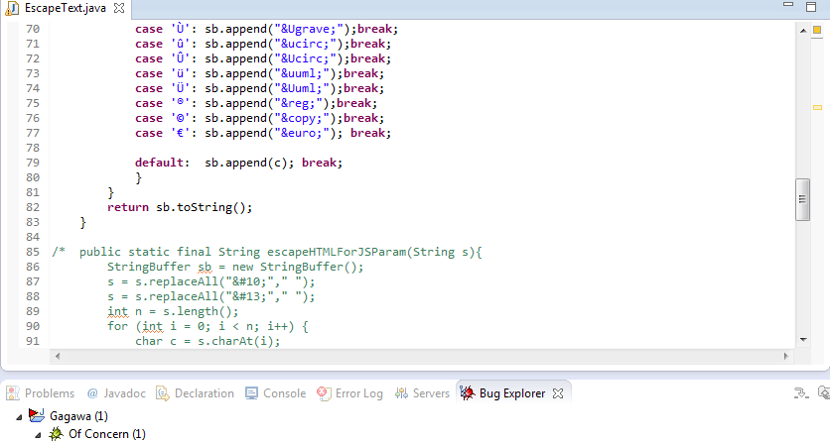
Static Analysis with FindBugs
Patch by Code Refactoring or commenting out either method
In spite of doing either, 1 Bug reported about ‘duplicate code’

Slide 8
Static Analysis with FindBugs
Both refactoring and commenting out the duplicate code resulted in same ‘duplicate code’ bug being reported

Slide 9
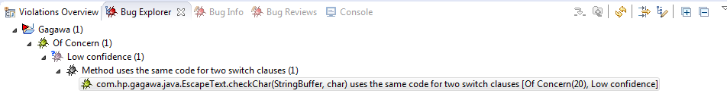
Static Analysis with FindBugs
Safe to term bug as FALSE-POSITIVE

Slide 10
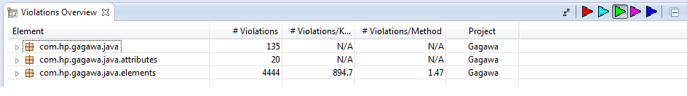
Static Analysis with PMD
Reported whole lot of Violations though only coding-style related, no Bugs inferred
PMD documentation itself says:
“PMD has a very large list of rules, so not everybody is likely to agree with all of them.”

Slide 11
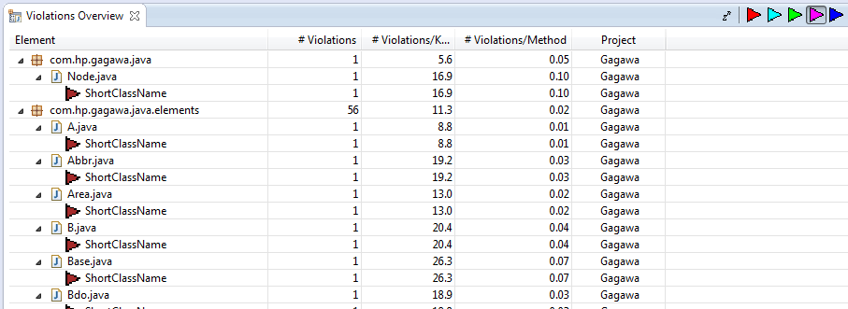
Static Analysis with PMD
Even the Important Violations only turn out to ‘ShortClassName’ violations, no bugs inferred

Slide 12
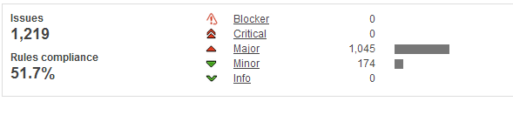
Static Analysis with SonarQube
1219 Issues found

Slide 13
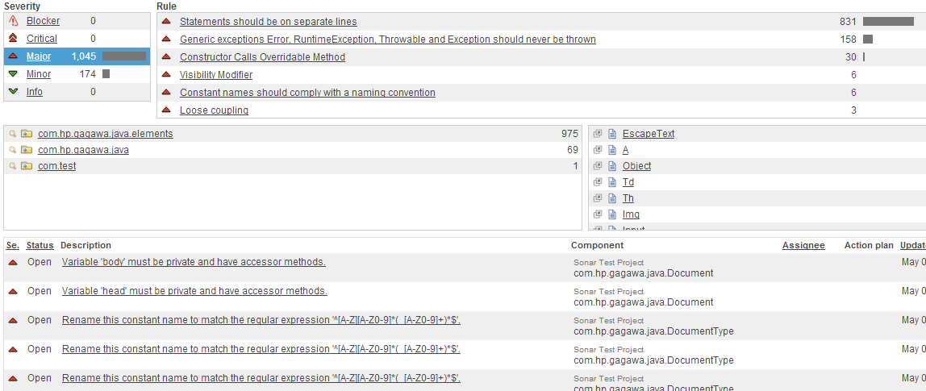
Static Analysis with SonarQube
1045 Major Issues found

Slide 14
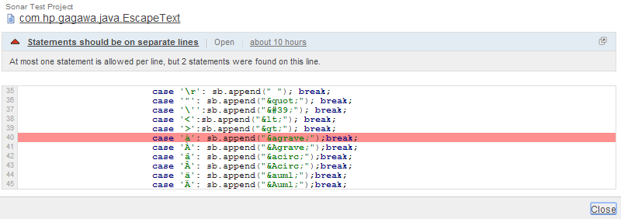
Static Analysis with SonarQube
Large number of issues were coding style-related
Sample 1
“‘At most one statement is allowed per line, but 2 statements were found on this line.” in class com.hp.gagawa.java.EscapeText was reported the most

Slide 15
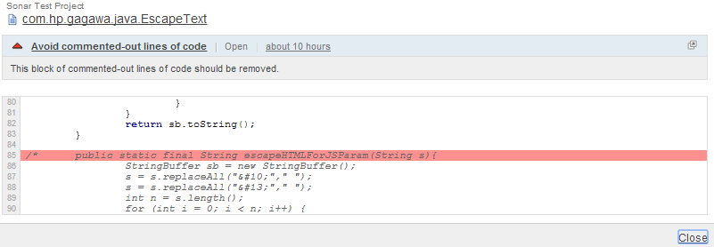
Static Analysis with SonarQube
Large number of issues were coding style-related
Sample 2
“This block of commented-out lines of code should be removed.” in class com.hp.gagawa.java.EscapeText

Slide 16
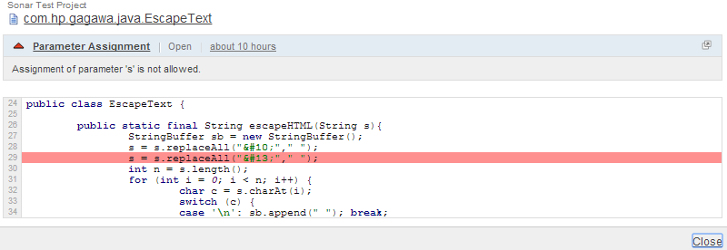
Static Analysis with SonarQube
Reported quite a few known Bad Coding Practices
Sample 1
“Assignment of parameter 's' is not allowed.” in class com.hp.gagawa.java.EscapeText

Slide 17
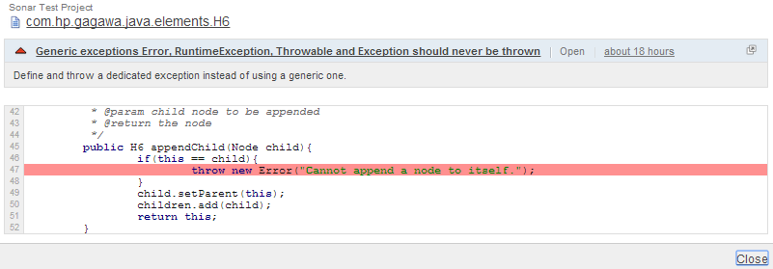
Static Analysis with SonarQube
Reported quite a few known Bad Coding Practices
Sample 2
“Define and throw a dedicated exception instead of using a generic one.” in class com.hp.gagawa.java.elements.H6
Plenty instances where class member variables were not declared ‘private’ but ‘public’

Slide 18
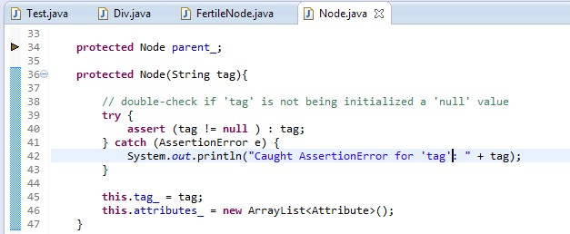
Assertions inserted in code
A tag member variable assigns the name of every element in its class constructor.
This tag is specific for each element, for e.g. tag = “div” for the Div element.
An assert is added in
the Node class’s
constructor to
double-check if any
element’s tag variable is
not being assigned a
null value.

Slide 19
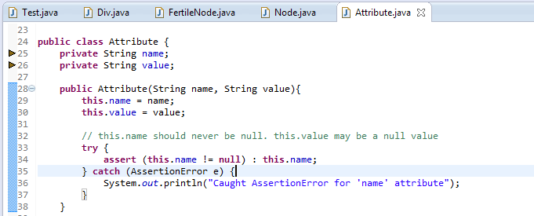
Assertions inserted in code
An element’s attribute field’s key value cannot be ‘null’.
E.g., a para element with some attributes looks like
<p name=”someName” id=”someID”>, where keys ‘name’ and ‘id’ are actually String variables
An assert is added in the Attribute class’s constructor to double-check if the attribute is not being assigned a null value.

Slide 20
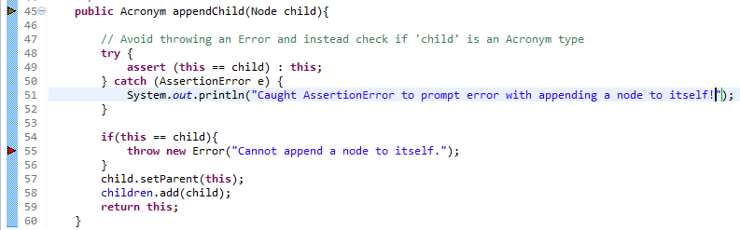
Assertions inserted in code
Sonar does not recommend throwing a generic type Error but a specific one
To avoid throwing the generic Error, an assert is added to throw AssertionError before the if statement to check if the Node being appended to the child object is in fact not another child object itself.

Slide 21
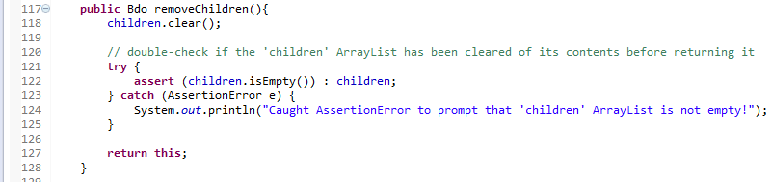
Assertions inserted in code
removeChildren() method is being used in every element to clear all contents of the ArrayList children before finally returning the empty children ArrayList.
An assert is added to double-check if the ArrayList returned is actually empty.
All classes defined in the package com.hp.gagawa.java.elements; have almost the same class structure. Similar asserts above may be added in all the element classes.

Slide 22
Writing test cases
Wrote a test class - Test.java
Running Test.java without test cases generated standard HTML output
<!DOCTYPE html PUBLIC "-//W3C//DTD XHTML 1.0 Strict//EN" "http://www.w3.org/TR/xhtml1/DTD/xhtml1-strict.dtd"><html xmlns="http://www.w3.org/1999/xhtml"><head></head><body bgcolor="#FFFF99"><!-- >First comment
This is my first comment.
< --><div id="firstDiv" style="float:center"><div class="classCSS">Inside Div2<br><br><a href="http://www.google.com" target="_blank">Search with Google</a><br><br></div></div><null></null><table><tr><td>0</td><td>1</td><td>2</td><td>3</td><td>4</td><td>5</td><td>6</td><td>7</td><td>8</td><td>9</td></tr><tr><td>10</td><td>11</td><td>12</td><td>13</td><td>14</td><td>15</td><td>16</td><td>17</td><td>18</td><td>19</td></tr><tr><td>20</td><td>21</td><td>22</td><td>23</td><td>24</td><td>25</td><td>26</td><td>27</td><td>28</td><td>29</td></tr><tr><td>30</td><td>31</td><td>32</td><td>33</td><td>34</td><td>35</td><td>36</td><td>37</td><td>38</td><td>39</td></tr><tr><td>40</td><td>41</td><td>42</td><td>43</td><td>44</td><td>45</td><td>46</td><td>47</td><td>48</td><td>49</td></tr><tr><td>50</td><td>51</td><td>52</td><td>53</td><td>54</td><td>55</td><td>56</td><td>57</td><td>58</td><td>59</td></tr><tr><td>60</td><td>61</td><td>62</td><td>63</td><td>64</td><td>65</td><td>66</td><td>67</td><td>68</td><td>69</td></tr><tr><td>70</td><td>71</td><td>72</td><td>73</td><td>74</td><td>75</td><td>76</td><td>77</td><td>78</td><td>79</td></tr><tr><td>80</td><td>81</td><td>82</td><td>83</td><td>84</td><td>85</td><td>86</td><td>87</td><td>88</td><td>89</td></tr><tr><td>90</td><td>91</td><td>92</td><td>93</td><td>94</td><td>95</td><td>96</td><td>97</td><td>98</td><td>99</td></tr></table></body></html>

Slide 23
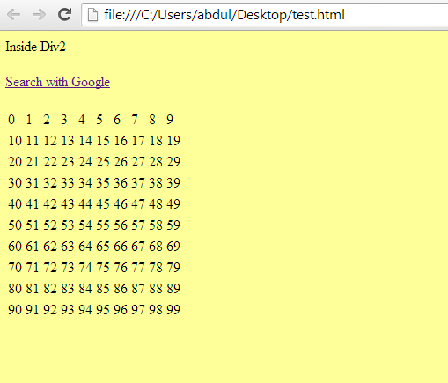
Writing test cases
HTML output to the browser

Slide 24
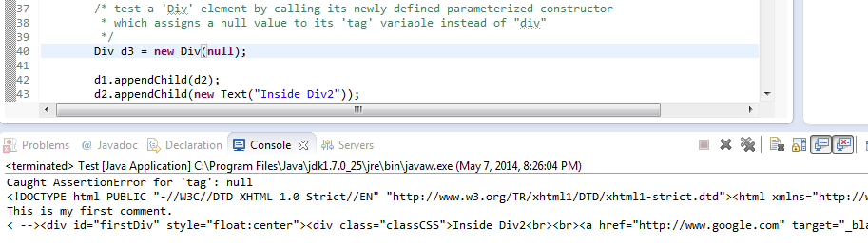
Writing test cases
Triggering the 1st assert : Instantiating the ‘Div’ element with a null parameter fired the first assert.

Slide 25
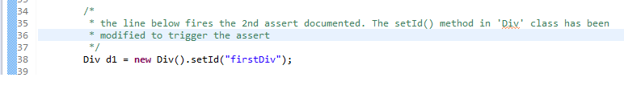
Writing test cases
Triggering the 2nd assert : Simply call a Div object in the Test class with a setId() method…

Slide 26
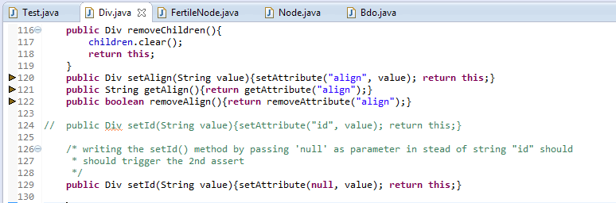
Writing test cases
Triggering the 2nd assert : The ‘Div’ class’s setId() method is modified to accept a ‘null’ parameter instead of the “id” string.

Slide 27
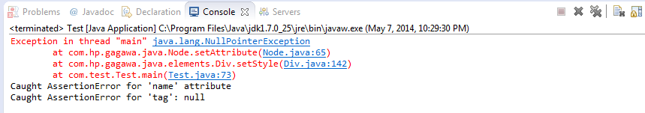
Writing test cases
Triggering the 2nd assert : Calling the ‘Div’ with setId results in a NullPointerException and the assert’s AssertionError exception.

Slide 28
Thank you
Abdul mudabir patel

