Slide 1

IRB E1 Session
NATIONAL CAPABILITY TRANSFORMATION BLUEPRINT · V4.6
A Semantic Layer for Sovereign Development
The capability ontology that orders solutions into one comparable space — and the markets it transparently unlocks.
Start where you are, go where you want — involve stakeholders and make data-driven decisions for holistic development.
IRB E1 · Cross-cutting Standards
Geneva · August 2026 · from NCTB v4.6, §15 & §27
Notes:
This is the Blueprint condensed for our own board: the ontology we steward, why it is a semantic layer rather than a catalogue, and what it economically unlocks. Source: NCTB v4.6, Sections 15 and 27.

Slide 2
IRB E1 Session
THE PANEL
Speakers of This Panel
Five voices on cross-cutting standards for sovereign development.
JS
VM
SL
KS
RG
Jeremy Stein
Vibhav Mithal
Sönke Lund
Konrad Sztolc
Rahul Ghatalia
Panelist
Panelist
Panelist
Panelist
Panelist
IRB E1 · Cross-cutting Standards
Geneva · August 2026 · from NCTB v4.6, §15 & §27

Slide 3
SETTING THE STANDARDS
Think of the World in Processes and Capabilities
Describe the capability independently of anyone’s product — durable, governed, forkable — then describe how each solution relates to it.
Everything is a process — so everything that needs evaluation can be mapped as one. An organization is a collection of processes; what it can reliably do with them is its capabilities.
Comparison then happens in a space that outlives the procurement, and the relations carry the distinctions a feature list flattens.
Yet a procurement team facing four offers for “digital water management” receives four feature lists that share almost no vocabulary — each asserting, implicitly, that the product does the thing.
The ask: each sector IRB defines the capabilities of its sector — in the shared vocabulary, as governed processes.
A weighted scoring matrix is defensible only to whoever chose the weights. It is not portable: the next ministry, sector or country starts over.
Notes:
Blueprint 27.1. The failure is not missing data but a missing shared subject: four vendors, four vocabularies. Scoring matrices produce a number defensible only to whoever chose the weights — and it is not portable. The next ministry starts over.

Slide 4
THE UNIT OF THE SEMANTIC LAYER
A Node Is a Definition, Not an Implementation
The definition says
An instance says
What the capability is: its purpose, what it requires, what human outcomes it touches, which outcomes would be unacceptable, what evidence would show it working.
That this organisation runs this realisation of it. “Brunnen Nord” and “Brunnen Süd” are two instances of one definition — their states independent.
Capacity
Quality of service
THE TWO CORE PARAMETERS
How much — stated in the holder’s unit: 50 litres per person per day for a household, cubic metres per day for a municipality.
How well — evidenced against the definition’s criteria and monitored over time, never claimed.
Two municipalities are comparable because they are measured against the same definition — on the same two parameters.
§27.2 · §27.5
Notes:
Blueprint 27.2 and 27.5. Water access is a capability; the well behind the school is one realisation of it. The two core parameters live on the target profile: capacity — how much, stated in the holder's unit — and quality of service — how well, evidenced and monitored, never claimed. Two municipalities are comparable because they measure against the same definition.

Slide 5
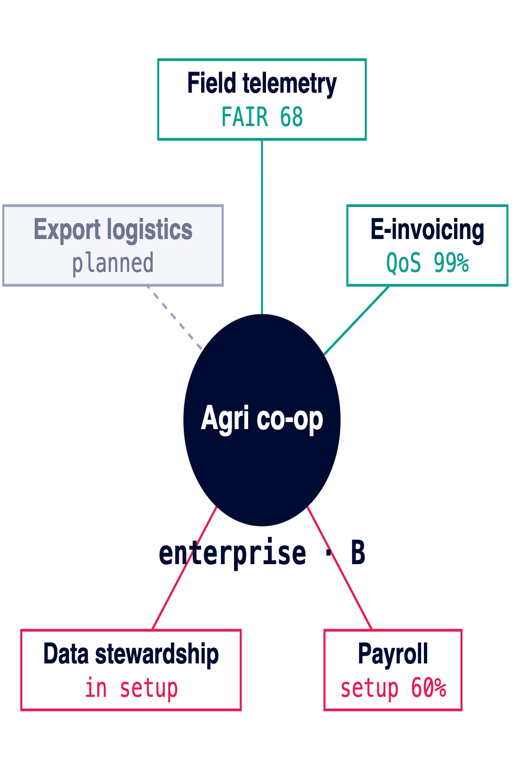
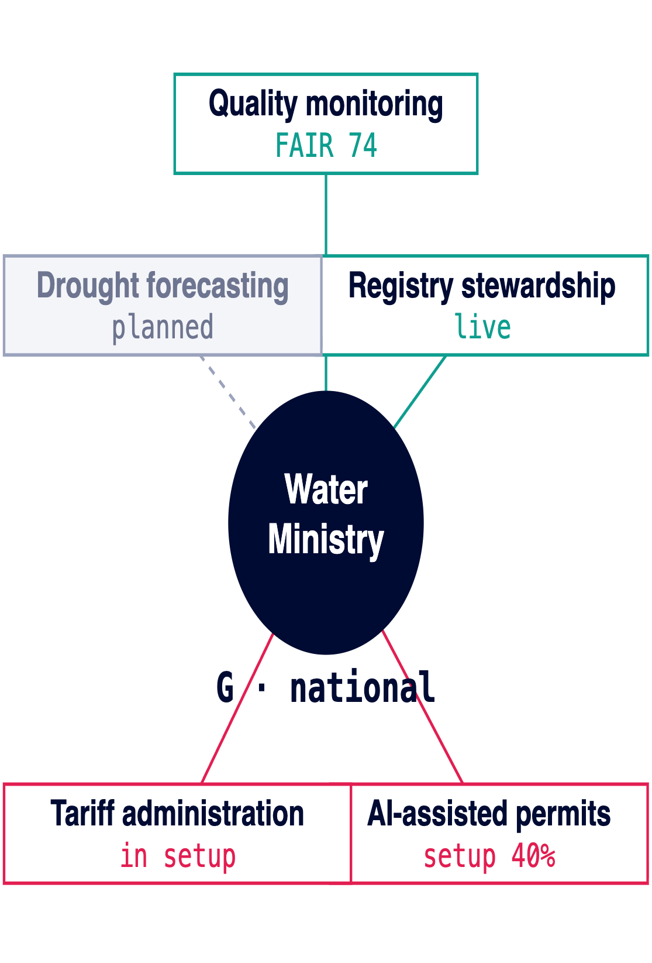
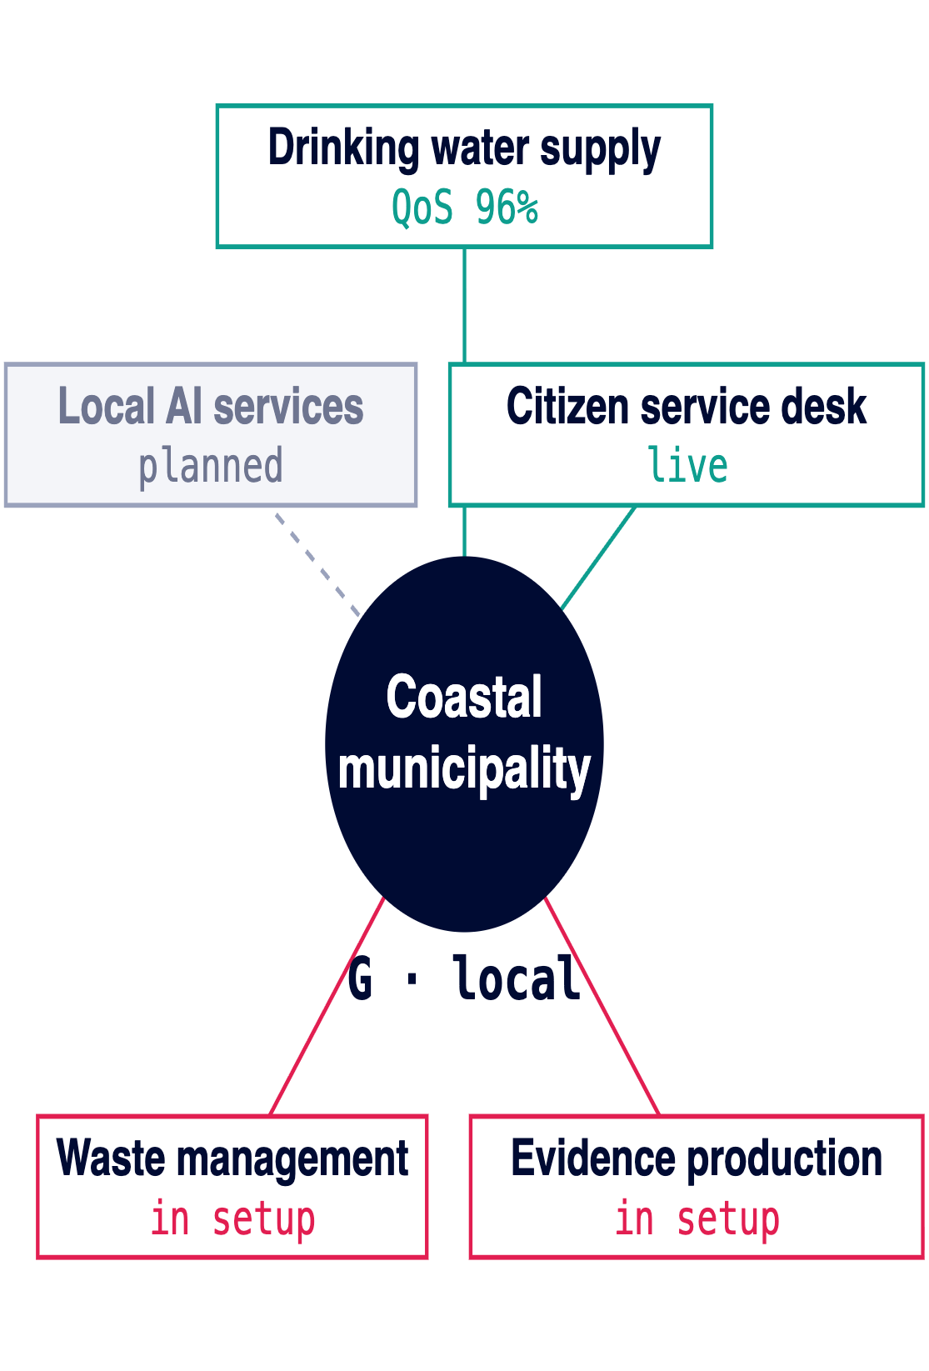
HOW SOLUTIONS ARE ORDERED ON THE SEMANTIC LAYER
● live · FAIR where certified
● in setup
● planned
Every Entity at the Centre of Its Capability Flower
Heterogeneous by design — states per capability, never a composite score for the whole.
§27.3 · §27.6
Notes:
Blueprint 27.3 and 27.6, shown as graphs instead of tables. Every entity — enterprise, ministry, municipality — sits at the centre of its capability flower: the capabilities it holds, each in its own state. Heterogeneous by design: live nodes carry FAIR scores and measured quality of service, setup nodes show progress, planned nodes show intent. The ordering machinery underneath is unchanged: enumerated coordinates (category, sectors, targets — closed vocabularies) and the closed relation vocabulary (implements, may_implement, enables + five non-binding). A solution never HAS a capability — it stands in a relation to one. Deliberately absent: no readiness score, no maturity number, no composite — an organization is a collection of processes, and the flower shows exactly which ones, in which state.

Slide 6
A COMPLETE NODE, BY EXAMPLE
Anatomy of a Capability Node
Smart Seeding
reference implementation
Setup
how it comes into being
Site assessment, sensor and model deployment, operator training — priced in hours, money, skills, resources. The royalty trigger.
Category
sector · aifod:sector/AGRI
Target profile
smallholder cooperative — core
Run
how it operates day to day
Seasonal seeding cycles, monitoring against the quality-of-service criteria, evidence produced continuously.
Capacity
hectares seeded per season
Quality of service
verified yield delta, baseline + follow-up
Change
how it evolves
Depends on
connectivity · soil data governance · operator credentials
Model updates, new crop varieties, scaling to more plots — versioned, so every fork can trace what changed.
Evidence
field telemetry into the node’s evidence log
Retire
how it ends without harm
Data returned to the cooperative, skills and equipment handed over — exit is designed in, not negotiated later.
The definition is forkable; this audited realisation of it is what the UCX publishes as the reference.
All four views validated — only then is the node eligible for FAIR assessment.
Notes:
A complete node, made concrete with the reference implementation used later in the story: Smart Seeding. Left: what the node states — coordinates, target profile with capacity and quality of service, dependencies, evidence. Right: the four process views every complete node carries. Only a node with all four validated is eligible for FAIR assessment; the reference implementation on the UCX is the audited, forkable original.

Slide 7
THE ONTOLOGY IN GOVERNANCE — FIGURE 34
Three Graphs per Nation, One Comparable Space
Sector graphs
The capability nodes of one industry — definitions, dependencies, target profiles. Agriculture, Health, Education, Energy, Water, Digital …
one per sector IRB
Enabling graph
Capabilities more than one sector requires — a capability needed by two sectors is by that fact not sectoral.
jointly contributed
Foundational graph
The national baseline every sector presupposes: identity, connectivity, data governance, basic institutional capability.
one per nation
Sets the standards the sector IRBs define their sectorial, enabling and foundational nodes in — together, tested against the real world — and stewards the capability catalogue: FAIR solutions carrying implementation passports — each stamp granted per jurisdiction by AIFOD partnering universities and innovation hubs after re-engineering in the local context.
IRB E1
sets the standards
Twelve graphs authored by twelve boards — and they remain one comparable space.
Notes:
Figure 34, read bottom-up. Foundational graph: the national baseline every sector presupposes. Enabling: what more than one sector requires — by that fact not sectoral. Sector graphs: one per sector IRB. E1 sets the standards — axes, fork chain, relation vocabulary, target-type registry — that the sector IRBs use to define their sectorial, enabling and foundational nodes together, test them against the real world, and steward the capability catalogue: FAIR solutions carry implementation passports; a passport stamp is granted per jurisdiction by AIFOD partnering universities and innovation hubs, after the solution is re-engineered in the local context. That is how twelve graphs by twelve boards remain ONE comparable space.

Slide 8
A FOUNDATIONAL GRAPH, WORKED FOR ONE SMALL NATION
● live · FAIR where certified
● setup
● planned
The AI Tech Stack for Nations
National AI services — the unlock
sector graphs draw from here
Citizen services in local language · FAIR 78 · 2.1M req/mo · QoS 96%
AI-assisted health triage
· setup 40% ⓘ
Agri advisory · FAIR 68 · 340k farmers
Education tutoring · planned
↑ dependsOn
Enabling — where the nation localises
forked national, verified by universities
Digital Public Infrastructure · FAIR 81 · 12M tx/day · 99.2%
Local-language corpus & models · 60% · 3/5 languages
Regional rulebook alignment · QoS audited
Sovereign compute access · 4/10 MW
Credentialed AI operators · 240 certified
AI leadership · cohort 1
Process governance · FAIR 71
Capability governance · on ProcesOS
Change management · planned
↑ dependsOn
Foundational — the national baseline
one graph per nation
Digital identity · 9.4M · QoS 99.6%
Energy production · 120/180 MW
Datacenter capacity · tier-3, 2027
Connectivity · 68% coverage
Data governance · FAIR 74
Institutional capability · NTO staffed
AI literacy · 12k trained
Measure what matters — every node runs as a Setup–Run–Change–Retire process with an evidence log, auditable by construction.
Regional rules by inheritance — forked common → regional → national, in local language.
Sovereign at every node — eleven-dimension profile; red flags override averages. Compare your AS-IS state with the SHOULD-BE state you defined for a given capability.
Notes:
A worked foundational graph for a small nation on the way to national AI services. Read bottom-up like Figure 34: the foundational baseline carries everything; the enabling layer localises — language corpus, regional rulebook, credentialed operators; the top is the unlock: AI services in the local language, under regional context and rules. The right rail is the guardrail: every node runs as an auditable Setup-Run-Change-Retire process — sovereignty checked as a profile, never assumed. Sectorial dependency example: Digital Public Infrastructure (sector Digital Infrastructure) depends on energy production and datacenter capacity in the foundational layer — the graph makes that explicit and queryable. States are deliberately heterogeneous: live nodes carry their achieved FAIR score plus measured capacity and quality of service, setup nodes show progress, planned nodes show what blocks them. Numbers are illustrative placeholders for one small nation.

Slide 9
THE ASSURANCE CHAIN
IRBs: the First Independent Review
The sector IRB is the first independent reviewer and scorer of a FAIR solution — independent of the vendor and of any single buyer. Because that review is scored against the shared ontology, it holds internationally.
→
→
01 · Sector IRB
02 · UCX
03 · Universities & hubs
First independent review & FAIR scoring
International rollout
National assurance
The scored node is published once and becomes adoptable in every participating nation — the review travels with it.
Partner universities and innovation hubs verify locally against the same definition — assurance without re-certifying from zero.
One audit against the sector’s capability graph — capacity and quality of service evidenced, not claimed.
Review once, independently — assure everywhere, nationally.
Notes:
The assurance chain that makes international rollout possible. The sector IRB is the FIRST independent reviewer and scorer of a FAIR solution — independent of vendor and of buyer. Because that first review is scored against the shared ontology, it holds everywhere at once, and partner universities and innovation hubs can take over national assurance without re-certifying from zero: they verify against the same definition, the same parameters.

Slide 10
WHY EXCHANGE IS POSSIBLE AT ALL — FIGURE 18
Every Actor Type Holds a Different Foundation
The types are not tiers of the same thing — a person’s foundation is not a smaller ministry’s. Because the baselines differ, one type holds capability another lacks.
Person
P
Household & community
C
Enterprise
B
Identity · AI literacy · professional judgement · credentials · the right to refuse
Local knowledge · language and culture · collective voice · participation · trust
Process ownership · delivery capacity · credentialed workforce · compliance
University
U
Municipality
G · local
Ministry & nation
G · national
Validation method · research · curriculum · certification · independent challenge
Local legitimacy · service delivery · evidence production · translating national direction
Mandate · legal authority · portfolio governance · registry stewardship · sovereignty and exit
The levels stack rather than repeat — and one node format lets capability move between them.
Notes:
Figure 18. Foundational capability is not one baseline at different sizes: a person's foundation — identity, literacy, judgement, the right to refuse — is categorically different from a ministry's. The typing is what makes exchange possible: because baselines differ, one type holds capability another lacks. This slide sets up the markets slide.

Slide 11
UNIVERSAL CAPABILITY ECONOMY, COORDINATED ON THE UCX
The Markets One Model Unlocks
P2P
B2C
B2B
B2G
Credentialed practitioners exchange method, mentoring and validated forks.
Certified capability delivered to people as a service, under FAIR scoring.
Reusable capability modules, delivery partnerships, joint ventures.
Governed procurement with exit, portability and knowledge transfer.
G2B
G2C
C2G
Enable the FAIR Universal Capability Economy
Published rulebooks, open blueprints, capability tenders.
Certified public services delivered to citizens against published target profiles.
Communities contribute local knowledge, evidence and validated forks back to government.
Ecosystem members collaborate in defining shared processes and supply chains — governed by the people actually doing the work: the stakeholders.
unit of exchange — the capability node
unit of value — the Verified Capability Delta
unit of trust — the assurance ladder
Notes:
One shared capability model opens these exchange directions — transparently, because every trade runs on the same three instruments: the node as unit of exchange, the Verified Capability Delta as unit of value, the assurance ladder as unit of trust. The Blueprint's Figure 20 names six directions including G2G; G2C and C2G make the citizen side explicit. Value flows only after deployment and evidence — publishing an idea earns attribution, not income.

Slide 12
ADAPTATION WITHOUT FRAGMENTATION
The rights floor
Sovereign by Construction
A national adaptation may change language, risk criteria and community protocols — it may not remove a rights protection or a preserved human judgement. Enforced, not requested.
A profile, never a ranking
Sovereignty is scored on eleven dimensions separately — data control, exit readiness, key-person dependency … Red flags override averages; no country is ranked by a single number.
common
→
regional
→
national
→
sector
→
institution
A definition forks along an ordered chain; it does not multiply. A fork inherits the substance — and never inherits its parent’s jurisdiction, publication status or review.
Holistic development
Person, community, enterprise, university, municipality, nation — every layer develops on its own foundational baseline, in one connected graph.
Notes:
Blueprint 27.4 and Section 14. Definitions fork along an ordered chain, never multiply — the order is the invariant. A fork never inherits jurisdiction, publication status or review. The rights floor is enforced, not requested. And sovereignty is a profile of eleven dimensions scored separately — red flags override averages, no composite. Holistic: every layer from person to nation develops on its own baseline.

Slide 13
FAIR + AID + IRBS, ON ONE GRAPH
One World Model for Digital Reality Checks
FAIR
AID
IRBs
The trust layer
The value layer
The governance layer
Independent, reproducible scoring of solutions — the seal that makes a claim credible anywhere.
Impact funding paid per verified capability delta — money flows where the evidence is.
Sector boards review and score; E1 keeps the vocabulary one comparable space.
The capability graph beneath all three
the shared world model
One semantic layer of definitions, instances, relations and evidence — every stated capacity and quality of service checkable against measured reality. Proven data-driven decision points through self-calculating process metrics: the ability to holistically see, discuss and decide on what, why and with what impact changes are made.
Three initiatives, one graph — trust, value and governance reading the same reality.
Notes:
The integration slide: the NCTB is what connects the three AIFOD initiatives into one system. FAIR contributes the independent scoring, AID the impact funding, the IRBs the governance and review. The capability graph underneath is the shared world model — every claim in it is checkable against evidence: stated capacity and quality of service versus measured reality. That is what a digital reality check means: not a report, a query.

Slide 14
THE LANE, WORKED ON ONE CAPABILITY — FIGURE 33
Smart Seeding, End to End
A Kenyan agritech collective runs AI-supported seeding that lifts yields on smallholder plots. Today it is invisible beyond its county. On the lane, it travels:
01
02
03
04
05
06
Shaped into a FAIR solution
Passes the gate
Scored & mapped
Anchored on Cardano
Published on the UCX
Escrow triggers on Setup
Process maturity plus technical readiness level 6 — only then can the solution enter review.
The sectorial IRB runs FAIR scoring and capability mapping against the Agriculture graph.
With an innovation hub or AIFOD regional chapter: Setup, Run and Retire modelled, at minimum. Intake: af.net/fair
Immutable authorship; royalty shares locked in escrows — defined once, for the whole chain.
Reference implementation, discoverable by need — forkable with lineage, worldwide.
Each successfully completed Setup releases the escrow — royalties flow along the contribution chain, back to Kenya.
Value follows evidence — publication earns attribution, a completed Setup earns the royalty.
Notes:
The canonical lane, worked on Smart Seeding (Blueprint §23.1, Figure 33). Stage 1: the innovator brings the working system to a participating innovation hub or AIFOD regional chapter/partner, and together they shape it into a FAIR solution — at minimum the Setup, Run and Retire processes modelled. Intake runs through af.net/fair. Stage 2: the gate — process maturity plus technical readiness level 6; only then does the solution go to the sectorial IRB. Stage 3: the IRB runs scoring and capability mapping against the sector graph; clarification loops with university and innovator are part of the design. Stage 4: anchoring on Cardano — immutable authorship, royalty shares in escrow. Stage 5: publication on the UCX as reference implementation. Stage 6: every successful Setup completion triggers the escrow — royalties flow along the contribution chain. Value follows evidence, never publication alone.

Slide 15
ADOPTING THE NCTB — FIGURE 32
The Roadmap, and Every Way In
PHASE 0 · Convene
PHASE 1 · Foundation
PHASE 2 · Transfer
PHASE 3 · Consolidate
Geneva Summit, Aug 2026
Sep–Dec 2026
H1 2027
Nairobi Summit 2027
Framework clause adopted; 3–5 pilot nations selected; charters signed.
AS-IS assessments, national catalog forks seeded, first engineers certified.
First cross-pilot transfers: fork → localise → validate, with university verification.
Pilot evidence enters the IRB report; certification pathway decided; cohort 2 launched.
AIFOD as convener
AIFOD as method steward
AIFOD as registry steward
AIFOD as reviewer
EVERY WAY IN — PICK YOUR DOOR
Nations
Join the pilot cohort — or fork the Blueprint independently; the chain keeps you comparable.
Sector IRBs
Design your sector graph in the shared ontology; contribute to enabling and foundational.
Universities & hubs
Become a national assurance partner — verify against the shared definitions.
Innovators
Publish your solution as a full-lifecycle capability; get FAIR-reviewed by your sector IRB.
Enterprises
Compete on evidence in the seven markets — verified cost, impact and exit terms.
Process designers
Shape the governance processes themselves — on the AIFOD instance of ProcesOS: os.af.net
Notes:
Figure 32 plus the adoption channels. The phased path runs Geneva to Nairobi with AIFOD's role receding by design — convener, method steward, registry steward, reviewer. Below: every door into the NCTB, from reading the Blueprint to running governance processes on the AIFOD ProcesOS instance. The International Capability Graph is a federation of sovereign national graphs, not a central database.

Slide 16
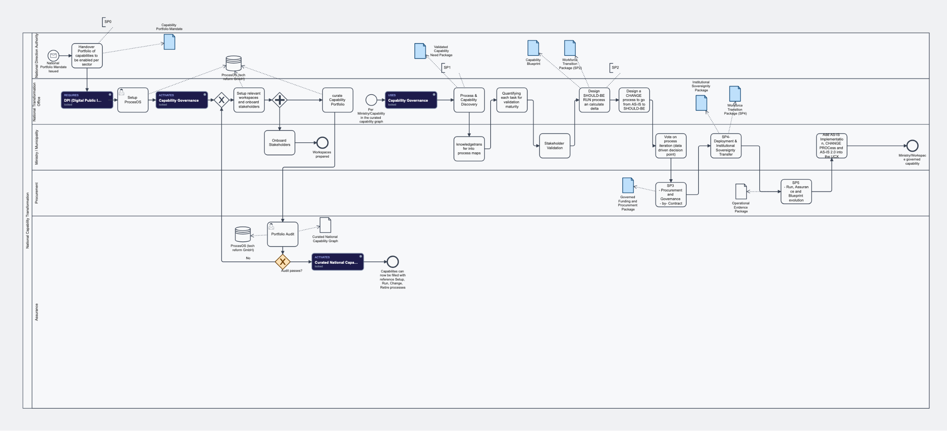
THE OPERATING PROCESS, MODELLED ON PROCESOS
BPMN 2.0 · os.af.net
NTO Setup & Run — One Pool, Five Accountable Actors
Phase 1 · Mandate & platform
Phase 2 · Workspaces & curation
Phase 3 · Per-capability loop
NDA hands over the portfolio; DPI unlocked is the precondition for ProcesOS setup.
Curated national graph, independently audited by Assurance — a failed audit loops back.
AS-IS → quantify → validate → SHOULD-BE → vote → SP3 governed funding.
Notes:
The operating process behind adoption, as modelled on the AIFOD ProcesOS instance. One pool, five lanes — five accountable actors: the National Direction Authority issues the mandate and hands over the portfolio; the National Transformation Office is the engine room — ProcesOS setup, graph curation, discovery, quantification, SHOULD-BE design; the Ministry or Municipality is the process owner — transfers knowledge, validates, votes, receives sovereignty; Procurement contracts and funds SP3 and carries SP5 Run; Assurance audits the portfolio and gates the release of the capability graph. Phase 1: mandate and platform setup — DPI must be unlocked before ProcesOS setup, which activates Capability Governance. Phase 2: workspaces and curation in parallel — curated graph goes to portfolio audit; a failed audit loops back. Phase 3: the per-capability governance loop — AS-IS discovery, knowledge transfer into process maps, task quantification, stakeholder validation, SHOULD-BE design with delta, CHANGE process with Workforce Transition Package, the data-driven vote, then SP3 procurement into governed funding.

Slide 17


THE MANDATE
One ontology, three graphs per nation, an independent first review — and the markets open on their own.
Each sector IRB designs its graph in the shared vocabulary. E1 keeps the space comparable. That is the whole ask — and the whole unlock.
af.net/irb/nctb
An open call for collaboration — in reforming into a better world.
Read the Blueprint — af.net/irb/nctb
Shape the governance processes — os.af.net
Notes:
Close with the working mandate. Each sector IRB designs its sector graph in the shared ontology; jointly they contribute the enabling and foundational graphs. E1 stewards the vocabulary so the space stays comparable. That is the whole ask — and the whole unlock.

