Slide 1
Hard Disk Failure Prediction Using Machine learning
Name of Group Members:
Harsh Dubey
Anuj Singh Bhadoriya
Abdulmuiz Shaikh
Shreyash Bajhal
Department of Computer Engineering,
Sinhgad Institute of Technology and Science, Pune
2022-23

Slide 2
Introduction
Failure of Hard Disk is a term most companies and people, fear about. People get concerned regarding data loss.
Therefore, predicting the failure of the HDD is an important and to ensure the storage security of the data center.
There exist a system named, S.M.A.R.T. in hard disk tools or bios tools which stands for Self-Monitoring, Analysis and Reporting Technology.
This method returns unlabeled data overtime, and the healthy and faulty data are highly mixed.
This returned data will be fed to ML algorithm to predict the hard drive failure
Hard Disk Failure Prediction Using Machine learning
2

Slide 3
Motivation
Hard disk storage is the most important information storage method in the Internet era, and failure of hard disk drives (HDDs) is also the most important fault source in data center.
Our main motivation behind this is to solve HDD failure problem and if we can surpass or somehow predict when it will fail, then it would be a great change and hence prevents data loss.
Hard Disk Failure Prediction Using Machine learning
3

Slide 4
Problem Statement
Project Topic:
Hard Disk Failure Prediction Using Machine learning
Problem Statement :
Hard Disks are core storage devices. They are mechanical, so they can fail any time after their life span. Hard Disk Drive S.M.A.R.T. values are given in the dataset. Predict the hard disk failure with highest accuracy possible.
Hard Disk Failure Prediction Using Machine learning
4

Slide 5
Project Scope
The project is currently being developed for the individual user, which uses hard disk drives as their storage device.
It can further be scaled up for data centres. The project requirements are satisfied by the available hardware and software.
The scope can be further expanded to surveillance system storage disks protection
Hard Disk Failure Prediction Using Machine learning
5

Slide 6
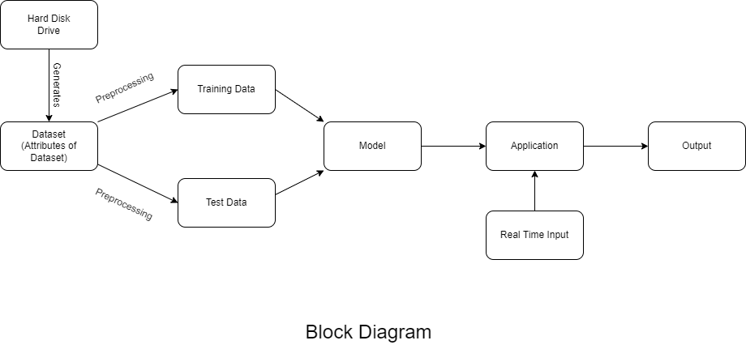
System Architecture
Hard Disk Failure Prediction Using Machine learning
6

Slide 7
Methodologies
1. Collecting Data:
As we know, machines initially learn from the data that you give them. It is of the utmost importance to collect reliable data so that your machine learning model can find the correct patterns. We collected data from a cloud service provider, which is a pioneer in robust, scalable low cost cloud backup and storage services.
2. Preparing the Data:
After data collection , data was cleaned. This helps make sure that data is evenly distributed, and the ordering does not affect the learning process. Cleaning the data to remove unwanted data, missing values, rows, and columns, duplicate values, data type conversion, etc.
3. Choosing a Model:
A machine learning model determines the output you get after running a machine learning algorithm on the collected data. It is important to choose a model which is relevant to the task at hand.
Hard Disk Failure Prediction Using Machine learning
7

Slide 8
Methodologies
4. Training the Model:
Training is the most important step in machine learning. In training, you pass the prepared data to your machine learning model to find patterns and make predictions. It results in the model learning from the data so that it can accomplish the task set.
5. Evaluating the Model:
After training your model, you have to check to see how it’s performing. This is done by testing the performance of the model on previously unseen data.
6.System Integration:
System integration step involves making prediction using GUI and saved model . This helps demonstrate application working of Machine Learning model.
Note:
Implementation details and model have not included intentionally with this presentation, as well as data source and other methodologies.
Hard Disk Failure Prediction Using Machine learning
8

Slide 9
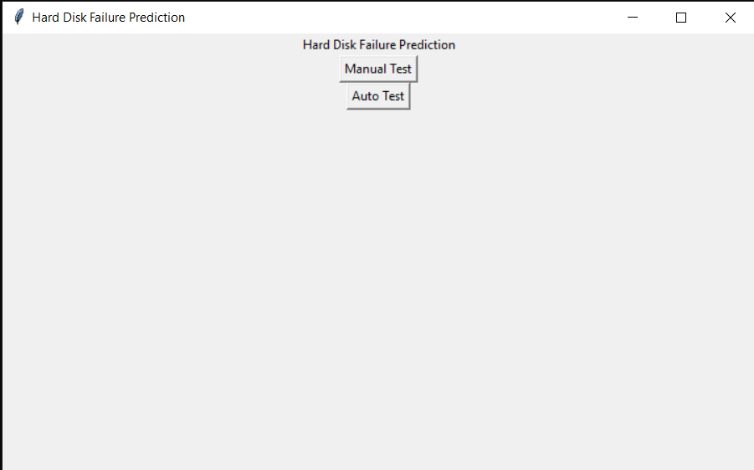
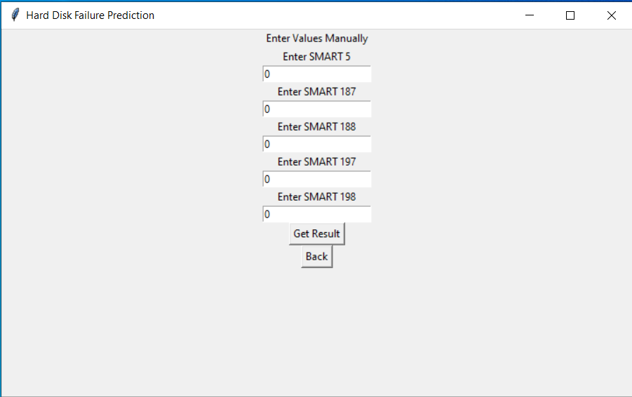
GUI & Demo
After Launching application you will see this window . Here manual test & Auto test two options are available.
On clicking manual test you will see this window.Here user is asked to enter 5 smart values of his drive or another hard drive.
Hard Disk Failure Prediction Using Machine learning
9

Slide 10
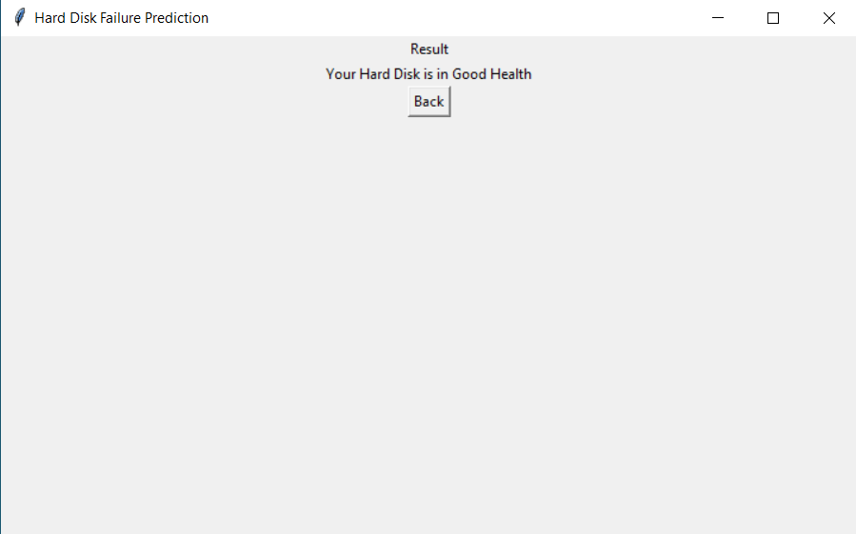
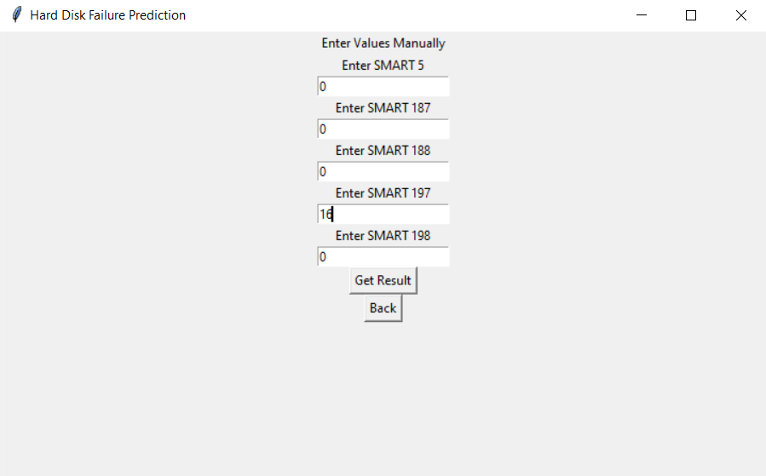
GUI & Demo
Machine learning model has been trained with all these 5 attributes.
On changing value of one of the smart value ,the result might change, depending on learning of value.
Hard Disk Failure Prediction Using Machine learning
10

Slide 11
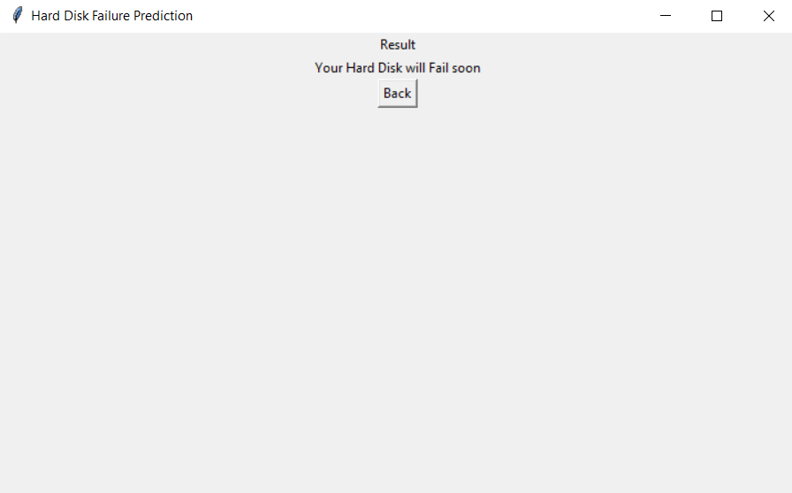
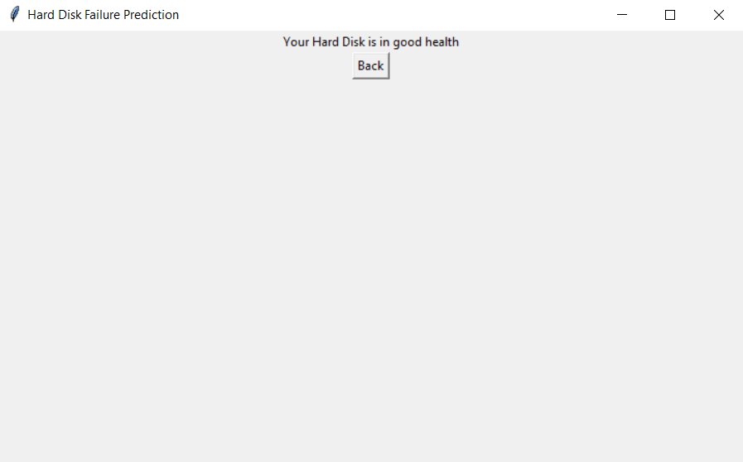
GUI & Demo
Here we got result as failure is predicted.
On clicking auto test from the main menu, your hard disk’s smart values will be fetched with some external software and python libraries and result will be shown.
Hard Disk Failure Prediction Using Machine learning
11

Slide 12
Thank you

