Slide 1
Knowledge Representation

Slide 2
KNOWLEDGE REPRESENTATION AND INFERENCE
What is knowledge
What is knowledge representation (KR)
Knowledge representation languages
Approaches to KR
  Semantic networks
  Frames
  Predicate Logic
  Production Rules

Slide 3
Epistemology: theory of knowledge
What is knowledge?
Is genuine knowledge attainable at all?
What are the limits of knowledge?
From what faculties of the mind does knowledge originate?
Which method should be used to obtain valid knowledge?

Slide 4
The AI view of knowledge
Knowledge consists of models that attempt to represent the environment in such a way as to maximally simplify problem-solving.
It is assumed that no model can ever hope to capture all relevant information

Slide 5










Basic assumption in Artificial Intelligence
Intelligent behavior can be achieved through the manipulation of symbol structures (representing bits of knowledge).
This is based on the physical symbol system hypothesis, proposed by Newell and Simon 1976

Slide 6
Main questions
How we can represent knowledge as symbol structures ?
How we can use that knowledge to
intelligently solve problems ?

Slide 7
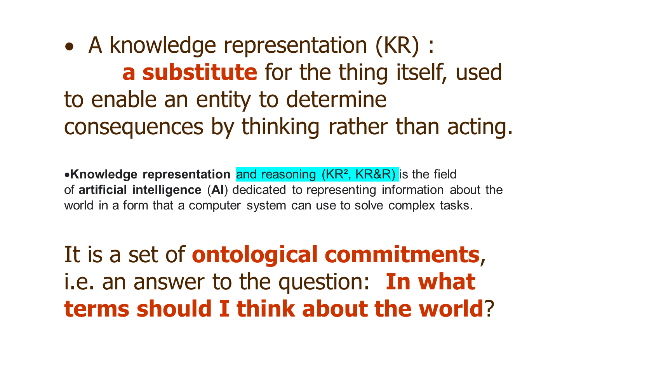
Features

Slide 8
Knowledge representation and other fields of study
Logic provides the formal structure and rules of inference
Ontology defines the kinds of things that exist in the application domain
Computation supports the applications that distinguish knowledge representation from pure philosophy

Slide 9

Knowledge Representation Languages
High level representation formalisms, that can in principle be implemented using programming languages.
should support inference.
inference - any way to get new expressions from old.

Slide 10
Requirements for Knowledge Representation Languages
Representational Adequacy: should allow to represent the knowledge we need
Inferential Adequacy: ability to infer new knowledge from a basic set of facts
Inferential Efficiency: Inferences should be made efficiently.
Clear Syntax and Semantics: what the allowable expressions are and what they mean
Naturalness: natural and easy to use

Slide 11

Knowledge Representation and Data structures
A KR is not a data structure
In KR: a correspondence between its constructs and things in the external world
KR - implemented by means of data structures

Slide 12
Approaches to Knowledge Representation in AI
Declarative vs procedural knowledge
Declarative representations:
Logic
Semantic networks and Frames
Production Rules

Slide 13
First Order Predicate Logic
    FOPL has a well defined syntax and semantics,
    It is concerned with truth preserving inference.
Problems : time, beliefs and uncertainty are difficult to represent

Slide 14
Semantic Nets and Frames
Represent factual knowledge about classes of objects and their properties
Not formal systems.
Basic inference mechanism: inheritance of properties
Problems: quantifiers, representing disjunction and negation

Slide 15



Production rules
Production systems:
a set of if-then rules - typically state that if certain conditions hold, then some action should be taken.
    If -then relation:
If high_temperature then prescribe aspirin
Production systems use a working memory - represents the facts (as semantic nets or frames) that are currently believed to hold.

Slide 16


































Semantic Nets
A semantic net is represented as a graph, where the nodes in the graph represent concepts,
and the arcs represent binary relationships between concepts.
    Nodes represent objects, attributes and values
    Links represent attributes and relationships between nodes
    Labels attached to links: the name of the corresponding attribute or relation

Slide 17










animal
Is_a
Is_a
Has part
reptile
mammal
head
Is_a
elephant
Is_instance_of
Clyde

Slide 18




Types of Relations
depending on the application.
(e.g. has_parts, likes, etc)
Important relations:
subclass / member
Is a / is instance of

Slide 19












Inheritance of Information
More specific (sub)classes inherit (get) properties from more general (super)classes through
is_a / is_instance_of links
Example: Inferring facts not explicitly represented: Clyde has a head

Slide 20
Representational and Inferential Adequacy
Problems with representing quantifiers,
(such as ``every dog in town has bitten the constable'')
May have 2 arguments only
Cannot represent disjunction and negation

Slide 21
Applications
ontologies, relational networks
Example:
http://www.troubleshooters.com/tpromag/199907/_model.htm
Using Semantic Nets
to Model Troubleshooting's Knowledge

Slide 22
Frames
Proposed in 1968 by Marvin Minsky http://web.media.mit.edu/~minsky
All the information relevant to a particular concept is stored in a single complex entity, called a frame.
Frames support inheritance.
Frames can be viewed as a structural representation of semantic nets.

Slide 23
Example
Mammal
subclass: Animal
warm_blooded: yes
Elephant
subclass: Mammal
* colour: grey
* size: large
Clyde
instance: Elephant
color: pink
owner: Fred

Slide 24
Components of a Frame Entity
Name - correspond to a node in a semantic net
Attributes or slots filled with particular values
E.G. in the frame for Clyde, instance is the name of a slot, and elephant is the value of the slot.
Names of slots correspond to the links in semantic nets
Values of slots correspond to nodes.
Hence each slot can be another frame.

Slide 25
Example
Size:
instance: Slot
single_valued: yes
range: Size-set
Owner:
instance: Slot
single_valued: no
range: Person
Fred:
instance: Person
occupation: Elephant-breeder

Slide 26
Representational Power
    Necessary attributes
    Typical attributes (``*'' )
    Type constraints and default values of slots,
    Overriding values.
    Slots and procedures: a slot may have a procedure to compute its value of the slot, if needed e.g. object area, given the size

Slide 27
Inheritance
    If a slot is not defined for a given frame, we look at the parent-class slot with the same name
Simple if single parent-class
several parent classes :
multiple inheritance problem
(e.g., Clyde is both an elephant and a circus-animal)
Choose which parent to inherit from first.

Slide 28
Applications
Classifying new instances of familiar entities (objects/events/places/tasks
Anticipating the attributes of such instances
Inferring the presence and properties of their parts or participants

