Slide 1
Simulation of a Telephone System

Slide 2
Objectives
Process a given number of calls and determine
what proportions are
successfully completed
blocked or
found to be busy calls

Slide 3
continued
The system has a number of telephones (8 are shown) connected to a switchboard by lines.
The switchboard has a number of links which can be used to connect any two lines, subject to the condition that only one connection at a time can be made to each line.
The system is lost call system.
i) A call is lost, if the called party is engaged, then it is a busy call.
ii) A call may be lost if no link is available, it is blocked call.

Slide 4
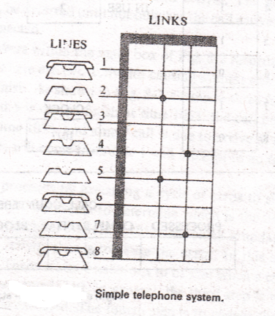

Slide 5
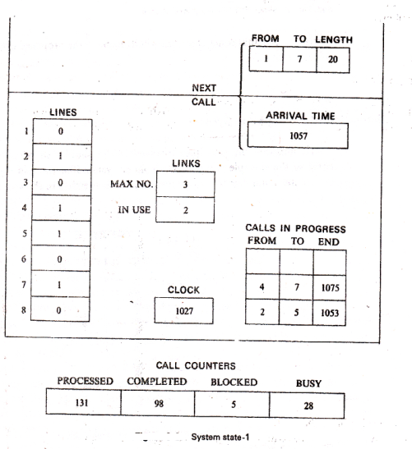

Slide 6
Each call is a separate entity having attributes
a) Origin
b) Destination
c) Lengthy, and
d) the time at which call finishes
0 represents Free
1 represents Busy
To keep track of event, a number representing clock time is included.
At present 1027(time unit)
To generate the arrival of call, a record is kept of the time the next call is due to arrive.
The set of numbers within the main box of figure records the state of the system at time 1027.
There are two activities causing events:
i) New calls arrive
ii) Existing calls vanish
Maximum link 3 and 2 is in use

Slide 7
The simulation proceeds by executing a cycle of steps to simulate event:
Scan the events to determine which is the next potential event(1053)
The clock is updated, and the second step is to select the activity that is to cause the event(activity disconnect a call)
Third step is to test whether the potential event can be executed.
The fourth step is to change the records to reflect the effect of the event(0 to 2&5).
Fifth step is the execution cycle, to gather some statistics for simulation output.

Slide 8
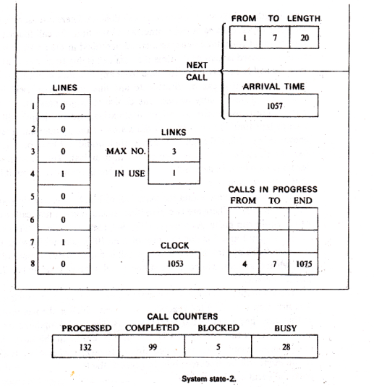

Slide 9
It can be seen that next event is the arrival of a call at time 1057.
Since the selected activity is to connect a call, it is necessary to carry out tests:
i) Link is available
ii) If the party is busy(7 is busy, lost call)
Both processed calls and busy calls are increased by 1.

Slide 10
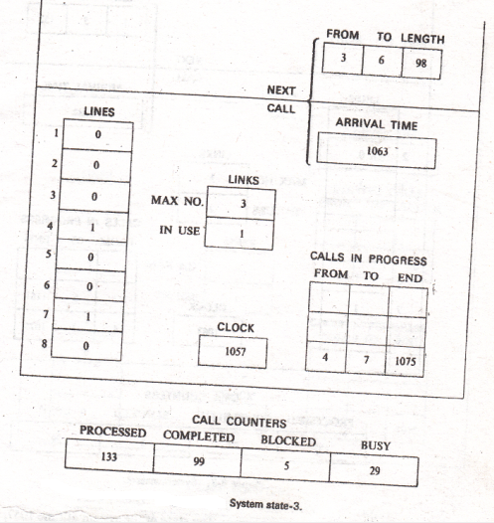

Slide 11
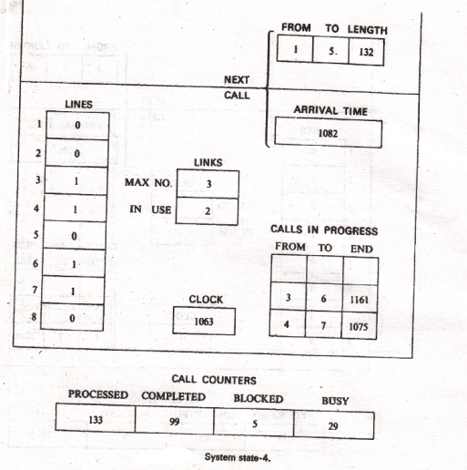

Slide 12
Termination of simulation
After processing a given number of calls
or
Until a certain time has elapsed.

