Slide 1
Discrete & Continuous System
Systems can be categorized as discrete or continuous.
A discrete system is one for which the state variables change instantaneously at separated points in time.
Example: The number of customers in the bank – change only when a customer arrives or when a customer finishes being served and departs.
A continuous system is one for which the state variables change continuously with respect to time.
Example: State variables such as position and velocity of an airplane can change continuously with respect to time.

Slide 2
Model of a system
Sometimes it is of interest to study a system to understand the relationships between its components or to predict how the system will operate under a new policy. To study the system, it is sometimes possible to experiment with the system itself.
However, a new system might not yet exist; it could be in only hypothetical form or at the design stage. Even if the system exists, it might be impractical to experiment with it. Consequently, studies of system are often accomplished with a model of a system.
A model is defined as a representation of a system for the purpose of studying the system. For most studies, it is only necessary to consider those aspects of the system that affect the problem under investigation. These aspects are represented in a model of the system.

Slide 3
Cntd.
On the other hand, the model should be sufficiently detailed to permit valid conclusions to be drawn about the real system. Different models of the same system could be required as the purpose of investigation changes.
Just as the components of a system are entities, attributes, and activities, models are represented similarly.

Slide 4
Types of model
Models can be classified as being mathematical or physical.
A mathematical model uses symbolic notation and mathematical equations to represent a system. A simulation model is a particular type of mathematical model of a system.
Simulation models may be further classified as:
i. Static or dynamic
ii. Deterministic or stochastic
iii. Discrete or continuous
A static simulation model is a representation of a system at a particular time, one that may be used to represent a system in which time simply plays no role. Ex. Monte Carlo models. Dynamic simulation models represent system as they change over time. Ex. The simulation of a bank from 9 :00 AM to 5:PM.

Slide 5
Cntd.
Simulation models that contain no random variables are classified as deterministic. Deterministic models have a known set of inputs, which will result in a unique set of outputs. Deterministic arrivals would occur at a Dentist’s office if all patients arrived at the scheduled appointment time.
A stochastic simulation model has one or more random variables as inputs. Random inputs lead to random outputs. Since the outputs are random, they can be considered only as estimates of the true characteristics of a model. The simulation of a bank would usually involve random interarrival times and random service times. Thus, in a stochastic simulation, the output measures - the average number of people waiting, the average waiting time of a customer- must be treated as a statistical estimates of the true characteristics of the system

Slide 6
Cntd.
Discrete and continuous models are defined in an analogous manner. However, a discrete simulation model is not always used to model a discrete system, nor is a continuous model always used to model a continuous system. Tanks and pipes are modeled discretely by some software vendors, even though we know that fluid flow is continuous.
In addition, simulation models may be mixed, both discrete and continuous. The choice of whether to use a discrete or continuous (or both discrete and continuous) simulation model is a function of the characteristics of the system and the objective of the study.
Thus, a communication channel could be modeled discretely if the characteristics and movement of each message were deemed important. Conversely, if the flow of messages in aggregate over the channel were of importance, modeling the system via continuous simulation could be more appropriate.

Slide 7
Physical Models
Physical models are based on some analogy between such systems as :
* mechanical and electrical
* electrical and hydraulic
In physical model of a system, the system attributes are represented by such measurements as a voltage or position of a shaft.
The system activities are reflected in physical laws that drive the model.
Example: The rate at which the shaft of a direct current motor turns depend upon the applied voltage to the motor. If the applied voltage is used to represent the velocity of a vehicle, then the number of revolutions of the shaft is a measure of the distance the vehicle has traveled; the higher the voltage, or velocity, the greater is the buildup of revolution, or distance covered, in a given time.

Slide 8
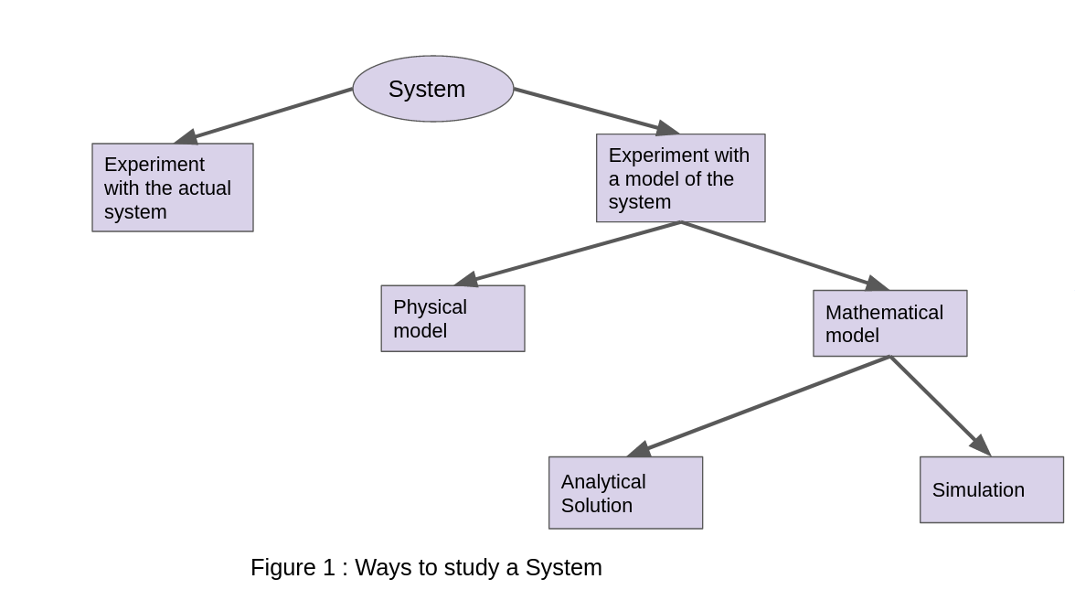
Ways to study a system

