Slide 1
Discrete Event System Simulation
Discrete – event system simulation is the modeling of systems in which the state variable changes only at a discrete set of points in time. The simulation models are analyzed by numerical methods rather than by analytical methods.
Analytical methods employ the deductive reasoning of mathematics to solve the model. For example, differential calculus can be used to compute minimum – cost policy for some inventory models.
Numerical methods employ computational procedures to solve mathematical models.
In the case of simulation models, which employs numerical methods, models are run rather than solved – that is, an artificial history of the system is generated from the model assumptions, and observations are collected to be analyzed and to estimate the true system performance measure.
Real-world simulation models are rather large, and the amount of data stored and manipulated is vast, so such runs are usually conducted with the aid of a computer.
Discrete – event simulation models consider discrete, dynamic, and stochastic models.

Slide 2
Steps in a simulation study
The following figure shows a set of steps to guide a model builder in a thorough and sound simulation study. The steps in a simulation study are as follows:
Problem formulation : Every study should begin with a statement of the problem. If the statement is provided by the policy makers, or those that have the problem, the analyst must ensure that the problem being described is clearly understood. If a problem statement is being developed by the analyst, it is important that the policymakers understand and agree with the formulation.
Setting of objectives and overall project plan: The objectives indicate the questions to be answered by simulation. At this point, a determination should be made concerning whether simulation is the appropriate methodology for the problem as formulated and objectives as stated. Assuming that it is decided that simulation is appropriate, the overall project plan should include a statement of the alternative systems to be considered and of a method for evaluating the effectiveness of these alternatives. It should also include the plans for the study in terms of the number of people involved, the cost of the study, and the number of days required to accomplish each phase of the work, along with the results expected at the end of each stage.

Slide 3
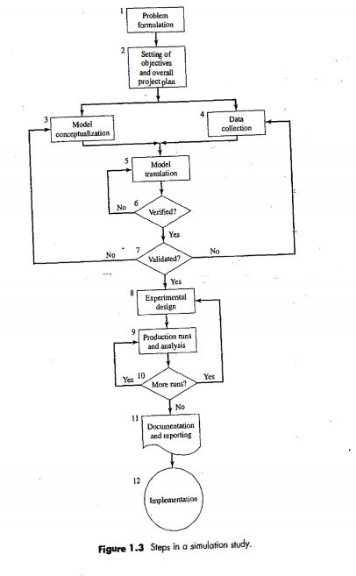
Cntd.

Slide 4
Cntd.
Model conceptualization : The construction of a model of a system is probably as much art as science. Experts state that although it is not possible to provide a set of instructions that will lead to building successful and appropriate models in en every instance, there are some general guidelines that can be followed. The art of modeling is enhanced by an ability to abstract the essential features of a problem, to select and modify basic assumptions that characterize the system, and then to enrich and elaborate the model until a useful approximation results. Thus it is best to start with a simple model and build toward greater complexity. It is not necessary to have a one-to- one mapping between the model and the real system. Only the essence of the real system is needed. It is advisable to involve the model user in model conceptualization.
Data collection : There is a constant interplay between the construction of the model and the collection of the needed input data. As the complexity of the model changes, the required data elements can also change.
The objectives of the study dictate, in a large way, the kind of data to be collected. In the study of a bank, for example, if the desire is to learn about the length of waiting lines as the number of tellers change, the type of data needed would be the distributions of interarrival times, the service – time distributions for the tellers, and historic distributions on the lengths of waiting lines under varying conditions. This last type of data will be used to validate the simulation model.

Slide 5
Cntd.
Model translation: Most real - world systems result in models that require a great deal of information storage and computation, the model must be entered into a computer - recognizable format. The modeler must decide whether to program the model in a simulation language, or to use special-purpose simulation software.
Verified: Verification pertains to the computer program prepared for the simulation model. Is the computer program performing properly? With complex models, it is difficult, if not impossible, to translate a model successfully in its entirety without a good deal of debugging; if the input parameters and logical structure of the model are correctly represented in the computer, verification has been completed.
Validated: Validation usually is achieved through the calibration of the model, an iterative process of comparing the model against actual system behavior and using the discrepancies between the two, insights gained, to improve the model. This process is repeated until model accuracy is judged acceptable.

Slide 6
Cntd.
Experimental design : The alternatives that are to be simulated must be determined. Often, the decision concerning which alternatives to simulate will be a function of runs that have been completed and analyzed. For each system design that is simulated, decisions need to be made concerning the length of the initialization period, the length of simulation runs, and the number of replications to be made of each run.
Production runs and analysis: Production runs, and their subsequent analysis, are used to estimate measures of performance for the system designs that are being simulated.
More Runs: Given the analysis of runs that have been completed, the analyst determines whether additional runs are needed and what design those additional experiments should follow.

Slide 7
Cntd.
Documentation and reporting: There are two types of documentation: program and progress. Program documentation is necessary for numerous reasons. If the program is going to be used again by the same or different analysts, it could be necessary to understand how the program operates. This will create confidence in the program, so that model users and policy makers can make decisions based on the analysis. Also, if the program is to be modified by the same or a different analyst, this step can be greatly facilitated by adequate documentation. Another reason for documenting a program is so that model user can change parameters at will in an effort to learn the relationships between input parameters and output measures of performance or to discover the input parameters that optimize some output measure of performance.
Reporting includes model specification, prototype demonstrations, animations, training results, intermediate analyses, program documentation, progress reports, and presentations. The results of all these analysis should be reported clearly and concisely in a final report.

Slide 8
Cntd.
Implementation: The success of the implementation phase depends on how well the previous 11 steps have been performed. It is also contingent upon how thoroughly the analyst has involved the ultimate model user during the entire simulation process. If the model user has been thoroughly involved during the model-building process and if the model user understands the nature of the model and its outputs, the likelihood of a vigorous implementation is enhanced. Conversely, if the model and its underlying assumptions have not been properly communicated, implementation will probably suffer, regardless of the simulation model’s ability.

