Slide 1
Public Bus Service Management System
Condition_Zero
Amrutheshwar O
Aaryan Agarwal
Abdul Muyiz Khazi
Amitesh Kumar Singh
Anusha Ashok Deshmukh

Slide 2
Team Condition_Zero
Team members
Amrutheshwar O
Aaryan Agarwal
Abdul Muyiz Khazi
Amitesh Kumar Singh
Anusha Ashok Deshmukh
Currently studying Information Science Engineering at Ramaiah Institute of Technology.
Aaryan Agarwal, Amitesh Kumar Singh and Anusha Ashok Deshmukh have been involving in Machine Learning workshops.
Abdul Muyiz Khazi as intern at TechMachinery working on developing IOT and Edge Intelligence-Computing solutions concerning infrastructre development.
Amrutheshwar O (Team Liquid)- 1st Place at REimagiNEWaste Season 4 (organised at IIMB) hackathon for developing a solution to prevent release of BioMedical Liquid Waste into the sewage from Hospitals with bed size less than 10.

Slide 3

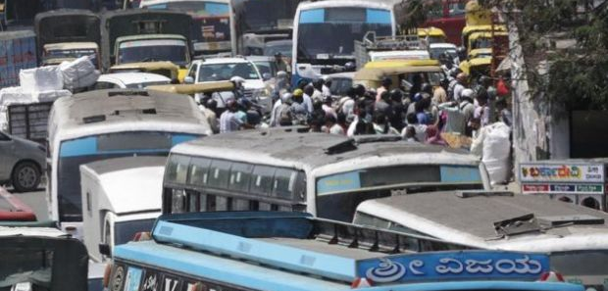
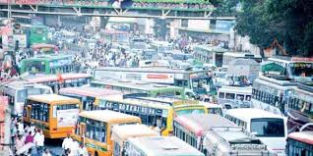
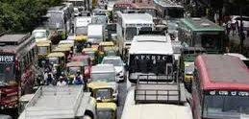
Problem statement
Traffic congestion is a major concern in most Indian cities, especially in Bengaluru; if you know, you know.
Traffic movement is neither consistently slow nor fast.
One of the factors is the inconsistency in public bus service.
Unmonitored bus frequency.
Traffic congestion due to buses’ movement.
No effective feedback system to rate public bus service.
*We consider BMTC as the test object for the solution, and hence would be using it to as a substitute for the 'Public Bus System' for convenience.

Slide 4
Solution
The solution comprises of
Database
Edge devices
Customer end devices
Nodes at Bus stations
And associated connections
We propose to implement an app for passenger’s access. This app is expected to have multiple portals through which a passenger can
Update his requirement for a bus to his destination on a route or using the bus number.
Know the estimated wait time for his bus.
Review the driver/conductor/the organization of the bus he boards.
Give general feedbacks which can be useful for the organisation.
The application also notes the time of arrival and departure, number of buses of a route in the terminal, the employees’ number and their services offered (and the bus associated with them if any). The buses are also given unique numbers which will used by the tracking application for data communication and data gathering. Employees are also given identification purpose number which can be used to review the bus driver and conductor.

Slide 5
Solution Contd.
Information conveyed.
Passengers
The number of people in a bus.
The feedback from people.
Daily density of people in stops at different intervals.
The peak hours depending on people and stops.
Buses
The arrival time and the traffic conditions changing during travel.
The information on the buses on the same route and conveying the time lag between the bus and stops so I route can be modified depending
The space utilized during a round and to warn people about the space constraints.
Stations
The number of buses yet to leave.
The number of buses in the station.
The number of buses already left.

Slide 6
Solution Contd.
For the initial stages, the device follows the data that is available at the organisation and implements the factors of the application based on it.
It is learned that BMTC has a higher frequency of bus at the peak time (usually in the morning from 7am to 10am and 5pm to 9pm). But as per the passenger reviews and the current trend, the buses aren’t consistent in the peak time with different delays at different time slots. Sometimes passengers witness a higher frequency of buses and no buses at all at a different time slot, consequently having to wait for a longer period.
What we aim to create is a solution preferably a tracking application, which can track the movement of a bus in its route and update the next bus requirement to a terminal based on the passenger count on a route.
Peak time
The tracking application intimates the bus terminals to have an increased frequency of bus traversal (between the routes which have higher passenger travel). The tracker is expected to intimate the bus driver the passenger count at a certain stop, the delay he must maintain from the previous bus on the same route to the same destination. This tracker receives the passenger count at a stop, through the passenger’s device by a request from them. Hereby enabling the tracking application to allot a bus on the route for the passenger. The delay might not be a constant but rather vary with the passenger count. The more the passenger at different stops on the same route, more buses intimated for the traversals.

Slide 7
Solution Contd.
Nonpeak time
In nonpeak time also the tracking application is dependent on the data or request for a bus to a certain destination by the passenger. The bus is intimated about the number of passengers at different stops on the same route. Once the passenger count reaches a certain number, the tracking application intimates the terminal to allot a bus then. If the passenger count is more than what is expected on that period, the terminal is intimated to increase the bus frequency with a certain delay between the buses as calculated by the tracking application. If there are no request for a bus on a route, the terminal is supposed to allot a bus on the route after a certain timeout from the departure of the previous bus on the same route.
We also propose to implement a time-out duration of a certain period from the departure of the previous bus to the same destination on the same route. If the passenger count (not zero) cumulative of all passengers on the same route doesn’t reach a certain number the bus is expected to depart from the terminal after the time-out period, assuming the addition of more passengers on the route by the time the bus reaches the stops on the route.

Slide 8
Pre-requisites and assumptions for the solution to be effective
Buses must/will
Have similar seating capacity.
Have digital boards with edge devices.
Drivers must/will
Have a knowledge about the different routes operating between the same source and destination stations.
Stations must/will
Have the minimum number of buses at any given time for a certain route.
Physically co-operate with the bus drivers in allocating bus to a route, changing the route of the bus (from its source).
End users must/will
Have smart phones.
Customer must/will
Be cooperative with us, in providing better service to the public.
Be open to accept technological upgrades to the solution.

Slide 9
Tech stack
The list of languages and protocols that have been used are
Firebase Realtime Database for Data base and server management.
XML for UI.
Satellite communication and GPS for bus tracking and distance measurement (presently not implemented).
Internet communication protocols between server, data base, bus device and station control (also provided by firebase).
Java for android app development.

Slide 10
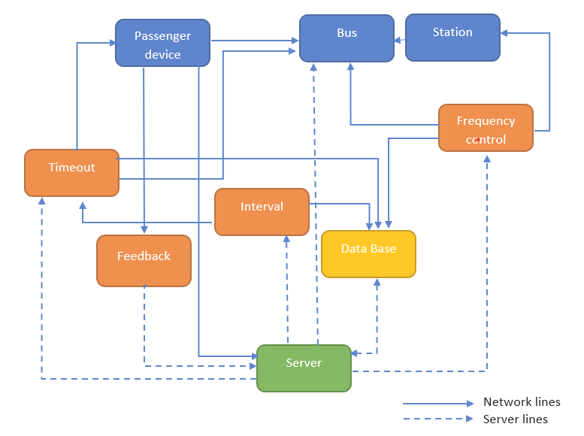
Case diagram

Slide 11
Social Business Canvas
Venture: To design a solution to manage bus frequency and enhance the feedback system.
Mission: To control traffic congestion and minimise fuel expenses.
Market
Value proposition
Major requirement for most public transport service corporations.
Enablement of digital payments.
Realtime management of bus frequency.
Regular updation of changing trends in commuters behaviour.
Involved intelligence in edge devices to limit the computation in the server.
Implementation
Customer Segments
As a BtoB service, the customer end would comprise of high- end public/ private bus transport providers with a huge network in a city or subcity; which require bus frequency management; maintain customer- service provider relationship; minimise expenses incurred on fuel requirement and seek to digitise the services.
Macro Economic Environment
The digitization of major sectors of the economy. Increasing need to save fuel.
Key partners
Maps service providers, edge device manufacturers, and other software licensors for database management
Resource requirements and prerequitsites
Database
Edge devices
Smart phones at customer end
Nodes at Bus stations
And associated connections
Introduction into the market
Passive advertisement to private businesses; Government mandation for public transport corporations.
Competitors
Reven school bus management system.
Federa school bus management system.
Cost Structure: Depends on the fleet of buses to be managed. For BMTC it should be around Rs. 3-5 Cr.
Revenue: The customer will pay for the services which is charged on a yearly basis which includes mainenance cost also.

Slide 12
Customer
The ideal customer for our solution will be those corporations which have a bus fleet that operate in a city or sub-city on which the public is most directly dependent on.
The product is specific to businesses that have the above qualities.
The public specific app, edge device and node station specific interfaces will be easy to understand work on as the output displayed will be in simpler terms. A bare minimum of training is required to educate the operators at the node stations and drivers to use their respective interfaces and stick with it.
The feedback procedure form the customer will be based usually on a physical dialogue. The feedback from the end users will be more option specific which will be used to update the solution variables from time to time.

Slide 13
Human resource
Operators for
Managing and maintaining databases and servers.
Managing activities at node stations.
Repairing edge devices if any problem encountered.
Professionals to manage the customer relationships and the company interests.

Slide 14
Market scope and marketing strategies
In India alone, there are many cities which have traffic congestion problems and have a public bus transport system. The situation is pretty similar to what it is in Bengaluru in other metropolitan cities too.
Once after installation, the solution might be feasible with the customer having to pay for the management charges and miscellaneous factors on a yearly basis.
Since the product is business to business oriented, the most effective strategies for marketing are
Trade shows and exhibitions
Promotional products
Trade ins
Promotion by the corporation among the public to use the mobile applications.
We may have to approach the corporation with the product and demonstrate.

Slide 15
Revenue stream
The cost of installation is dependent on the fleet size and the utility the corporation wishes to implement.
The cost of management is recurring over a yearly basis.
The income to the company by the customer is very much dependent on negotiations and deals, with cost management having a yearly pay.
As long as the main stream expenditure is contained (fuel expenses) and the services are enhanced, the customer must be willing to pay for the product (assumption).

Slide 16
Our EDGE over our competitors
Google maps as a competitor does provide an estimate on the arrival of the bus at a certain stop. It has been pretty accurate at that. But it doesn’t provide an interface which determines the frequency of bus departure and other functionalities (traffic consistency maintenance) that will be provided by the solution we are developing.
Raven connected software and Federa school bus services are more oriented towards tracking vehicles namely school buses, delivery vehicles, etc.
Our assumptions
No indigenous competitors present currently.
The data follows a trend that can be exploited.

Slide 17
Competition analysis table
Product by company | Flexibility* | Real time estimation of bus arrival | Bus frequency management | Digital payments | Exclusivity for a corporation
Google Maps | Yes | Yes | - | - | -
Reven | No | Yes | No | Yes | Yes
Federa | No | Yes | No | Yes | Yes
Our product | Yes | Yes | Yes | Yes | Yes
* in terms of usage other than school domain
- "Not Applicable"

Slide 18
Key partners
Google maps
Digital payment portals
Edge device manufacturers
Traffic department
Insurance companies

Slide 19
Thank you
Condition_Zero

