Slide 1
Indian Power Grid Analysis
EDA, Linear Regression, SVD, PCA (2021-2023)
Dataset: Mendeley Data (2024) - Electricity Demand, Solar and Wind Generation Data
Coverage: Sep 2021 to Dec 2023 (resampled to 5-minute intervals)
Focus: Demand modeling using generation mix + time features

Slide 2
Dataset and Scope
Source: Mendeley Data (Mukherjee, Kalita, Kumar, 2024)
Raw inputs: monthly Excel sheets in Datasets/ (Sep 2021 to Dec 2023)
Combined CSV: energy_combined.csv (4,062,240 raw rows)
Cleaned index: 245,376 rows at 5-minute frequency
Target: NLDC demand (nldc_demand_mw)

Slide 3
Data Preparation
Parse Date&Time, sort, set as index
Resample to 5-minute intervals using mean
Merge Solar+Wind with Wind+Solar and drop duplicate column
Drop duplicate Solar column after correlation check
Rename columns to snake_case
Clip negative solar and gas values to zero

Slide 4
Feature Engineering
Time features: hour, day_of_week, month
Peak-hour flag: 18:00 to 21:59
Seasons: summer, monsoon, post_monsoon, winter (one-hot)
Model features: generation mix + time + season dummies
Temporal split: first 80% train, last 20% test

Slide 5
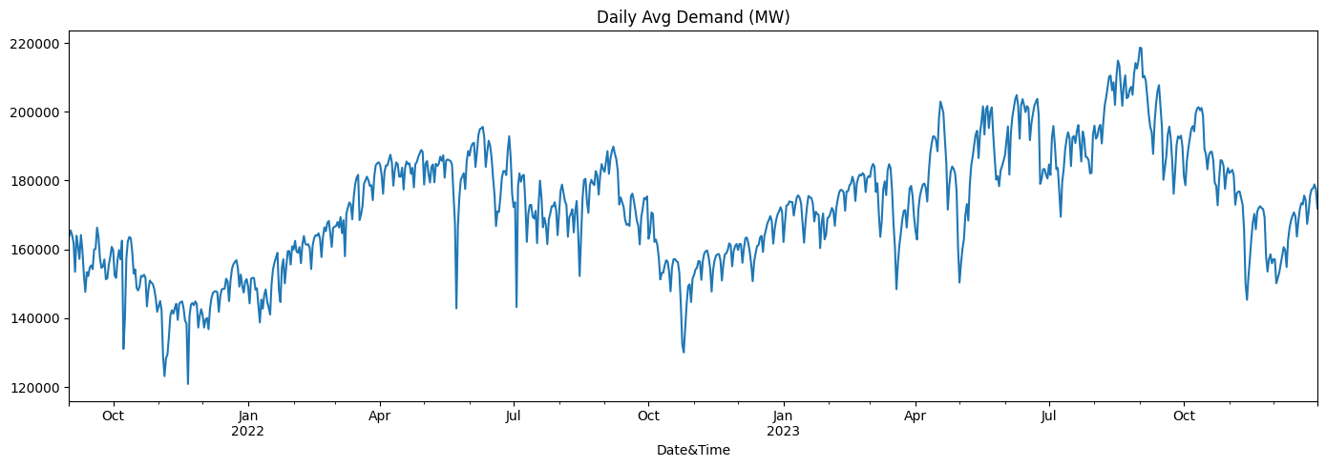
Daily Average Demand

Slide 6
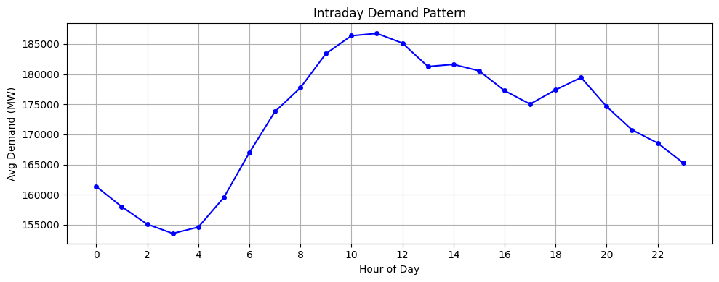
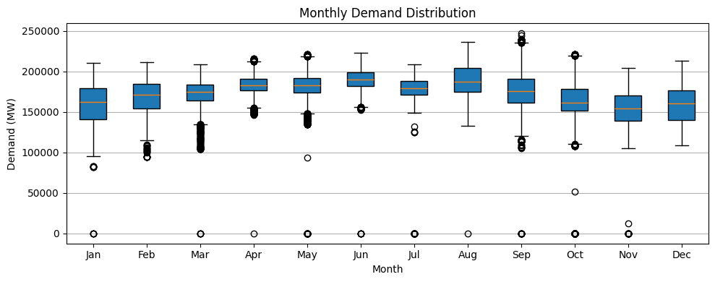
Intraday and Monthly Patterns

Slide 7
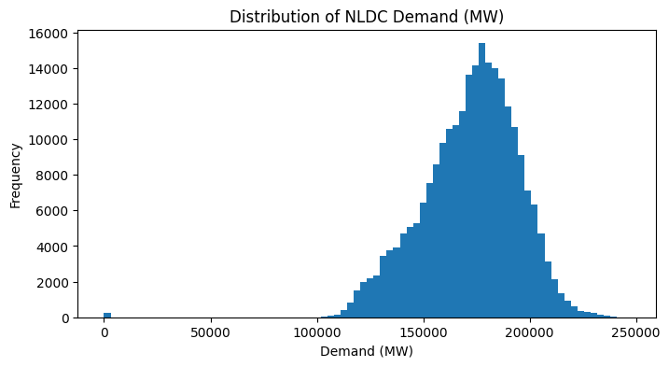
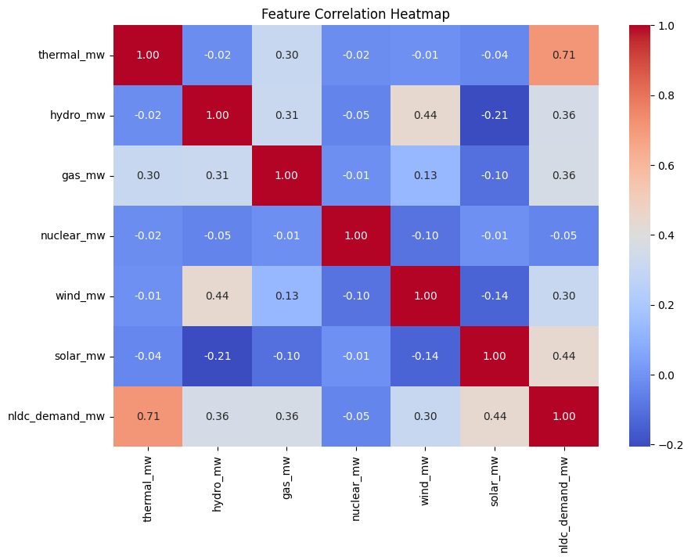
Demand Distribution and Correlations

Slide 8
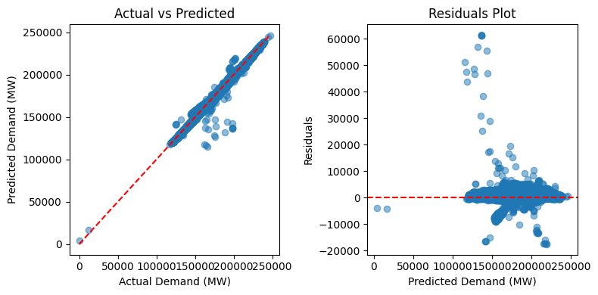
Linear Regression Results
Baseline linear regression on engineered features
Train R2: 0.9920 | RMSE: 1917.36
Test R2: 0.9931 | RMSE: 1824.24

Slide 9
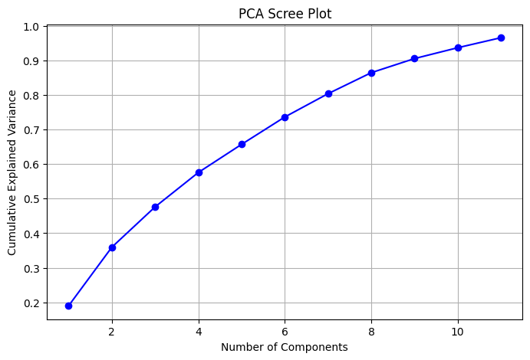
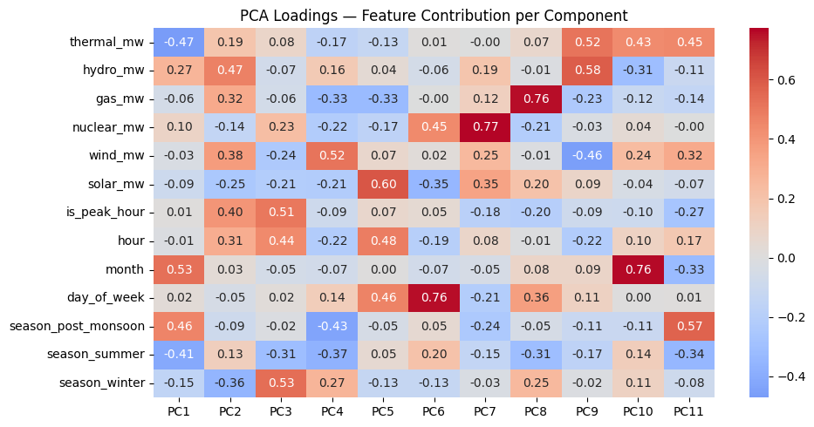
Dimensionality Reduction (SVD and PCA)
Truncated SVD (11 components): Test R2 0.9174 | RMSE 6306.89
PCA (95% variance, 11 components): Test R2 0.9174
Cumulative explained variance: 96.5%

Slide 10
Key Takeaways
Demand strongly aligns with total generation mix and time features
Baseline linear regression performs best on this feature set
SVD/PCA reduce dimensionality but lower predictive accuracy.
Key Flaw: Need production data to predict demand.
Future work: Fix key flaw,add weather, holidays, and regional demand signals, use torque for other predictions.

