Slide 1
PPT on ML/AI
By-
Abdul Najeeb

Slide 2
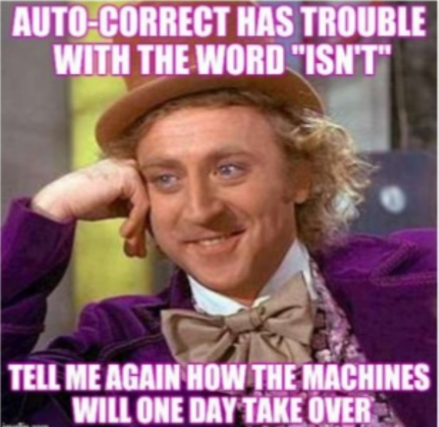
What is Machine Learning & Artificial Intelligence?
Artificial Intelligence
The theory and development of computer systems able to perform tasks normally requiring human intelligence, such as visual perception, speech recognition, decision-making, and translation between languages
Machine Learning
Machine learning is the science of getting computers to learn from data without being explicitly programmed.

Slide 3
Brief History
AlphaGo algorithm developed by Google DeepMind managed to win five games out of five in Chines Board Game Go competition
IBMS first major computer was successfully programmed to play checkers.
IBM’s Deep Blue beats the world champion at Chess.
The Nearest Neighbor Algorithm was written.
1952
1967
1979
1997
2002
2016
1950
1957
Alan Turing thinks up the Turing Test
First neural network for computers (the perceptron) was invented by Frank Rosenblatt, which simulated the thought processes of the human brain.
Students of Stanford Universiiy, California, invested the Stanford Cart which could navigate and avoid obstacles on its own.
Torch, a software library for Machine Learning Is released.

Slide 4
Types of Machine Learning Algorithms
Machine Learning
Supervised
Unsupervised
Reinforcement
Regression
1. Linear
2. Polynomial
Decision Tree
Random Forest
Classification
1. KNN
2. Trees
3. Logistic Regression
4. Naïve Bayes
5. SVM
Clustering
1. SVD
2. PCA
3. K-means
Association Analysis
1. Apriori
2. FP-Growth
Hidden Markov Model

Slide 5
Neural Networks
Input Layer
Output Layer
Hidden Layer

Slide 6
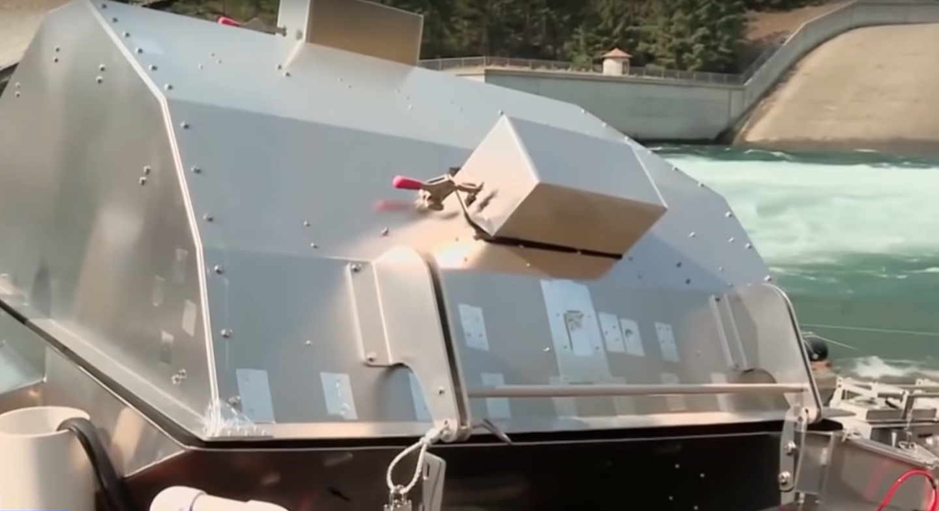
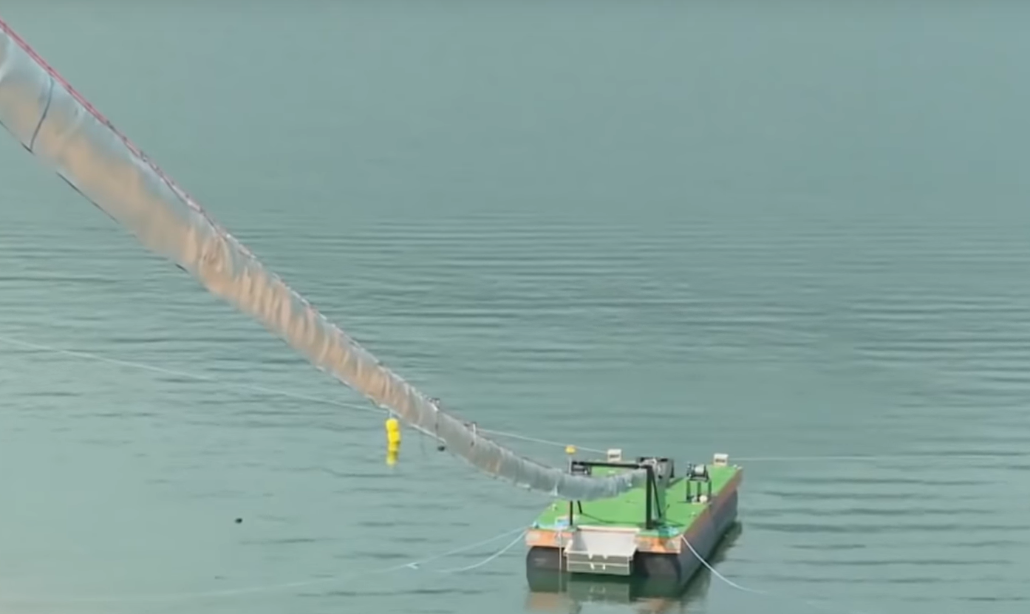
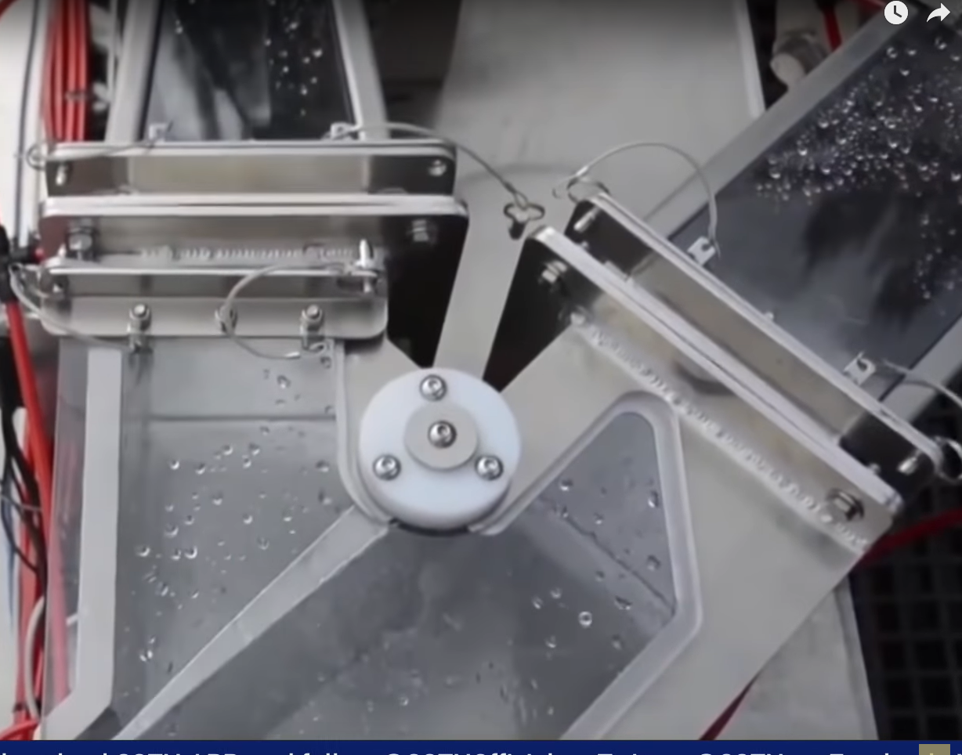
An Example: The Salmon Canon
A salmon canon is a fish transportation system that moves fishes through a flexible, pressurized tube from one area to another.
Fishes swim up to the entrance of the canon and swim up to a processing module.
Processing module processes one fish at a time and opens up the gate to the fish tube if it classifies the picture of the fish as a salmon.
This solves a big problem for migratory fishes like salmon who cannot survive without travelling on to the other side of human made dams.
Processing Module using ML algorithm.
Gate to fish canon controlled by stepper motor
Fish canon pressurized tube ending on other side of dam.

Slide 7
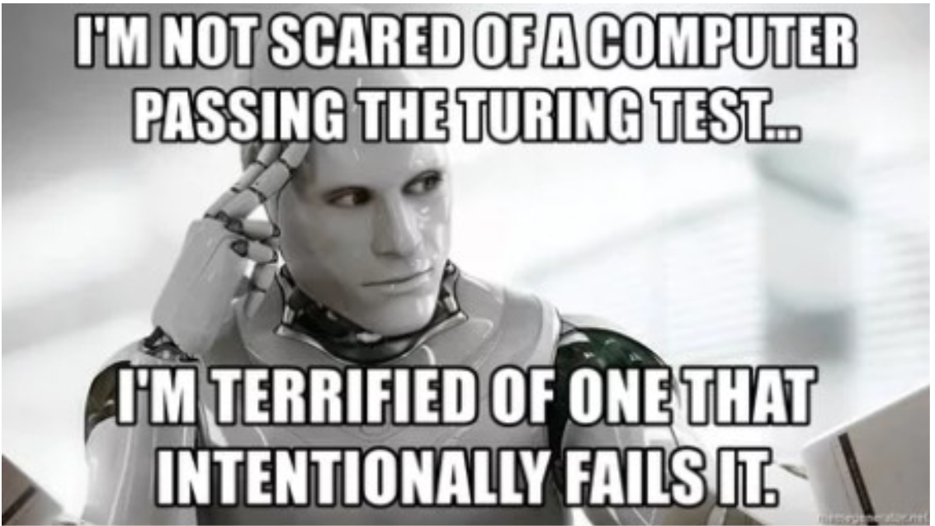
Future?
Replace healthcare professionals opinions in clinical settings.
Robots that completely take over warehouse management.
Level 5 automation self driving cars.
Facial recognition becomes common to combat crime.
Artificial General Intelligence.

