Slide 1
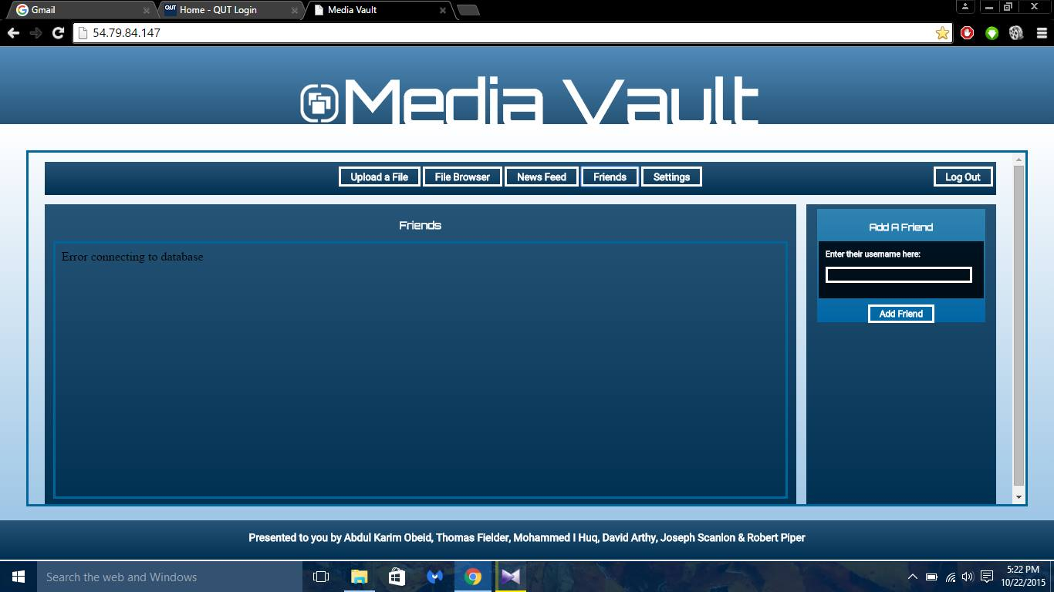
Karim
View
Del
David
View
Del
Joseph
View
Del
Thomas
View
Del
Robert
View
Del

Slide 2
Karim
View
Del
David
Are you sure you want to delete Karim from your friends?
View
Del
Joseph
View
Del
Y
N
Thomas
View
Del
Robert
View
Del

Slide 3
Settings
Who can view your uploads? Friends/Only Me
Do you want friends to be able to download your uploads? Y/N
Do you want to stay logged in? Y/N
Do you want to change your password? (Click here to create new)
Notes:
Just rough samples.

Slide 4
News Feed
Thomas upload a photo. 5 hours ago View
David uploaded a video 1 day ago View
Robert uploaded a video 16/10/2015 View
Thomas viewed you photo 14/10/2015 View
Notes:
Just rough samples.

