Slide 1
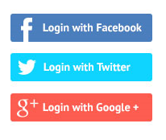
Username
OR
Login
Password
Forgot Password
Sign Up

Slide 2


Ourapp.com is requesting permission to access:
Public Profile, E-mail Address

Slide 3
Home
Account Settings
Upload!
Logout
Audio
Video
Others

Slide 4


Profile
Search
View: Most Recent
You are tagged in a upload by John123.
James045 commented on your upload.
Jane121 commented on a upload shared with you.
Furious7.mp4 has successfully uploaded.
You
Furious7.mp4 Play 7/8/15 Download
Comments Share Info Remove
You
See You Again.mp3 Play 3/8/15 Download
Comments Share Info Remove
You Shared with 2 others
Tintin.pdf Open 29/7/15 Download
Comments Share Info Remove
John123 Shared with you and 3 others
Ant-Man.mov Play 28/7/15 Download
Comments Shared With Info Hide Report

Slide 5
Account Setting
Change Background Upload Background
Push Notification On/Off
Facebook Disconnect
Twitter Connect
Google Plus Disconnect

Slide 6
Upload!
Drop a file here
Or
Browse for File

Slide 7
Ghost
You Open
Mission Impossible: Ghost Protocol.mp4 Uploaded on 2/5/15
You Shared with Paul111 Open
Ghost Rider.mp4 Uploaded on 3/3/15
Harrison982 Shared with you and 10 others Open
GHOST.jpg Uploaded on 1/1/15

Slide 8

GHOST.jpg by Harrison982 on 1/1/15
Comments Share Info Report
Lame!!! 2/1/15

Slide 9
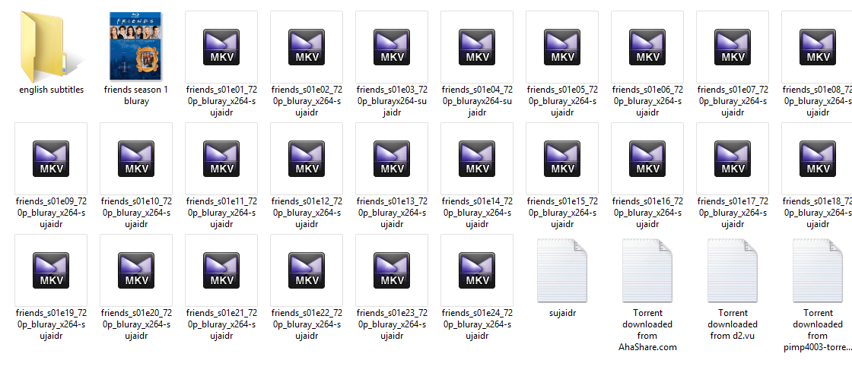
Select File
Upload

Slide 10
Messages
James105 Hey, …….. Today
Admin Dear User, ….. 5/8/2015
Admin Please Verify…. 1/1/2015

Slide 11
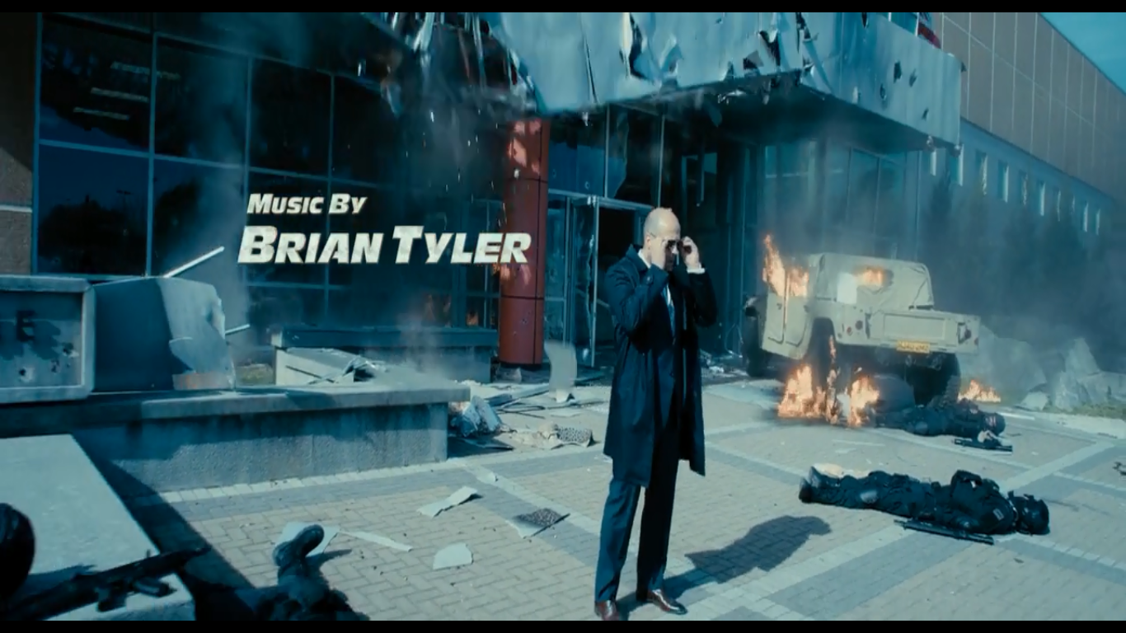
Furious7.mp4 Download

Slide 12
Share
Share on Facebook
Share on Instagram

