Slide 1

Login
Register

Slide 2
Please enter your details below
Username:
Password:
Login
Submit
Recover Password
Return to main menu

Slide 3

Please enter your details below
Full Name:
Username:
Password:
Confirm Password:
Contact E-mail:
Please agree to the following terms of use for the system:
I agree
Registration
Submit
Return to main menu

Slide 4
Please enter username below:
Username:
Password Recovery
Submit
Return to main menu

Slide 5

Logged in as Goliath006
Logout
Upload
Report to admin
Music
Videos
General
Pictures
Books

Slide 6
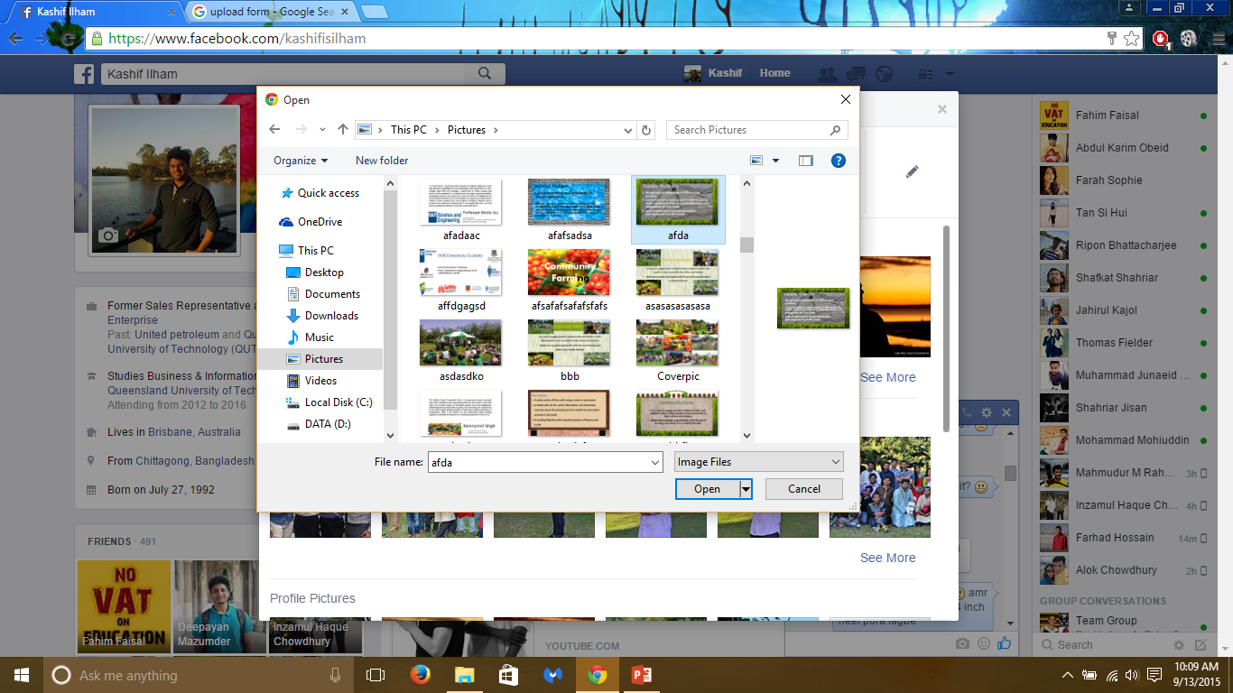
Logged in as Goliath006
Upload a file
Return to home

Slide 7
Logged in as Goliath006
Logout
Upload
Return to home
Filename.mp3 Uploading
Save to folder
Cancel Upload

Slide 8


Logged in as Goliath006
Logout
Upload
Return to home
Music
Title
21 Guns.mp3 | Play | Download | Delete
Timber.mp3 | Play | Download | Delete

Slide 9
Logged in as Goliath006
Logout
Upload
Return to home
Music
Title
21 Guns.mp3 | Play | Download | Delete
Timber.mp3 | Play | Download | Delete
Timber.mp3
5.69MB
Move
mp3
Uploaded on 27th August
Share

Slide 10

Logged in as Goliath006
Logout
Upload
Return to home
Pictures
Title
Linkin Park logo | View | Download | Delete
Pitbull | View | Download | Delete
Linking Park Logo
1.1MB
Move
Jpeg
Uploaded on
Share

Slide 11
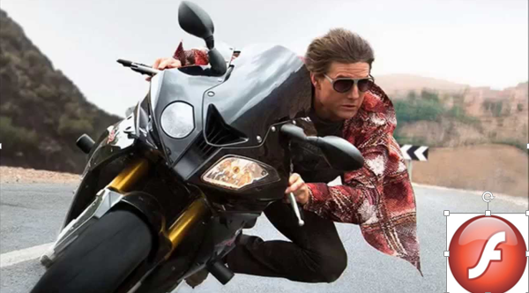
Logged in as Goliath006
Logout
Upload
Return to home
Videos
Title
MI5 Rogue Nation.mp4 | Stream | Download | Delete
MI5RN.mp4
1.82GB
Move
mp4
Uploaded on
Share

Slide 12
Logged in as Goliath006
Logout
Upload
Return to home
Videos
Title
MI5 Rogue Nation.mp4 | Stream | Download | Delete
MI5RN.mp4
1.82GB
Move
Music
mp4
Uploaded on
Share
Document
Pictures
General

