Slide 1
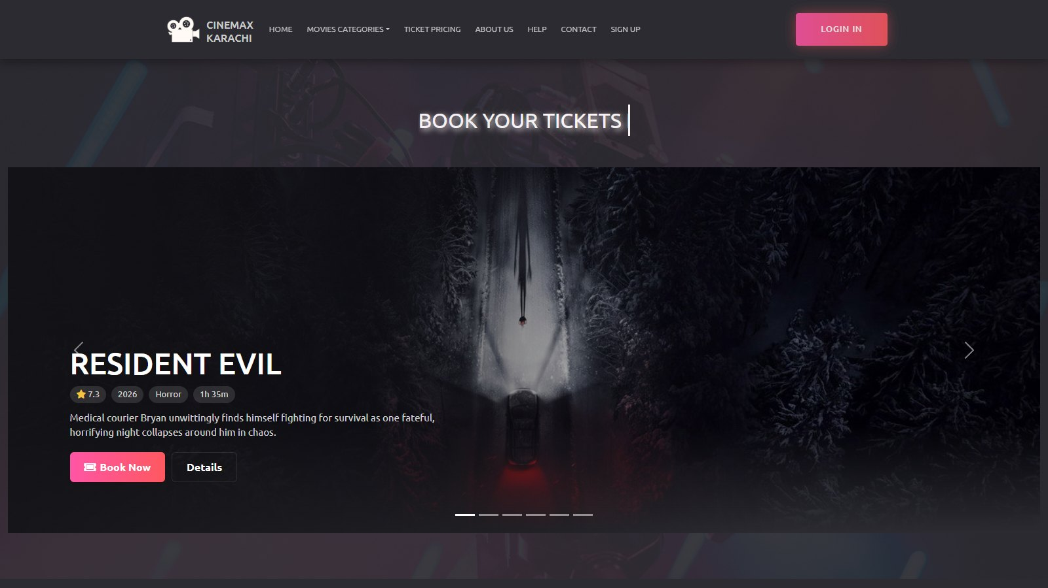

CineMax Karachi
FINAL YEAR PROJECT 2026
Online Movie Ticket Booking System, from browsing to a QR e-ticket, with a full admin panel
Presented by Abdul Rafay · Umair · Arqam
Notes:
Good morning. We are Abdul Rafay and Umair, and our final year project is CineMax Karachi: an online movie ticket booking system for cinemas in Karachi. In the next few minutes we will show the problem, how the system is built, a walk through every customer and admin feature, and how we kept bookings safe and secure.

Slide 2






Agenda
01
02
03
Problem and objectives
Why cinemas need online booking
System design
Tech stack, architecture and database
Customer website
Browse, pick seats, pay, get a QR e-ticket
04
05
06
Admin panel
Dashboard, shows, refunds, scanner, reports
Engineering and quality
Double-booking safety, security, testing
Conclusion
Team roles, limitations, future work, Q&A
Notes:
This is the plan for the presentation: the problem, the design, the customer side, the admin side, the engineering decisions, and then our conclusion and questions.

Slide 3




The problem with buying cinema tickets today
Problems
Our objectives
Long queues
Tickets are bought at the counter, often minutes before the show
Let customers browse movies, choose a show and pick exact seats online
Guarantee that one seat can never be sold twice
Support snacks, promo codes, demo card / JazzCash / Easypaisa payment
Issue an e-ticket with a QR code that staff scan at the door
Handle cancellations with an automatic refund policy
Give staff a secure admin panel with live sales reports
No seat choice
Customers cannot see or pick their exact seats in advance
Double bookings
Manual or naive systems can sell the same seat twice
Paper-based admin
Shows, refunds and sales are tracked by hand
Notes:
Today most cinema tickets in Karachi are still bought at a counter. You cannot pick your seat, queues are long, and the admin side is manual. Our objectives were to move the whole journey online, make double booking impossible, support local payment methods, and give staff a proper admin panel.

Slide 4

The solution: one database, two applications
21
database tables
Customer website
Admin panel
Browse, live search and filters
Movie pages with trailer, ratings, reviews
Seat map with 3 seat classes
Snacks, promo codes, demo payment
QR e-ticket, My Bookings, refunds
Profile, favorites, loyalty points
Dashboard with KPIs and 4 charts
Movies, shows, prices, snacks, promos
All bookings, refunds approve / reject
QR ticket scanner at the entrance
Reports with CSV export and print
Users, reviews, messages, activity log
83
PHP files, about 9,500 lines
96
seats per hall, 3 classes
5 min
seat hold during checkout
Notes:
CineMax Karachi is two applications on one shared MariaDB database: the customer website and the admin panel. The numbers on the right are from the actual project: 21 tables, 83 PHP files, 96 seats per hall in three classes, and a five minute seat hold during checkout.

Slide 5









Technology stack
PHP 7.4 / 8.2
Server-side pages, no framework
MySQL / MariaDB
Database dbmo, mysqli prepared statements
Bootstrap 5 and 4
FlixGo customer theme, Bootstrapious admin
JavaScript, jQuery
AJAX seat holds, live search, promo check
Chart.js
Dashboard revenue and booking charts
qrcode.js, html5-qrcode
QR on tickets, camera scanner for staff
SweetAlert2
Friendly confirmations and popups
TMDB API
Real movie catalog, posters and trailers
Docker / XAMPP
Runs the same on any machine
Git and GitHub
File ownership, migrations, small commits
Notes:
We used a classic, proven web stack. PHP on the server, MariaDB for data, Bootstrap for the interface, and small JavaScript for interactive parts like the seat map. Chart.js powers the dashboard, qrcode.js draws the ticket QR and html5-qrcode lets staff scan it with a camera. The movie catalog comes from the TMDB API, and Docker or XAMPP runs everything locally.

Slide 6
System architecture
Customer pages
index, seat_map, checkout, ticket ...
Customer
Web browser
Shared helpers
functions.php: queries, e(), CSRF
booking.php: holds, refunds
admin_functions.php: log
AJAX endpoints
seat hold, search, promo, OTP
MariaDB
database dbmo
21 tables
Cinema staff
Browser / camera
Admin panel
auth.php guard on every page
Posters
Admin/upload-images
TMDB API
seed_tmdb.php loads catalog
Every form follows Post / Redirect / Get: POST → check CSRF token → save → redirect → flash message
Notes:
This is a classic server-side architecture. The browser requests a PHP page; the page uses our shared helpers in the includes folder, which talk to MariaDB using prepared statements, and the page returns HTML. Small AJAX endpoints handle interactive parts like holding seats and live search. The admin panel is a separate set of pages protected by auth.php. The catalog is loaded from TMDB by a command-line seeder, which also downloads posters.

Slide 7


Database design: 21 tables in 4 groups
Catalog
Booking
Customers
Administration
addmovie
shows
user_reg_login
admin_login
cinema
seat_holds
reviews
activity_log
genre
booking_details
favorites
industry
booking_seats
contact_messages
language
booking_snacks
date
snacks
movie_price
promo_codes
coming_soon
addmovie is the hub, with foreign keys to cinema, genre, industry, language and date
UNIQUE (show_id, seat_label) on holds and sold seats blocks double booking
Favorites have a UNIQUE (user, movie) key; users carry status and loyalty points
Every admin add, edit and delete is written to the activity log
Notes:
The database has 21 tables in four groups. addmovie is the centre of the catalog. A show is one screening of a movie in a cinema hall. booking_details holds one booking and keeps copies of the movie name and date so old tickets never change. Seats being bought go into seat_holds, sold seats into booking_seats; both have a unique key on show and seat, so the database itself refuses a double booking. All schema changes were made through numbered migration files.

Slide 8
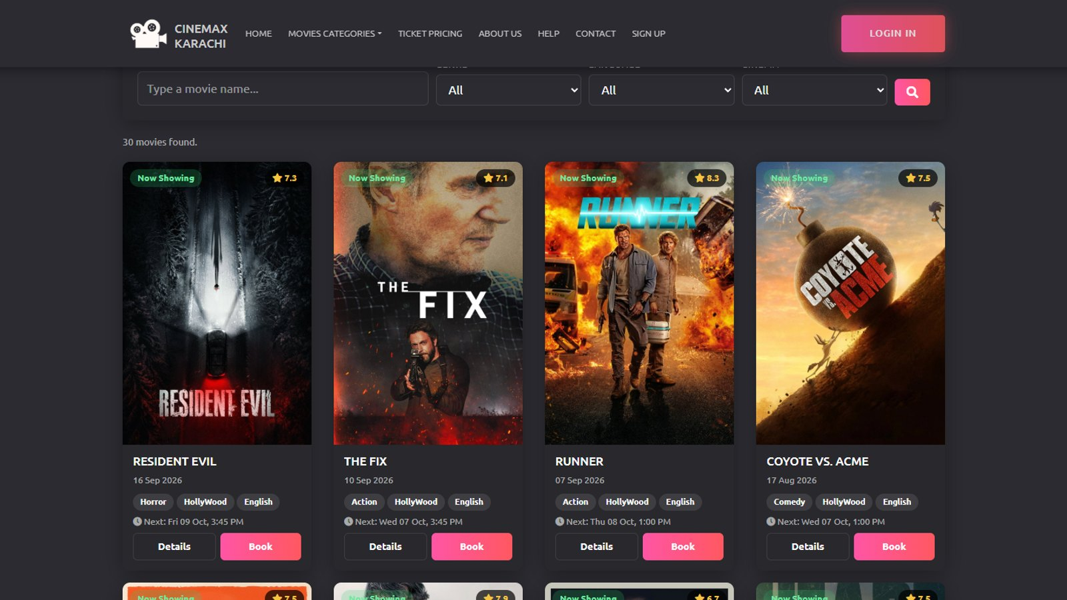
Customer website
01
From finding a movie to walking in with a QR e-ticket
Notes:
Now we will walk through the customer journey, in the same order a real customer would use it.

Slide 9





The booking journey in six steps
1
2
3
4
5
6
Browse
Search and filter movies
Pick a show
Date, time and hall
Choose seats
Live seat map, 5-min hold
Checkout
Snacks and promo code
Pay
Card, JazzCash, Easypaisa
E-ticket
QR code, print or PDF
Guests can browse freely; choosing seats asks them to sign in and then returns them to the same seat map.
Notes:
This is the whole booking journey: browse, pick a show, choose seats, checkout with snacks and promo codes, pay, and receive the e-ticket. Each of the next slides shows one of these steps from the running system.

Slide 10


Home page and Now Showing
index.php
Hero slider
TMDB backdrops with rating, year, genre, runtime and Book Now
Rated movie cards
Every card shows its TMDB rating and next show time
Industries
Hollywood, Bollywood and Lollywood pages, each with the same filters
Notes:
The home page opens with a slider of now-showing movies using real TMDB backdrops, ratings and runtimes, with a Book Now button. Below it, movie cards show rating and the next show. Hollywood, Bollywood and Lollywood have their own pages.

Slide 11
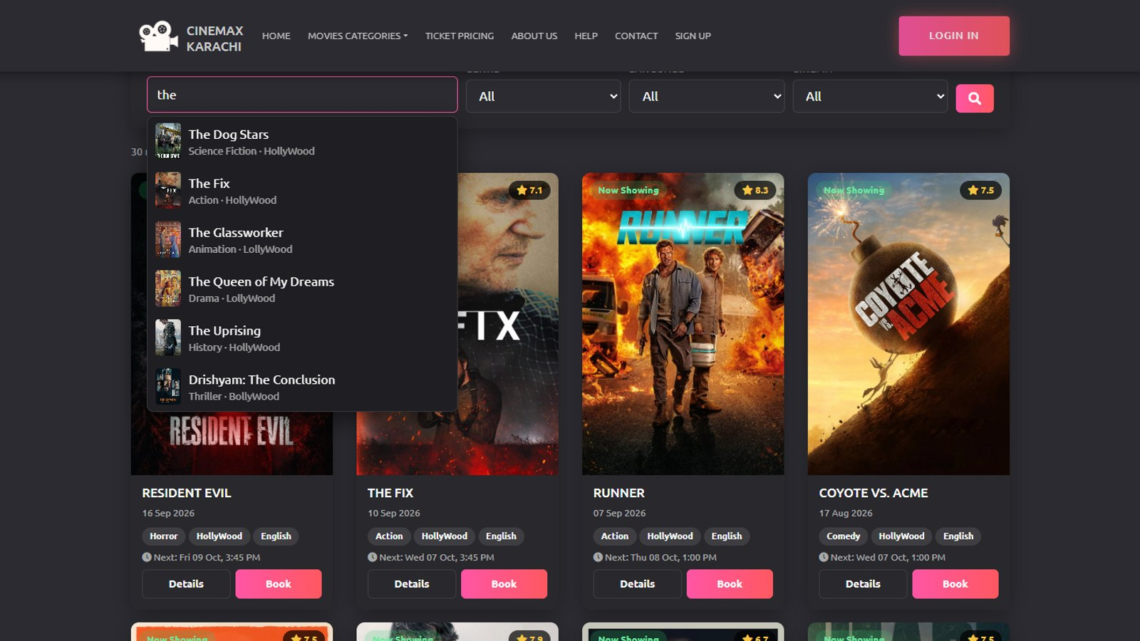

Live search and smart filters
Live search
Search as you type
Poster suggestions appear after a few letters, keyboard friendly
Filter by genre, language, cinema
The grid reloads instantly; cinema shows only movies with upcoming shows
Coming Soon
Upcoming releases with "In N days" badges and trailer links
Notes:
Search works as you type: an AJAX endpoint returns matching movies with posters, and you can use the arrow keys and Enter. The filters for genre, language and cinema can be combined. A cinema filter only lists movies that actually have upcoming shows there.

Slide 12
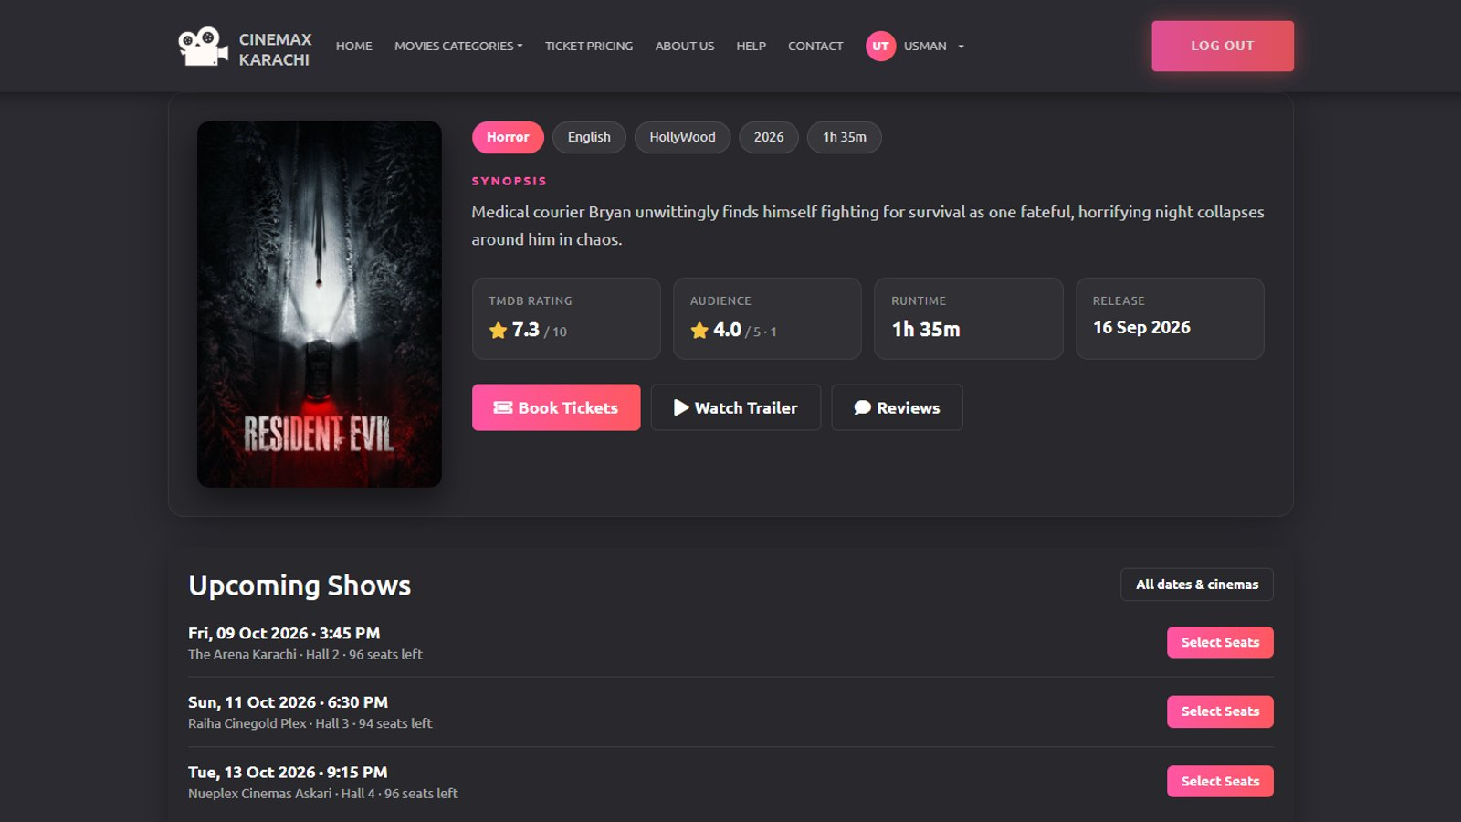


Movie details, ratings and reviews
moviedetail.php
Everything in one card
Poster, synopsis, genre, language, runtime, release date and trailer
Real audience rating
Average of visible reviews, one editable review per user
Favorites and more
Heart a movie, see "More like this" and the upcoming shows
Notes:
The movie page shows all details in one card, the trailer, the TMDB rating next to our own audience rating, and the upcoming shows. Logged-in users can write one review per movie, which they can edit or delete, and add the movie to favorites.

Slide 13
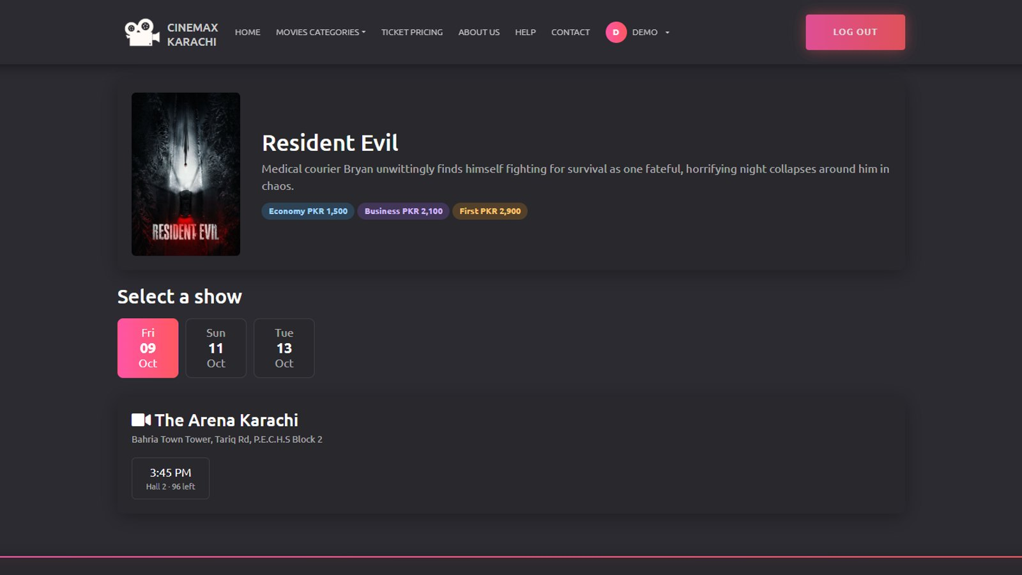

Choosing a show
select_show.php
Date tabs
Only dates that have shows for this movie are offered
Showtimes per cinema
Each time shows the hall and how many seats are left
Prices up front
Economy, Business and First prices are shown before choosing
Notes:
After clicking Book, the customer picks a date and a showtime. Showtimes are grouped by cinema and show the hall and seats left. The three seat class prices are visible before they continue.

Slide 14
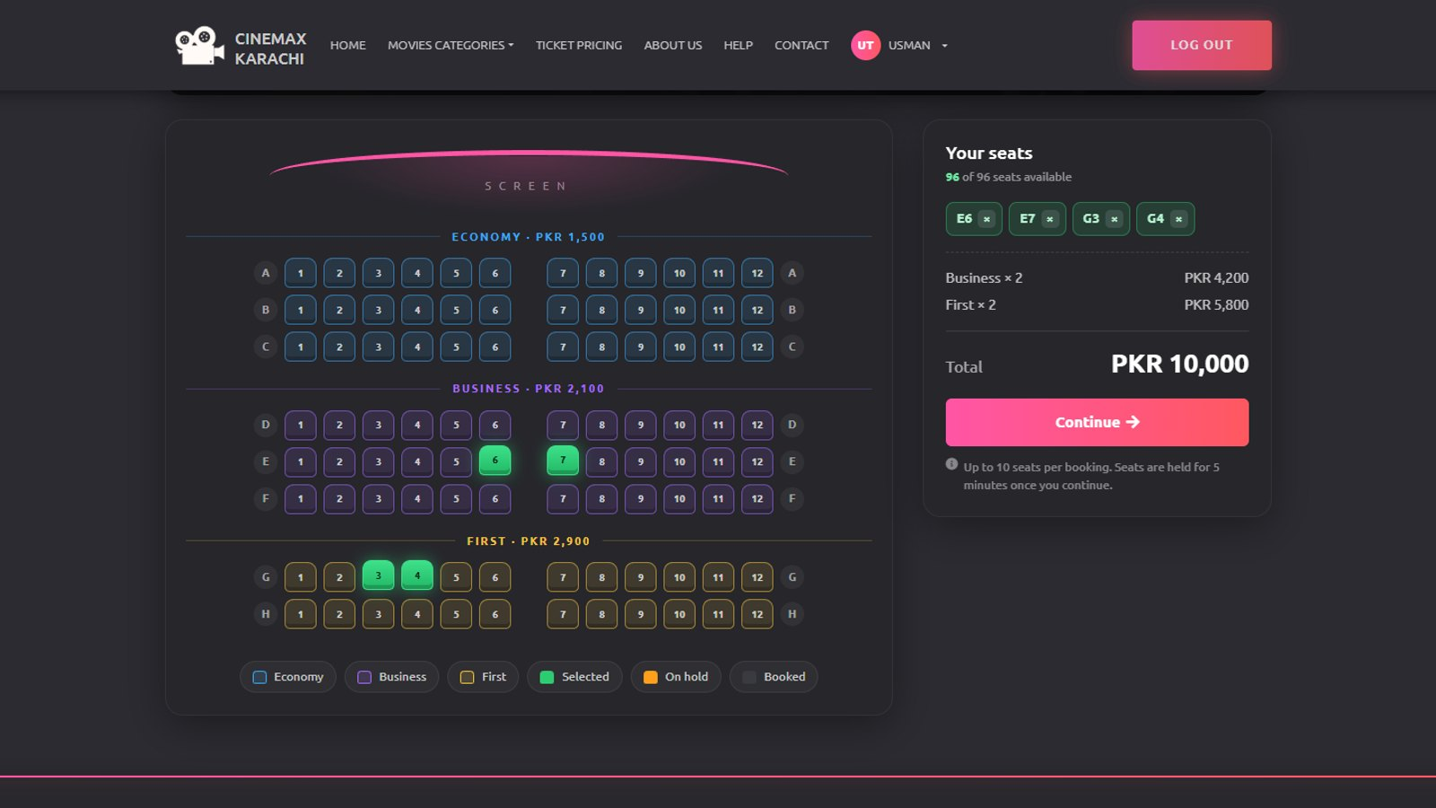


Interactive seat map
Three seat classes
Rows A–C Economy, D–F Business, G–H First, 8 × 12 seats per hall
seat_map.php
Live total
Selected seats turn green; the side panel updates the price
Seats held for 5 minutes
Continue reserves the seats; others see them "On hold"
Clear limits
Booked seats are disabled, max 10 seats per booking
Notes:
This is the seat map. The screen is at the top, and the colours show the three classes. When you click seats they turn green and the total updates live. Pressing Continue holds the seats for five minutes, so another customer looking at the same show sees them as on hold and cannot click them.

Slide 15
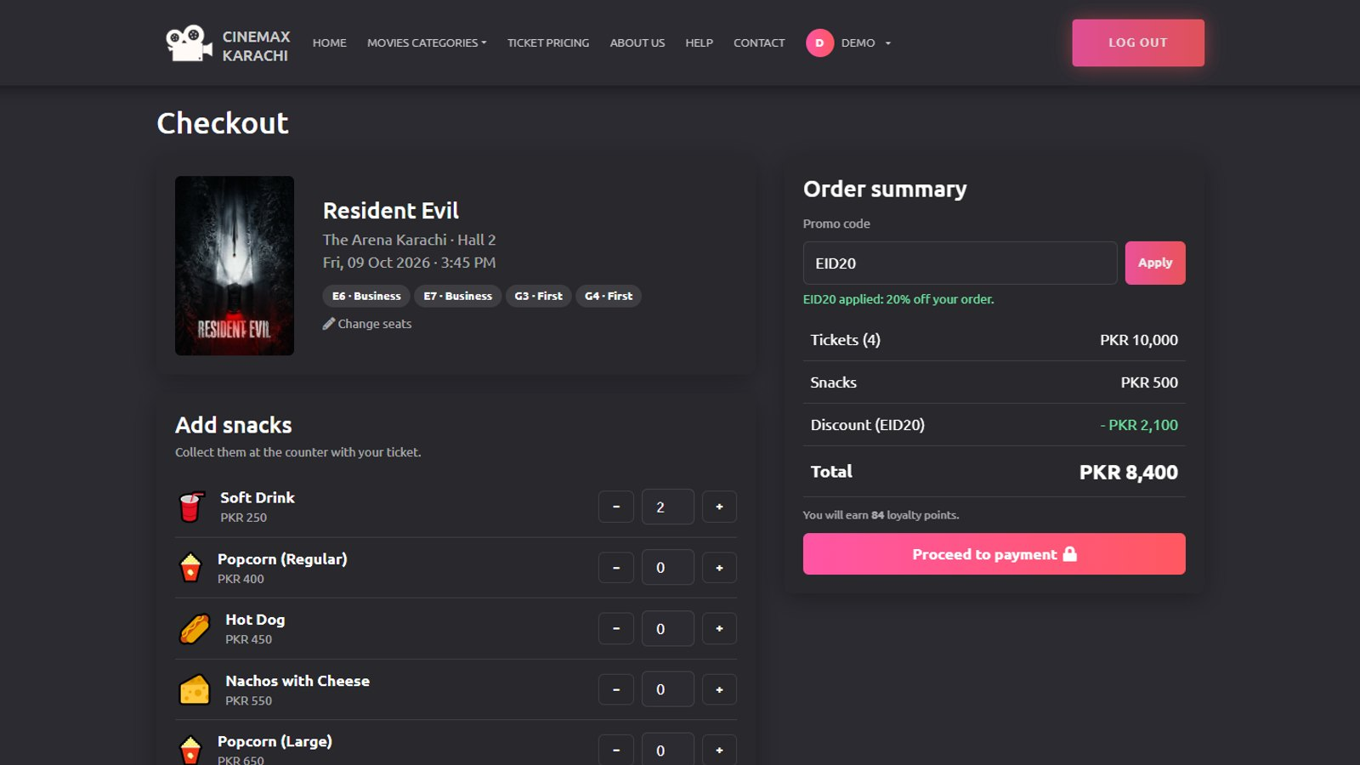


Checkout: snacks and promo codes
Add snacks
Popcorn, drinks and combos with + / − buttons, managed by admin
checkout.php
Promo codes
EID20, FYP10, WELCOME50 checked for expiry and usage limits
Loyalty points
1 point for every PKR 100, shown before paying
Hold countdown
A timer shows how long the seats stay reserved
Notes:
At checkout the customer adds snacks and applies a promo code. Here EID20 gives twenty percent off: tickets plus snacks minus discount. The countdown in the corner shows how long the seats remain held.

Slide 16
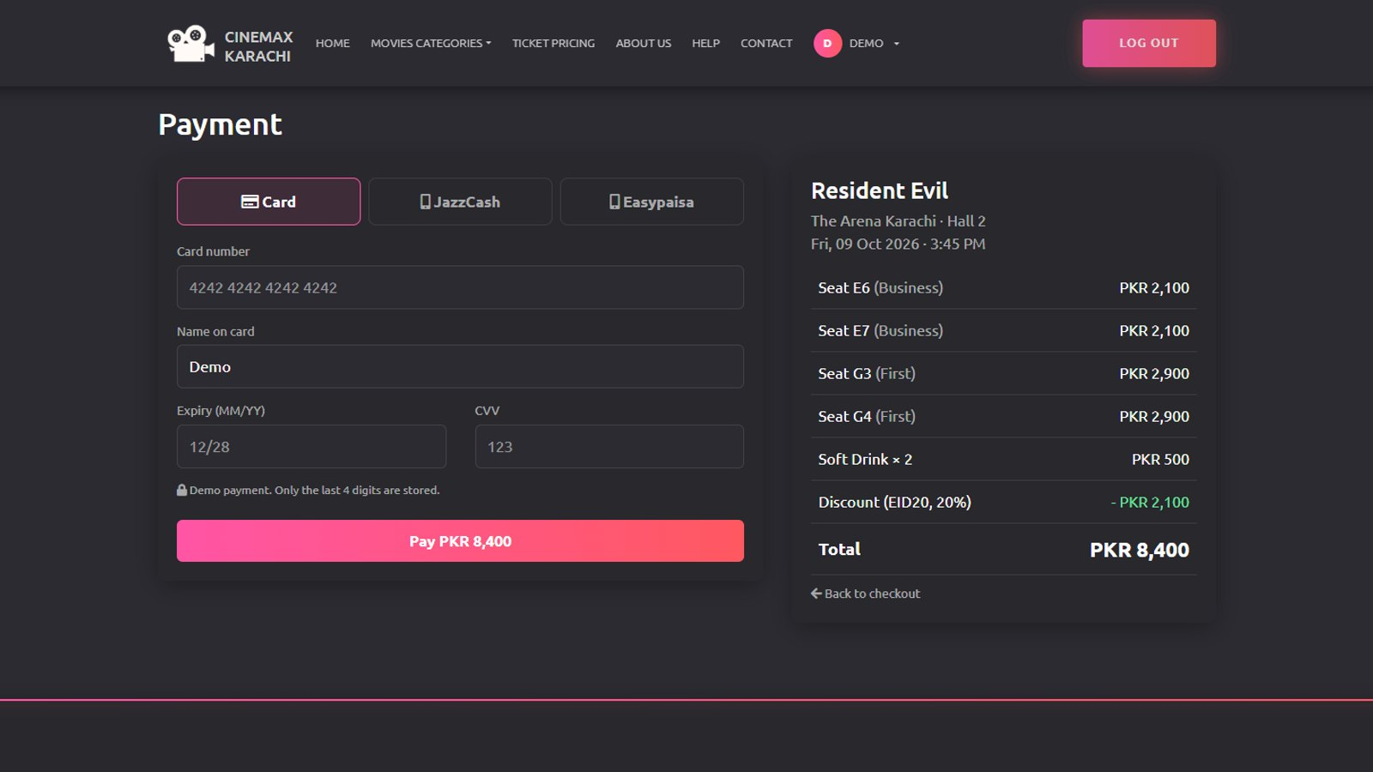

Payment: card and mobile wallets
payment.php
Card payment
Auto-spaced card number and expiry, only the last 4 digits are stored
JazzCash and Easypaisa
Mobile number plus an OTP step, as in the real wallets
Saved in one transaction
Booking, seats, snacks, promo use and points succeed together
Notes:
Payment is a realistic demo. Card payment formats the number as you type; JazzCash and Easypaisa use a mobile number and an OTP. When the payment succeeds, finalize_booking saves the booking, seats, snacks, promo usage and loyalty points inside one database transaction.

Slide 17
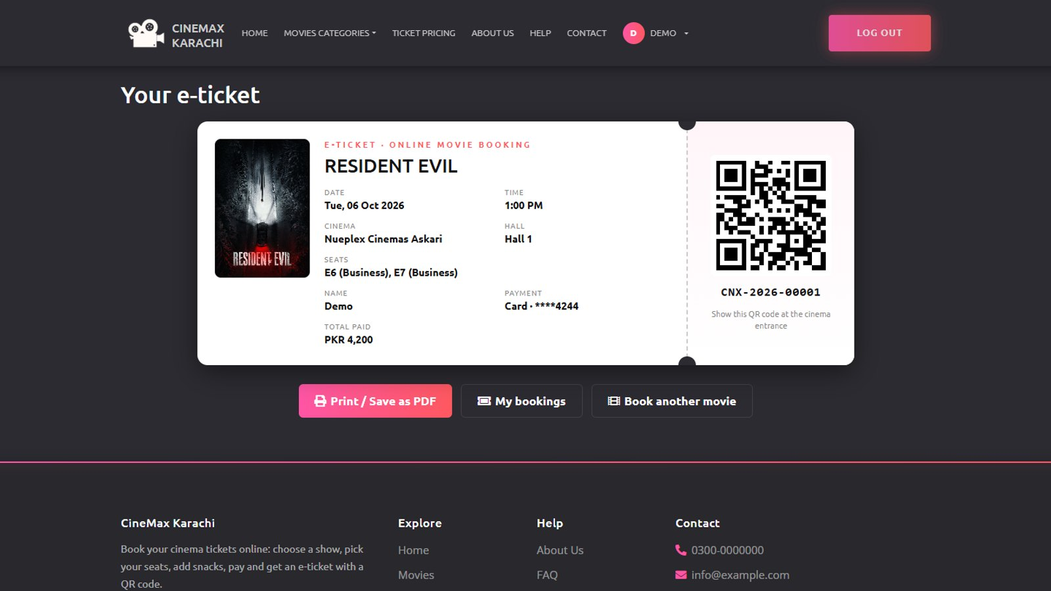

E-ticket with QR code
ticket.php
Reference CNX-YYYY-00001
Movie, cinema, hall, date, time, seats, snacks and total
QR holds only the reference
No personal data inside; staff scan it at the entrance
Print or save as PDF
Print layout shows only the ticket; a USED stamp after check-in
Notes:
After payment the customer gets an e-ticket with a reference like CNX-2026-00001 and a QR code. The QR contains only the reference, no personal data. The ticket can be printed or saved as PDF, and only its owner can open it.

Slide 18
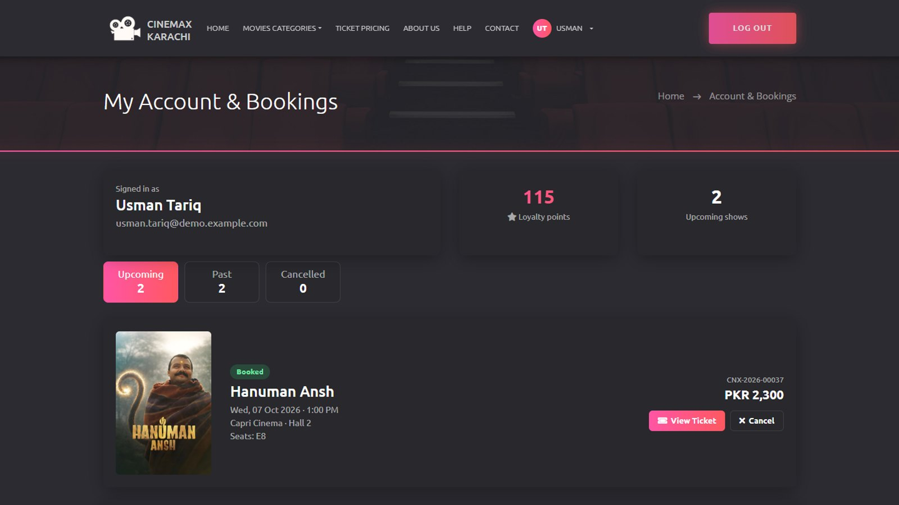


My Bookings and cancellations
userbooking.php
Upcoming, Past, Cancelled
Tabs with counts, plus loyalty points at the top
Cancel with automatic refund
100% refund 24h or more before the show, 50% after that
Refund status
Pending, Refunded or Rejected with the admin's reason
Notes:
My Bookings groups bookings into upcoming, past and cancelled. A customer can cancel an upcoming booking; the refund is calculated automatically: one hundred percent if it is at least 24 hours before the show, fifty percent otherwise. The seats are released and the refund waits for admin approval.

Slide 19
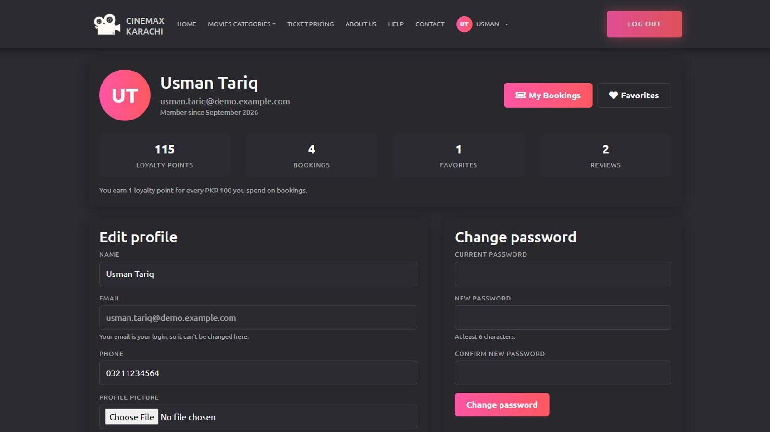
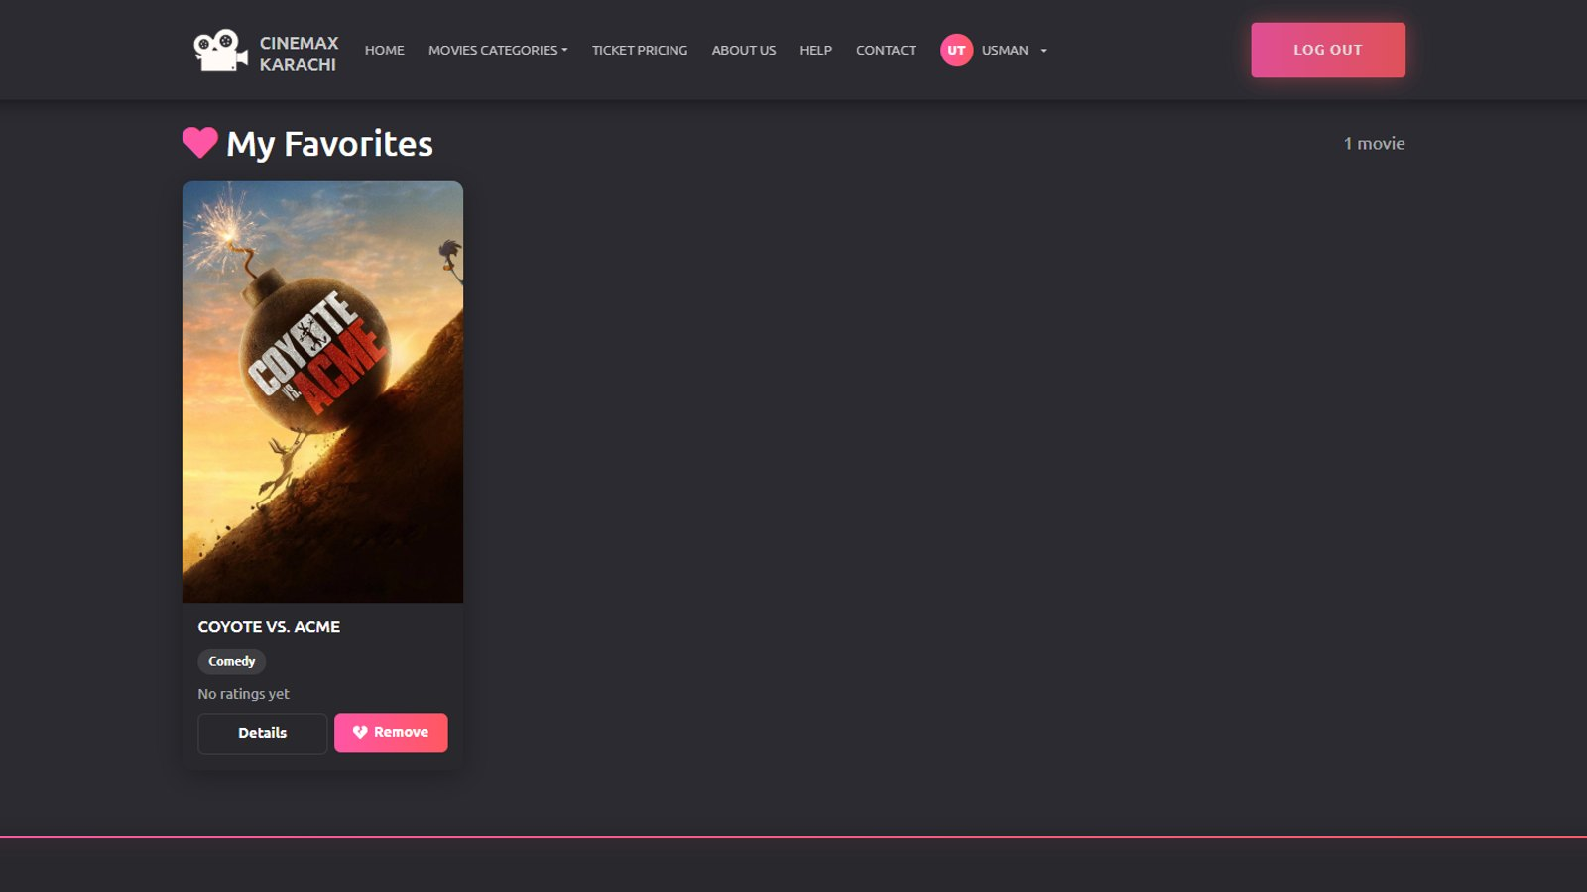
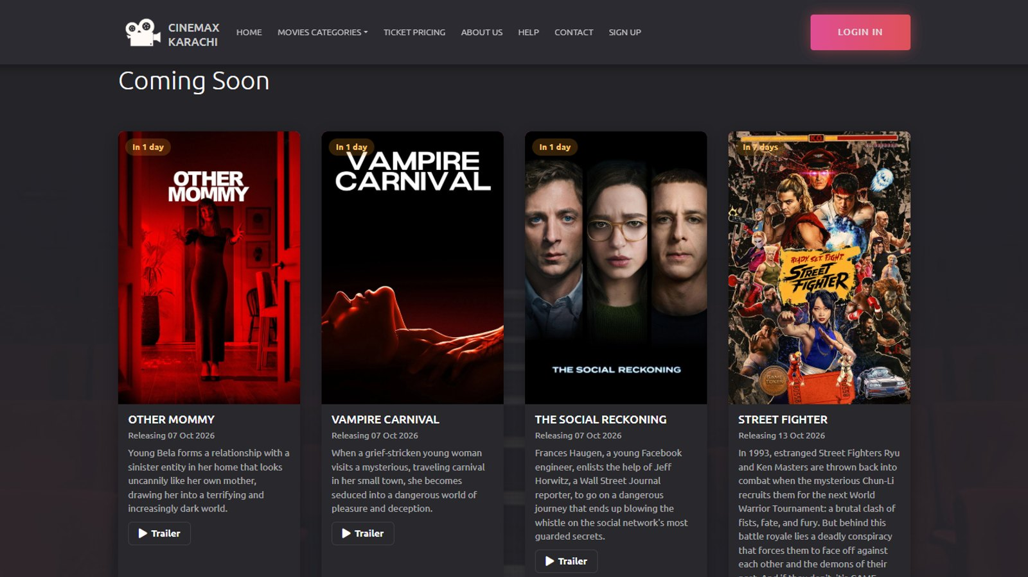

Profile, favorites and Coming Soon
profile.php
favorites.php
Coming Soon
Profile
Photo upload, edit details, change password, points and stats
Favorites
Movies saved with the heart button, removable in one click
Coming Soon
Upcoming releases from TMDB with trailer links
Notes:
The customer account also has a profile page with photo upload and password change, a favorites list, and the Coming Soon section on the home page, which is managed from the admin panel.

Slide 20
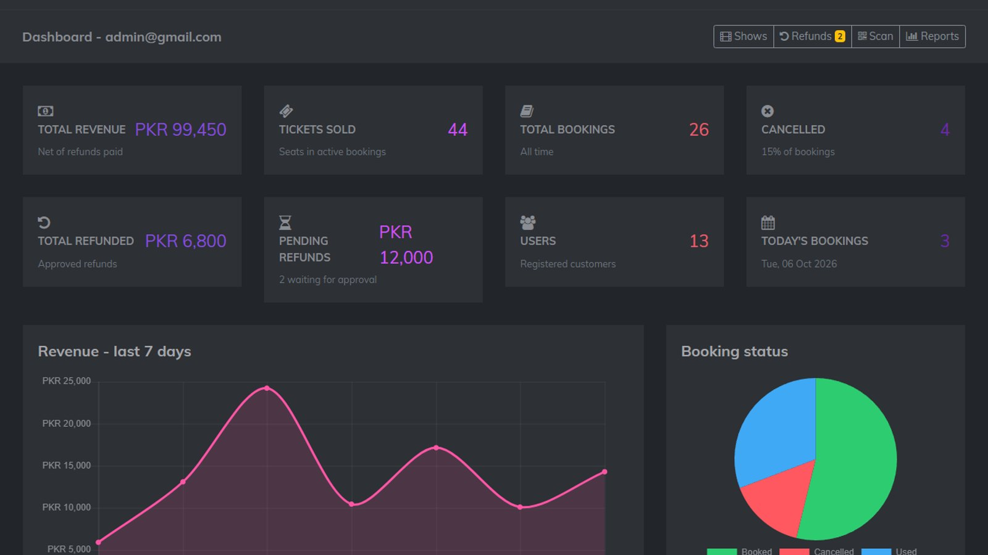
Admin panel
02
Everything cinema staff need to run shows, sales and refunds
Notes:
Now the admin side. Every admin page is protected by auth.php, which redirects to the login page if no admin is signed in.

Slide 21
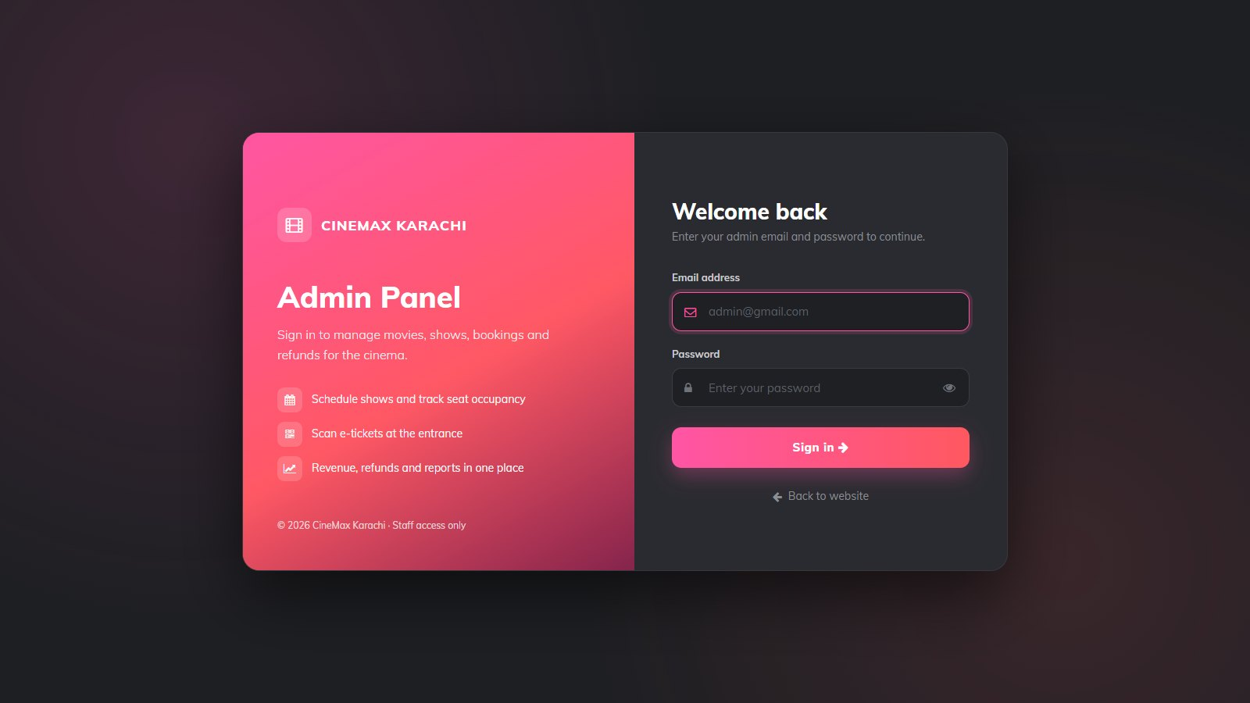


Secure admin login
Admin/login.php
Separate admin accounts
Admins are stored apart from customers in admin_login
auth.php on every page
Pages and delete links redirect to login when no admin session exists
Safe login
Prepared statement, inline errors, show / hide password
Notes:
The admin login is separate from customer accounts. After login, every admin page, including delete handlers, starts with auth.php, so nothing can be viewed or changed without an admin session.

Slide 22
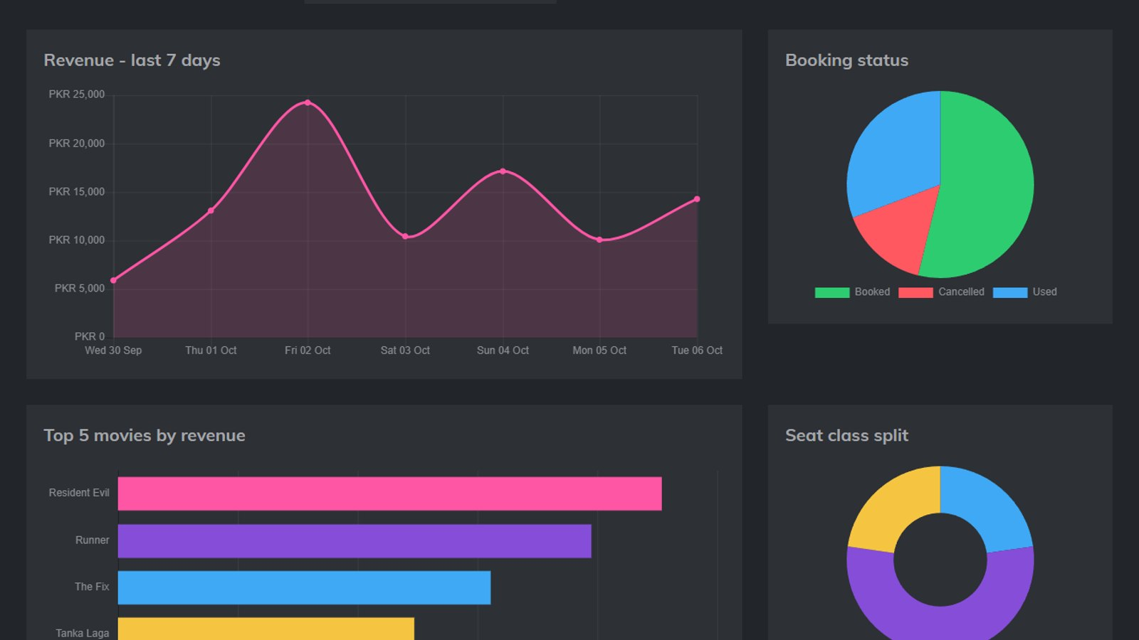
Dashboard: the cinema at a glance
Admin/dashboard.php
Charts
Live KPIs
Revenue, tickets sold, bookings, cancellations, refunds, users and today's bookings
Four Chart.js charts
Revenue for the last 7 days, top 5 movies, booking status and seat class split
Notes:
The dashboard shows live numbers straight from the database: total revenue, tickets sold, cancellations, refunds and users, plus four charts and the most recent bookings.

Slide 23
Real data from the running system
Notes:
These two charts use the actual demo data in our database at the time of this presentation: the five highest earning movies, and the 26 bookings split into booked, checked in and cancelled. Together they made PKR 84,950 in net bookings.

Slide 24
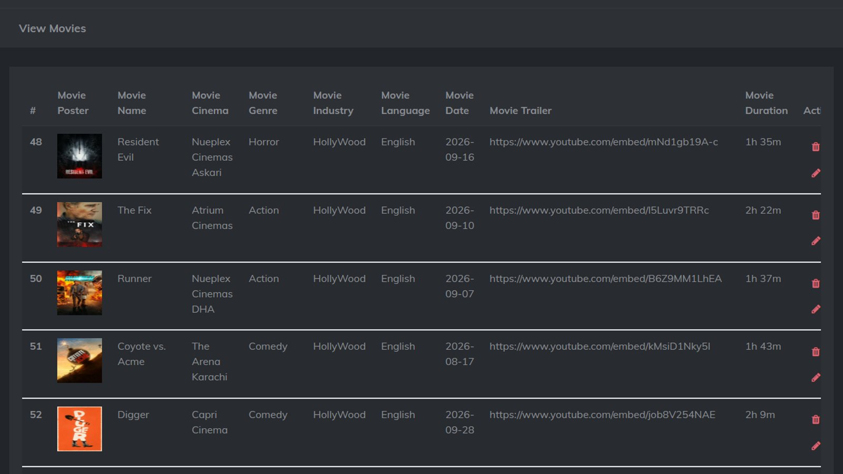
Movie catalog management
Add, edit and delete movies
Poster, trailer, description, genre, language, industry, cinema
Admin/viewmovie.php
Real catalog from TMDB
seed_tmdb.php loads now-playing movies, posters and trailers
Seat prices per movie
Economy, Business and First prices used by checkout
Lookup tables
Cinemas, genres, industries, languages and dates
Notes:
Admins manage the catalog: movies with poster, trailer and description, the lookup tables, and the three seat prices per movie. To have realistic data we wrote a TMDB seeder that loads the current now-playing movies with their posters and trailers.

Slide 25
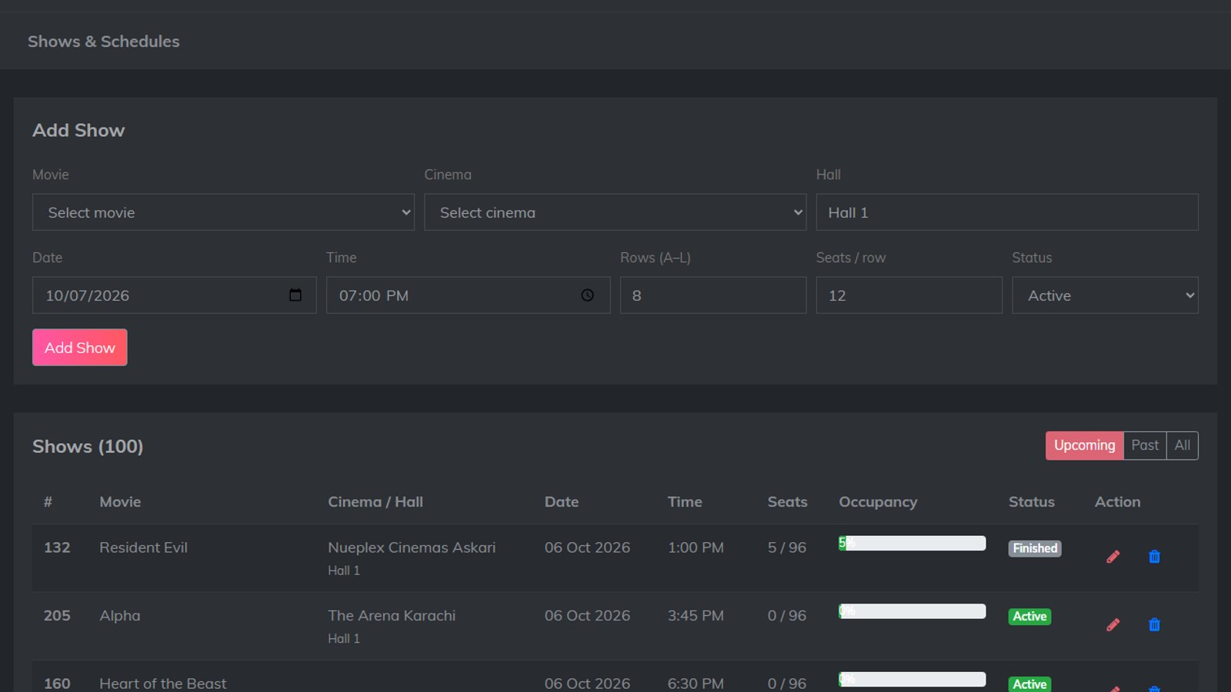
Shows and schedules
Add a show
Movie, cinema, hall, date, time, rows and seats per row
Admin/shows.php
Clash check
The same hall cannot have two shows at the same date and time
Occupancy bars
Sold seats out of capacity for every show
Safe delete
Shows with bookings must be cancelled, not deleted
Notes:
The Shows page schedules screenings. It checks for clashes in the same hall and time, shows occupancy for each show, and refuses to delete a show that already has bookings.

Slide 26
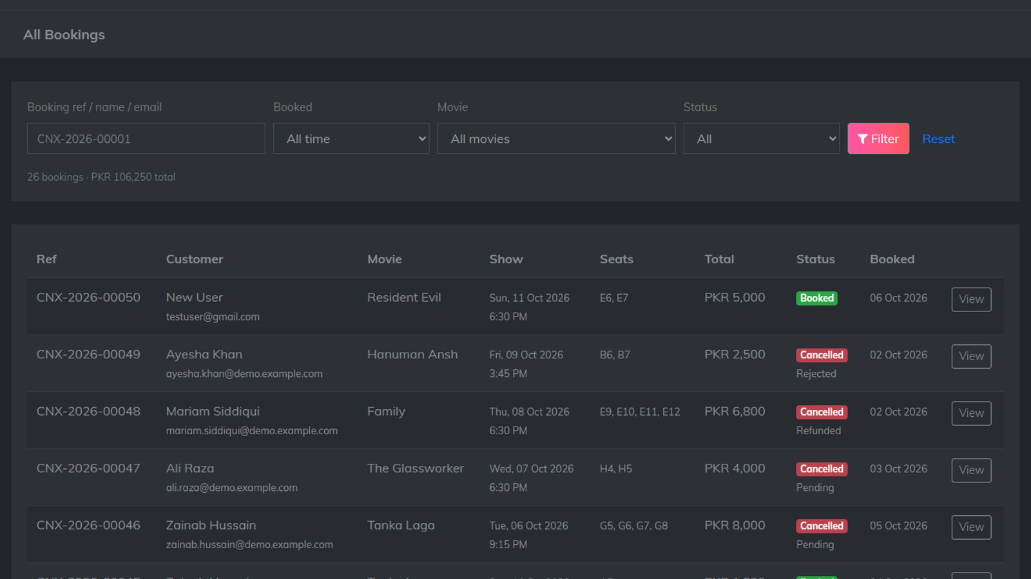
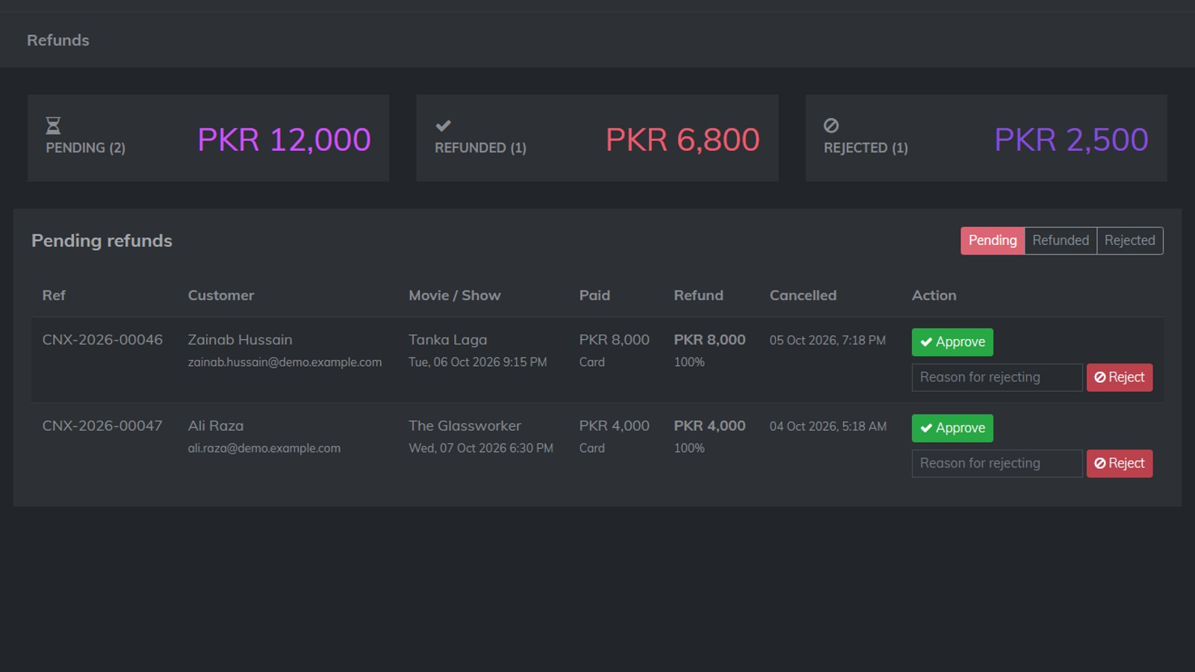
All bookings and refund decisions
Admin/booking.php
Admin/refunds.php
All bookings
Filter by reference, date range, movie and status; view seats, snacks, discount and payment
Refunds
Pending, Refunded and Rejected tabs; approve, or reject with a reason the customer sees
Notes:
All Bookings lists every booking with filters and a details view. When a customer cancels, the refund appears under Pending. The admin approves it, or rejects it with a reason, and the customer sees the result in My Bookings.

Slide 27

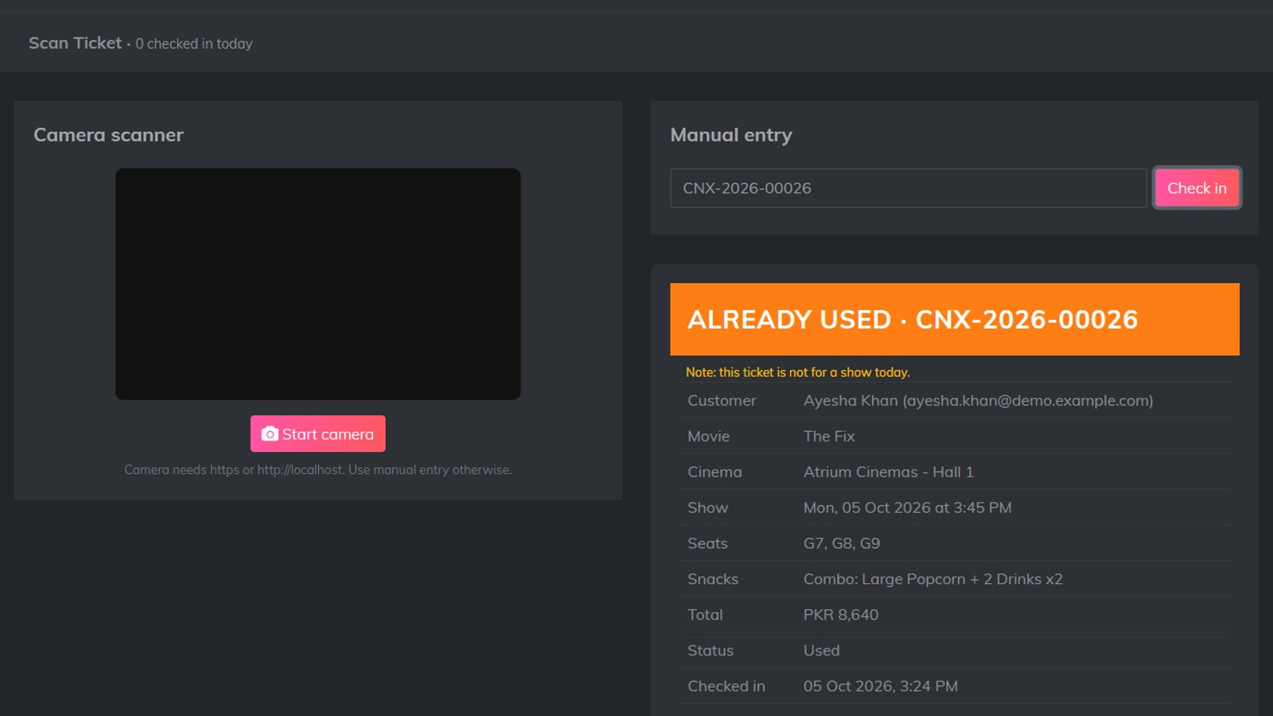
QR ticket scanner at the door
Camera or manual entry
html5-qrcode reads the ticket QR from a phone or printout
Admin/scan_ticket.php
VALID
Booked ticket: entry allowed, status becomes Used with a check-in time
ALREADY USED
A second scan of the same ticket is refused
CANCELLED / NOT FOUND
Cancelled or unknown references are rejected
Notes:
At the entrance staff open the scanner and point the camera at the ticket. A valid ticket is checked in and marked as used. Scanning it again shows Already Used, and cancelled or fake references are rejected.

Slide 28
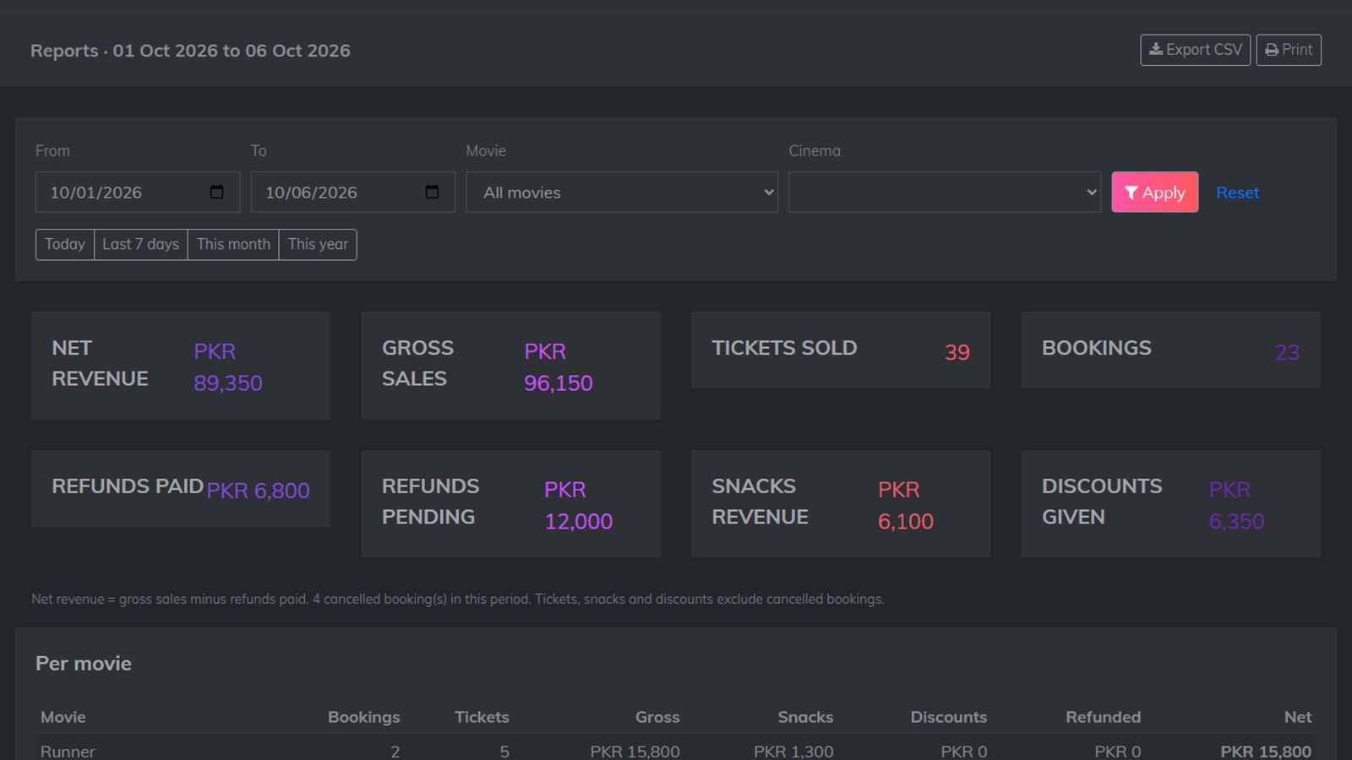

Sales reports
Any date range
Today, last 7 days, this month, this year or custom
Admin/reports.php
Revenue breakdown
Net and gross revenue, tickets, refunds, snacks and discounts
Export CSV
Opens in Excel; per-movie and per-cinema tables
Print view
Clean printable report for management
Notes:
Reports summarise sales for any date range and can be filtered by movie or cinema. They can be exported as CSV for Excel or printed.

Slide 29
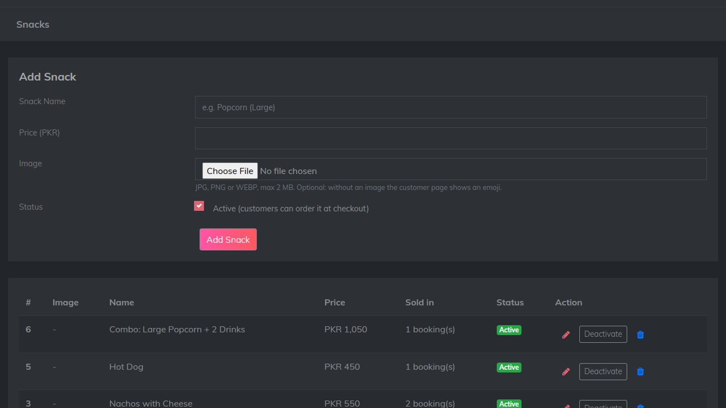
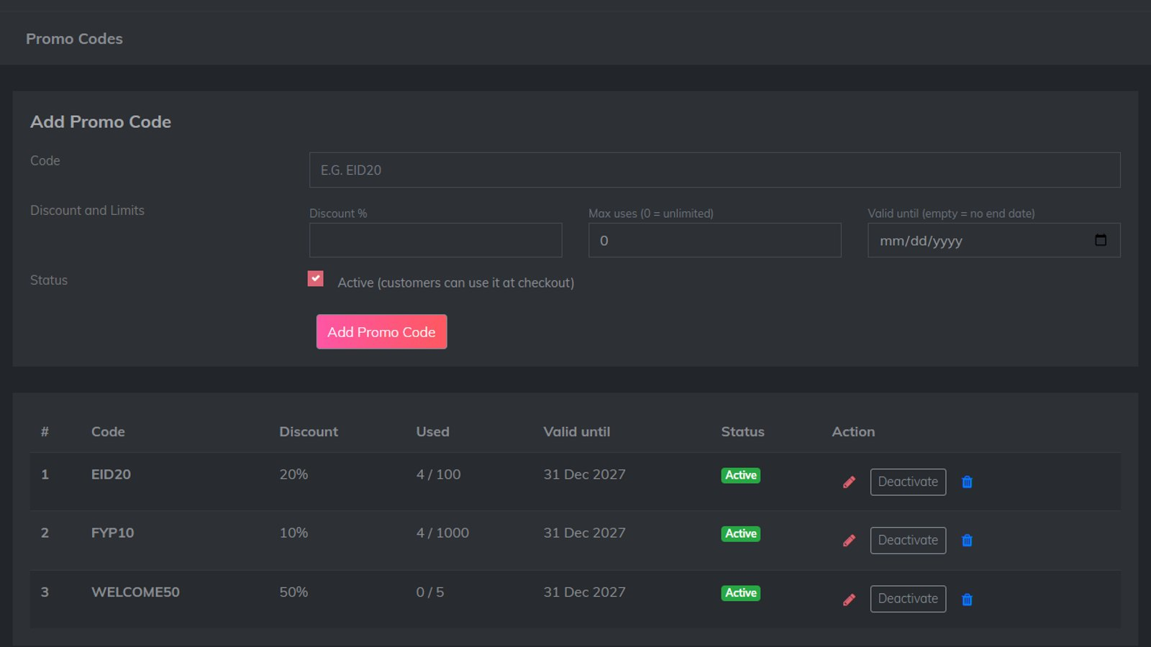
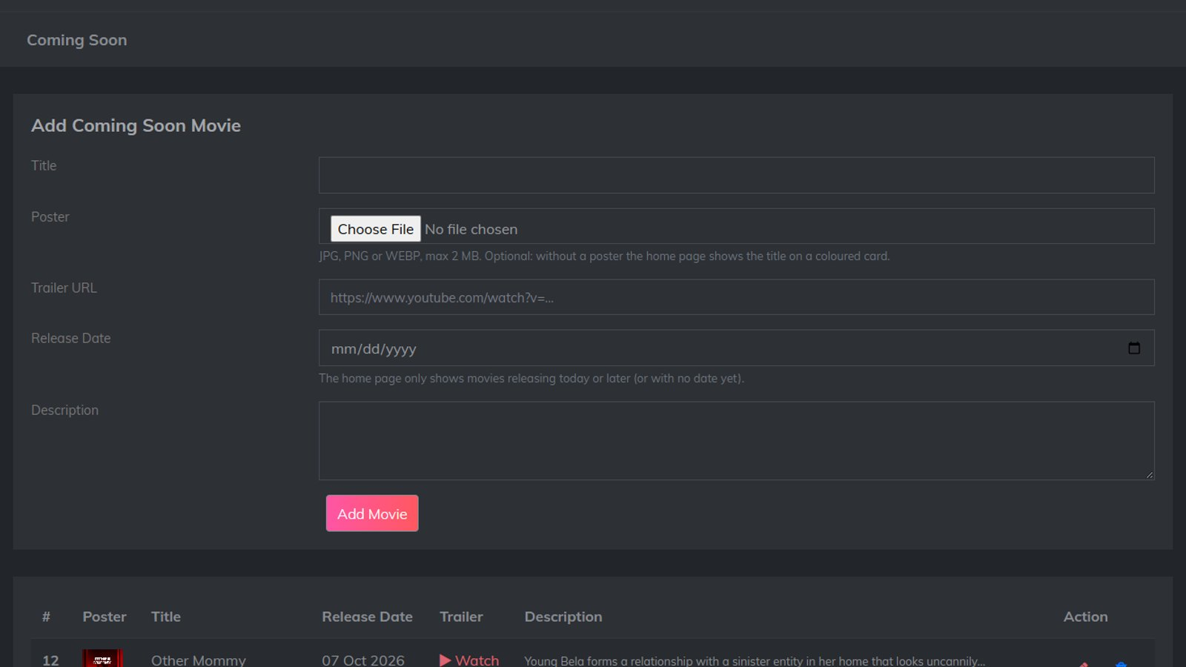
Snacks, promo codes and Coming Soon
Admin/snacks.php
Admin/promo_codes.php
Admin/coming_soon.php
Snacks
Name, price and image; sold snacks are deactivated, not deleted
Promo codes
Discount %, usage limit, expiry date, active switch
Coming Soon
Upcoming movies with poster, trailer and release date
Notes:
Admins also manage the snack menu, promo codes with usage limits and expiry dates, and the Coming Soon list shown on the home page.

Slide 30
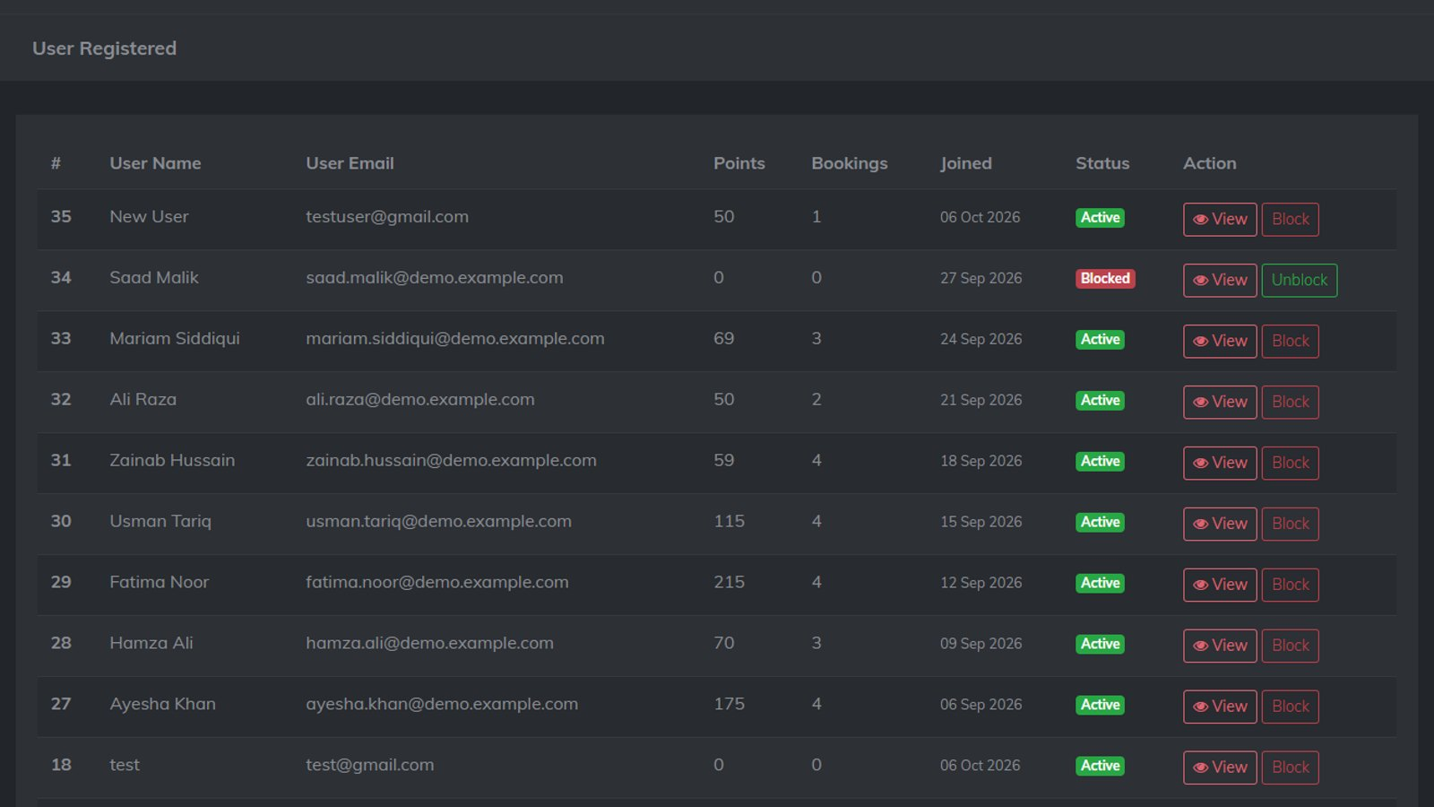
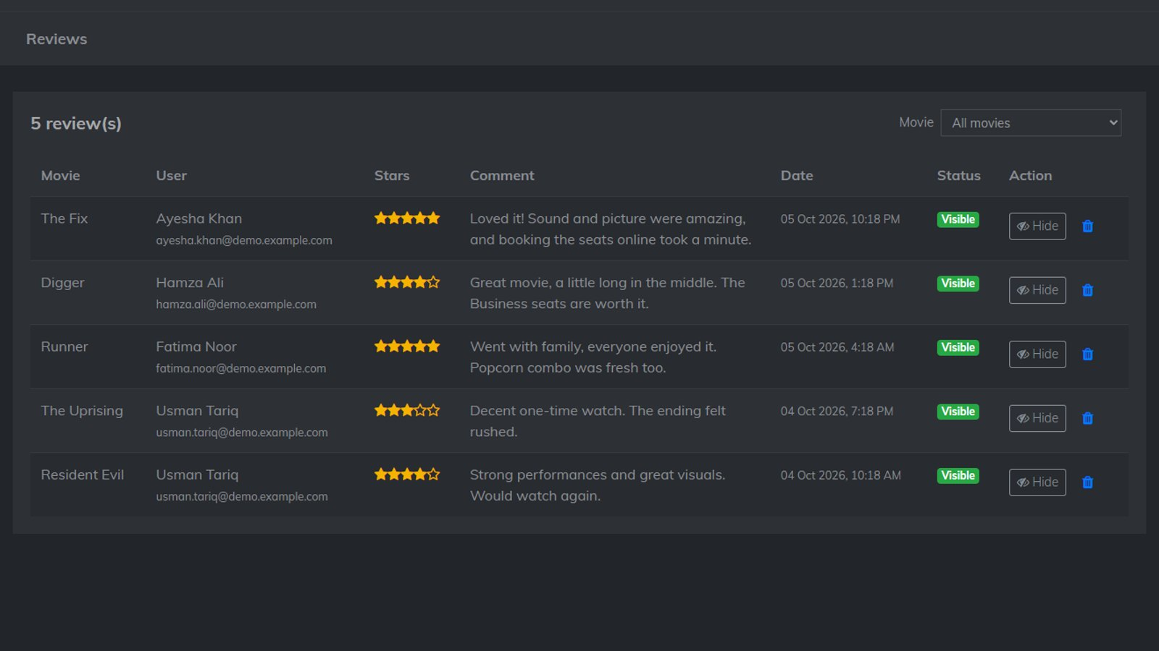
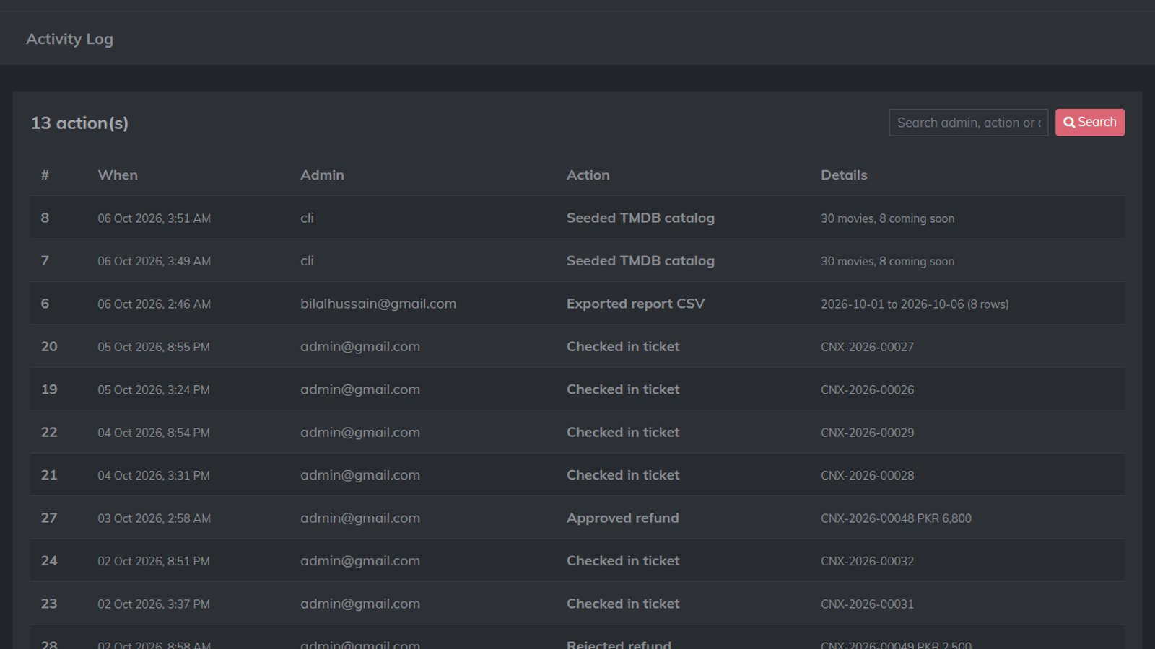
Users, review moderation and activity log
Admin/user.php
Admin/reviews.php
Admin/activity_log.php
Users
Points and bookings per user; Block signs the user out on the next page
Reviews
Hide or show reviews; hidden reviews leave the average rating
Activity log
Who did what and when, for every admin add, edit and delete
Notes:
The users page shows each customer with points and bookings and lets the admin block them. Reviews can be hidden, which also removes them from the average rating. The activity log records every admin change for accountability.

Slide 31
Engineering
03
Quality, security and how bookings stay correct
Notes:
Finally, the engineering decisions that make the system reliable and secure.

Slide 32
No seat can ever be sold twice
1
Seat holds
Continue writes the seats to seat_holds. A UNIQUE (show_id, seat_label) key makes the database refuse a second hold on the same seat.
Tested with two users
User 1 selects C9 and presses Continue
User 2 opens the same show: C9 shows On hold
If both press Continue together, the second one gets "Sorry, C9 was just taken"
Result: one booking, one seat, no double sale
2
5-minute expiry
Holds expire after 5 minutes, so abandoned checkouts never block seats; the seat map refreshes and shows them as On hold.
3
Transaction on payment
finalize_booking() moves seats to booking_seats (also UNIQUE) inside BEGIN … COMMIT. Any failure rolls the whole booking back.
Notes:
Double booking is prevented in three layers. First, seat holds with a unique key, so even if two requests arrive at the same moment the database accepts only one. Second, holds expire after five minutes. Third, payment moves the seats into booking_seats, which also has a unique key, inside a transaction, so either the whole booking is saved or nothing is. We tested this with two users racing for the same seat.

Slide 33


Security built into every page
SQL injection
Cross-site scripting
CSRF tokens
db_query() uses prepared statements: input is always data, never SQL
Every printed value goes through e() = htmlspecialchars
Random token per session on every form and admin delete link, checked with hash_equals
Access control
Safe uploads
Minimal card data
auth.php guards all admin pages; blocked customers are signed out
JPG / PNG / WEBP only, real-image check, 2 MB max, random file names
Only the last 4 digits are kept; the QR holds no personal data
Notes:
Security was part of every page we wrote. Prepared statements stop SQL injection, the e function escapes output against XSS, CSRF tokens protect every form, auth.php guards the admin panel, uploads are checked to be real images with random names, and we store only the last four card digits.

Slide 34
Business rules in numbers
100%
50%
1 pt
10
refund when cancelled 24 hours or more before the show
refund when cancelled less than 24 hours before
loyalty point for every PKR 100 spent
seats maximum per booking
How a total is calculated
Total = seat prices + snacks − floor((seats + snacks) × promo % / 100)
Example from the demo: 4 seats PKR 10,000 + 2 soft drinks PKR 500 − EID20 (20%) PKR 2,100 = PKR 8,400, earning 84 loyalty points.
Notes:
These are the business rules the system enforces. Refunds are 100 percent at least 24 hours before the show and 50 percent after that, and no cancellation once the show starts. One loyalty point per hundred rupees, and at most ten seats per booking. All money is whole rupees, and this is the formula with a real example from our checkout.

Slide 35
Testing: end-to-end scenarios
Scenario | Result
Browse, live search, genre / language / cinema filters | ✓ Pass
Seat map, 10-seat limit, 5-minute holds | ✓ Pass
Two users racing for the same seat | ✓ Pass
Checkout with snacks and promo EID20, invalid code rejected | ✓ Pass
Card and JazzCash payment with OTP, wrong OTP rejected | ✓ Pass
E-ticket and QR; other users get "Ticket not found" | ✓ Pass
Cancel at 100% and 50%; refund approve and reject | ✓ Pass
Scanner: VALID, ALREADY USED, CANCELLED, NOT FOUND | ✓ Pass
Dashboard, reports and CSV export | ✓ Pass
XSS in reviews and contact form, admin pages without login | ✓ Blocked
How we tested
Scripted end-to-end runs of every feature on XAMPP (PHP 8.2) and Docker (PHP 7.4)
Each developer tested the other's features
Demo data seeder for realistic dashboards, refunds and reports
Bugs found were logged and fixed through TEAM_NOTES.md
Notes:
We tested every feature end to end, on both XAMPP with PHP 8.2 and Docker with PHP 7.4. Each of us tested the other person's features. These are the main scenarios; all passed, and the security tests confirmed that script injection and unauthenticated admin access are blocked.

Slide 36
Conclusion
04
Team, limitations, future work and questions
Notes:
To finish, how we split the work, what we would improve next, and a summary.

Slide 37
Team and contributions
AR
Abdul Rafay
Core booking engine and operations
U
Umair
Admin management and customer account
Database design and migrations
Shows, seat map and seat holds
Checkout, payment, e-tickets and QR scanner
Cancellations and refunds
Dashboard, reports, live search, TMDB catalog
Admin pages: movies, prices, snacks, promo codes
Coming soon, users, reviews, messages, activity log
Sign up, profile, favorites, reviews and ratings
Contact form, navbar, footer, about, FAQ, pricing
Secure image uploads and admin auth guards
Worked on one GitHub repository with clear file ownership (TEAM_NOTES.md), numbered SQL migrations and a shared schema contract.
Notes:
Rafay built the booking engine: the database, shows, seat holds, checkout, payment, tickets, the scanner, refunds, the dashboard and reports. Umair built the admin management pages and the customer account features. We worked in one repository with clear file ownership, so we never overwrote each other's work.

Slide 38
Thank you
Try it yourself
Customer
Demo@outlook.com / 123
Admin (/Admin)
admin@gmail.com / 12345
Test card
4242 4242 4242 4242, 12/28, 123
CineMax Karachi delivers the full cinema journey online: safe seat booking, payments, QR e-tickets and a complete admin panel. Questions?
Notes:
Thank you. CineMax Karachi brings the full cinema experience online, from browsing to scanning the ticket at the door, with double booking made impossible by the database itself. The demo logins are on the slide if you would like to try it. We are happy to take your questions.

