Slide 1
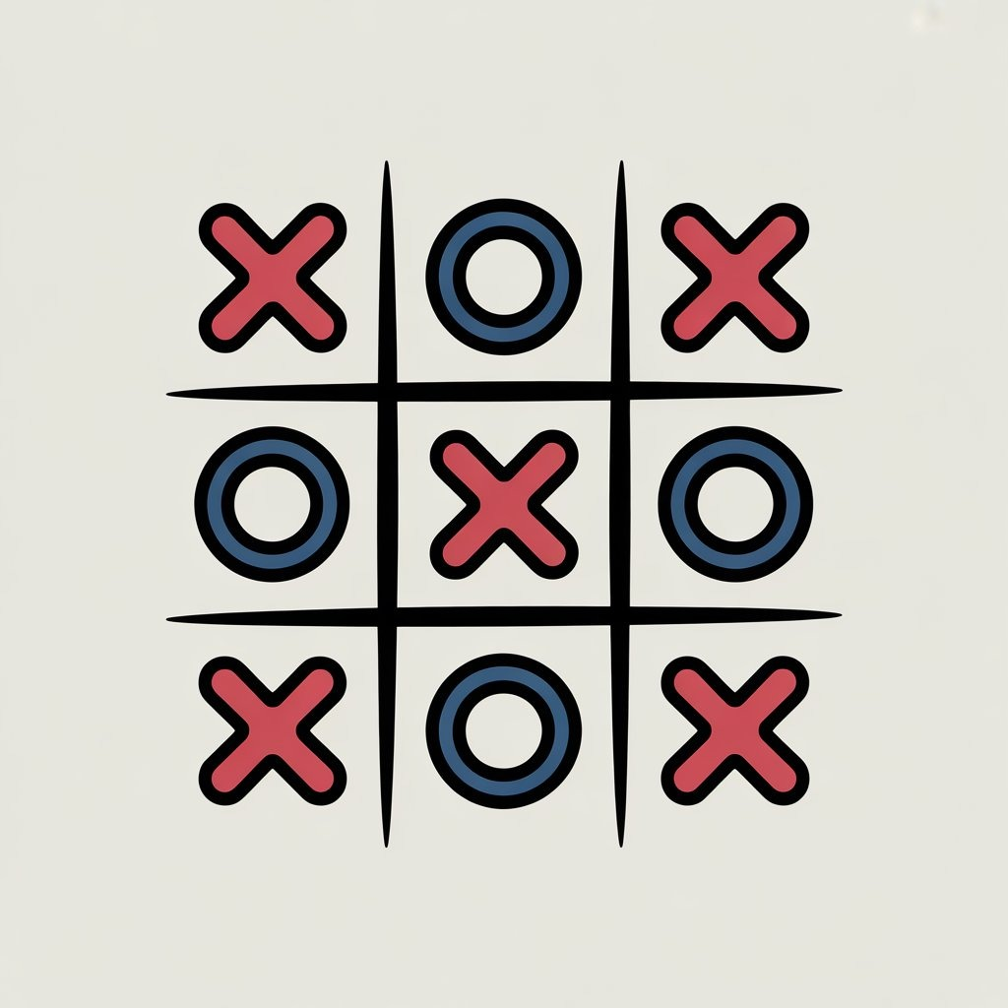
Tic Tac Toe Game in C-Language
Team Name: Quantum Coders
Members:
Taha Ahmed Mallick CT-183
Abdul Raheem Sheikh CT-192
Maryum Mairaj CT-170

Slide 2
Introduction
This project is a simple Tic Tac Toe game written in the C language. It allows two players to take turns marking spaces on a 3×3 grid with ‘X’ and ‘O’. The goal is to form a line horizontally, vertically, or diagonally. The program displays the board after each move and checks for a winner or a draw. It uses concepts like arrays, loops, conditional statements, and user input to control the game.

Slide 3
Step 1 – Code Setup
At the beginning, the stdio.h header file is included to use functions like printf() and scanf() for input and output. Then stdlib.h is included for the system() function, using which we clear the screen. Then windows.h library is only included when it detects it is a windows machine, we use this library to set windows console to UTF-8 encoding so that grid can be presented neatly which is made up of Unicode characters. The array board[9] stores the game cells, each cell labeled 1 to 9. These numbers are replaced by ‘X’ or ‘O’ when players make their moves. Other arrays store winning patterns to check for results later in the program. This setup forms the base structure of the game.

Slide 4
Step 2 – Main Function Flow
The main function controls the overall game flow. The variable player tracks whose turn it is, and mark holds either ‘X’ or ‘O’; corresponding to the player. The while(1) loop runs infinitely until the game ends. Each time, the board is printed using print_board(), and the player enters their move. If the input is valid then that box is marked otherwise a flag is raised and using continue statements same player is asked to input his position again, until done correctly.

Slide 5
Step 3 – Marking and Checking for Win
Once the player chooses a valid box, that cell in the array is updated with their mark. Then the program calls check_win() to see if the current move completes any winning line. If yes, the game ends showing a winner message. If all boxes are filled without a winner, the game is declared a draw. This part is where the game logic works to decide the result.

Slide 6
Functions in our programs…
print_board()
check_win()

Slide 7
Display Board Function
This function is responsible for displaying the 3×3 grid to the players. It clears the screen and prints the board after every move and uses colors to make it visually clear which boxes are marked by which player. If a player wins, it highlights the winning line. This function keeps the players informed about the game’s status. It uses loops to efficiently print the board and marks X as red and O as green, while if a winning pattern is found then it colors it with blue.

Slide 8
Win Checker
This function checks all 8 possible winning combinations: three rows, three columns, and two diagonals. It compares the symbols in each line to see if they are the same. If yes, it returns 1, meaning a win. If the board is full and no winner is found, it returns -1 for a draw. Otherwise, it returns 0 to continue as normal. It makes the use of arrays and loops to efficiently loop through all the winning combinations.

Slide 9
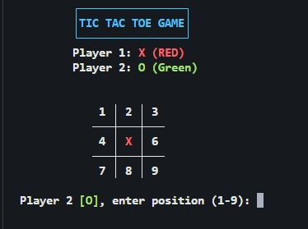
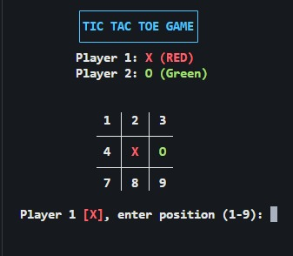
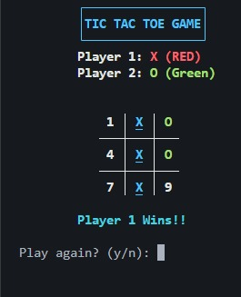
Sample Output

Slide 10
Difficulties Faced and Their Resolutions
Throughout the development of the Tic Tac Toe Game in C, several challenges were encountered that tested both logic and debugging skills. Each issue provided an opportunity to understand the inner workings of C programming more deeply and strengthen the overall structure of the project. The following sections describe the key problems faced, their causes, and how they were effectively resolved.

Slide 11
1.Input Validation Errors
One of the earliest challenges was dealing with invalid player inputs. When a user entered characters or symbols instead of numbers, the program either entered an infinite loop or crashed unexpectedly. This occurred because the scanf() function attempted to read an integer but encountered incompatible data types, leaving unread characters in the input buffer.
To solve this, input validation was implemented using:
if (scanf("%d", &box) != 1)
and a buffer-clearing statement:
while (getchar() != '\n');
This ensured that any invalid input was discarded safely before the program accepted new data. As a result, the game became much more stable and user-friendly.

Slide 12
2. Overwriting of Player Moves
At first, players were able to overwrite each other’s moves, which broke the fairness of the game. This happened because there was no condition preventing users from selecting a position that was already filled.
The solution was to add a validation check:
if (box < 1 || box > 9 || board[box - 1] != box + '0')
This ensured that each move could only be placed in an unoccupied box. Once a cell contained an ‘X’ or ‘O’, the program disallowed any further changes to it, thus enforcing proper game rules.

Slide 13
3. Incorrect Win Detection
Another major difficulty was the program’s failure to correctly detect diagonal victories. Initially, the game recognized horizontal and vertical wins but sometimes ignored diagonal ones.
This was due to a mismatch between logical indices and their displayed positions. After carefully analyzing the board layout, the formula:
n = j + i * 3
was applied to maintain consistent mapping between the 1D array indices and the 3×3 grid. This correction ensured that all eight winning combinations — three rows, three columns, and two diagonals — were properly detected.

Slide 14
4. Draw Condition Not Recognized
In early tests, when all boxes were filled without any winner, the program continued prompting players for moves indefinitely. This occurred because there was no condition to check whether the grid was full.
The solution involved counting the number of filled cells within the check_win() function. When all nine boxes contained either ‘X’ or ‘O’, and no winning combination was found, the function returned -1, indicating a draw. This addition made the game logic complete and realistic.

Slide 15
5. Replay Feature Malfunction
While adding the replay feature, an error was observed where the board displayed mixed symbols from the previous match. This happened because the board array was not being reinitialized properly before a new round began.
To fix this, a reset loop was added:
for (int i = 0; i < 9; i++)
board[i] = i + '1';
This restored the board to its default numbered state, allowing the players to start fresh each time without restarting the entire program.

Slide 16
6.Unicode character Compatibility
By default windows consoles aren’t compatible with UTF-8 encoding. We used Unicode characters to print a neat grid. To display it properly onto windows terminals we first need to enable it which is done using the lines below.
#ifdef _WIN32
SetConsoleOutputCP(CP_UTF8);
#endif
This line enabled UTF-8 output on Windows systems, making the interface work universally across different platforms.

Slide 17
Lessons Learned
Overcoming these challenges taught valuable lessons about programming discipline and systematic debugging. The process reinforced several key principles:
Input Validation is Essential – Never trust user input; always verify data types and boundaries.
Modular Code Design – Keeping related logic within functions like print_board() or check_win() improves readability and maintainability.
Logical Consistency – Always map visual representation and data structure correctly to avoid index mismatches.
Cross-Platform Awareness – Programs should be tested across environments to ensure consistent behavior.
Incremental Debugging – Testing one feature at a time helps isolate bugs and leads to efficient troubleshooting.
In conclusion, every difficulty faced during the development process contributed to stronger problem-solving ability, deeper command over C syntax, and a practical understanding of structured programming. These lessons not only improved the project’s final outcome but also provided foundational skills for tackling more advanced software development challenges in the future.

Slide 18
Conclusion
This Tic Tac Toe game is a perfect example of how to use arrays, loops, functions, and conditions in C programming. It also teaches how to manage player turns, validate user input, and display results interactively. By studying this program, beginners can improve their logical thinking and understand how small programs combine to create complete games. This game also eliminates the need to use paper and pen and makes it easier to play it again and again.

