Slide 1

AutoParts Hub
An e-commerce platform for car parts and repair services — built for car owners, enthusiasts, and repair shops.
Presented by: Fix My Car Group
· Course: Mobile Commerce
· Dr. Mohammed Haitham
Arab Academy for Science, Technology & Maritime Transport

Slide 2

What Is AutoParts Hub?
AutoParts Hub is a comprehensive e-commerce platform for car parts and repair services, designed to simplify vehicle maintenance for every car owner.
Browse & Purchase
Mechanic on Demand
AI Assistant
Shop car parts from trusted vendors with a seamless checkout experience.
Request professional mechanics directly to your location.
AI-powered car advice to help you make informed decisions.
Favorites & Tracking
Save favorite products and track orders in real-time.
Target Audience: Car owners, car enthusiasts, and repair shops.

Slide 3
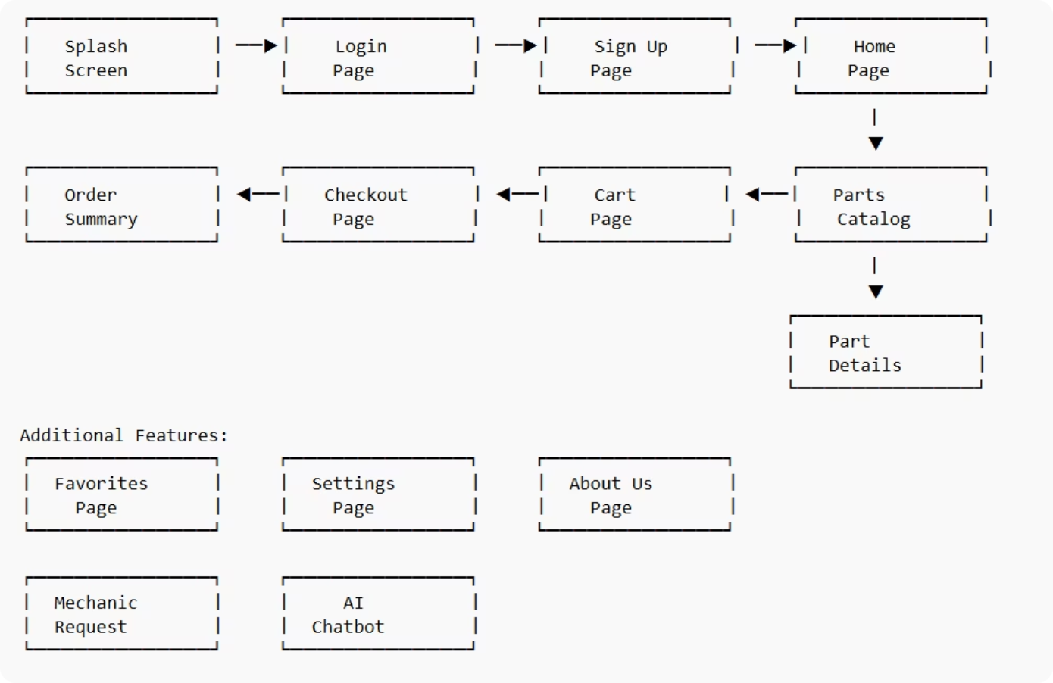
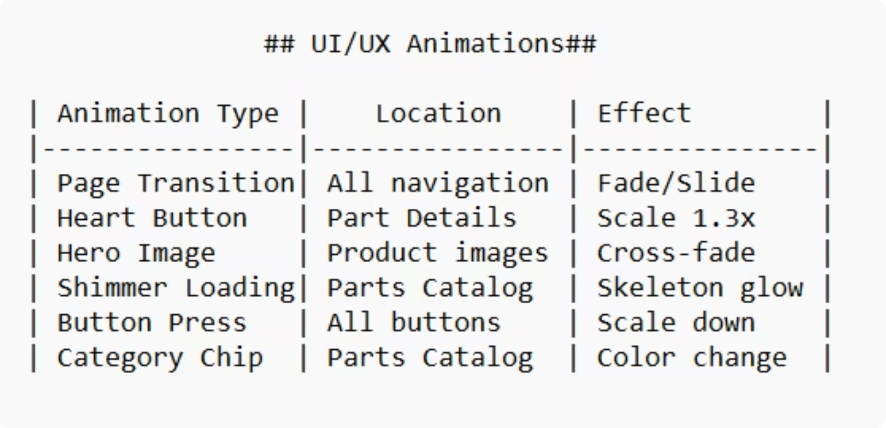
Flow Diagram & UI/UX Animations
The diagram below illustrates the complete user journey through the AutoParts Hub application, from onboarding to order completion and service requests.

Slide 4
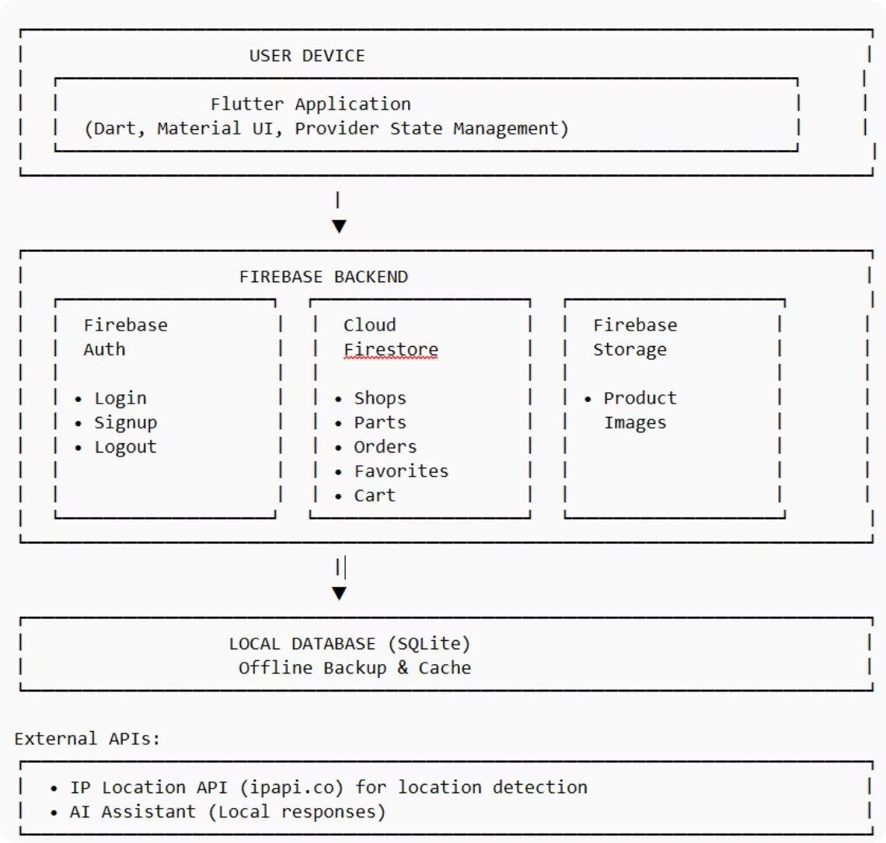
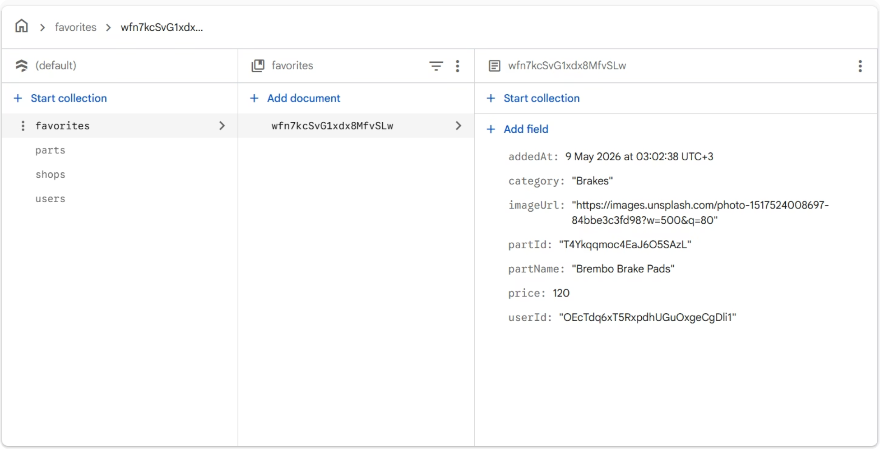
System Architecture
The system architecture diagram below outlines the technical structure of AutoParts Hub, showing how frontend, backend, and data layers interact.

Slide 5
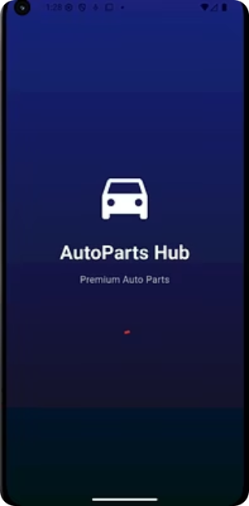
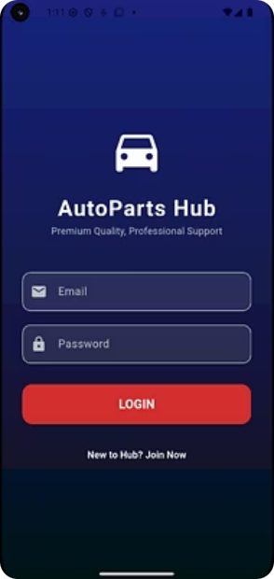
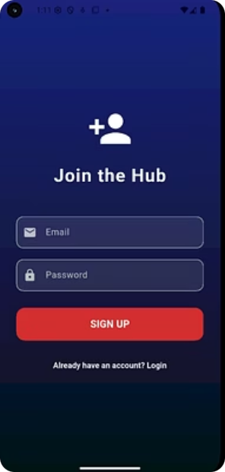
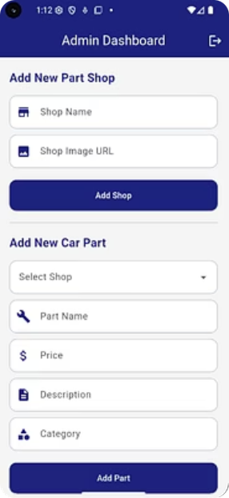
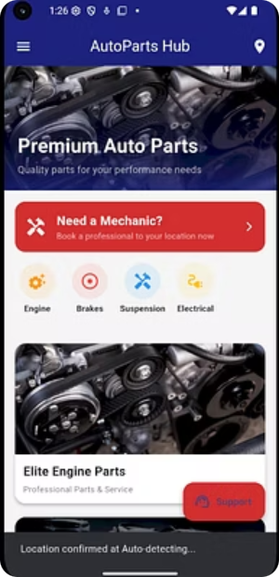
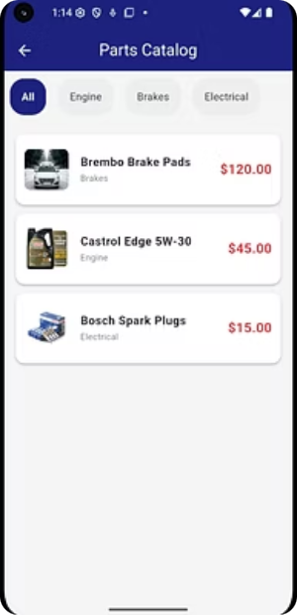
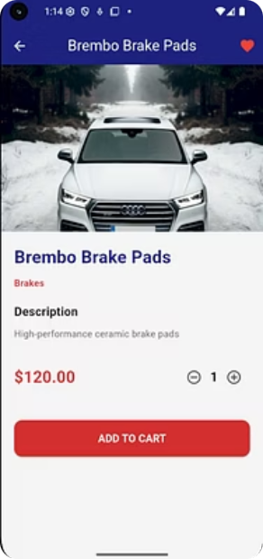
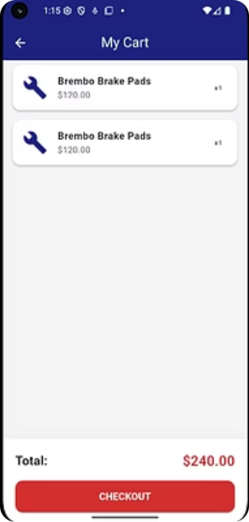
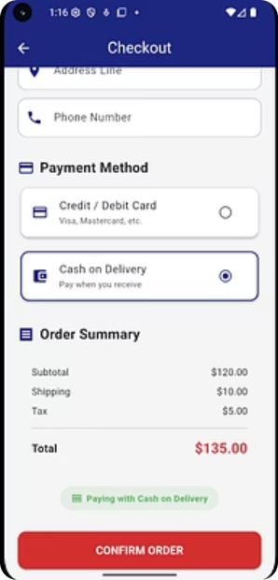
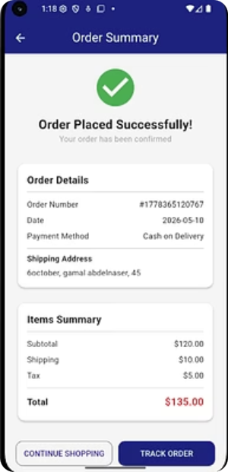
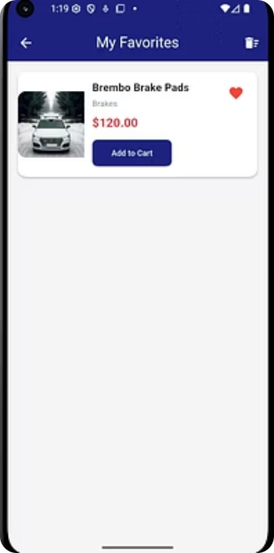
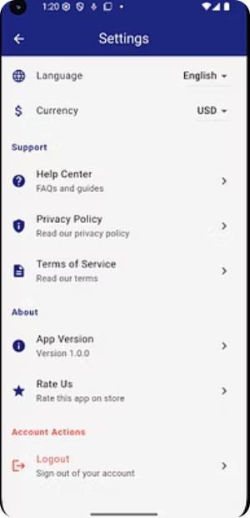
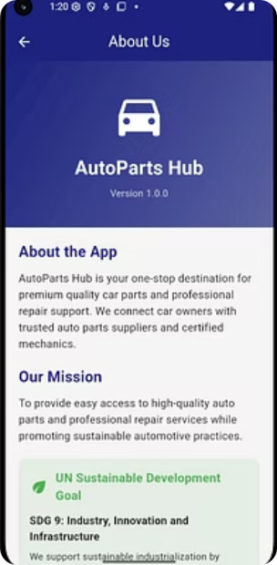
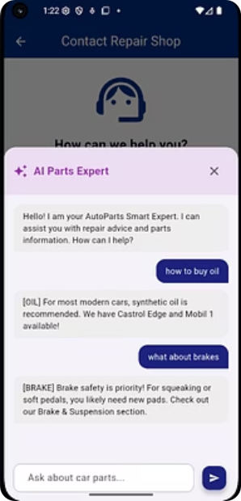
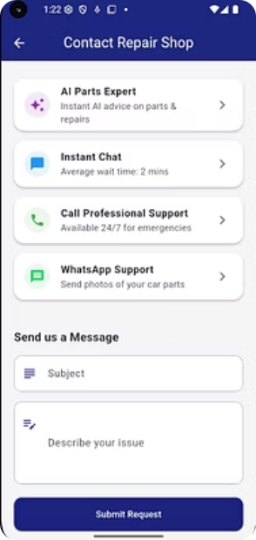
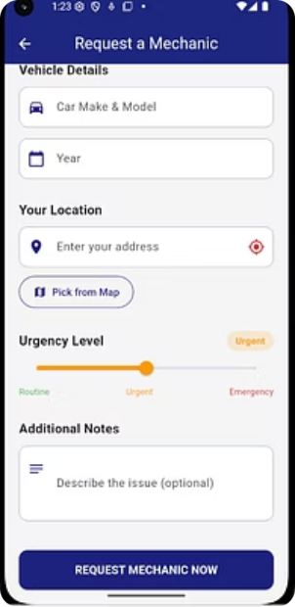
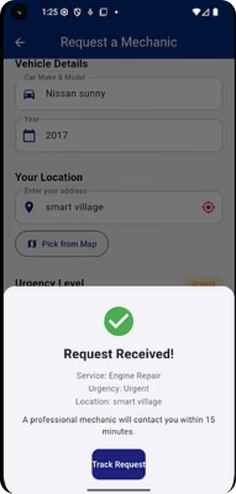
Screenshots
A visual walkthrough of the AutoParts Hub mobile application interface, showcasing the home screen, product browsing, AI assistant, mechanic booking, order tracking, and more.

Slide 6
UN SDG Alignment
Our Commitment
How We Contribute
AutoParts Hub is designed with sustainability at its core, contributing to multiple United Nations Sustainable Development Goals through eco-conscious features and community-driven services.
Promotes sustainable industrialization
Supports eco-friendly auto parts
Reduces waste through quality products
Connects users with local repair shops
Reduces transportation emissions
Encourages innovation in auto parts industry
"Our app makes car maintenance more sustainable by connecting users with local suppliers and promoting eco-friendly parts."

Slide 7



Future Work
AutoParts Hub follows a phased release strategy to progressively enhance functionality and user experience.
Short-Term
Medium-Term
Long-Term
Next Release
Second Release
Third Release
Push notifications for order updates
Real-time order tracking
Multi-language support (Arabic/English)
Dark mode theme
Payment gateway integration (Stripe, PayPal, Fawry)
User reviews and ratings for products
Loyalty points system
Social media login (Google, Apple)
AR part viewer (see parts in 3D)
Voice search for products
Mechanic scheduling calendar
Admin analytics dashboard
Chat between users and mechanics
AI-powered part recommendations

Slide 8
Technologies Used
Frontend
Backend
Local Database
Flutter SDK 3.41.4
Dart Programming Language
Material Design 3
Firebase Authentication
Cloud Firestore (NoSQL Database)
Firebase Storage
SQLite (sqflite package)
APIs & Services
Development Tools
State Management
IP Location API (ipapi.co)
HTTP Client for API calls
VS Code
Android Studio
Git & GitHub
Firebase Console
setState (UI state)
FutureBuilder (Async data)

Slide 9
Team Members & Roles
AutoParts Hub was developed by a collaborative team, each contributing specialized expertise to deliver a complete mobile commerce solution.
Project Lead & Backend Developer
UI/UX Designer
Database Developer
App design, theme, and user experience
SQLite and local storage implementation
Firebase, Firestore integration and backend architecture
AI Integration
QA Tester
Chatbot and AI-powered features
Testing and bug fixes

Slide 10
Conclusion
AutoParts Hub successfully delivers a complete, production-ready mobile commerce experience for the automotive market.
E-Commerce
Firebase Backend
AI Assistant
Mechanic Integration
Complete e-commerce functionality
Firebase cloud backend
AI-powered assistant
Professional mechanic integration
User-Friendly UI
UN SDG Aligned
User-friendly interface
UN SDG alignment
Thank You!
Questions? We'd love to hear from you.

