Slide 1
Data Science Project 1
Name: Abdulrahman Mohammed Samir
Dept: CS
Sec: 3

Slide 2
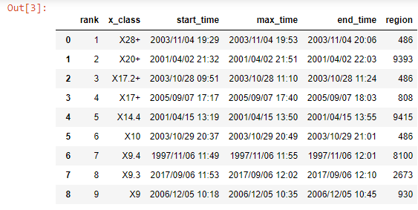
Part 1: Data scraping and preparation
Step 1: Scrape your competitor's data
First, import the libraries.
Save the spaceweatherlive url in ‘url’ and then I use requests.get(url) to get url, use beautifulsoup to get content of url and parsing it into html and prettify the html using prettify to view content.
Now we have data in html, use function find to find the appropriate table, now need to save table in dataframe so we create dataframe using reading in html by pandas and save table.
Finally for this step we renamed the columns because there are unnamed columns.
Here the result of this step:

Slide 3
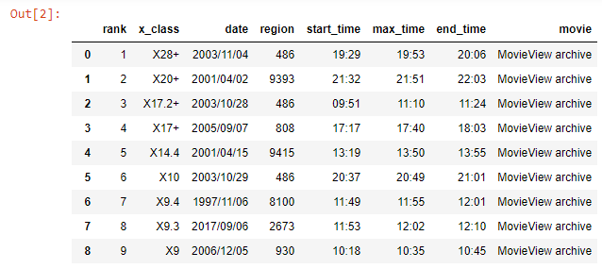
Part 1,..
Step 2: Tidy the top 50 solar flare data
First we remove the last unused column called “movie”.
Then we use functions called “iterrows” and “set_value” to loop over our dataframe and combine 2 columns in one and then put the new value then drop unused columns after combining.
We need to insure that column “Region” doesn’t have any “-” value so we replacing it using function called “replace”.
Finally reindexing the columns to organize the dataframe after combining and droping.
Here the result of this step:

Slide 4
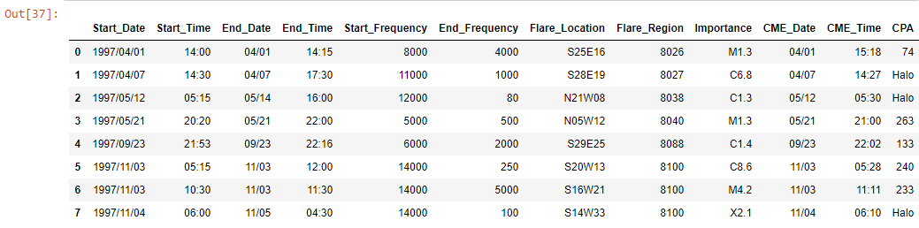
Part 1,..
Step 3: Scrape the NASA data
First get the url then read the content then get table from “pre” then split the content into lines and remove unnecessary lines, create dataframe of table with it's columns names and split each line by space to remove unnecessary data, drop unnecessary columns, rename some columns.
Finally save the dataframe into NASA.csv file.
Here the result of this step:

Slide 5
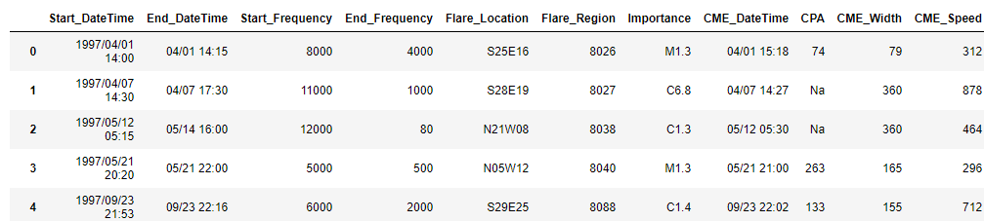
Part 1,..
Step 4: Tidy the NASA table
First replacing missing records(dashes) with “NaN”.
Create new column called “Is_halo” and mapping it to "CPA" column and put “True” value if there is “Halo” value else put “false” value, then replace any “Halo” value by “Na” value.
Create new column called “Width_Lower_Bound” and mapping it to “CME_Width” column and put “True” value if there is “>” sign else “false” value , create new function check if value is numeric or not in "CME_Width" column and if it isn’t a numeric value replace it by “ ” else “no change”.
Finally use “iterrows” and “set_value” to loop over dataframe and combine 2 columns in one and then put the new value then drop unused columns then rename the columns name.
Here the result of this step:

Slide 6
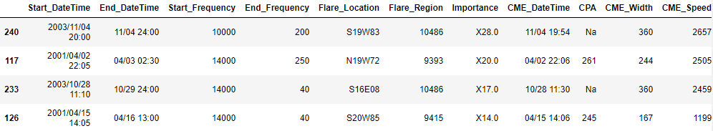
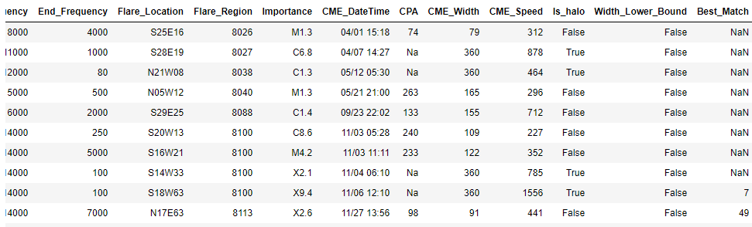
Part 2: Analysis
Question 1: Replication
First get the rows contain “X” value, remove “X” symbol to get only numbers then convert them into float to compare them, sort the numbers by descending, then convert them into string again and concatenate “X” to them..ANS to the question is we can replicate the top 50 solar flare table in SpaceWeatherLive.com exactly using the data obtained from NASA since column “Importance” strongly looks like “x_cLass” so we can extracted the top 50 solar flare by their importance.
Question 2: Integration
First save the 2 tables into new 2 tables and create new column called “Best_Match” and take index of NASA table then define function that take index as input then use “iterrowrs” to iterate over dataframe and check if the“Flare_Classification”(CPA) in NASA table is same at “x_class” in space table if it’s return the rank value in the new column we created else return “NaN”, Finally call the function and iterate over column and put the rank in it, we have 29 rows matched.

Slide 7
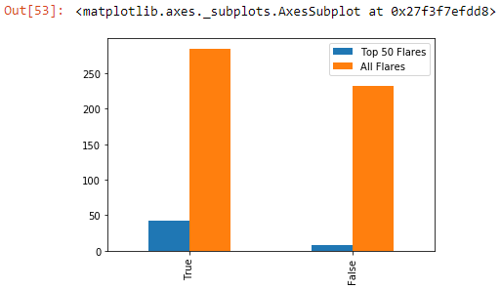
Part 2,..
Question 3: Analysis
First I will solve number 2.
Use iterrows to iterate over the 2 tables(top flare data, NASA data) and count number of true and false values.
Then create an 3x3 array to save the counts and create dataframe of it, convert them into integer.
Finally use matplotlib to plot the bar.

