Slide 1
Docker
A DevOps love story ☺
Abdulrahman Azab
23, Mar 2018

Slide 2
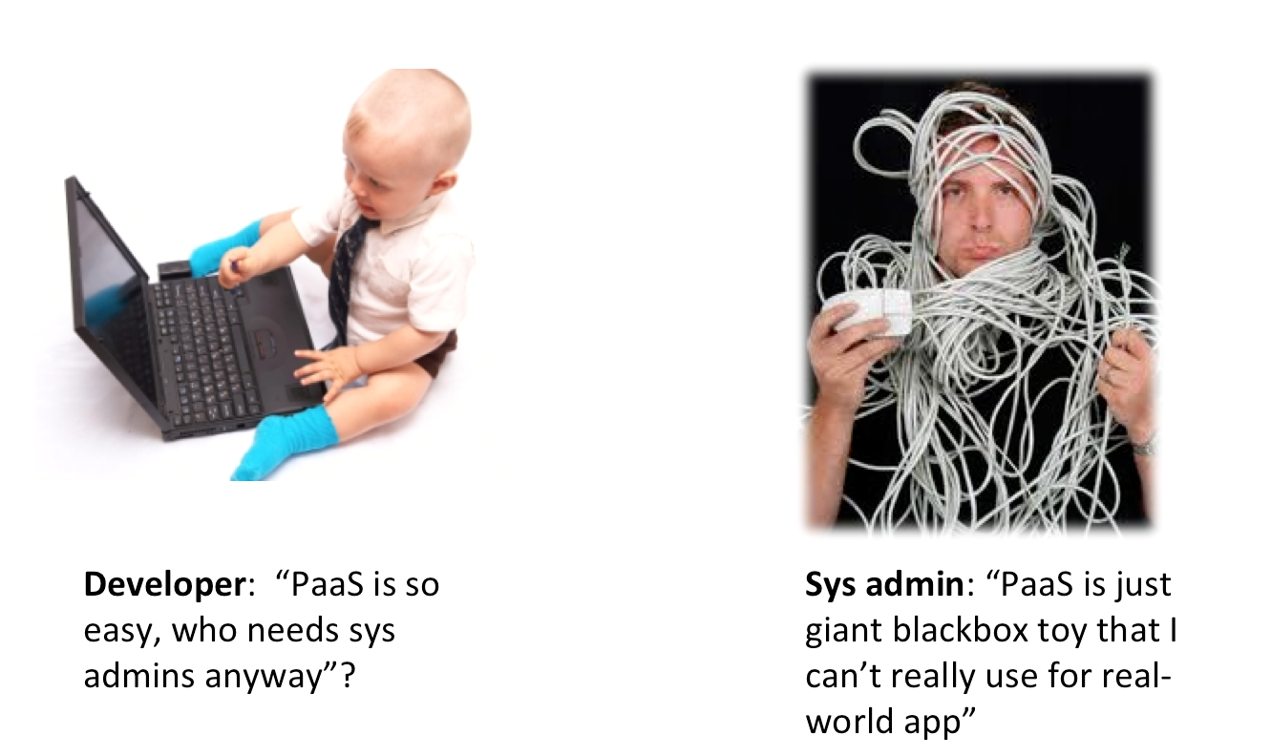
DevOps

Slide 3
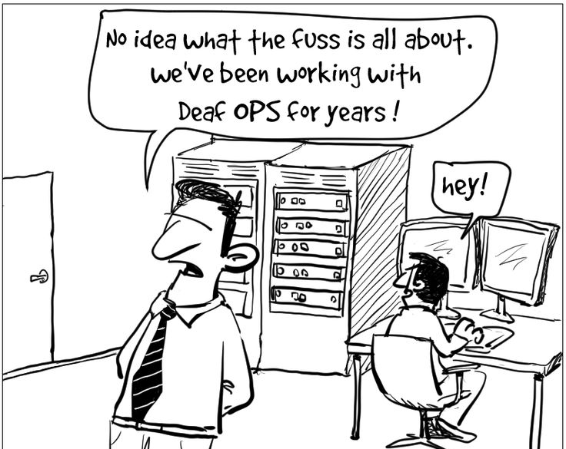
DevOps

Slide 4
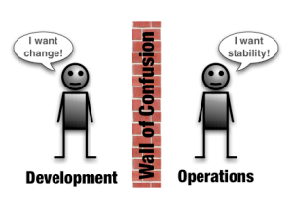
DevOps

Slide 5



Slide 6
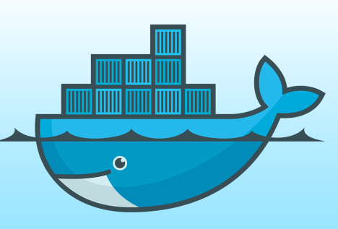
Docker
Docker is an open-source project that automates
the deployment of applications inside software
containers, by providing an additional layer of
abstraction and automation of operating system–
level virtualization on Linux.
[www.docker.com]

Slide 7
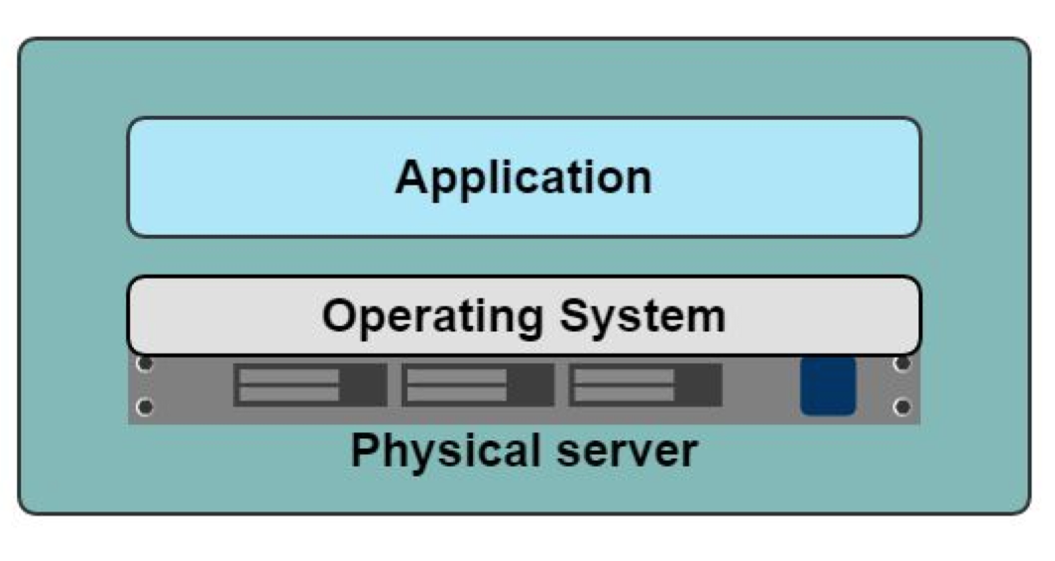
Application-Server
Slow deployment
Huge cost
Wasted resources
Difficult to Scale
Difficult to Migrate

Slide 8
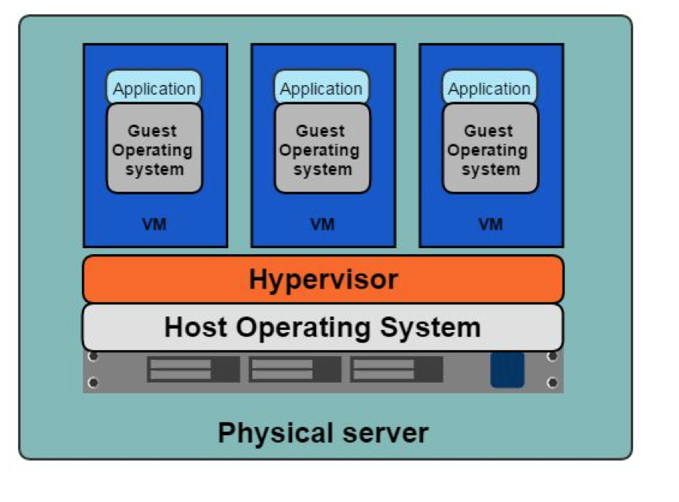
VMs
Benefits
Better resource pooling
Easier to scale
VM’s on the cloud.
Limitations
Dedicated resources for each VM (more VM = more resources).
Guest VM = Wasted resources.

Slide 9
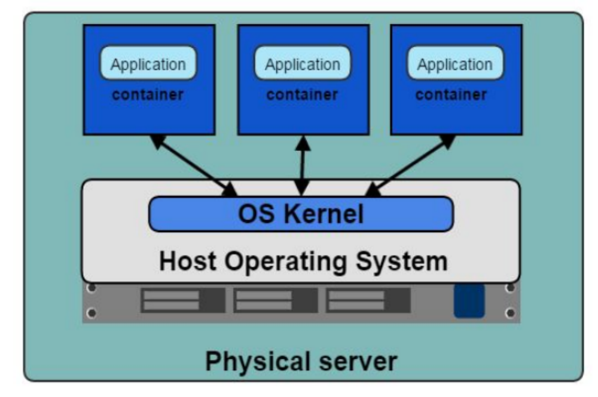
Containers

Slide 10
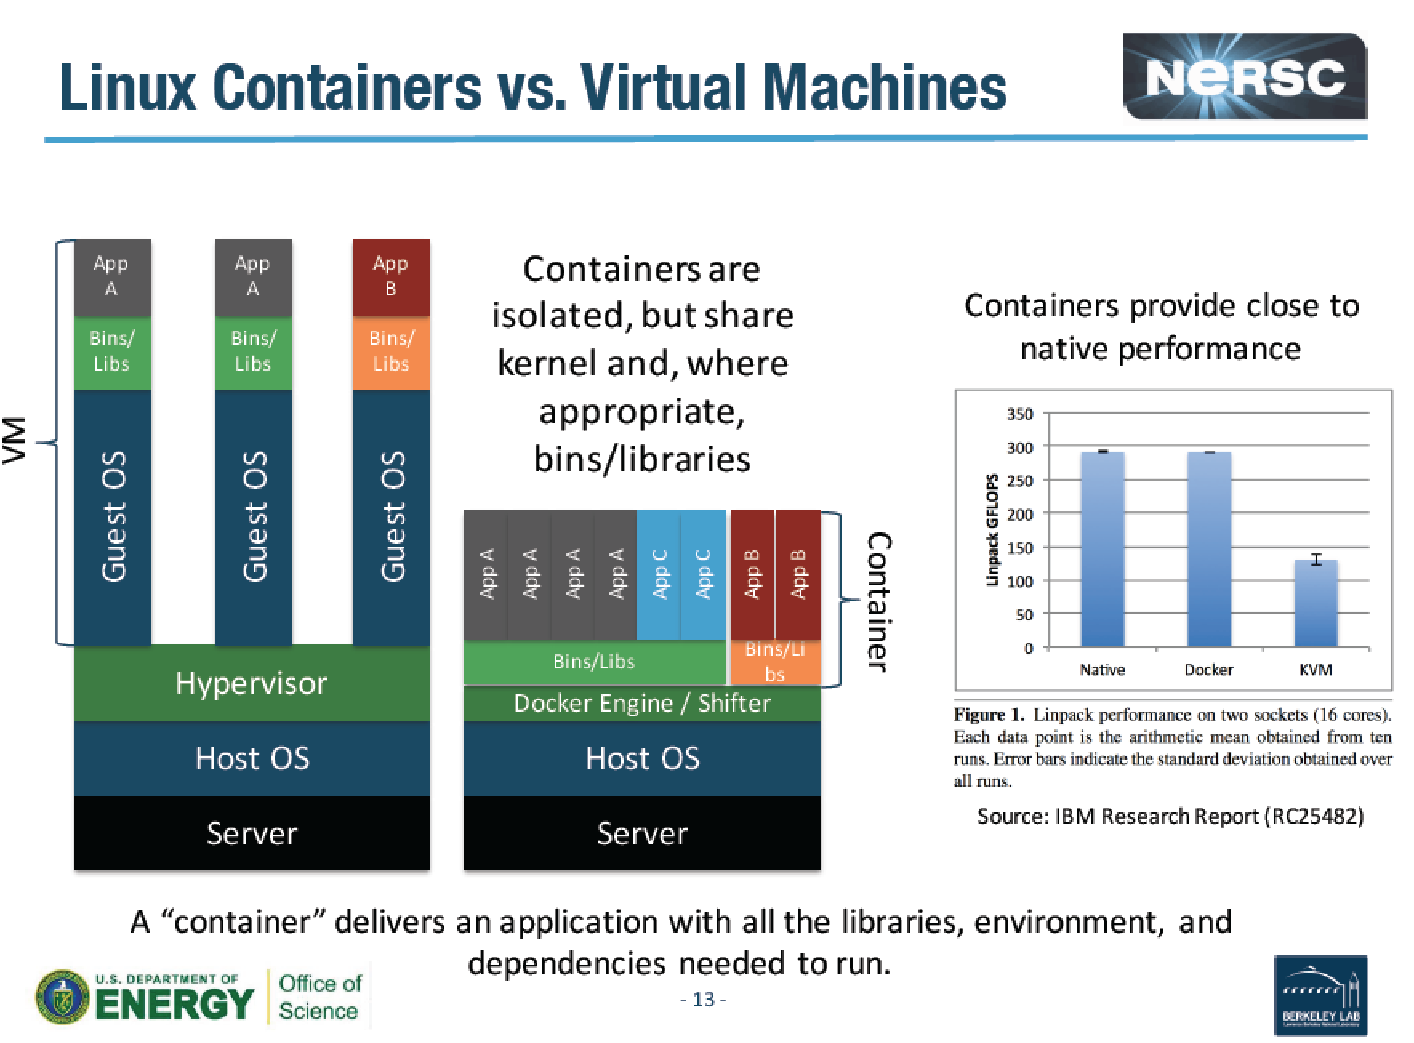
Docker
Notes:
LINPACK is a software library for performing numericallinear algebra on digital computers. It was written in Fortran. and was intended for use on supercomputers in the 1970s and early 1980s.

Slide 11
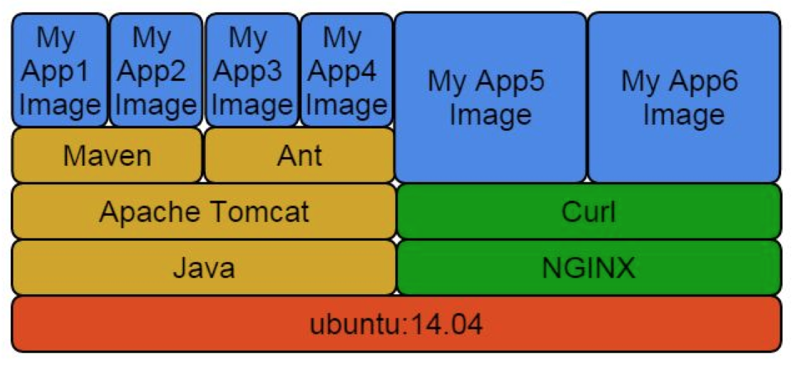
Docker Layers

Slide 12
Images and Layers
ubuntu : 200 Mb
ubuntu + R : 250 Mb
ubuntu + matlab : 250 Mb
All three: 300 Mb

Slide 13
Containers
Containers vs VMs
Containers are more lightweight.
No need for a guest OS.
Less resources.
Greater portability
Faster

Slide 14
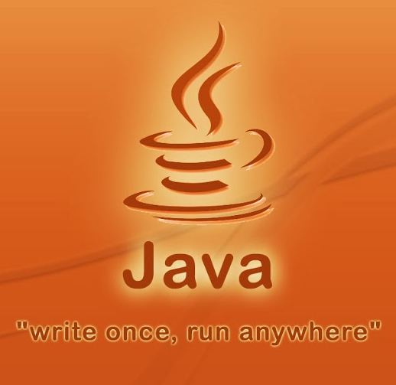
In short:
Build once run anywhere

Slide 15
Ready for fun?..
Access your VM

Slide 16


86.50.170.102
docker-tutorial-[1-26]
[your-username@your-machine]$ chmod 600 docker-tutorial.pem
[your-username@your-machine]$ ssh -i docker-tutorial.pem cloud-user@86.50.170.102
[cloud-user@docker-tutorial-terminal ~]$ ssh -i docker-tutorial.pem cloud-user@<VM-name>

Slide 17
Let’s get our hands
dirty ☺
Goto the tutorial…

Slide 18
…return

Slide 19
Building a Docker Image
Interactive building
Building from a Docker File
Base Image (Disk)
Base Image (Disk)
Run
Load
Run the
Installation
procedure
Container (Memory)
Dockerfile
Installation
script
Commit
Build
New Image (Disk)
New Image (Disk)

Slide 20
Extra slides ...

Slide 21
Interactive building Example: curl & vim
$ docker run -t -i ubuntu:14.04
root@2a896c8cdd83:/# apt-get update-y
root@2a896c8cdd83:/# apt-get install -y curl
root@2a896c8cdd83:/# apt-get install -y vim
root@2a896c8cdd83:/# exit
$ docker commit 2a896c8cdd83 youruser/curlvim:1.0
$ docker run youruser/curlvim:1.0 curl --version
curl 7.35.0 (x86_64-pc-linux-gnu) libcurl/7.35.0 OpenSSL/1.0.1f zlib/1.2.8 libidn/1.28 librtmp/2.3
Protocols: dict file ftp ftps gopher http https imap imaps ……..
$ docker login
$ docker push youruser/curlvim:1.0
Hands-on

Slide 22
Interactive building Example: Bowtie2
$ docker run -t -i ubuntu:14.04
root@2a896c8cdd83:/# apt-get update -qq --fix-missing
root@2a896c8cdd83:/# apt-get install -qq -y wget unzip
root@2a896c8cdd83:/# wget -q -O bowtie2.zip http://sourceforge.net/projects/bowtie-bio/files/bowtie2/2.2.4/bowtie2-2.2.4-linux-x86_64.zip/download
root@2a896c8cdd83:/# unzip bowtie2.zip -d /opt/
root@2a896c8cdd83:/# ln -s /opt/bowtie2-2.2.4/bowtie2 /usr/bin/bowtie2
root@2a896c8cdd83:/# rm bowtie2.zip
root@2a896c8cdd83:/# exit
$ docker commit 2a896c8cdd83 youruser/bowtie2
$ docker run youruser/bowtie2 bowtie2 --version
/bowtie2/bowtie2-align version 2.1.0
64-bit
Built on do-dmxp-mac.win.ad.jhu.edu
Tue Feb 26 13:34:02 EST 2013
……..
Hands-on
$ docker login
$ docker push youruser/bowtie2

Slide 23
Building a Docker Image from a Dockerfile
<source-directory>
Dockerfile
files
.dockerignore
$docker build -t <image-name> <source-directory>

Slide 24
Dockerfile Example: curl & vim
FROM ubuntu:14.04
MAINTAINER your name <your email>
RUN apt-get update -y
RUN apt-get install curl -y
RUN apt-get install vim -y

Slide 25
Dockerfile Example: curl & vim
FROM ubuntu:14.04
MAINTAINER your name <your email>
RUN apt-get update -y
RUN apt-get install curl -y && apt-get install vim -y

Slide 26
Dockerfile Example: Bowtie2
FROM ubuntu:14.04
RUN apt-get update -qq --fix-missing; \
apt-get install -qq -y wget unzip;
RUN wget -q -O bowtie2.zip http://sourceforge.net/projects/bowtie-bio/files/bowtie2/2.2.4/bowtie2-2.2.4-linux-x86_64.zip/download; \
unzip bowtie2.zip -d /opt/; \
ln -s /opt/bowtie2-2.2.4/ /opt/bowtie2; \
rm bowtie2.zip
ENV PATH $PATH:/opt/bowtie2

Slide 27
Inspect containers
$ docker ps # shows running containers.
$ docker inspect # info on a container (incl. IP address).
$ docker logs # gets logs from container.
$ docker events # gets events from container.
$ docker port # shows public facing port of container.
$ docker top # shows running processes in container.
$ docker diff # shows changed files in container's FS.
$ docker stats # shows metrics, memory, cpu, filsystem
http://www.jayway.com/2015/03/21/a-not-very-short-introduction-to-docker/

Slide 28
Containers
# Run a container interactively
$ docker run -it --rm ubuntu
# Run a container in the background
$ docker run -d hadoop
# Publish container port 80 on a random port on the Host
$ docker run -p 80 nginx
# Publish container port 80 on port 8080 on the Host
$ docker run -p 8080:80 nginx
http://www.jayway.com/2015/03/21/a-not-very-short-introduction-to-docker/
Notes:
--interactive (-i) – send stdin to the process.
-tty (-t) – tell the process that a terminal is present. This affects how the process outputs data and how it treats signals such as (Ctrl-C).
--rm – remove the container on exit.
ubuntu – use the ubuntu:latest image.
--detached (-d) – Run in detached mode, you can attach again with docker attach

Slide 29
Containers
# Publish container port 80 on port 8080 on the localhost interface on the Host
$ docker run -p 127.0.0.1:8080:80 nginx
# Publish all EXPOSEd ports from the container on random ports on the Host
$ docker run -P nginx
http://www.jayway.com/2015/03/21/a-not-very-short-introduction-to-docker/
Notes:
--interactive (-i) – send stdin to the process.
-tty (-t) – tell the process that a terminal is present. This affects how the process outputs data and how it treats signals such as (Ctrl-C).
--rm – remove the container on exit.
ubuntu – use the ubuntu:latest image.
--detached (-d) – Run in detached mode, you can attach again with docker attach

Slide 30
Containers
# Limit the amount of memory
$ docker run -m 256m yourapp
# Limit the number of shares of the CPU this process uses (out of 1024)
$ docker run --cpu-shares 512 mypp
# Change the user for the process to www instead of root (good for security)
$ docker run -u=www nginx
http://www.jayway.com/2015/03/21/a-not-very-short-introduction-to-docker/
Notes:
--interactive (-i) – send stdin to the process.
-tty (-t) – tell the process that a terminal is present. This affects how the process outputs data and how it treats signals such as (Ctrl-C).
--rm – remove the container on exit.
ubuntu – use the ubuntu:latest image.
--detached (-d) – Run in detached mode, you can attach again with docker attach

Slide 31
Volumes
# Start a new nginx container with /var/log as a volume (created)
$ docker run -v /var/log nginx
# Start a new nginx container with /var/log as a volume mapped to /tmp on Host
$ docker run -v /tmp:/var/log nginx
# Start a db container
$ docker run -v /var/lib/postgresql/data --name mydb postgres
# Start a backup container with the volumes taken from the mydb container
$ docker run --volumes-from mydb backup
http://www.jayway.com/2015/03/21/a-not-very-short-introduction-to-docker/
Notes:
--interactive (-i) – send stdin to the process.
-tty (-t) – tell the process that a terminal is present. This affects how the process outputs data and how it treats signals such as (Ctrl-C).
--rm – remove the container on exit.
ubuntu – use the ubuntu:latest image.
--detached (-d) – Run in detached mode, you can attach again with docker attach

Slide 32
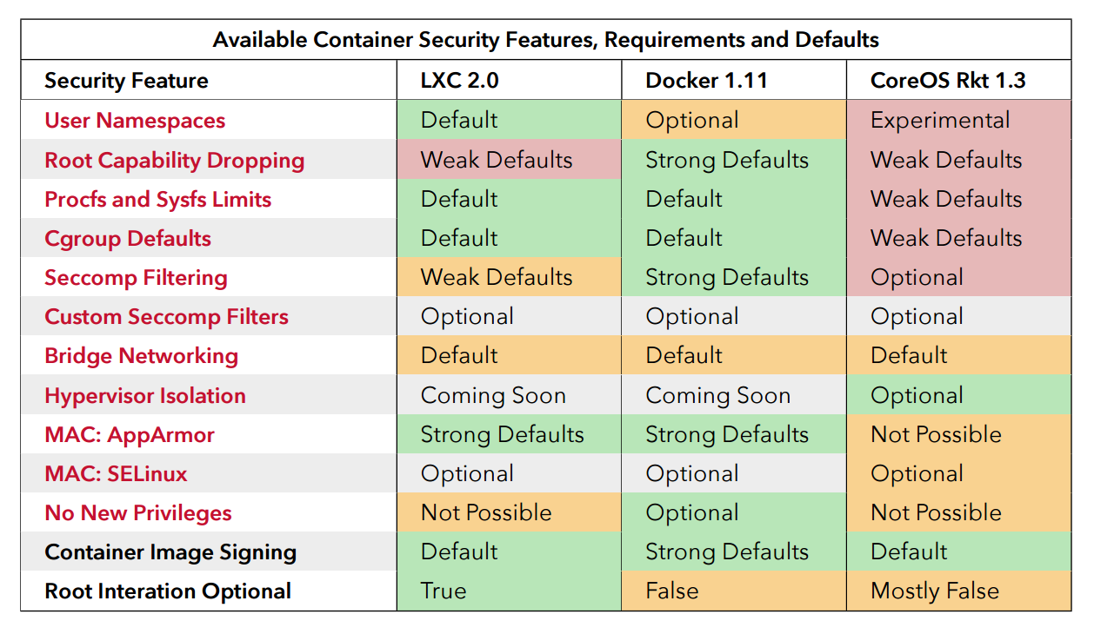
Security
source: “Understanding and Hardening Linux Containers”, page 96

Slide 33
Docker Run Platforms
Various Linux distributions (Ubuntu, Fedora, RHEL, Centos, openSUSE, ...)
Cloud (Amazon EC2, Google Compute Engine, Rackspace)
Windows, OSX: Docker Toolbox

Slide 34
Docker Ecosystem
Docker Engine or “Docker” creates and runs Docker containers. Install Docker on Ubuntu, Mac OS X, or Windows.
Docker Hub Public registry service for managing images.
Docker Registry provides open source Docker image distribution.
Docker Swarm used to host clustering and container scheduling.

Slide 35
Docker Ecosystem
Kitematic is the desktop GUI for Docker.
Docker UI is a web responsive GUI to administrate Docker
Docker Trusted Registry (DTR) supplies a private dedicated image registry.
Docker Machine automates container provisioning on your network or in the cloud. Install machine on Windows, Mac OS X, or Linux.
Docker Compose defines multi-container applications. You can install Docker Compose on Ubuntu, Mac OS X, and other systems.

Slide 36
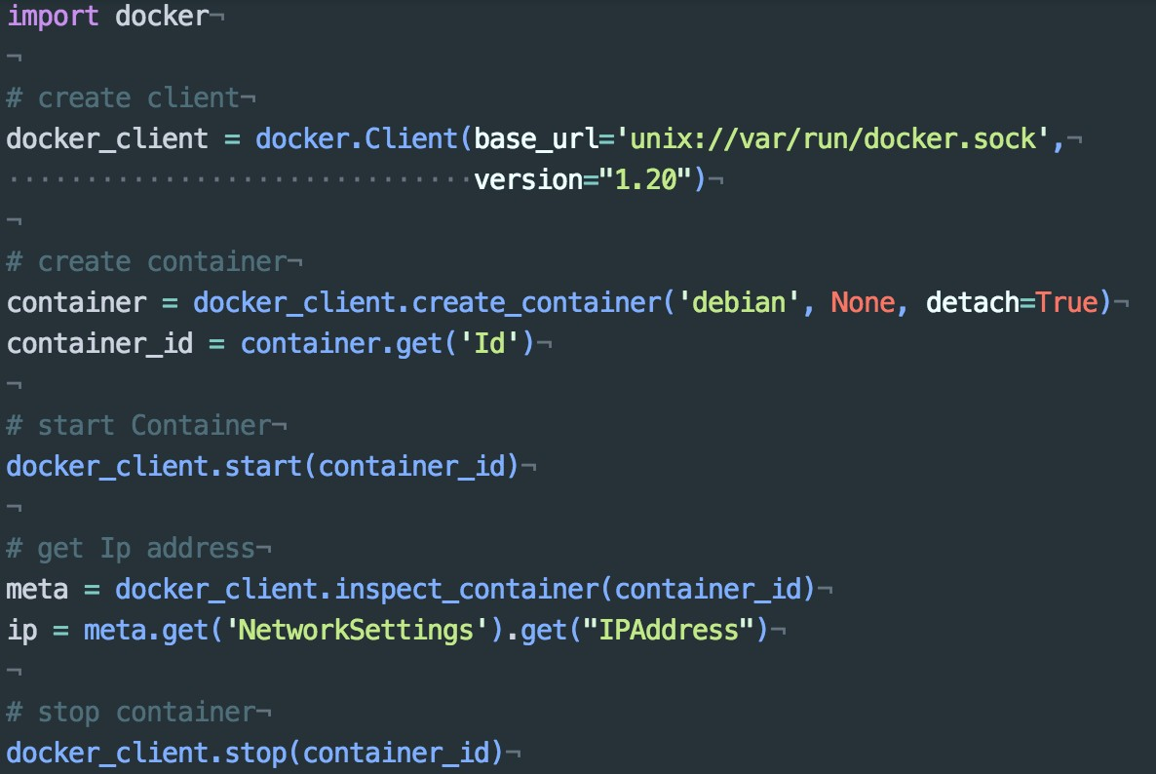
Docker APIs - Python

Slide 37
HTCondor
GYOC2: Get Your Own
Cluster in the Cloud
GYOC3: Get Your Own
Container Cluster in the Cloud
uh-iaas.no

Slide 38
Getting Condor
Available as a free download from
http://www.cs.wisc.edu/condor
Download Condor for your operating system
  Available for most UNIX (including Linux and Apple’s OS/X) platforms
  Also for Windows NT / XP

Slide 39
Condor Releases
Stable / Developer Releases
  Version numbering scheme similar to that of the (pre 2.6) Linux kernels …
  Major.minor.release
    Minor is even (a.b.c): Stable
      Examples: 6.6.3, 6.8.4, 6.8.5
      Very stable, mostly bug fixes
    Minor is odd (a.b.c): Developer
      New features, may have some bugs
      Examples: 6.7.11, 6.9.1, 6.9.2

Slide 40
Definitions
Job
  The Condor representation of your work
Machine
  The Condor representation of computers and that can perform the work
Match Making
  Matching a job with a machine “Resource”

Slide 41
Job
Jobs state their requirements and preferences:
  I need a Linux/x86 platform
  I want the machine with the most memory
  I prefer a machine in the chemistry department

Slide 42
Machine
Machines state their requirements and preferences:
  Run jobs only when there is no keyboard activity
  I prefer to run Frieda’s jobs
  I am a machine in the physics department
  Never run jobs belonging to Dr. Smith

Slide 43
Matchmaking
Jobs and machines state their requirements and preferences
Condor matches jobs with machines
based on requirements and preferences

Slide 44
Getting Started:
Submitting Jobs to Condor
Overview:
  Choose a “Universe” for your job
  Make your job “batch-ready”
  Create a submit description file
  Run condor_submit to put your job in the queue

Slide 45
Choose the “Universe”
Controls how Condor handles jobs
Choices include:
  Vanilla
  Standard
  Grid
  Java
  Parallel
  Docker
  ….

Slide 46
The Architecture
Condor
CM
HTCondor Pool
Compute
Node
Compute
Node
Compute
Node
Compute
Node
Docker Engine
Docker Engine
Docker Engine
Docker Engine

Slide 47
Job script
Universe = docker
Executable = /usr/local/bin/bowtie
Arguments = -S -v 2 -m 1 /hg19 input.fastq
docker_image = genomicpariscentre/bowtie1
output = out.sam
error = bowtie.err
log = bowtie.log
queue

Slide 48
Submitting The Job
% condor_submit my_job.sub
Submitting job(s).
1 job(s) submitted to cluster 1.

Slide 49


