Slide 1
Docker
Swarm
Abdulrahman Azab
19, Jan

Slide 2
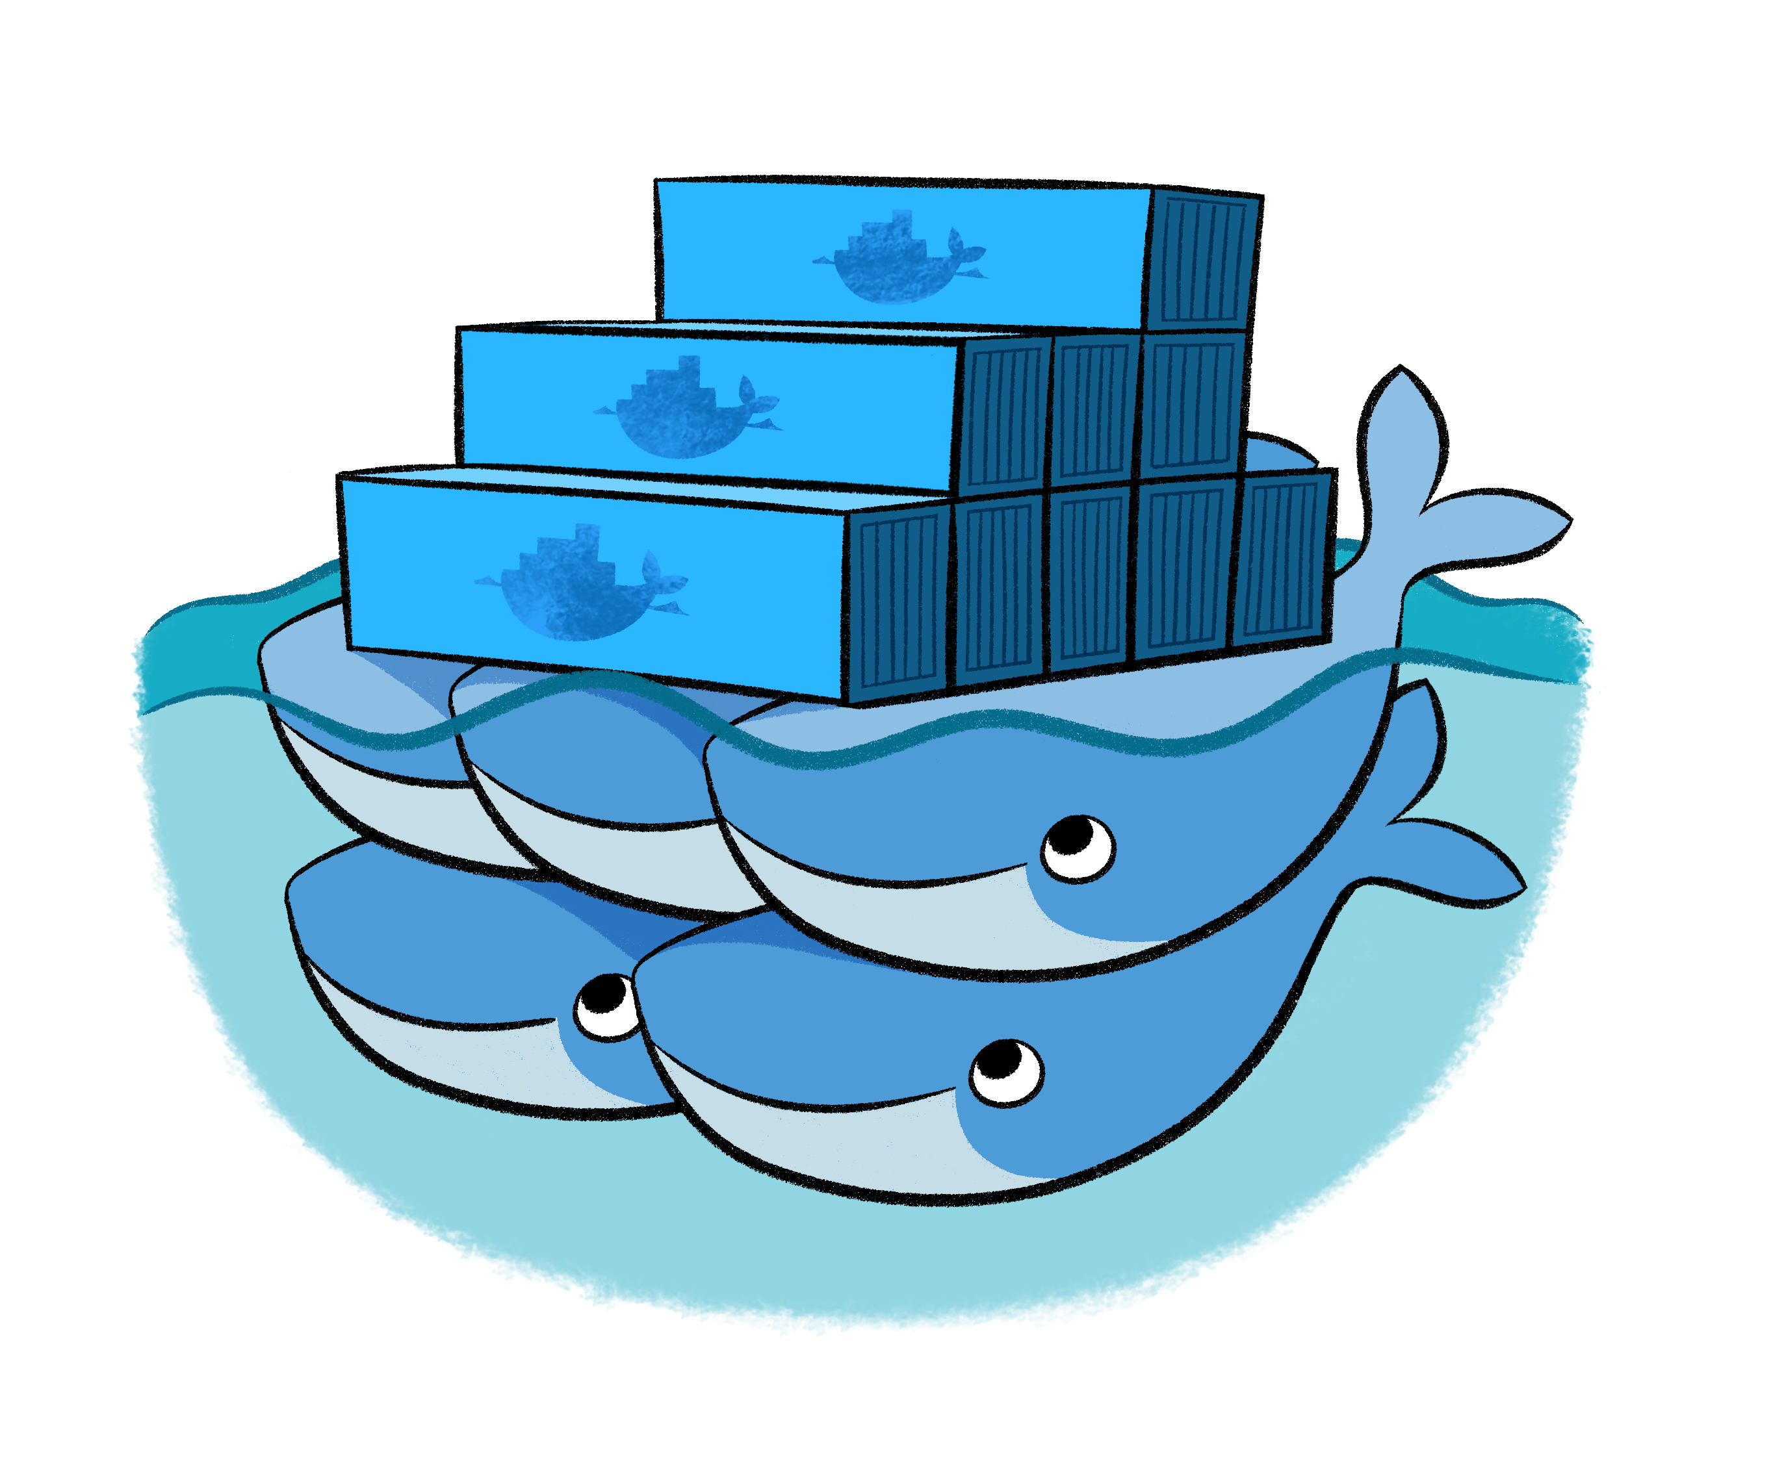
Docker swarm

Slide 3
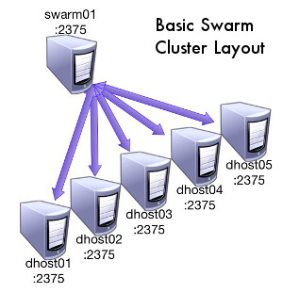
Docker swarm
http://technolo-g.com/intro-to-docker-swarm-pt1-overview/

Slide 4
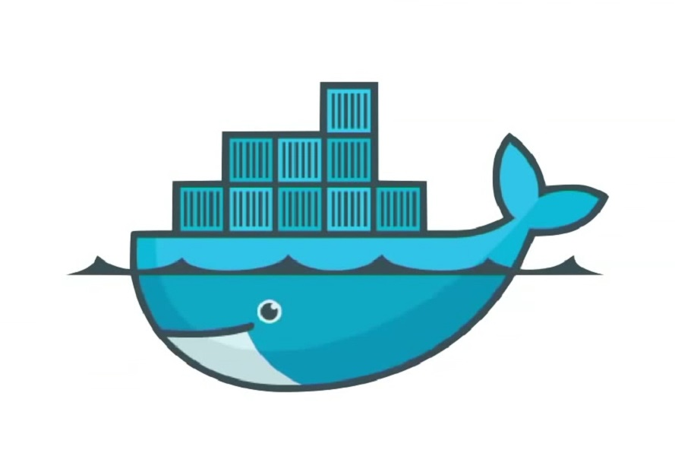
Swarm Architecture
Swarm
manager
Docker Hub
Swarm
node
Swarm
node
Swarm
node
Swarm
node
Swarm
node
Swarm
node

Slide 5
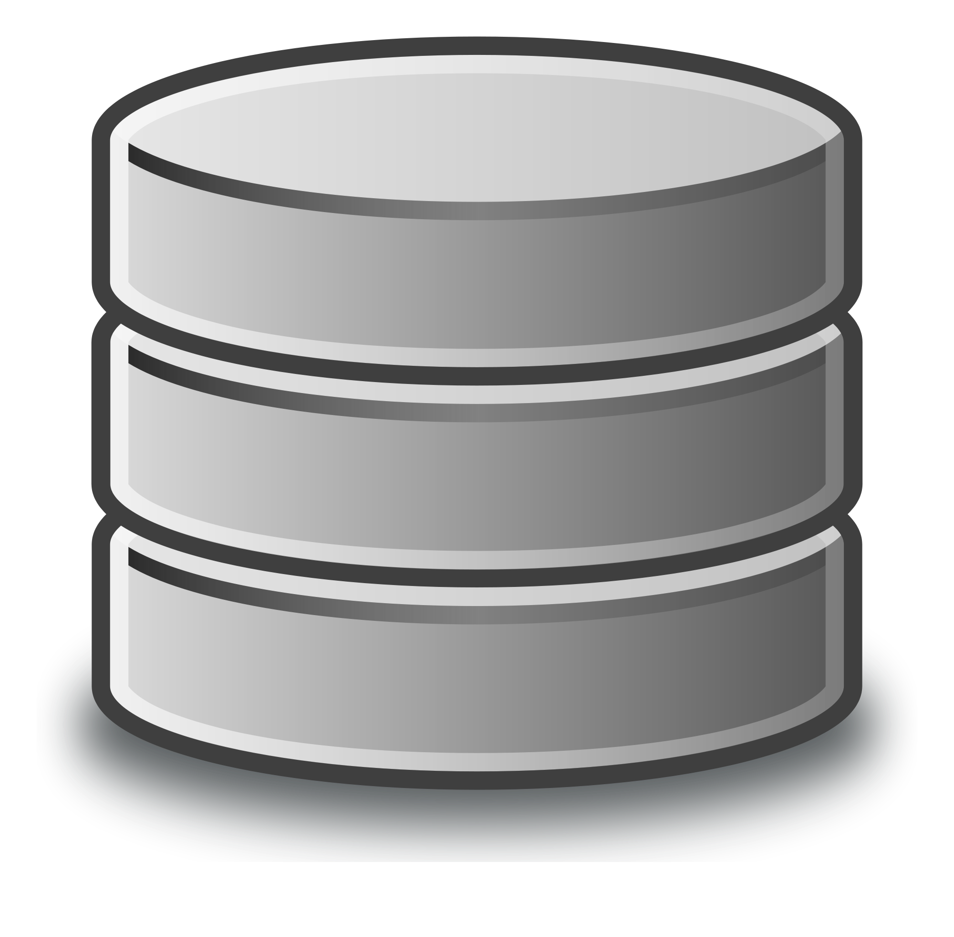
Swarm Architecture
Swarm
manager
Docker Hub
Swarm
node
Swarm
node
Swarm
node
Swarm
node
Swarm
node
Swarm
node
Shared disk

Slide 6
Ready for fun?..
Access your VM

Slide 7


192.168.1.93
86.50.170.102
From: 192.168.1.95 -118
To: 192.168.1.118
[your-username@your-machine]$ ssh -i docker-tutorial.pem cloud-user@86.50.170.102
[cloud-user@galaxy ~]$ ssh -i docker-tutorial.pem 192.168.1.

Slide 8
goto Docker tutorial…

Slide 9
Backup slides

Slide 10
Building a Docker Image
Interactive building
Building from a Docker File
Base Image (Disk)
Base Image (Disk)
Run
Load
Run the
Installation
procedure
Container (Memory)
Dockerfile
Installation
script
Commit
Build
New Image (Disk)
New Image (Disk)

Slide 11
Interactive building Example: curl & vim
$ docker run -t -i ubuntu:14.04
root@2a896c8cdd83:/# apt-get update-y
root@2a896c8cdd83:/# apt-get install -y curl
root@2a896c8cdd83:/# apt-get install -y vim
root@2a896c8cdd83:/# exit
$ docker commit 2a896c8cdd83 youruser/curlvim:1.0
$ docker run youruser/curlvim:1.0 curl --version
curl 7.35.0 (x86_64-pc-linux-gnu) libcurl/7.35.0 OpenSSL/1.0.1f zlib/1.2.8 libidn/1.28 librtmp/2.3
Protocols: dict file ftp ftps gopher http https imap imaps ……..
$ docker login
$ docker push youruser/curlvim:1.0
Hands-on

Slide 12
Interactive building Example: Bowtie2
$ docker run -t -i ubuntu:14.04
root@2a896c8cdd83:/# apt-get update -qq --fix-missing
root@2a896c8cdd83:/# apt-get install -qq -y wget unzip
root@2a896c8cdd83:/# wget -q -O bowtie2.zip http://sourceforge.net/projects/bowtie-bio/files/bowtie2/2.2.4/bowtie2-2.2.4-linux-x86_64.zip/download
root@2a896c8cdd83:/# unzip bowtie2.zip -d /opt/
root@2a896c8cdd83:/# ln -s /opt/bowtie2-2.2.4/bowtie2 /usr/bin/bowtie2
root@2a896c8cdd83:/# rm bowtie2.zip
root@2a896c8cdd83:/# exit
$ docker commit 2a896c8cdd83 youruser/bowtie2
$ docker run youruser/bowtie2 bowtie2 --version
/bowtie2/bowtie2-align version 2.1.0
64-bit
Built on do-dmxp-mac.win.ad.jhu.edu
Tue Feb 26 13:34:02 EST 2013
……..
Hands-on
$ docker login
$ docker push youruser/bowtie2

Slide 13
Building a Docker Image from a Dockerfile
<source-directory>
Dockerfile
files
.dockerignore
$docker build -t <image-name> <source-directory>

Slide 14
Dockerfile Example: curl & vim
FROM ubuntu:14.04
MAINTAINER your name <your email>
RUN apt-get update -y
RUN apt-get install curl -y
RUN apt-get install vim -y

Slide 15
Dockerfile Example: curl & vim
FROM ubuntu:14.04
MAINTAINER your name <your email>
RUN apt-get update -y
RUN apt-get install curl -y && apt-get install vim -y

Slide 16
Dockerfile Example: Bowtie2
FROM ubuntu:14.04
RUN apt-get update -qq --fix-missing; \
apt-get install -qq -y wget unzip;
RUN wget -q -O bowtie2.zip http://sourceforge.net/projects/bowtie-bio/files/bowtie2/2.2.4/bowtie2-2.2.4-linux-x86_64.zip/download; \
unzip bowtie2.zip -d /opt/; \
ln -s /opt/bowtie2-2.2.4/ /opt/bowtie2; \
rm bowtie2.zip
ENV PATH $PATH:/opt/bowtie2

Slide 17
Inspect containers
$ docker ps # shows running containers.
$ docker inspect # info on a container (incl. IP address).
$ docker logs # gets logs from container.
$ docker events # gets events from container.
$ docker port # shows public facing port of container.
$ docker top # shows running processes in container.
$ docker diff # shows changed files in container's FS.
$ docker stats # shows metrics, memory, cpu, filsystem
http://www.jayway.com/2015/03/21/a-not-very-short-introduction-to-docker/

Slide 18
Containers
# Run a container interactively
$ docker run -it --rm ubuntu
# Run a container in the background
$ docker run -d hadoop
# Publish container port 80 on a random port on the Host
$ docker run -p 80 nginx
# Publish container port 80 on port 8080 on the Host
$ docker run -p 8080:80 nginx
http://www.jayway.com/2015/03/21/a-not-very-short-introduction-to-docker/
Notes:
--interactive (-i) – send stdin to the process.
-tty (-t) – tell the process that a terminal is present. This affects how the process outputs data and how it treats signals such as (Ctrl-C).
--rm – remove the container on exit.
ubuntu – use the ubuntu:latest image.
--detached (-d) – Run in detached mode, you can attach again with docker attach

Slide 19
Containers
# Publish container port 80 on port 8080 on the localhost interface on the Host
$ docker run -p 127.0.0.1:8080:80 nginx
# Publish all EXPOSEd ports from the container on random ports on the Host
$ docker run -P nginx
http://www.jayway.com/2015/03/21/a-not-very-short-introduction-to-docker/
Notes:
--interactive (-i) – send stdin to the process.
-tty (-t) – tell the process that a terminal is present. This affects how the process outputs data and how it treats signals such as (Ctrl-C).
--rm – remove the container on exit.
ubuntu – use the ubuntu:latest image.
--detached (-d) – Run in detached mode, you can attach again with docker attach

Slide 20
Containers
# Limit the amount of memory
$ docker run -m 256m yourapp
# Limit the number of shares of the CPU this process uses (out of 1024)
$ docker run --cpu-shares 512 mypp
# Change the user for the process to www instead of root (good for security)
$ docker run -u=www nginx
http://www.jayway.com/2015/03/21/a-not-very-short-introduction-to-docker/
Notes:
--interactive (-i) – send stdin to the process.
-tty (-t) – tell the process that a terminal is present. This affects how the process outputs data and how it treats signals such as (Ctrl-C).
--rm – remove the container on exit.
ubuntu – use the ubuntu:latest image.
--detached (-d) – Run in detached mode, you can attach again with docker attach

Slide 21
Volumes
# Start a new nginx container with /var/log as a volume (created)
$ docker run -v /var/log nginx
# Start a new nginx container with /var/log as a volume mapped to /tmp on Host
$ docker run -v /tmp:/var/log nginx
# Start a db container
$ docker run -v /var/lib/postgresql/data --name mydb postgres
# Start a backup container with the volumes taken from the mydb container
$ docker run --volumes-from mydb backup
http://www.jayway.com/2015/03/21/a-not-very-short-introduction-to-docker/
Notes:
--interactive (-i) – send stdin to the process.
-tty (-t) – tell the process that a terminal is present. This affects how the process outputs data and how it treats signals such as (Ctrl-C).
--rm – remove the container on exit.
ubuntu – use the ubuntu:latest image.
--detached (-d) – Run in detached mode, you can attach again with docker attach

Slide 22
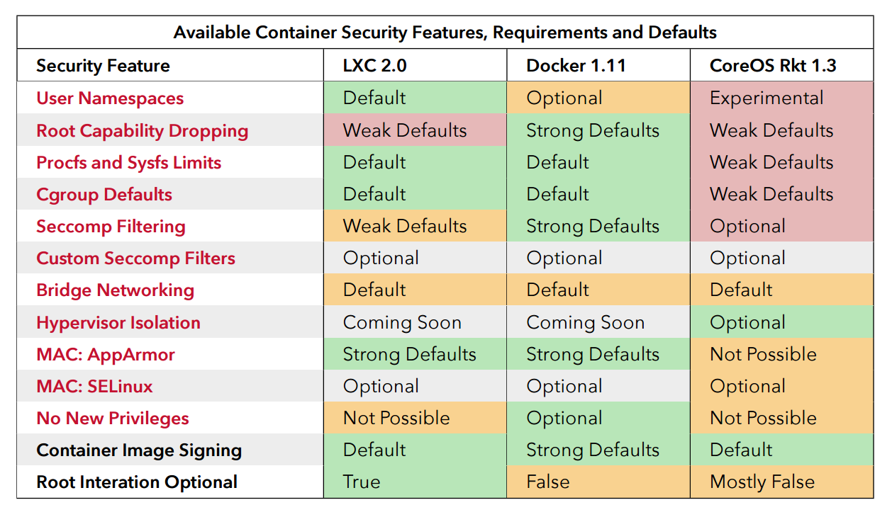
Security
source: “Understanding and Hardening Linux Containers”, page 96

Slide 23
Docker Run Platforms
Various Linux distributions (Ubuntu, Fedora, RHEL, Centos, openSUSE, ...)
Cloud (Amazon EC2, Google Compute Engine, Rackspace)
Windows, OSX: Docker Toolbox

Slide 24
Docker Ecosystem
Docker Engine or “Docker” creates and runs Docker containers. Install Docker on Ubuntu, Mac OS X, or Windows.
Docker Hub Public registry service for managing images.
Docker Registry provides open source Docker image distribution.
Docker Swarm used to host clustering and container scheduling.

Slide 25
Docker Ecosystem
Kitematic is the desktop GUI for Docker.
Docker UI is a web responsive GUI to administrate Docker
Docker Trusted Registry (DTR) supplies a private dedicated image registry.
Docker Machine automates container provisioning on your network or in the cloud. Install machine on Windows, Mac OS X, or Linux.
Docker Compose defines multi-container applications. You can install Docker Compose on Ubuntu, Mac OS X, and other systems.

Slide 26
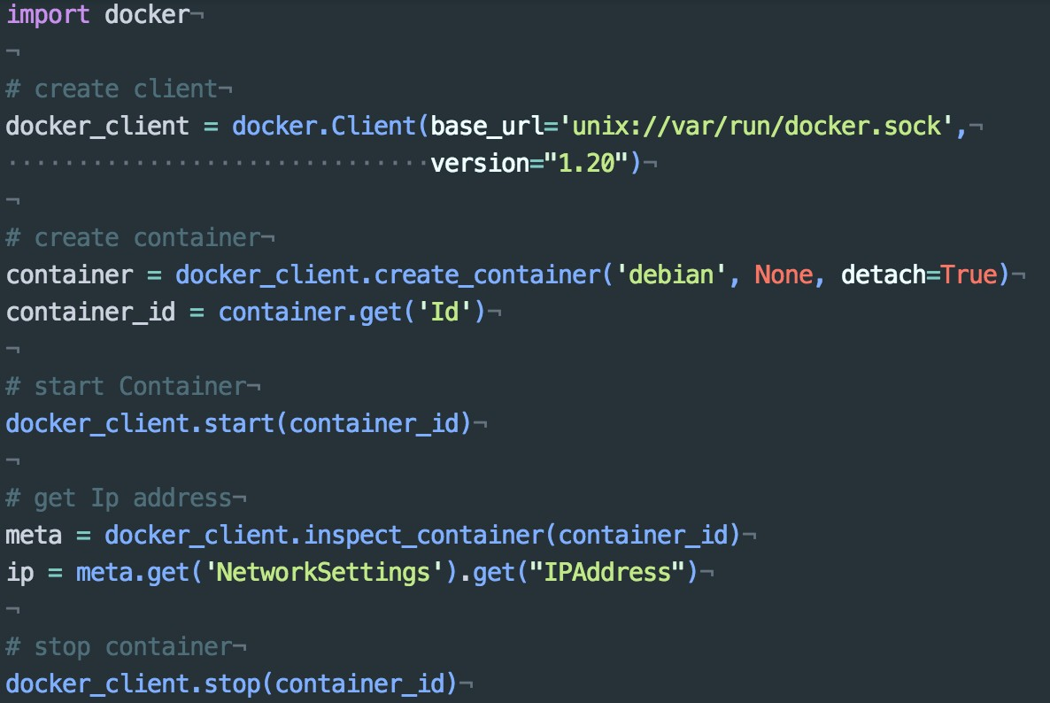
Docker APIs - Python

Slide 27


