Slide 1
Workflow Management on Slurm
Abdulrahman Azab
March 2022
NORBIS

Slide 2
Kiss!
Keep It Simple Stupid!

Slide 3
What is a Workflow?
A series of activities that are necessary to complete a task.

Slide 4
What is a Workflow?
B
outB.txt
A
D
input.txt
outA.txt
output.txt
outC.txt
C

Slide 5
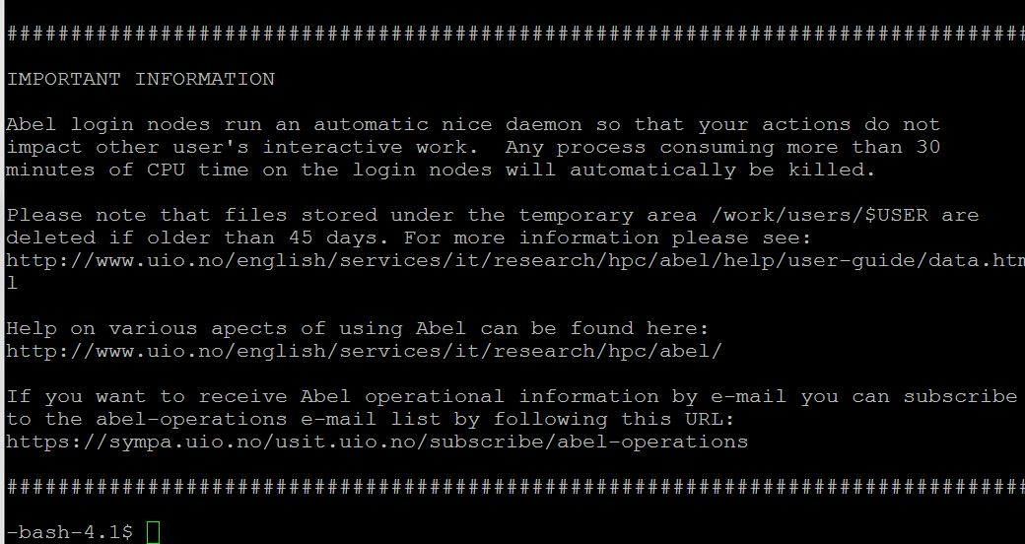
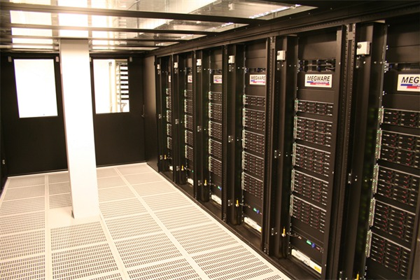
Workflow Control
Login Node (abel.uio.no)
Controller
B
outB.txt
Abel
input.txt
A
outA.txt
D
outD.txt
outC.txt
C

Slide 6
Workflow Control
Login Node (abel.uio.no)
Controller
B
outB.txt
Abel
input.txt
A
outA.txt
D
outD.txt
outC.txt
C

Slide 7
SDAG: Direct Acyclic Graph Workflow Submitter for SLURM

Slide 8
Direct Acyclic Graph (DAG)
Directed graph with no directed cycles.
Formed by a collection of vertices and directed edges.
there is no way to start at some vertex and follow a sequence of edges that eventually loops back to the same vertex.
No Loops

Slide 9
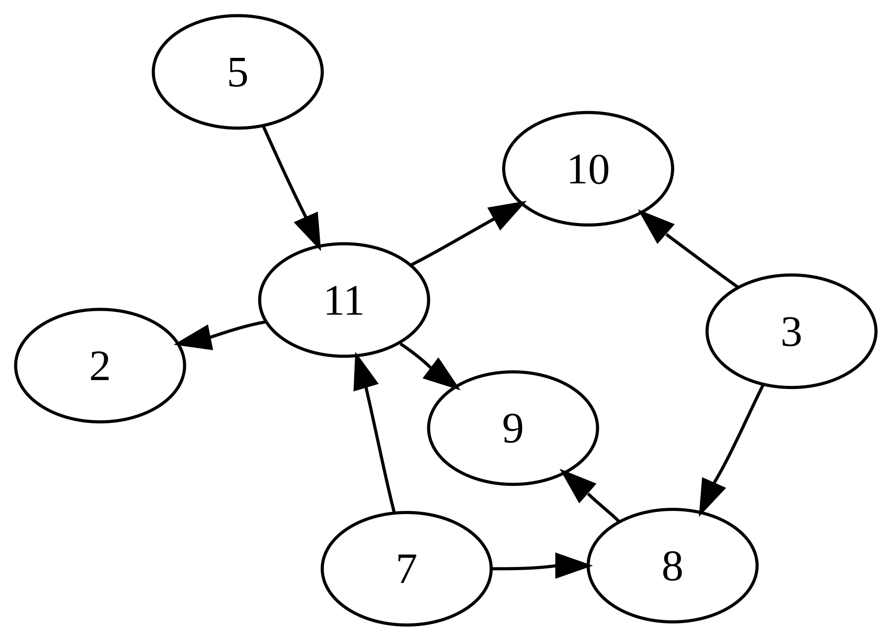
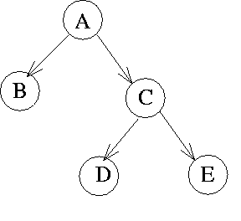
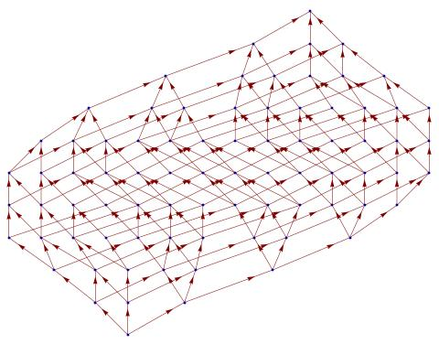
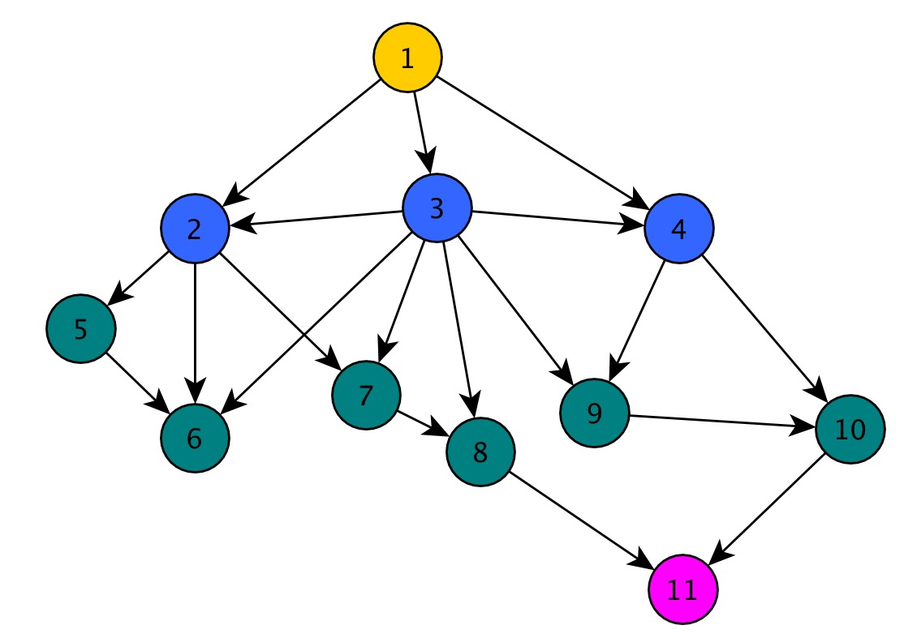
Direct Acyclic Graph (DAG)

Slide 10
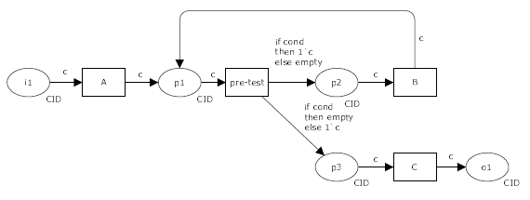
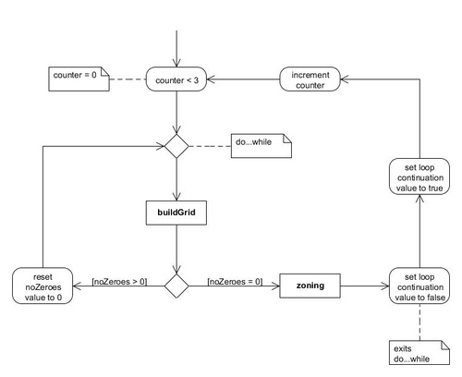
Non-Direct Acyclic Graph (DAG)

Slide 11
SDAG Example
JOB A jobA.sbatch
JOB B jobB.sbatch
JOB C jobC.sbatch
PARENT A CHILD B
PARENT B CHILD C
A
B
C

Slide 12
SDAG Example
B
JOB A jobA.sbatch
JOB B jobB.sbatch
JOB C jobC.sbatch
JOB D jobD.sbatch
PARENT A CHILD B C
PARENT B C CHILD D
A
D
C

Slide 13
SDAG hands-on
On GitHub: https://github.com/abdulrahmanazab/sdag

Slide 14
SDAG hands-on
Login
$git clone https://github.com/abdulrahmanazab/sdag
$cd sdag/example1
$vim i1
I want to go home :(
$vim i2
I REALLY want to go home :’(

Slide 15
SDAG hands-on
python test.py i1,i2,… output 30 j-XX
Interpreter
code
Input files
output file
Run-time
Job name
$python test.py i1,i2 out 5 gift
$cat out

Slide 16
SDAG hands-on
$projects
$vim jobA.sbatch
#SBATCH --account=<your-project-name>
The same with jobB.sbatch, jobC.sbatch, and jobD.sbatch
B
A
D
C

Slide 17
SDAG hands-on
$sbatch jobA.sbatch
$squeue -u <your-username>
$ module load Python/2.7.15-GCCcore-8.2.0
$ cd sdag/example1
$ python ../sdag.py example1.sdag
$squeue -u <your-username>

Slide 18


