Slide 1
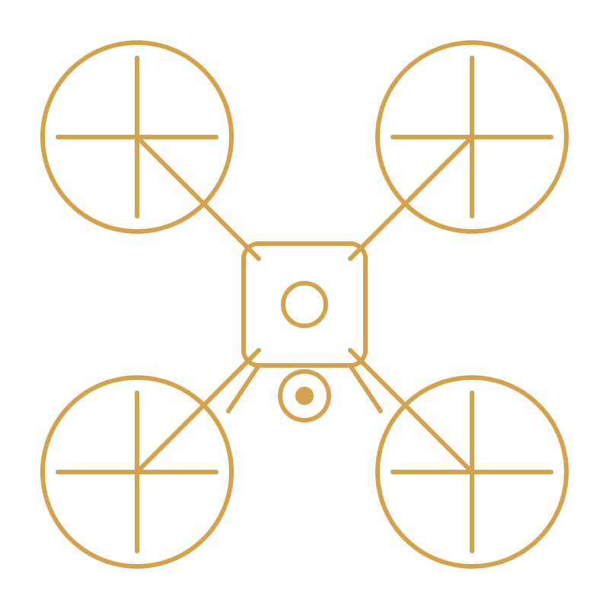
EQAAB · MISSION CONTROL
CALLSIGN EQB-01
PROJECT ID 503593
2025 / 2026
◇ CAPSTONE II · TAIF UNIVERSITY · 2026 ◇
EQAAB
عقاب
Intelligent Autonomous Aerial Surveillance System
ENGINEERING TEAM
FACULTY SUPERVISOR
Abdulrahman Al-otaibi · Turki Al-otaibi Saeed Al-harthi · Rayan Al-ghamdi Hossain Al-hubailee · Mohammed Al-sharif Omar Al-anzi
Dr. Ahmed bin Mahfoudh College of Computers & IT Taif University, KSA
LAT 21.4373°N
LON 40.5127°E
ALT 1879M
EQAAB / CAPSTONE II / 2026 — V1.0

Slide 2
EQAAB · AGENDA
SECTION 02 / 24
OPS BRIEFING
02
BRIEFING OUTLINE
Agenda / 24 segments
A complete walkthrough of design, build, test, and field validation of the Eqaab platform.
DURATION
~45 MIN
01 Title & Team
09 Hardware Stack
17 Results & Performance
02 Agenda
10 ROS 2 Software Stack
18 Live Demo
03 Project Recap
11 AI Detection Pipeline
19 Cost Analysis
04 Problem Statement
12 IFF System
20 Objectives vs Achieved
05 Literature & Gap
13 Backend & Comms
21 Challenges & Solutions
06 Objectives & KPIs
14 GCS Dashboard
22 Future Work
07 Real-World Use Cases
15 Training & Dataset
23 Conclusion
08 System Architecture
16 Testing Methodology
24 Q & A
FRAME 02
SECTION_INDEX
EQAAB · BRIEFING

Slide 3
EQAAB · RECAP
SECTION 03 / 24
03
WHERE WE LEFT OFF → WHERE WE ARE
Project Recap
Capstone I delivered a simulated prototype. Capstone II delivers a deployed, real-hardware system flying real missions.
PHASE SHIFT
SIM → FIELD
◇ CAPSTONE I · 2024 / 2025
● CAPSTONE II · 2025 / 2026
Concept & Simulation
Built. Trained. Flying.
◐
Gazebo simulation
●
Real assembled drone
Virtual drone, autonomous waypoint flight in SITL
Carbon-fiber airframe, Pixhawk + RPi5 + Pi Cam
◐
Basic YOLO prototype
●
Full ROS 2 software stack
Off-the-shelf detection on recorded footage
Mission FSM, detection, IFF, alert publisher
◐
System design on paper
●
Trained YOLOv8 model
Block diagrams, sensor selection, requirements
Custom dataset, 94.3% mAP@50, 8.3 FPS edge
◐
No physical hardware
●
Deployed cloud backend
No flight, no live communication, no real model
FastAPI + PostgreSQL + WSS over 4G LTE
●
Live GCS dashboard
React + Leaflet, real-time alerts & commands
PHASE TRANSITION
EQAAB · RECAP

Slide 4
EQAAB · THREAT MODEL
SECTION 04 / 24
04
WHY THIS MATTERS
The Problem
Today's wide-area surveillance is built on fixed sensors and tired human operators — both fail exactly when threats become unconventional.
FAILURE MODES
4 IDENTIFIED
01
02
Fixed-camera blind spots
Operator fatigue
Static CCTV cannot cover wide, irregular terrain — borders, holy-site perimeters, remote infrastructure. Every fixed installation creates predictable, exploitable gaps in coverage.
Human watch-standers monitoring dozens of feeds miss critical events as attention degrades over hours. Vigilance decrements are well-documented and unavoidable.
03
04
Radar can't see small UAVs
Piloted UAVs replicate the fatigue problem
Traditional radar is tuned for large aircraft. Small, low-altitude drones present a radar cross-section close to noise — they pass under conventional air defense entirely undetected.
Existing deployed UAV solutions require dedicated human pilots per airframe — recreating the same fatigue and scaling bottleneck the system was meant to eliminate.
THREAT VECTORS · 4
EQAAB · PROBLEM

Slide 5
EQAAB · LITERATURE
SECTION 05 / 24
05
PRIOR ART & RESEARCH GAP
Literature Review
Each related work covers a slice. None integrate detection, autonomy, GPS-tagged alerts, IFF, and a live operator interface into one cohesive system.
STUDIES REVIEWED
5 + 1
REFERENCE
VEHICLES
HUMANS
DRONES
AUTONOMOUS
GPS
GCS UI
IFF
Yun et al. — Multi-UAV RL
—
—
—
✓
✓
—
—
Guettala et al. — Thermal human detection
—
✓
—
—
—
—
—
Yasmine et al. — Anti-drone YOLOv7
—
—
✓
—
—
—
—
Aydin & Singha — Drone detection YOLOv5
—
—
✓
—
—
—
—
Ghazlane et al. — YOLOv7 + DeepSort
✓
✓
—
—
—
—
—
EQAAB (this work)
✓
✓
✓
✓
✓
✓
✓
Research gap: no published work delivers an end-to-end autonomous surveillance UAV with multi-class onboard detection, IFF classification, and an operator-facing GCS — all on commodity hardware.
GAP IDENTIFIED
EQAAB · LITERATURE

Slide 6
EQAAB · OBJECTIVES
SECTION 06 / 24
06
WHAT SUCCESS LOOKS LIKE
Objectives & KPIs
Five measurable goals, each tied to a verifiable performance indicator and an evidence source.
KPIS
5 / 5
01
Autonomous mission execution
A complete flight loop — takeoff, waypoint traversal, observation, and return-to-home — executed end-to-end with zero operator input.
FSM · WAYPOINTS · RTH
02
Onboard real-time detection
Sustained inference at ≥ 5 FPS on the edge device with no cloud round-trip. Detection latency must stay bounded even under thermal load over a full mission.
RPI5 · YOLOV8N
03
IFF classification
Every drone-class detection routed through a deterministic Friendly-vs-Unknown decision with fail-safe defaults toward UNKNOWN on any uncertainty.
REGISTRY LOOKUP
04
GPS-tagged alerts over 4G LTE
Detection → alert → GCS render in under 3 seconds , end-to-end, including network hops. Payload is structured JSON over WSS — no video streaming.
WSS · JSON · TLS
05
Live GCS dashboard
A single operator pane with live map, telemetry, alert feed, and commands — updating in real time as the drone flies and detects.
REACT · LEAFLET
KPI MATRIX
EQAAB · OBJECTIVES

Slide 7

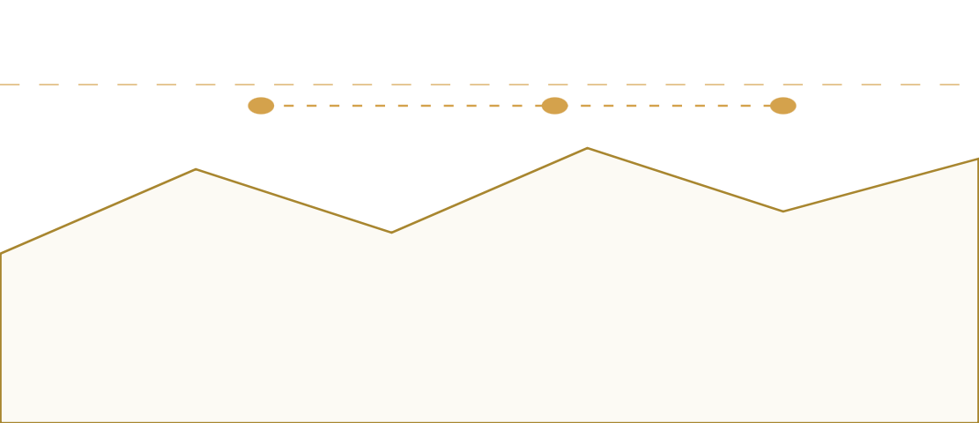
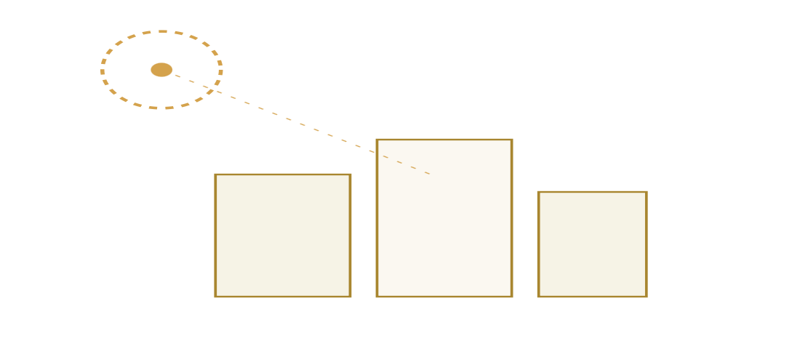
EQAAB · DEPLOYMENT
SECTION 07 / 24
07
WHERE EQAAB EARNS ITS KEEP
Real-World Use Cases
Three deployment scenarios that drove the requirements — and that the platform is built to serve from day one.
MISSION TYPES
3 PRIMARY
Scenario 01
Scenario 02
Scenario 03
Hajj Season Security
Border Surveillance
Critical Infrastructure
Aerial overwatch of dense pilgrim crowds and unauthorized drone activity around Makkah and the holy sites — coverage no fixed sensor array can match.
Wide-area perimeter patrol across remote terrain where fixed cameras and radar coverage are economically and operationally infeasible.
Persistent surveillance over power plants, airports, refineries, and restricted facilities — including detection of small unauthorized UAVs entering protected airspace.
OPS THEATERS
EQAAB · USE CASES

Slide 8
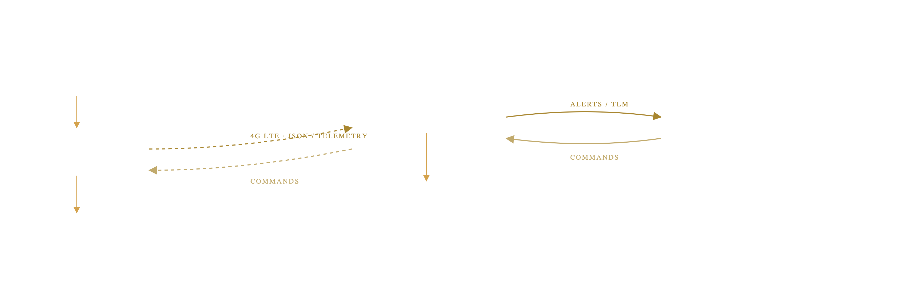
EQAAB · ARCHITECTURE
SECTION 08 / 24
08
END-TO-END SIGNAL FLOW
System Architecture
Three tiers — drone edge, cloud backend, operator interface — connected over 4G LTE with structured JSON only.
TIERS
3 LAYERS
DRONE EDGE · ONBOARD
CLOUD BACKEND · REGIONAL
GCS · OPERATOR
SENSOR
Pi Camera 12MP
CSI · 1920×1080 @ 30fps
RELAY
INTERFACE
FastAPI
React Dashboard
COMPUTE
WSS endpoint · auth · broadcast
Leaflet map · alert feed · telemetry
Raspberry Pi 5
ARM A76 · 8GB · ROS 2
PERSISTENCE
OPERATOR
PostgreSQL
Command Panel
FLIGHT CTRL
Alert history · telemetry log
RTH · Takeoff · Land · Waypoints
Pixhawk · PX4
MAVROS bridge · GPS · IMU
DATA POLICY
Only structured JSON alerts and telemetry cross the LTE link — no video streaming. Bandwidth requirement drops by approximately 95%.
SIGNAL FLOW · 3-TIER
EQAAB · ARCHITECTURE

Slide 9
EQAAB · AIRFRAME
SECTION 09 / 24
09
BILL OF MATERIALS & FLIGHT ENVELOPE
Hardware Stack
Off-the-shelf components, integrated and tuned. Production-grade behaviour from commodity hardware.
COMPONENTS
8 SUBSYSTEMS
A · BILL OF MATERIALS
Frame
Carbon-fiber quadcopter · 450mm wheelbase
Flight Controller
Pixhawk · PX4 firmware · 32-bit ARM
Companion Computer
Raspberry Pi 5 · Quad-core A76 · 8GB RAM
Camera
Pi Camera Module · 12MP CSI
GPS
u-blox M8N · ±2m accuracy
Comms
4G LTE USB dongle · global reach
📷
Battery
LiPo 4S 5000mAh
RC Backup
2.4GHz receiver · manual override
PHOTO PLACEHOLDER
Insert hero photograph of the fully assembled Eqaab drone — propellers, gimbal, antenna mast visible.
B · FLIGHT SPECIFICATIONS
ALTITUDE
FLIGHT TIME
RANGE
GEOFENCE
FAILSAFE
~50 m
15–20 min
∞ 4G
Polygon
RTH @ 30%
WEIGHT 1.8KG
THRUST/W 2.4
REF · EQB-HW-01
EQAAB · HARDWARE

Slide 10
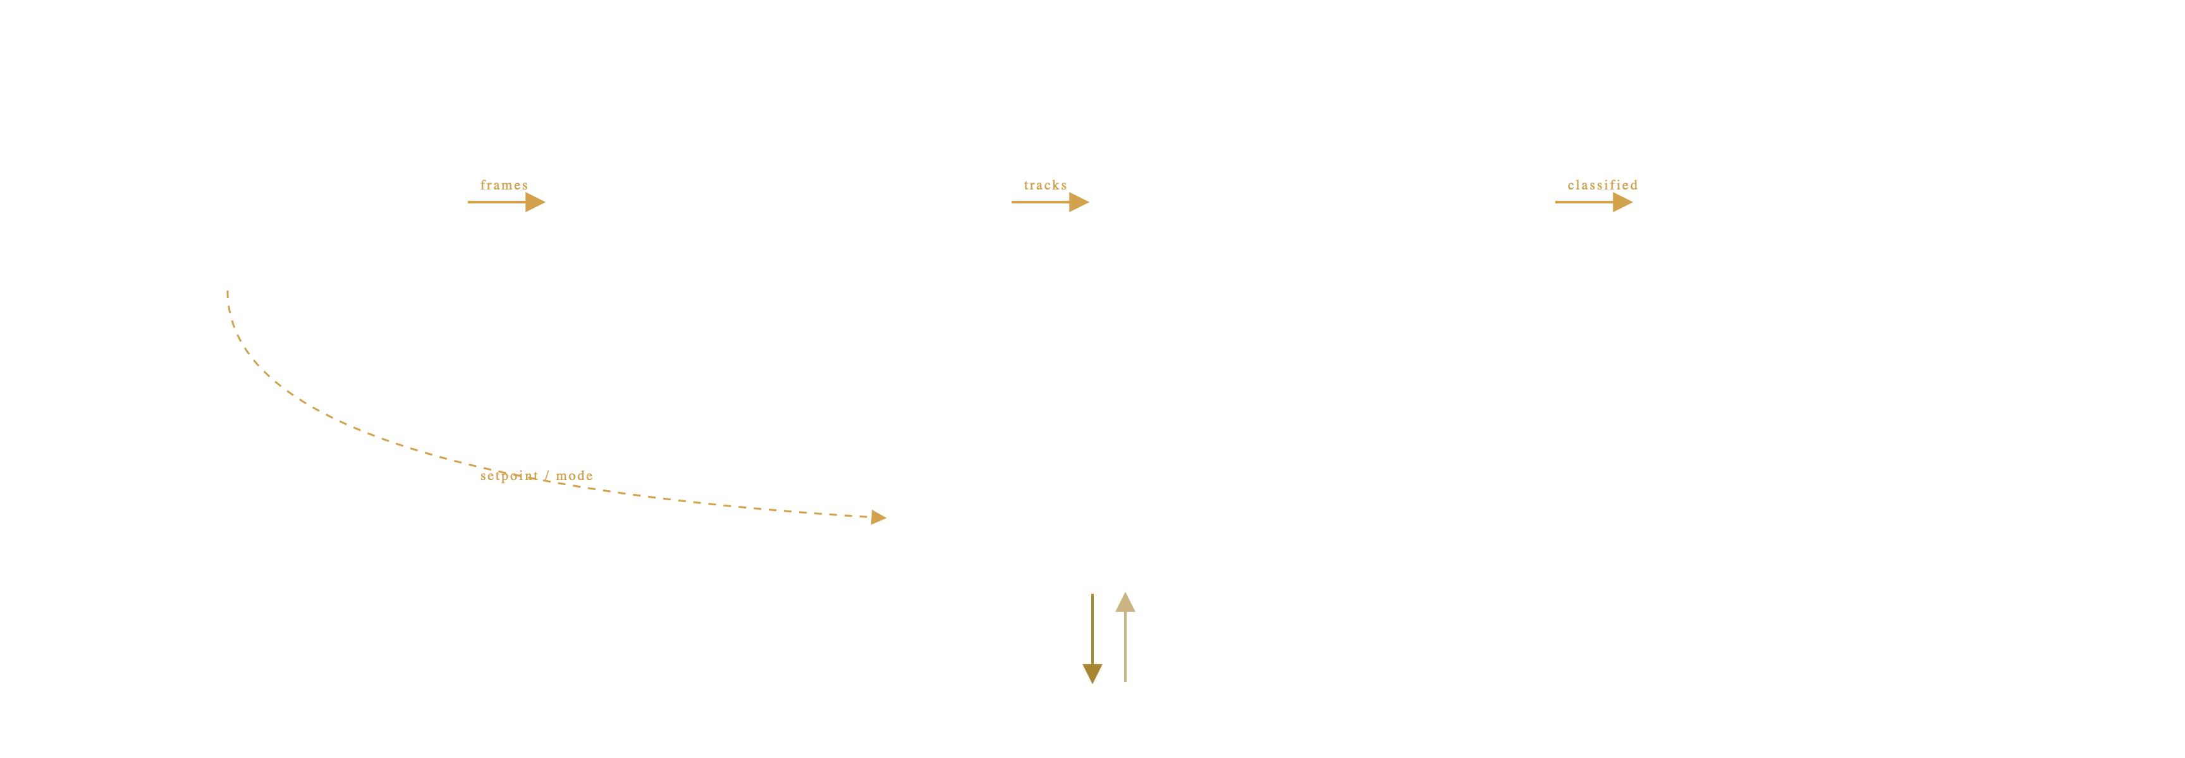
EQAAB · ROS 2 STACK
SECTION 10 / 24
10
SOFTWARE ARCHITECTURE · ONBOARD
ROS 2 Node Graph
Four cooperating nodes orchestrate mission, perception, identification, and uplink.
NODES
4 + MAVROS
01 · CONTROL
02 · PERCEPTION
03 · IDENTIFICATION
04 · UPLINK
mission_manager
detection_node
iff_node
alert_publisher
FSM · waypoints · commands
YOLOv8 · OpenCV · DeepSORT
Registry lookup · classification
WebSocket · telemetry · JSON
/mission/state · /cmd
/detections
/iff/classified
→ wss://eqaab.cloud
MAVROS BRIDGE
MAVLink ↔ ROS 2
Pose · GPS · battery · commands
/mavros/...
FLIGHT HARDWARE
Pixhawk · PX4
ROS 2 HUMBLE
DDS · CYCLONE
EQAAB · SOFTWARE

Slide 11


EQAAB · PERCEPTION
SECTION 11 / 24
11
FROM PIXELS TO GPS-TAGGED ALERTS
AI Detection Pipeline
A dual-model perception stack with tracking, GPS fusion, and identity classification — all on the edge device.
MODELS
2 · PARALLEL
MODEL A
FRIENDLY
YOLOv8n.pt
Discard
COCO · Person · Car
no alert raised
INPUT
FUSE
TRACK
GEO-REF
Camera Frame
Merge + Filter
DeepSORT
GPS Fusion
1920×1080 · 30fps
conf ≥ 0.45
Track ID · Kalman
pixel → lat / lon
UNKNOWN
MODEL B
Alert ↑
best.pt
GPS-tagged · uplinked
Custom · Drone
DESIGN NOTE
Dual-model architecture adopted to prevent catastrophic forgetting — single-model fine-tuning caused measurable degradation of COCO classes during early experiments.
EDGE INFER · 8.3 FPS
EQAAB · PERCEPTION

Slide 12
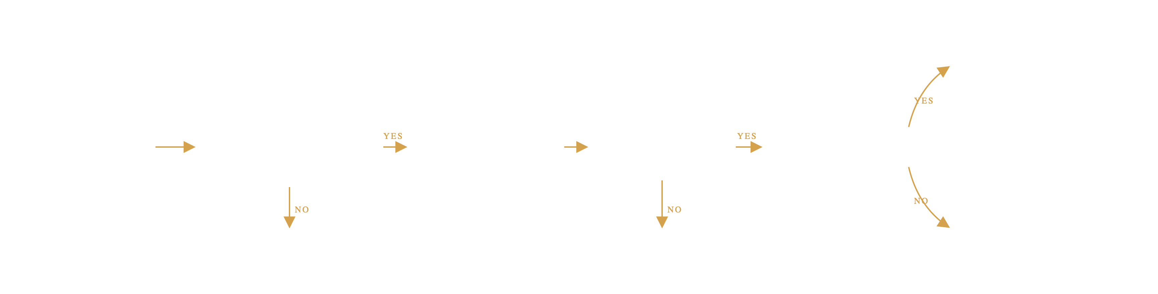
EQAAB · IFF LOGIC
SECTION 12 / 24
12
IDENTIFICATION FRIEND OR FOE
IFF Decision Logic
A deterministic, fail-safe decision tree. Persons and cars never authenticate. Drones do — or get flagged.
FAIL-SAFE
→ UNKNOWN
REGISTRY HIT
→ FRIENDLY
discard · no alert
Detected target
Is it a drone?
DRONE DETECTED
Signal received?
Registry match?
CLASS CHECK
Query identifier
PERSON · CAR
NO SIGNAL
NO MATCH
→ UNKNOWN
→ UNKNOWN
→ UNKNOWN
never authenticates
comms timeout
unrecognized ID
FAIL-SAFE
Every failure path — class mismatch, missing signal, registry miss — defaults to UNKNOWN. The system raises false alerts rather than miss a threat.
DETERMINISTIC LOGIC
EQAAB · IFF

Slide 13


EQAAB · COMMS LAYER
SECTION 13 / 24
13
CLOUD RELAY & PERSISTENCE
Backend & Communication
A thin, opinionated cloud tier — relay, persist, broadcast. Nothing more.
PROTOCOL
WSS · TLS
ARCHITECTURE
MESSAGE · TELEMETRY
Alert Publisher
4G · WSS · TLS
FastAPI relay
PostgreSQL persist
{
"type": "telemetry" ,
"drone_id": "EQB-01" ,
"ts": 1717938472 ,
"lat": 21.4373 ,
"lon": 40.5127 ,
"alt": 47.2 ,
"battery": 68 ,
"mode": "AUTO" }
GCS clients broadcast
95%
BANDWIDTH SAVED
Structured JSON only — no video streaming over LTE. Cuts uplink requirement to a fraction of comparable telepresence systems.
MESSAGE · ALERT
{
"type": "alert" ,
"class": "drone" ,
"iff": "UNKNOWN" ,
"lat": 21.4391 ,
"lon": 40.5103 ,
"conf": 0.87 ,
"track_id": 42 }
WSS · TLS 1.3
JSON ONLY
EQAAB · COMMS

Slide 14
EQAAB · GROUND STATION
SECTION 14 / 24
14
THE OPERATOR'S WINDOW
GCS Dashboard
One pane of glass — map, alerts, telemetry, commands. Built with React + Leaflet.
LATENCY
~1.4S E2E
01
Live Leaflet map
Drone position, heading, and flight path rendered in real time over satellite tiles.
02
Alert feed
Streaming list of GPS-tagged detections with class, IFF state, and confidence.
📷
03
Telemetry bar
Battery · altitude · speed · flight mode at a glance.
GCS DASHBOARD SCREENSHOT
Insert real GCS dashboard screenshot — should show the Leaflet map with the active drone marker and flight path, the real-time alert feed, and the telemetry bar with battery / altitude / speed / mode.
04
Command panel
RTH · Takeoff · Land · Waypoint upload from the operator's seat.
REF · EQB-GCS-01
REACT · LEAFLET · WSS
EQAAB · GCS

Slide 15
EQAAB · MODEL TRAINING
SECTION 15 / 24
15
FROM DATASET TO DEPLOYED WEIGHTS
Training & Dataset
Reproducible pipeline — open dataset, public framework, single GPU. Result is the best.pt shipped to the drone.
FINAL MAP@50
94.3%
A · DATASET
B · TRAINING
Composition
Configuration
Source
Roboflow
Platform
Kaggle T4 GPU
📷
Total images
~5,500
Framework
Ultralytics YOLOv8
Classes
3 (drone · person · car)
Base model
yolov8n.pt
TRAINING CURVES
Split
80 / 10 / 10
Epochs
100
Insert results.png from Ultralytics — loss curves and mAP over 100 epochs.
Augmentation
flip · brightness · mosaic · crop
Batch
16
Optimizer
AdamW
REF · EQB-TR-01
YOLOV8N · ADAMW
EQAAB · TRAINING

Slide 16
EQAAB · VERIFICATION
SECTION 16 / 24
16
HOW WE PROVED IT WORKS
Testing Methodology
Four stages — from individual ROS nodes up to live field flights — each with its own tooling and pass criteria.
STAGES
4 LEVELS
STAGE
WHAT WAS TESTED
METHOD
TOOL
UNIT
Individual ROS 2 nodes
Isolated node testing
ros2 launch · pytest
INTEGRATION
Full pipeline data flow
End-to-end message tracing
rqt_graph · terminal logs
SIMULATION
Autonomous mission FSM
Virtual flight
Gazebo · ArduPilot SITL
FIELD
Detection accuracy
Real flights · live targets
Physical drone + GCS
▢
⇆
◉
✈
Unit
Integration
Simulation
Field
Each ROS node validated in isolation against mocked inputs.
Topic graph traced from camera frame to alert publish.
FSM executed virtual missions in Gazebo before real flight.
Eqaab flown against drone, vehicle, and human targets.
V&V · 4 STAGES
EQAAB · TESTING

Slide 17
EQAAB · METRICS
SECTION 17 / 24
17
WHAT THE PLATFORM ACTUALLY DELIVERS
Results & Performance
Validated across model accuracy, edge inference, and end-to-end alert latency.
STATUS
ALL TARGETS MET
94.3%
8.3fps
91.7%
~1.4s
MAP @ 0.5
EDGE INFERENCE
PRECISION
ALERT LATENCY
Validation on held-out test split (550 images)
On Raspberry Pi 5 · CPU-only · 640px input
Averaged across 3 classes, conf ≥ 0.45
Detection → GCS render, measured end-to-end
PER-CLASS BREAKDOWN
CLASS
PRECISION
RECALL
F1
MAP@50
Drone
0.923
0.901
0.912
0.947
📷
Person
0.914
0.889
0.901
0.938
DETECTION SAMPLES
Car
0.915
0.908
0.911
0.944
Insert detection example imagery — bounding boxes drawn over real footage of drone, person, and car targets.
Macro avg
0.917
0.899
0.908
0.943
REF · EQB-DET-01
KPI · 5/5 PASSED
EQAAB · RESULTS

Slide 18
EQAAB · LIVE DEMO
SECTION 18 / 24
REC ●
18
THE SYSTEM IN MOTION
Live Demo
Full loop: drone detects target → onboard inference → IFF check → GPS-tagged alert → GCS map updates.
PLAYBACK
~45 SEC
📷
DEMO VIDEO / GIF
Insert the demo recording — should walk through the full chain: drone detecting a target, onboard inference + IFF, GCS receiving the alert, and the map marker updating in real time.
REF · EQB-DEMO-01
A
Detection
B
IFF + alert
C
GCS update
YOLOv8 identifies a drone target in the live camera frame; DeepSORT assigns a track ID.
Identifier query fails → target marked UNKNOWN → JSON alert published over WSS.
Backend relays the alert; React dashboard renders the GPS-tagged marker on the live map.
LIVE RECORDING
EQAAB · DEMO

Slide 19
EQAAB · ECONOMICS
SECTION 19 / 24
19
PRODUCTION-GRADE FOR 1% OF LEGACY COST
Cost Analysis
A complete intelligent surveillance platform — airframe through cloud — for less than a single high-end CCTV install.
TOTAL BUILD
2,690 SAR
EQAAB · THIS WORK
TRADITIONAL SURVEILLANCE
2,690
100,000s
SAR · TOTAL
SAR
Fixed CCTV + tower install
100k+
Carbon-fiber frame & motors
820
Long-range radar
300k+
Pixhawk + PX4 stack
450
Piloted UAV system
500k+
Raspberry Pi 5 (8GB)
380
Operator staffing (annual)
200k+
Pi Camera Module
190
Maintenance & comms
recurring
GPS · 4G dongle · battery
540
RC receiver · misc.
310
~1%
Production-grade intelligent surveillance at roughly 1% of traditional infrastructure cost — without sacrificing autonomy, identification, or operator control.
BOM · TURN-KEY
EQAAB · COST

Slide 20
EQAAB · DELIVERY MATRIX
SECTION 20 / 24
20
WHAT WE PROMISED VS WHAT WE DELIVERED
Objectives vs Achieved
Five for five — every committed KPI met or exceeded, each backed by verifiable evidence.
RESULT
5 / 5 ✓
OBJECTIVE
TARGET
ACHIEVED
EVIDENCE
Autonomous flight
Full mission
✓ Verified
Gazebo + field flights
Real-time detection
≥ 5 FPS
✓ 8.3 FPS
RPi5 benchmark · 640px
IFF classification
Friendly / Unknown
✓ Operational
Registry lookup tested
Alert transmission
< 3s latency
✓ ~1.4s
End-to-end measurement
GCS dashboard
Live map + commands
✓ Deployed
React dashboard live
5
5
2
Detection FPS exceeded target by 66%; alert latency came in at less than half the requirement.
OBJECTIVES SET
OBJECTIVES MET
EXCEEDED TARGET
ALL TARGETS · GREEN
EQAAB · DELIVERY

Slide 21
EQAAB · LESSONS LEARNED
SECTION 21 / 24
21
WHAT BROKE — AND HOW WE FIXED IT
Challenges & Solutions
Three real engineering problems that shaped the final architecture.
PIVOTS
3 MAJOR
01
CHALLENGE
→
SOLUTION
Catastrophic forgetting
Dual-model parallel architecture
Fine-tuning a single YOLOv8 model on the custom drone class measurably degraded its accuracy on the COCO person and car classes — making the model worse at the things it was already good at.
Run the stock yolov8n.pt and the custom best.pt in parallel on every frame, then merge and filter. Each model stays specialised; nothing forgets.
02
CHALLENGE
→
SOLUTION
4G LTE latency for piloting
Fully autonomous FSM
Manual remote piloting over cellular incurs latency too high for safe low-altitude flight — control-loop lag became unacceptable as soon as we left line of sight.
Eliminate the manual control loop entirely. Operator issues high-level commands (RTH, takeoff, waypoints); the FSM executes locally with onboard sensors at deterministic rates.
03
CHALLENGE
→
SOLUTION
CPU-only inference on RPi5
Nano variant + frame-rate cap
No GPU, no NPU. Larger YOLOv8 variants stalled below 3 FPS — well under our 5 FPS KPI — and risked thermal throttling during long missions.
Switched to YOLOv8 nano, capped the inference loop, and kept the input at 640px. Sustained 8.3 FPS with stable thermals and headroom for tracker overhead.
POST-MORTEM · 3 ITEMS
EQAAB · CHALLENGES

Slide 22




EQAAB · ROADMAP
SECTION 22 / 24
22
WHERE EQAAB GOES NEXT
Future Work
Four directions that build directly on the v1 platform — none require throwing the architecture away.
ROADMAP
V2 · V3
V2 · COORDINATION
V2 · SENSOR
Multi-drone Coordination
Thermal Imaging
Multiple Eqaab airframes sharing a single GCS — unified alert feed, deconflicted patrol routes, and cooperative tracking of fast-moving targets.
Add a thermal payload alongside the RGB camera. Detection at night, through smoke, and against camouflaged targets — same pipeline, fused channels.
V3 · SECURITY
V2 · PERFORMANCE
Cryptographic IFF
Edge Optimization
Replace proximity-based identifier matching with hardware-authenticated transponders. Public-key challenge / response — spoof-resistant by design.
INT8 quantization and structured pruning of the YOLOv8 weights. Target: double the edge FPS without dropping mAP — opens headroom for larger backbones.
ROADMAP · 4 ITEMS
EQAAB · FUTURE

Slide 23
EQAAB · CLOSING
SECTION 23 / 24
23
WHAT WE BUILT · AND WHO BUILT IT
Conclusion
STATUS
DELIVERED
“ Eqaab demonstrates that a seven-member student engineering team can design, build, and validate a complete production-grade intelligent aerial security platform — integrating autonomous flight, onboard AI, IFF classification, and live operator interfaces into a single cohesive system at a fraction of traditional surveillance cost. ”
THE TEAM
Abdulrahman Al-otaibi
Team Lead · Systems Integration
Turki Al-otaibi
Flight Controller · PX4 tuning
Saeed Al-harthi
Perception · YOLOv8 training
Rayan Al-ghamdi
Backend · FastAPI · Postgres
7
24
1
94.3%
Hossain Al-hubailee
GCS Frontend · React · Leaflet
STUDENTS
WEEKS
FLYING DRONE
mAP @ 50
Mohammed Al-sharif
ROS 2 Mission FSM · IFF
Omar Al-anzi
Hardware Build · Field Testing
MISSION COMPLETE
EQAAB · CONCLUSION

Slide 24
EQAAB · END OF BRIEFING
SECTION 24 / 24
PROJECT ID 503593
◇ THANK YOU ◇
Q & A
شكراً لكم
We welcome your questions — on architecture, training, comms, IFF, cost, or anything else.
Abdulrahman Al-otaibi
Turki Al-otaibi
Saeed Al-harthi
Rayan Al-ghamdi
abdulrahman@tu.edu.sa
turki@tu.edu.sa
saeed@tu.edu.sa
rayan@tu.edu.sa
Hossain Al-hubailee
Mohammed Al-sharif
Omar Al-anzi
PROJECT ID
hossain@tu.edu.sa
mohammed@tu.edu.sa
omar@tu.edu.sa
503593
TAIF UNIVERSITY
CCIT · CAPSTONE II · 2026
EQAAB · 503593

