Slide 1
Generation of 3D Structural Descriptors of Protein Conformations from NetCDF-formatted MD Trajectory Files
Abdul-Rashid B. Sampaco III

Slide 2
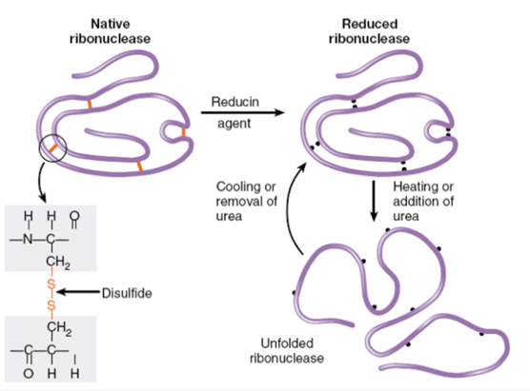
Anfinsen’s Experiment

Slide 3
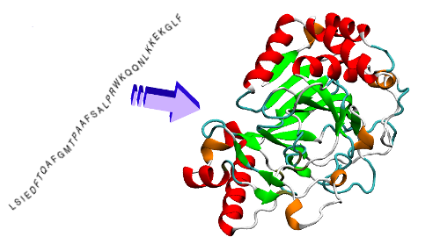
Anfinsen’s Experiment

Slide 4
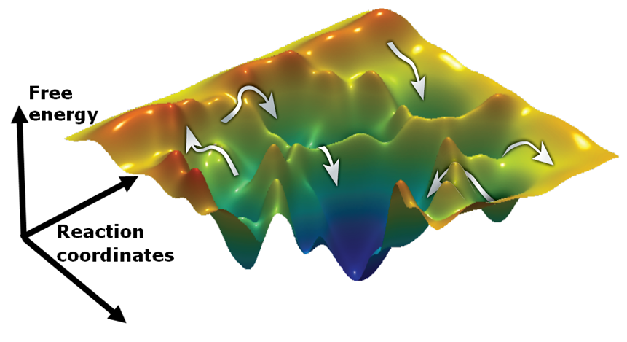
Free Energy Surface

Slide 5
Problem
There is a need to derive other scoring functions that may be able to distinguish native conformations from a large of protein structure data, e.g. MD trajectories.
The problem is to convert the information stored in the sampled structures to something that is both quantifiable and physically meaningful and then correlate said quantities with closeness to the native state.

Slide 6
Proposed Solution
Generate structural descriptors that vary according to a protein’s conformation.
Possible descriptors may be counts of noncovalent intramolecular interactions, i.e. hydrogen bonds, ionic interactions, aromatic interactions ,etc.

Slide 7
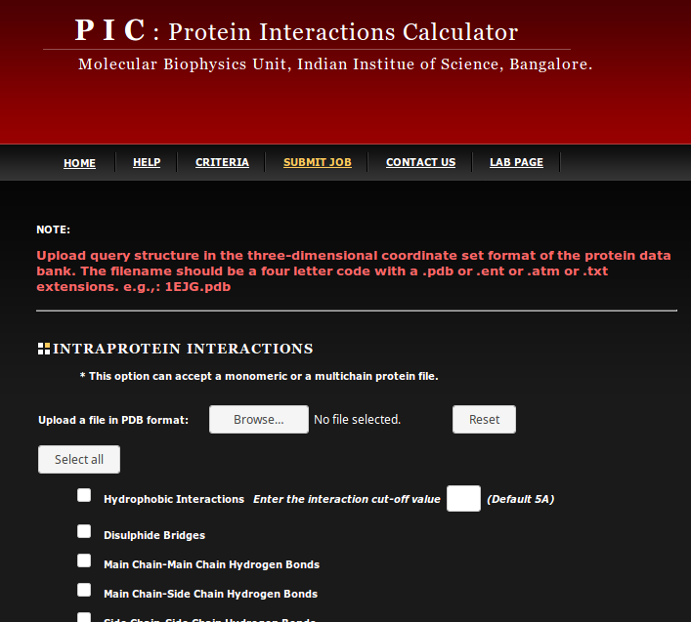
Existing tools that can accomplish the task
Protein Interactions Calculator (PIC)
A webserver that takes PDB files as input and calculates interactions based on empirical and semi-empirical rules.

Slide 8
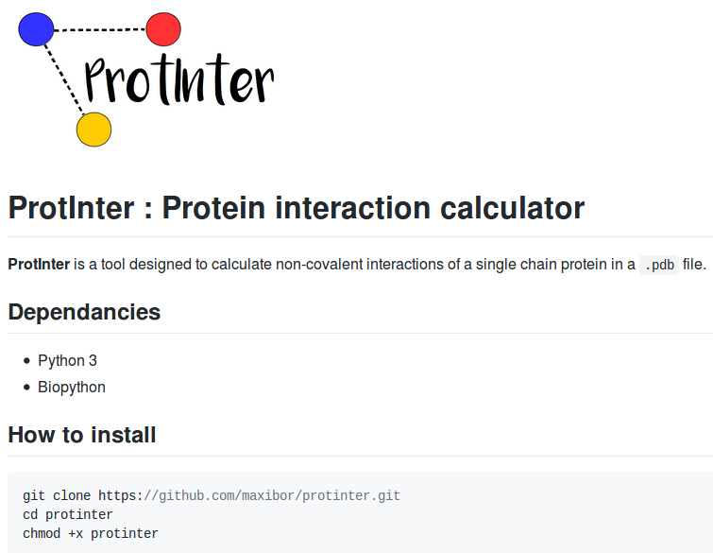
Existing tools that can accomplish the task
ProtInter
An open-source command line interface tool written in Python3 that utilizes the library BioPython to parse through PDB files.

Slide 9
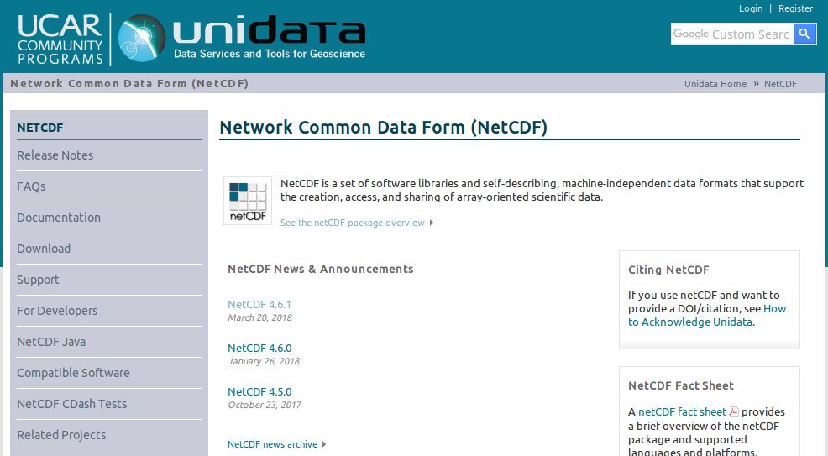
NetCDF

Slide 10
Why reinvent the wheel?
The existing tools are not specialized for handling large amounts of data.
The file format I work on is not compatible with the existing tools.
I want to be able to extend my analyses to other structural descriptors, and not limit analyses to intramolecular interactions.

Slide 11
Control Flow
Parse through NetCDF files (trajectory files).
Parse through parameter and topology files (AMBER uses prmtop format).
Calculate structural descriptors.
Write results to output.

Slide 12
Calculations Supported
Hydrogen Bonds
Ionic Interactions
Aromatic-Aromatic Interactions
Cation-Pi Interactions
Aromatic-Sulfur Interactions
Disulfide Bonds
Hydrophobic Interactions
Hydrophobic over Hydrophilic Ratio

Slide 13
Code Description
Two Modules
describe.cpp, describe.hpp – contains the data types and class that performs the calculations.
vecop.cpp, vecop.hpp – contains functions for manipulation of vectors (vector operations).
Main program
main.cpp – Instantiates a Class Describe taking input from the stream, and calls all functions from the class.

Slide 14
describe.cpp
Custom Data Type traj – where the information from both input files are stored. It contains:
coords – three-dimensional vector of coordinates. (number of frames * number of atoms * xyz)
atoms – string array of atom names.
residues – string array of residue names.
charges – float vector of partial atomic charges.
masses – float vector of atomic masses.

Slide 15
describe.cpp
Class Describe – takes care of parsing the input files and calculation of the desired quantities.
Functions:
Constructor(string, string)
HydrogenBonds(string, string)
IonicInteractions(string, string)
AromaticAromatic(string, string)
CationPi(string, string)
AromaticSulphur(string, string)
Disulfide(string, string)
Hydrophobic(string, string)
HydrophobicOverHydrophilic(string, string)

Slide 16
vecop.cpp
Functions
Distance(vector<float>, vector<float>)
Angle(vector<float>, vector<float>, vector<float>)
Scale(vector<float>, float)(vector<float>, int)
VectorSum(vector<float>, vector<float>)
DotProduct(vector<float>, vector<float>)
FindLargestNegativeInteger(vector<int>)
Translate(vector<float>, int)(vector<float>, float)(vector<int>, int)(vector<int>, float)
CenterOfMass(vector<vector<float>>, vector<float>)
IsIn(int, vector<int>)(string, vector<string>)
Where(string, vector<string>)
VectorSummation(vector<float>)
VectorError

Slide 17
Future Plans
Writing program of the program was rushed, so it is not at its optimum state.
Most functions were implemented brute-force without referring to existing functions in the standard library.
First action point is to clean the code to make it run faster and manage memory more efficiently.
The program is envisioned to be further extended to support a wider selection of structural descriptors.
Parsers for other file formats will also be implemented as needed.

