Slide 1
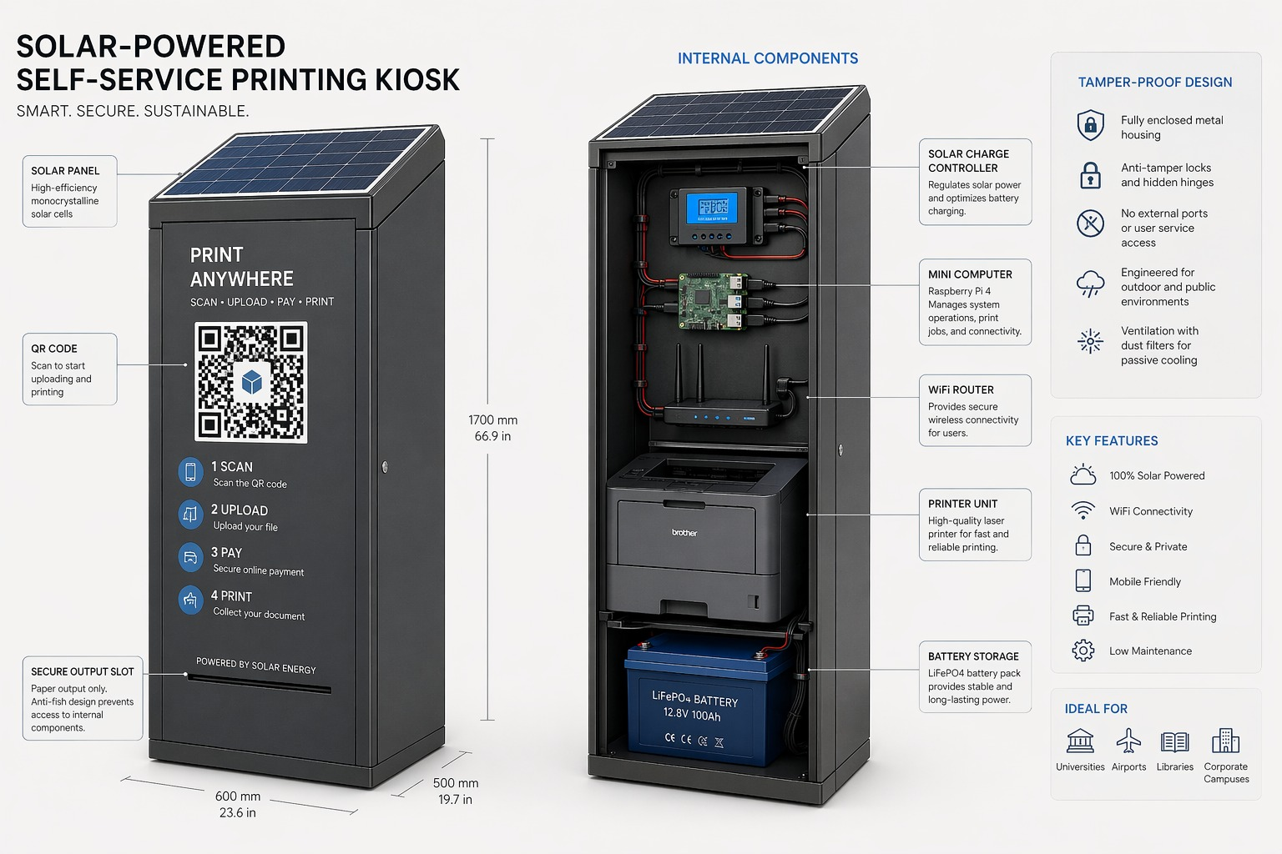
HASNET ICT SOLUTION
Hasnet PrintHub
Secure, mobile-money-first self-service printing for Zanzibar and beyond.
No Payment, No Print
Hasnet PrintHub | Zanzibar deployment-ready concept deck
Notes:
Open with core value proposition: unattended print infrastructure with revenue protection and scalable operations.
[Sources]
- Hasnet PrintHub internal milestone handoff (2026-04-22) and product documentation.
- Target deployment environments validated in current kiosk concept mockups.

Slide 2
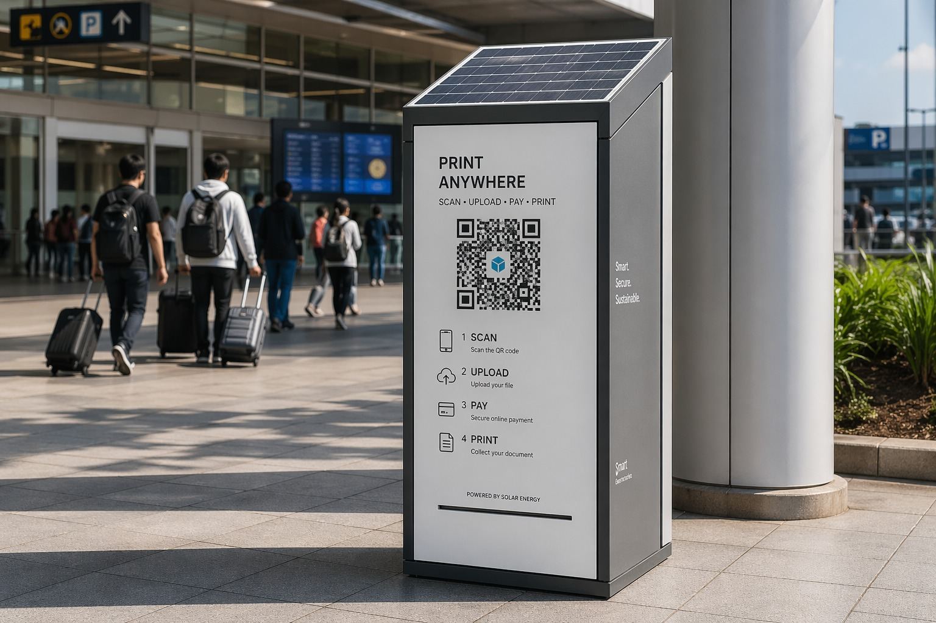
THE PROBLEM
02 / 10
Traditional Print Shops Leak Revenue and Scale Poorly
Manual operations create payment disputes, weak audit trails, and inconsistent customer experience.
Revenue Leakage
Operator Dependency
Low Visibility
Unpaid prints and manual
reconciliation reduce profit
confidence and slow daily
cash control.
Service quality varies by
operator shift, and
unattended expansion is
difficult.
Multi-site oversight is
limited without centralized
device, payment, and
incident reporting.
Hasnet PrintHub | Zanzibar deployment-ready concept deck
Notes:
Frame this as the market gap: current print points are service businesses, not managed digital infrastructure.
[Sources]
- Hasnet PrintHub internal milestone handoff (2026-04-22) and product documentation.
- Edge-agent architecture and backend operational runbooks in repository docs.

Slide 3

THE SOLUTION
03 / 10
Hasnet PrintHub Delivers Control, Automation, and Scale
A full-stack kiosk platform connecting customer flow, payments, and local print execution.
1 Platform
100%
Multi-Kiosk
Customer + Admin + Edge Agent
Payment Gate Enforcement
Central Backend by DEVICE_CODE
Integrated stack
No successful payment, no print
Designed for scale
Hasnet PrintHub | Zanzibar deployment-ready concept deck
Notes:
Emphasize that this is not a single app but an operational platform with strict transaction control.
[Sources]
- Hasnet PrintHub internal milestone handoff (2026-04-22) and product documentation.
- Edge-agent architecture and backend operational runbooks in repository docs.

Slide 4
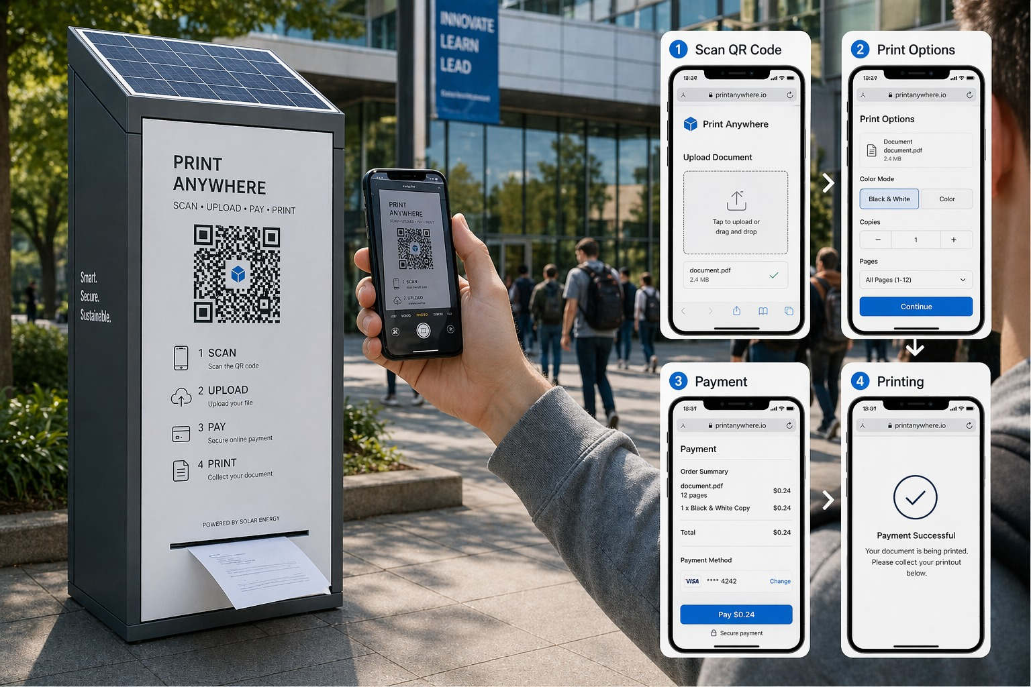
CUSTOMER FLOW
04 / 10
Scan -> Upload -> Pay -> Print
Fast, mobile-friendly flow with clear status tracking and receipt visibility.
Scan and Upload
Secure Payment
Status and Collection
Customer scans kiosk QR,
uploads PDF, and chooses
mode, copies, and page
range.
Server-side quote and
payment request prevent
manipulation of billing
values.
Only confirmed payments are
dispatched to print, then
customer receives status and
receipt.
Hasnet PrintHub | Zanzibar deployment-ready concept deck
Notes:
Tie this slide to trust and ease-of-use: fewer disputes and a predictable user journey.
[Sources]
- Hasnet PrintHub internal milestone handoff (2026-04-22) and product documentation.

Slide 5
OPERATIONS
05 / 10
Local-First Architecture for Real Kiosk Conditions
Designed for reliability with Raspberry Pi edge runtime and centralized admin oversight.
Edge Execution
Shared Control Plane
Provisioning Discipline
Pi-based agent handles
queueing, printer checks,
and heartbeat reporting per
kiosk.
One admin backend manages
many kiosks using unique
device identity and scoped
jobs.
Profile-based provisioning
and runbooks reduce
deployment variance across
new sites.
Hasnet PrintHub | Zanzibar deployment-ready concept deck
Notes:
Position this as infrastructure-grade ops, not ad hoc kiosk scripting.
[Sources]
- Edge-agent architecture and backend operational runbooks in repository docs.
- Hasnet PrintHub internal milestone handoff (2026-04-22) and product documentation.

Slide 6
TRACTION
06 / 10
Build Progress and Technical Readiness
Core milestone foundation is already implemented and validated for next rollout phase.
106 Passed
Auth + RBAC Base
Brand Refresh
Backend Regression Tests
Admin Protection Implemented
Hasnet Customer/Admin UX
Latest documented run
Role expansion in next phase
Current milestone shipped
Hasnet PrintHub | Zanzibar deployment-ready concept deck
Notes:
Show that execution risk is reducing: baseline is built, remaining work is focused hardening and rollout.
[Sources]
- Hasnet PrintHub internal milestone handoff (2026-04-22) and product documentation.
- Edge-agent architecture and backend operational runbooks in repository docs.

Slide 7
BUSINESS MODEL
07 / 10
Multiple Revenue Paths per Kiosk Network
Hasnet can monetize transaction volume, operations, and service reliability.
Per-Page Margin
SaaS + Support
Institutional Contracts
Direct transaction margin
from secure paid printing
events.
Monthly fee per kiosk for
platform operations,
monitoring, and updates.
Campus, airport, and office
deployments create
repeatable B2B rollout
value.
Hasnet PrintHub | Zanzibar deployment-ready concept deck
Notes:
Present flexibility: hybrid pricing can be tuned per client type and location economics.
[Sources]
- Hasnet PrintHub internal milestone handoff (2026-04-22) and product documentation.
- Target deployment environments validated in current kiosk concept mockups.

Slide 8
GO-TO-MARKET
08 / 10
Pilot, Prove, Then Replicate
Execution strategy prioritizes controlled pilots and fast template-based expansion.
Phase 1: Pilot
Phase 2: Multi-Site
Phase 3: Expansion
Deploy 1 to 3 kiosks,
measure uptime,
payment-to-print success,
and customer adoption.
Scale with profile-driven
provisioning and centralized
admin governance.
Extend into institutional
clusters with standardized
operations playbooks.
Hasnet PrintHub | Zanzibar deployment-ready concept deck
Notes:
Communicate disciplined scaling: performance gates before broad rollout.
[Sources]
- Edge-agent architecture and backend operational runbooks in repository docs.
- Target deployment environments validated in current kiosk concept mockups.

Slide 9
FUNDING USE
09 / 10
Capital Will Accelerate Deployment and Reliability
Funding converts current technical momentum into production footprint and recurring revenue.
Hardware
Operations
Product
Kiosk + Printer Buildout
Field Support + Monitoring
Telemetry + Alerts + QA
Deployment capacity
Uptime and service quality
Reliability at scale
Hasnet PrintHub | Zanzibar deployment-ready concept deck
Notes:
This slide should support your ask discussion; update with exact TZS numbers before investor meeting.
[Sources]
- Hasnet PrintHub internal milestone handoff (2026-04-22) and product documentation.
- Edge-agent architecture and backend operational runbooks in repository docs.

Slide 10
THE ASK
10 / 10
Partner With Hasnet to Build Zanzibar's Print Infrastructure Layer
We are ready for a controlled scale phase with measurable milestones and disciplined governance.
Investment Ask
Milestone Commitments
Immediate Next Step
Set amount, runway, and
expected milestone outcomes
directly in this final
slide.
Define kiosk count, uptime
target, and monthly
transaction milestones for
transparency.
Align on pilot financing
structure and launch
timeline for first
production sites.
Hasnet PrintHub | Zanzibar deployment-ready concept deck
Notes:
Close with confidence: platform foundation is built, and funding unlocks scale execution.
[Sources]
- Hasnet PrintHub internal milestone handoff (2026-04-22) and product documentation.
- Target deployment environments validated in current kiosk concept mockups.

