Slide 1
Online BookStore SQL Project
Relational Database Design & Analytics using PostgreSQL
By:
Abdul Razzaq

Slide 2
Project Overview
Designed and implemented a relational database for an Online Bookstore using PostgreSQL.
Created three main tables: Books, Customers, and Orders with appropriate relationships.
Imported real-world style data from CSV files using the COPY command.
Wrote analytical SQL queries to extract actionable business insights.
Applied core SQL concepts: joins, groupings, aggregations, subqueries, and window functions.
Focused on performance metrics such as total revenue, customer spending, and product sales.
The project simulates real-life business reporting and inventory analysis.

Slide 3

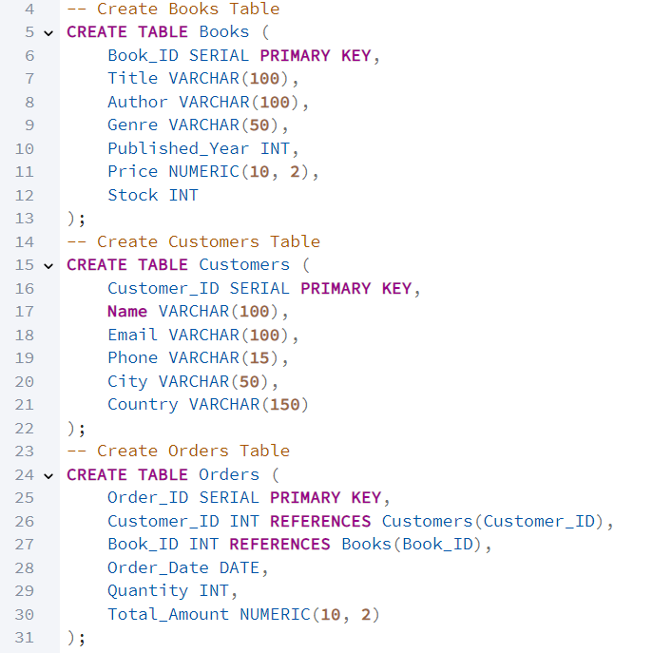
Database & Table Creation (DDL)
Created OnlineBookstore database using PostgreSQL.
Defined three tables: Books, Customers, and Orders.
Applied Primary Keys and Foreign Key constraints for relationships.
Structured schema to support clean, normalized data flow.
Query

Slide 4
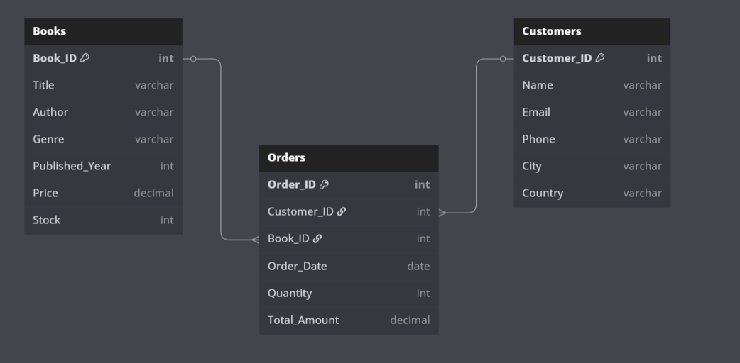
ER Diagram

Slide 5
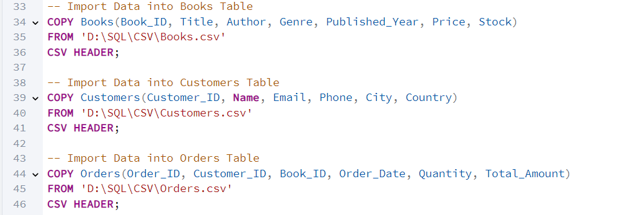
CSV Data Import into Tables
Imported real-world-style data using PostgreSQL’s COPY command.
Used .csv files for Books, Customers, and Orders tables.
Ensured headers matched table columns to avoid import errors.
Data import enabled meaningful analysis on sales, inventory, and customer behavior.
Query

Slide 6
SQL Query Analysis Goals
Key Points
Uncover insights to drive bookstore decisions.
Focus: Customer behavior, inventory, revenue, genre trends.
Use advanced SQL for actionable results.
Impact: Better marketing, optimized stock, higher profits.

Slide 7
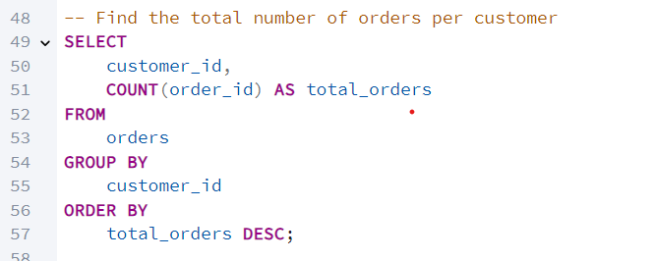
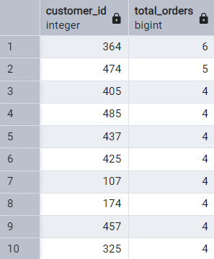
Customer Order Frequency Analysis
Insight
This query counts the total number of orders placed by each customer. It helps identify how often individual customers interact with the bookstore and shows overall engagement levels.
Query
Query Output

Slide 8
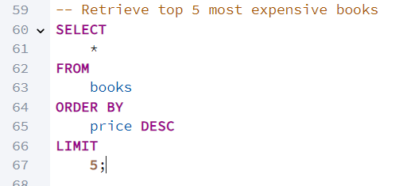
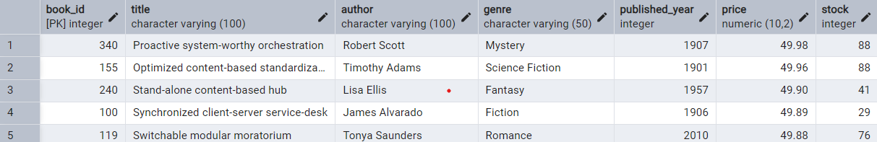
Top 5 Most Expensive Books
Insight
This query selects the five most expensive books by sorting the Books table in descending order of price. It highlights premium titles that may require special marketing or attention.
Query
Query Output

Slide 9
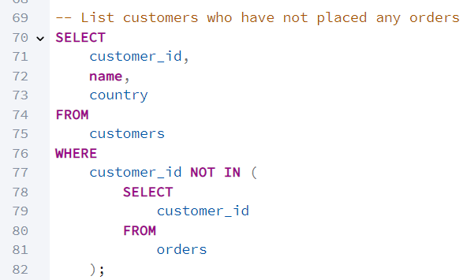
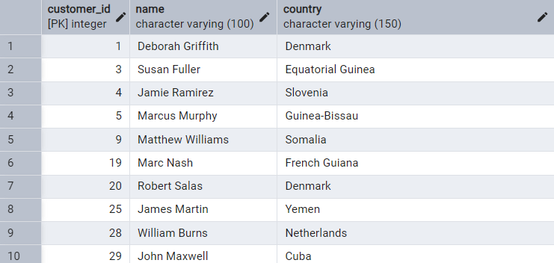
Customers With No Orders
Insight
This query finds customers who have never placed an order by checking which customer IDs do not appear in the Orders table. It helps spot inactive users in the system.
Query
Query Output

Slide 10
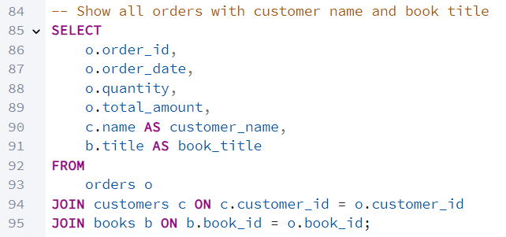
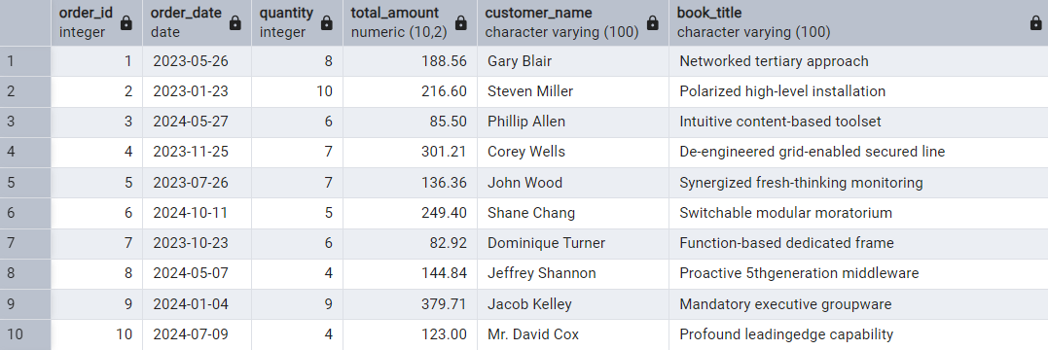
Comprehensive Order Details
Insight
This query joins the Orders, Customers, and Books tables to display full order records, including customer names and book titles. It’s useful for creating reports or detailed order views.
Query
Query Output

Slide 11
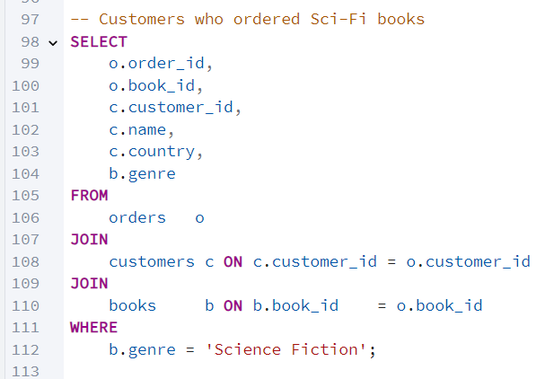
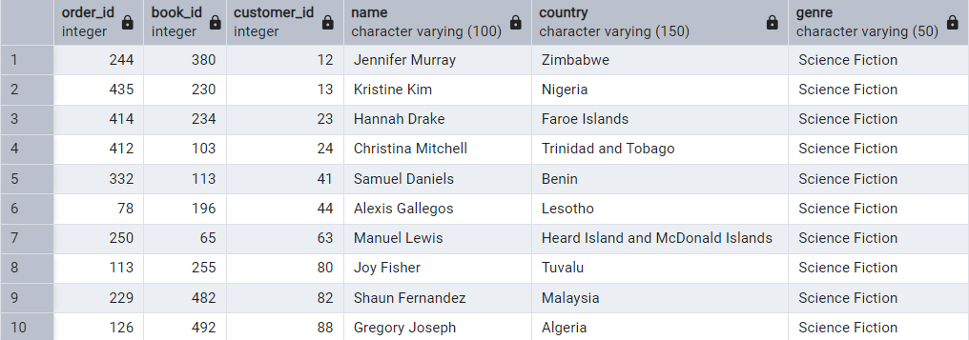
Identifying Science Fiction Book Buyers
Insight
This query filters orders to return only those linked to books from the “Science Fiction” genre. It also includes customer details, helping analyze genre-specific customer interest and behavior.
Query
Query Output

Slide 12
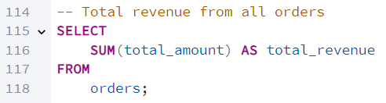

Overall Revenue Snapshot
Insight
This query calculates the total revenue generated by summing the Total_Amount column across all orders. It provides a quick and accurate overview of overall business sales performance
Query
Query Output

Slide 13
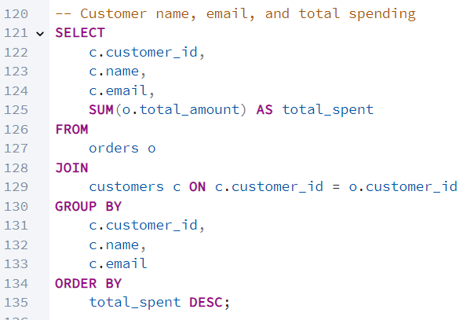
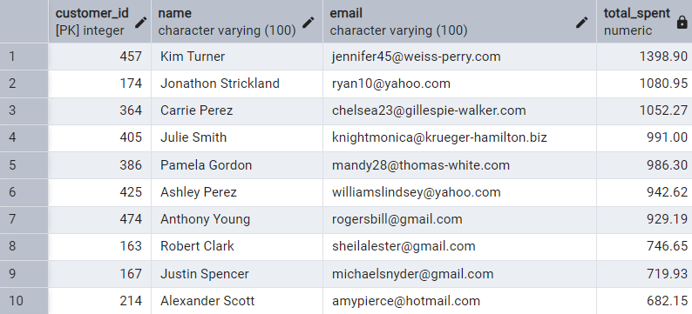
Customer Spending Profiles
Insight
This query returns the name, email, and total spending amount for each customer. It helps identify top spenders and analyze purchase behavior for customer-level financial insights.
Query
Query Output

Slide 14
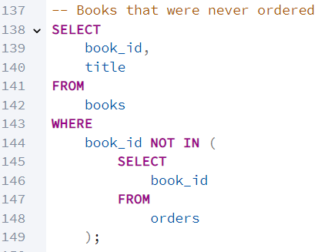
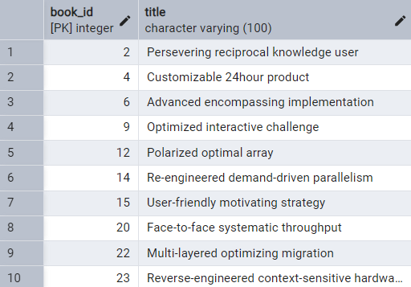
Unsold Books Inventory
Insight
This query identifies books from the Books table that have never been ordered by checking which book IDs do not exist in the Orders table. It helps detect unsold inventory.
Query
Query Output

Slide 15
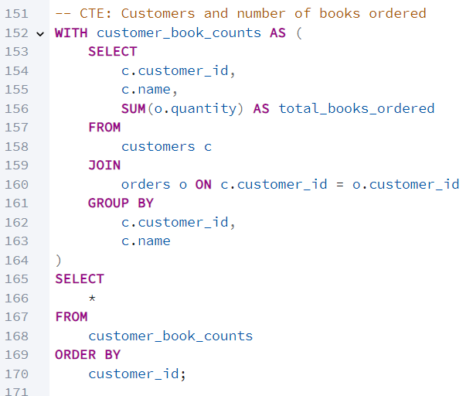
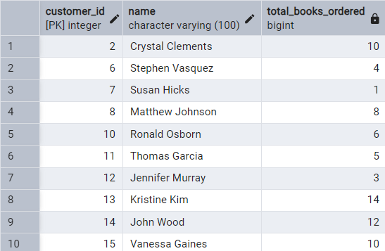
Total Quantity Ordered per Customer
Insight
This query uses a Common Table Expression (CTE) to calculate how many books each customer has ordered, based on the sum of quantity grouped by customer in the orders table.
Query
Query Output

Slide 16
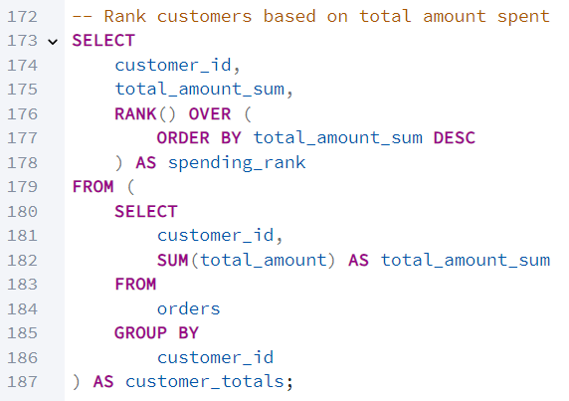
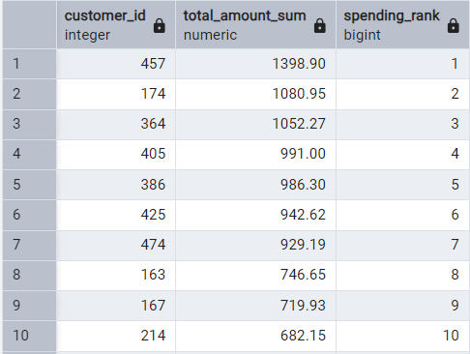
Top Spenders: Customer Ranking
Insight
This query ranks customers based on the total amount they have spent using a window function. It shows who contributed most to revenue and helps prioritize high-value users.
Query
Query Output

Slide 17
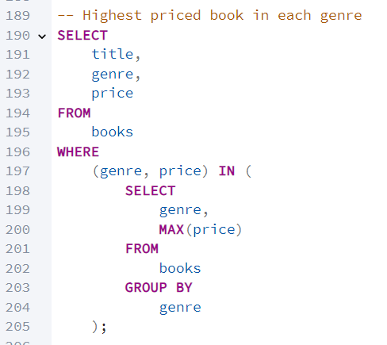
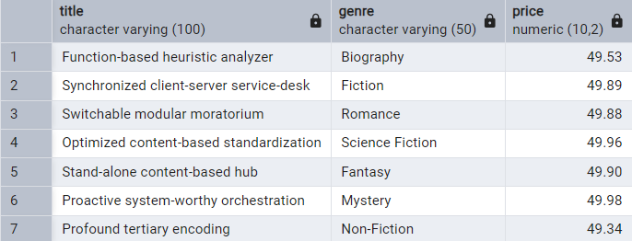
Most Expensive Book In Each Genre
Insight
This query returns the highest-priced book in every genre by combining filtering with grouping. It helps understand price distribution and identify premium books across different categories.
Query
Query Output

Slide 18
Conclusion
Through these queries, I understood how to extract real insights from data.
I learned how to find top customers, best-selling books, and order trends.
Writing queries improved my grip on joins, grouping, and filters.
This project showed how SQL can be used to solve practical, real-world business problems.

Slide 19
Thank you for Viewing My SQL Project.
By:
Abdul Razzaq

