Slide 1
Project 4 - Amazon EC2 Backup and Restore Using AWS Backup
Under the guidance of =
● Hari Prasad k sir
-By Taissery Suhaib , Abdul Rehiman Shaik, Maheswara Reddy, gnaeshwar T

Slide 2
PROJECT AGENDA
IN THIS PROJECT, YOU WILL:
Create an on-demand backup job of an Amazon EC2 instance
Use a backup plan to back up Amazon EC2 resources—using a backup plan within AWS Backup lets you automate your backups on a schedule
Add resources to an existing backup plan using tags
Services Used:
EC2-CloudFormation, AWS Backup Service, EBS Lifecycle policies, Backup and Restore.
Reference : https://aws.amazon.com/getting-started/hands-on/replicate-data-using-amazon-s3-replication/

Slide 3
What is AWS Backup and what all involved
AWS Backup is a fully-managed service that makes it easy to centralize and automate data protection across AWS services, in the cloud, and on premises. Using this service, you can configure backup policies and monitor activity for your AWS resources in one place. It allows you to automate and consolidate backup tasks that were previously performed service-by-service, and removes the need to create custom scripts and manual processes. With a few clicks in the AWS Backup console, you can automate your data protection policies and schedules.
AWS Backup does not govern backups you take in your AWS environment outside of AWS Backup. Therefore, if you want a centralized, end-to-end solution for business and regulatory compliance requirements, start using AWS Backup today.
Config involved in AWS Backup .
> AWS plan : AWS Backup plan is a policy expression that defines when and how you want to back up your AWS resources, such as Amazon DynamoDB tables or Amazon Elastic File System (Amazon EFS) file systems.
> AWS on Demand backup : The On Demand Backups feature allows you to begin a new backup at the click of a button any time you need one as long as there isn't already a backup or restore in progress.
>AWS Backup vault :
In AWS Backup, a backup vault is a container that stores and organizes your backups.

Slide 4
EBS LIFE CYCLE POLICY
You can select one or more Amazon EBS volumes in the Amazon EC2 console to create an Amazon Data Lifecycle Manager policy that's used to manage snapshots of the EBS volumes. An Amazon Data Lifecycle Manager policy creates and deletes snapshots according to the policy schedule. This saves you on costs and effort because you don't have to match the snapshots manually.
Like :
* Count of snapshot
* How frequent
* For how long

Slide 5
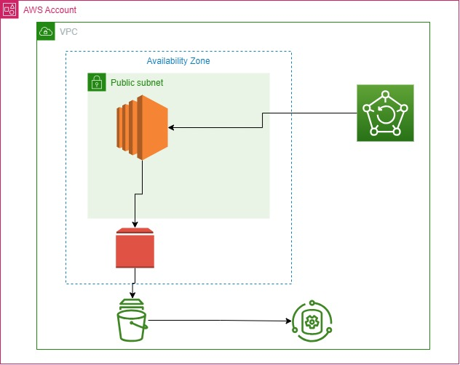
ARCHITECTURAl DIAGRAM

Slide 6
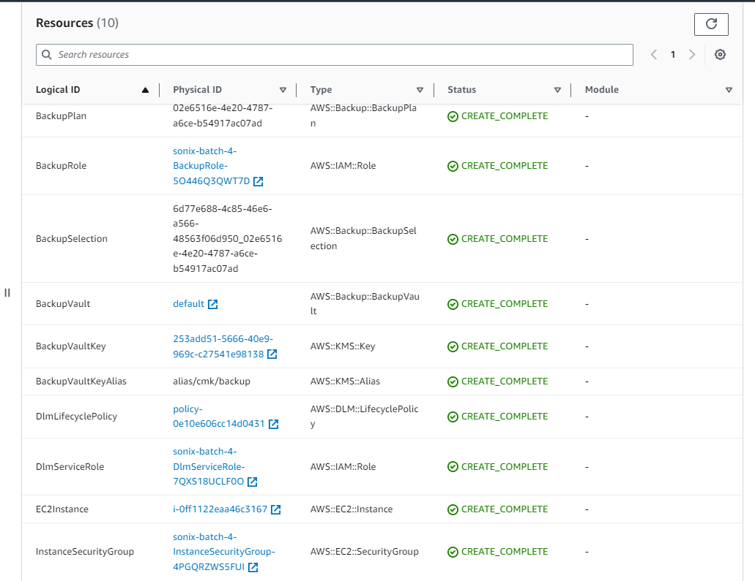

CREATION OF RESOURCES USING CF
Copied AWS EC2 public ip and paste in new tab

Slide 7
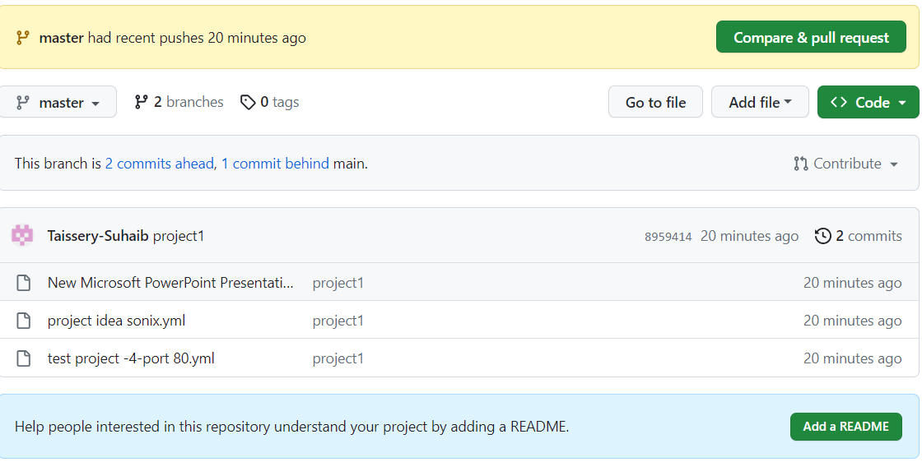
PUSH CODE TO GIT HUB

Slide 8
RESULT :
For every 5 hours the backup plan is initiated
Delete the backup job after 60 days
DLM life cycle policy for volume using a tag which is used in ec2 , the interval of snapshot is 24hrs with maximum count of 7 .

Slide 9
THANK YOU
-- Project by AWS BATCH 2 – group _4

