Slide 1

TezMail
Smart Email Marketing
$75/month managed service:
Cloud VPS (monthly)
Amazon SES email sending charges
Platform hosting & monitoring
Basic support

Slide 2


The Problem
• Rising monthly costs
• Data on third-party platforms
• Emails going to spam
• Complex tools

Slide 3

The Solution
• Unlimited emails & contacts
• Full data control
• Simple to use

Slide 4


How It Works
1. Upload contacts
2. Create email
3. Send or schedule
4. Track results

Slide 5

Cost Comparison
Other tools: Monthly fees are mostly higher
TezMail: Only 75$/ month

Slide 6
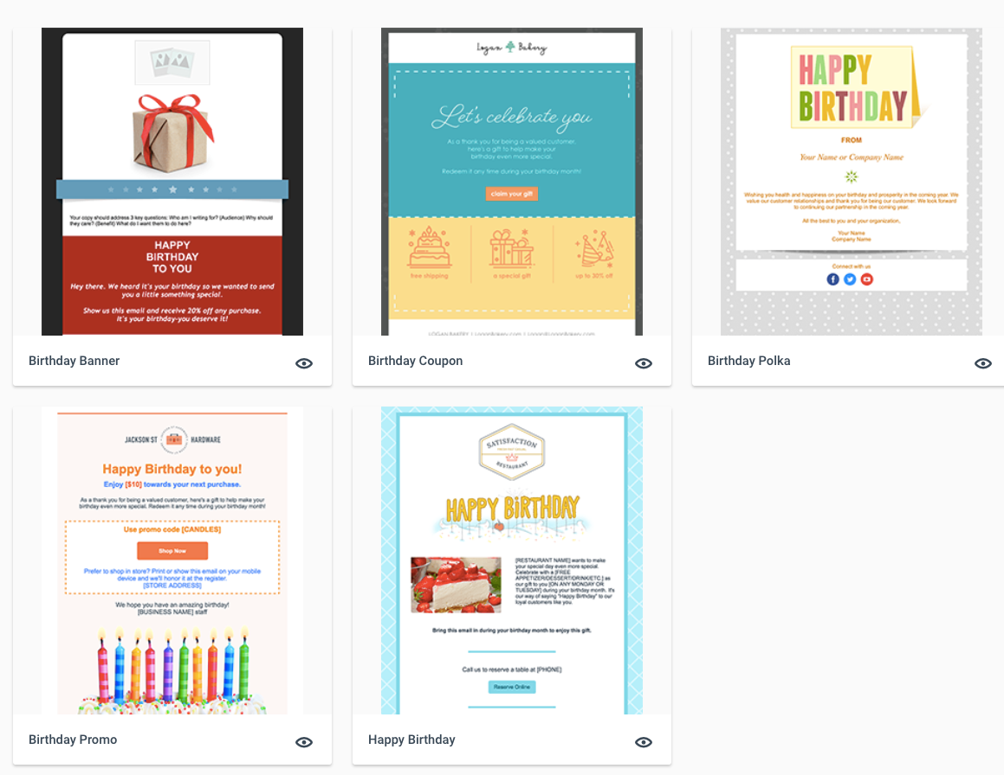
Easy Email Design
• Visual editor
• Mobile friendly
• Reusable templates

Slide 7

AI-Powered Writing
• Write content
• Suggest subject lines
• Improve tone

Slide 8

Reports & Analytics
• Opens
• Clicks
• Campaign performance

Slide 9

Data Privacy
• Self-hosted
• Full ownership
• GDPR friendly

Slide 10

Email Sending with Amazon SES
TezMail connects with Amazon SES
A trusted email service by Amazon
Used by global companies

Slide 11
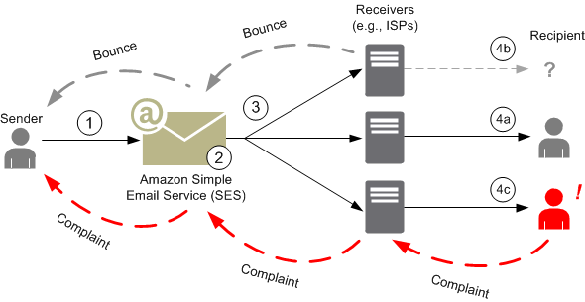
What is Amazon SES?
Amazon SES is a professional email delivery service
Designed for high reliability
Trusted by Gmail & Outlook

Slide 12
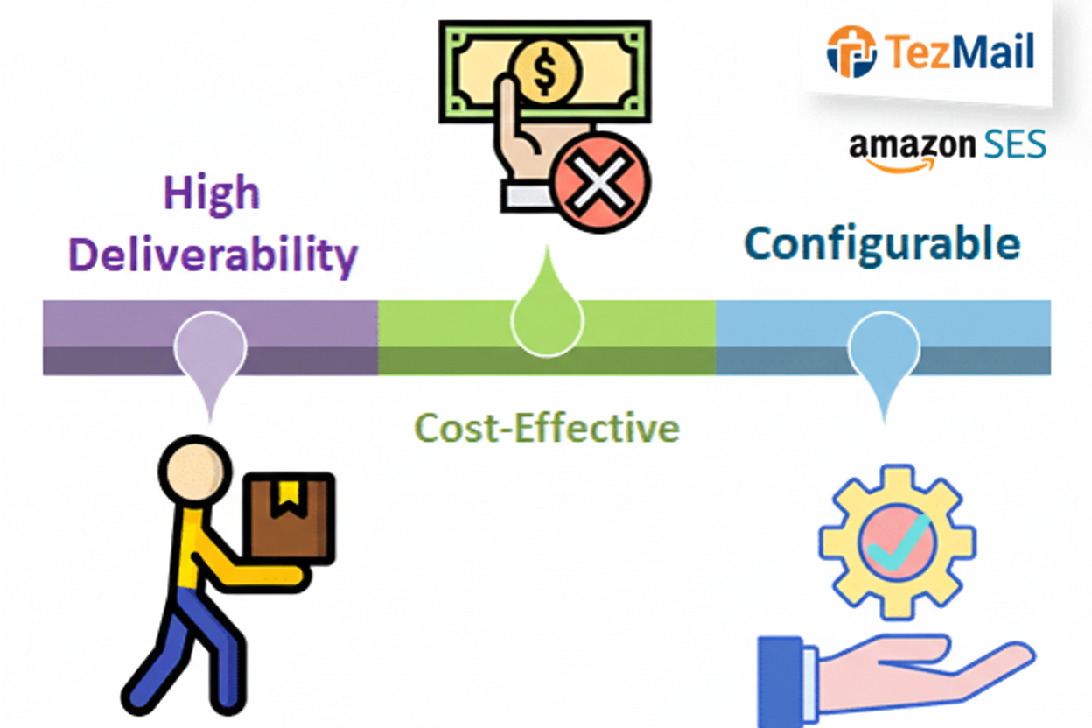
Why We Use Amazon SES
• Excellent inbox delivery
• Very low email sending cost
• High trust & reliability
• Handles large volumes

Slide 13
Benefits for Your Business
• Emails reach inbox, not spam
• Faster delivery
• Secure & stable
• Ideal for marketing emails

Slide 14
TezMail + Amazon SES
TezMail manages campaigns & reports
Amazon SES ensures safe delivery
Simple, powerful combination

Slide 15
Easy Setup
• We install
• We train
• You send

Slide 16
Summary
Smart, affordable & powerful
Fully Managed Email Marketing Service Includes server, Amazon email delivery, setup, and support.

