Slide 1

Basic Weather Display: Predefined Data
GROUP MEMBERS:
M. Abdul Rehman
M. Ayyan Shakeel:
This presentation explores the fundamental concepts of displaying weather information using pre-defined data, covering the key elements, data sources, visualization techniques, and interpretation.

Slide 2
Key Weather Elements
Temperature
Wind Speed and Direction
Precipitation
Cloud Cover
Measured in Celsius or Fahrenheit, temperature reflects the degree of heat or cold in the atmosphere. It's a crucial indicator of the overall weather conditions and human comfort.
Precipitation refers to any form of water falling from the atmosphere, including rain, snow, sleet, and hail. It's measured in millimeters or inches of rainfall.
Cloud cover is expressed as an amount (e.g., "mostly cloudy") or percentage (e.g., "70% cloud cover"). It reflects the extent of cloudiness in the sky.
Wind speed is measured in meters per second or miles per hour. Wind direction indicates where the wind is blowing from, often represented by compass directions (north, south, east, west).

Slide 3




Data Sources and Formats
Weather Stations
Ground-based weather stations measure local conditions and transmit data in real time.
Satellites
Satellites provide a wide-area view of weather patterns and conditions over large regions.
Radar Systems
Radar stations detect precipitation and track its movement, offering detailed insights into storm activity.
Data Formats
Weather data is often transmitted in standardized formats like XML or JSON, facilitating easy sharing and integration.

Slide 4




Visualizing Weather Information
Basic Icons
Simple icons representing sun, rain, clouds, and wind provide a quick overview.
1
Charts and Graphs
Temperature, wind speed, and precipitation can be effectively illustrated using line
graphs or bar charts.
2
Weather Maps
Maps overlayed with weather data, including contours, symbols, and color gradients, offer a comprehensive view.
3
Animations and Visualizations
Animated weather maps and 3D visualizations provide dynamic insights into changing conditions.
4

Slide 5
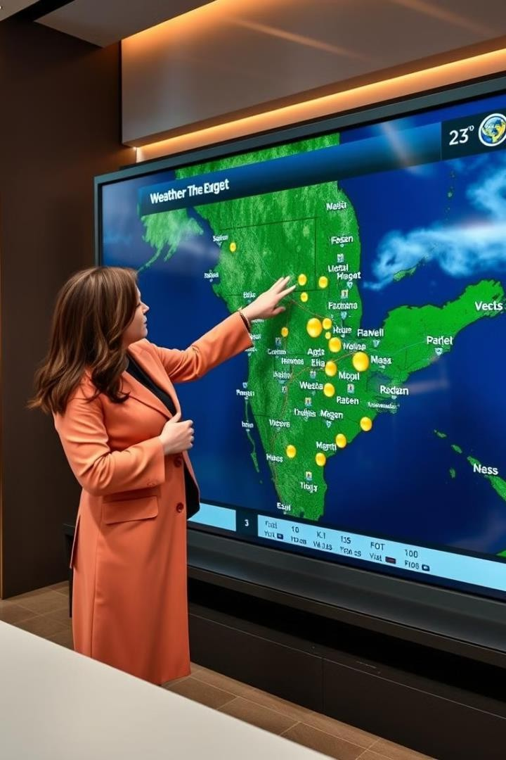
Interpreting and Presenting Weather Data
1
Clarity and Accuracy
Data should be presented accurately and clearly, avoiding misinterpretation by the audience.
2
Contextual Understanding
Provide context by relating weather data to specific locations, times, and potential impacts.
3
Accessibility and Engagement
Make weather information readily accessible and engaging through user-friendly interfaces and interactive elements.

