Slide 1
Multi-Agent Refactoring for Python
Fine-tuning a small local code model for guard-clause refactoring
Abdelrahman Magdy
Backend, integration and coordination
Abdullah Tarek
Agent workflow and verification
Abdelrahman Adel
Models and training
Shahd Abdelhay
Data, research and evaluation
Dania El-Walily
Frontend, report and presentation
1
Notes:
Abdelrahman Magdy, 0:30. One sentence: a local tool that proposes one refactoring for one small Python function, reports every check separately, and a study of whether fine-tuning and role coordination make the proposals more reliable.

Slide 2
The problem and our questions
• AI can rewrite code that looks cleaner but behaves differently
• So every proposal must be checked, and each check reported on its own
• We study one refactoring on one small Python function
Research questions
1. Do several coordinated roles beat one model call?
2. Does fine-tuning a small model help?
3. Is any gain worth its cost in time and calls?
Abdelrahman Magdy · 1:00
2
Notes:
A model's refactoring can look cleaner and still be unnecessary, invalid or behaviorally wrong. The three research questions come from the project proposal (docs/proposal/project-proposal.md). Improvement was a hypothesis, not a promise; a negative result is a valid outcome of the study.

Slide 3
What others found
Fowler
Defines guard clauses, the refactoring we use
LLM refactoring studies
Models often break behavior, so checks must be separate
Multi-agent tools
Shown with large closed models; we test a 0.5B local model
Self-repair
Corrections help only when the feedback is good
LoRA / PEFT
Lets a 4 GB GPU adapt a model
Tests and datasets
Tests can miss bugs; duplicates leak between splits
Shahd Abdelhay · 1:00
3
Notes:
From the reading table in docs/research/related-work.md: Fowler defines the task (R1); language models produce unsafe refactorings (R3); multi-agent refactoring and role-based generation exist with large closed models (R5, R6); self-repair gains depend on feedback quality and cost (R8); LoRA and PEFT make adaptation fit a small GPU (R9, R10); tests can be insufficient (R14); code datasets leak through duplicates (R15).

Slide 4
The task: flatten nested if statements
Before: depth 2
After: depth 1
def shipping_cost(weight, express):
"""Return the shipping cost."""
if weight > 0:
if express:
return weight * 3
else:
return weight * 2
else:
raise ValueError("weight must be positive")
def shipping_cost(weight, express):
"""Return the shipping cost."""
if weight <= 0:
raise ValueError("weight must be positive")
if express:
return weight * 3
return weight * 2
• One function, at most 60 lines; anything else gets “Nothing to change” with no model call
Abdullah Tarek · 1:00
4
Notes:
Example from docs/requirements/task-scope.md. Scope: one synchronous top-level function, at most 3,000 characters and 60 lines. Out-of-scope input ends as no_change with a reason code and no model call. The rubric has eight structural checks, and a deterministic reference transformation produces the training targets. Why this task (ADR12): the rubric is deterministic and behavior is checkable on pure functions.

Slide 5
How the system fits together
Browser
React interface
Web service
FastAPI, queue, SQLite
Coordinator
find, rewrite, review
Model worker
Qwen 0.5B + LoRA
The web service never runs your code.
It only reads it with Python's parser.
Checks
syntax, rubric, tests, review
Test runner
separate, limited process
Abdelrahman Magdy · 1:00
5
Notes:
Browser, FastAPI service, workflow coordinator, then the model worker process and the isolated reference runner, with SQLite run history behind the service. A bounded queue and one worker thread. The API parses code and never executes it. /health reports the actual mode (fake or local model) and the exact model identity (docs/architecture/contracts.md).

Slide 6
Two ways to run
Fast
Rewrite
1 model call
With review
Find → Rewrite → Review
3 calls, up to 5 with one retry
• Input outside the task stops before any model call
• Model output must match a strict format; one automatic repair at most
Abdullah Tarek · 1:00
6
Notes:
Deterministic validation first: out-of-scope input ends as no_change with zero calls. Single-role (Fast in the interface): exactly 1 call. Multi-role (With review): analysis, refactoring and review, at most 5 calls and 1 correction. Strict parsing with at most one deterministic repair; the model is never asked again. A run deadline; a run fails when the provider reports another adapter state than requested (docs/architecture/workflow.md).

Slide 7
Four checks, never merged
Valid Python
Python's parser
Guard clauses
8 structure checks
Tests
trusted examples, isolated
Review
the model's opinion
The result is one of five:
Ready to use
Not safe to use
Not sure
Nothing to change
Something went wrong
• A missing check is never shown as a pass; the review never overrides a failed test
• Passing tests cover the tested inputs only, not every possible input
Abdullah Tarek · 1:00
7
Notes:
Syntax, rubric, trusted reference tests and model review are reported separately. Disposition order: failed, no_change, rejected, uncertain, proposal_ready. The runner: static admission, a separate interpreter, Job Object or rlimits, an audit hook, and 19 self-checks that disable execution if any fails. Honest limit: it is not a sandbox for hostile code (docs/development/runner-safety.md).

Slide 8
The model and the laptop
0.5B
4 GB
~1 GB
14-26
Qwen2.5-Coder, Apache-2.0
laptop GPU (RTX 2050)
GPU memory in use
tokens per second
• The original model mostly copied the input back unchanged (14 of 24)
• Putting the code block first fixed the output format (24 of 24 parsed)
• So the open question was: can fine-tuning teach the actual rewrite?
Abdelrahman Adel · 1:00
8
Notes:
Qwen2.5-Coder-0.5B-Instruct at revision ea3f2471 (Apache-2.0), on an RTX 2050 with 4 GB. Measured: 17.6 s warm load, about 1.0 GB of GPU memory, 13.8 to 26.1 tokens per second; the 1.5B candidate was not measured because of the disk limit (experiments/models/README.md). The explanation-first prompt gave no code block on the pilot functions; the code-first refactor-v2 format parsed 24 of 24 validation outputs, but 14 were unchanged copies (experiments/models/2026-10-20-prompt-format-selection.md).

Slide 9
Fine-tuning with LoRA
627
training functions
20.5 min
on a free Kaggle T4 GPU
0.69 → 0.01
training loss
69 vs 6
of 84 validation cases ready, with vs without the adapter
Abdelrahman Adel · 1:00
9
Notes:
LoRA rank 8, alpha 16 on the refactoring role; 4,399,104 trainable parameters. The pilot was saved, reloaded in a fresh process, interrupted and resumed. The full run failed on the laptop after 22 of 237 steps (out of virtual memory) and moved to Kaggle's T4 in fp32. Training record experiments/training/full-2026-10-21.json: 627 training records, 3 epochs, 120 optimizer steps with an effective batch of 16 (two GPUs were visible), 20.5 GPU minutes, best validation loss 0.0360 at epoch 3, adapter weights sha256 dff9ae02... The selection rule was written before any comparison; on validation, arm C was accepted in 69 of 84 cases against 6 of 84 for arm A, so the adapter was adopted (experiments/training/validation-selection-2026-10-20.json).

Slide 10
The dataset
799
5,168
95.1%
627 / 84 / 88
functions
trusted tests
of injected bugs caught
train / validation / test
• Real code rarely has this pattern, so most functions come from team-written templates
• Splits keep whole template families apart, and duplicates were checked
• The 88 test cases were frozen before any final run
Shahd Abdelhay · 1:00
10
Notes:
Real code rarely fits the task: 4 of 974 MBPP, 1 of 164 HumanEval and 4 of 2,630 TheAlgorithms functions. 799 records: 81 team template families plus 4 real functions. 5,168 trusted reference tests, which detect 95.1% of single-point mutants. Splits 627 / 84 / 88 by source group; no near-duplicates; the test split frozen by its case-content hash. The license of the team-authored data is pending (docs/data-and-training/data-plan.md).

Slide 11
How we compared
 | Original model | Fine-tuned model
Fast (1 call) | A | C
With review (3-5 calls) | B | D
• Same 88 test cases for all four
• Score: share marked “Ready to use”
• Targets fixed on validation first
• Paired tests: exact McNemar + Holm
Shahd Abdelhay · 1:00
11
Notes:
Arms A to D and four paired comparisons: B vs A, C vs A, D vs C, D vs B. Primary measure: proposal_ready over all attempted cases. Exact McNemar tests with a Holm adjustment; results also by family. Targets come from the validation baseline and were frozen in experiments/evaluation/protocol-freeze.json before the test run. The correction's oracle feedback (up to three failing tests) goes only to the multi-role arms (docs/evaluation/protocol.md).

Slide 12
Results on the 88 frozen test cases
79.5%
fine-tuned, Fast (C)
8.0%
original, Fast (A)
39.8%
fine-tuned, with review (D)
Shahd Abdelhay · 1:00
12
Notes:
One run of protocol eval-v1 on a Kaggle T4 in float32, from the clean commit 9582c66 (experiments/evaluation/test-2026-10-21/targets-report/summary.md). Denominator: all 88 attempted cases per arm. Ready (proposal_ready): A 7 (8.0%), B 1 (1.1%), C 70 (79.5%), D 35 (39.8%). Rejected: 80, 85, 18, 19. Uncertain: 0, 2, 0, 34. Failed: A 1 (unparseable_output). No timeouts. These are test results; the validation results are reported separately and must not be mixed with them.

Slide 13
What the comparisons show
Comparison | Only first ready | Only second ready | p (Holm)
Fine-tuning, Fast (C vs A) | 65 | 2 | < 0.0001
Fine-tuning, with review (D vs B) | 34 | 0 | < 0.0001
Adding review, fine-tuned (D vs C) | 1 | 36 | < 0.0001
Adding review, original (B vs A) | 0 | 6 | 0.031
Cost per case
Arm | Median time | Calls
A | 3.0 s | 1.0
C | 7.7 s | 1.0
B | 16.0 s | 4.9
D | 17.9 s | 3.4
• Fine-tuning helped a lot
• The review step lowered results: the untuned reviewer was often cut off
• 11 of 12 targets met; the with-review target was missed
Abdelrahman Adel and Shahd Abdelhay · 1:00
13
Notes:
Paired exact McNemar with Holm adjustment over the four comparisons (targets-report/paired.csv). C vs A: 65 cases only C accepts, 2 only A, p < 0.0001. D vs B: 34 vs 0, p < 0.0001. D vs C: 36 only C, 1 only D, p < 0.0001. B vs A: 6 only A, 0 only B, p = 0.031 (no direction was expected). Targets: 11 of 12 met; D's floor of 43.52% was missed with 39.8%. Why the review step hurts: the review role uses the original model; it often repeated itself until the 384-token limit, its verdict could not be read, and the run became uncertain (34 of D's 88). Cost: median latency A 3.0 s, C 7.7 s, B 16.0 s, D 17.9 s; mean calls per case 1.00, 1.00, 4.93, 3.43. The 88 cases come from 16 source groups and are not independent.

Slide 14
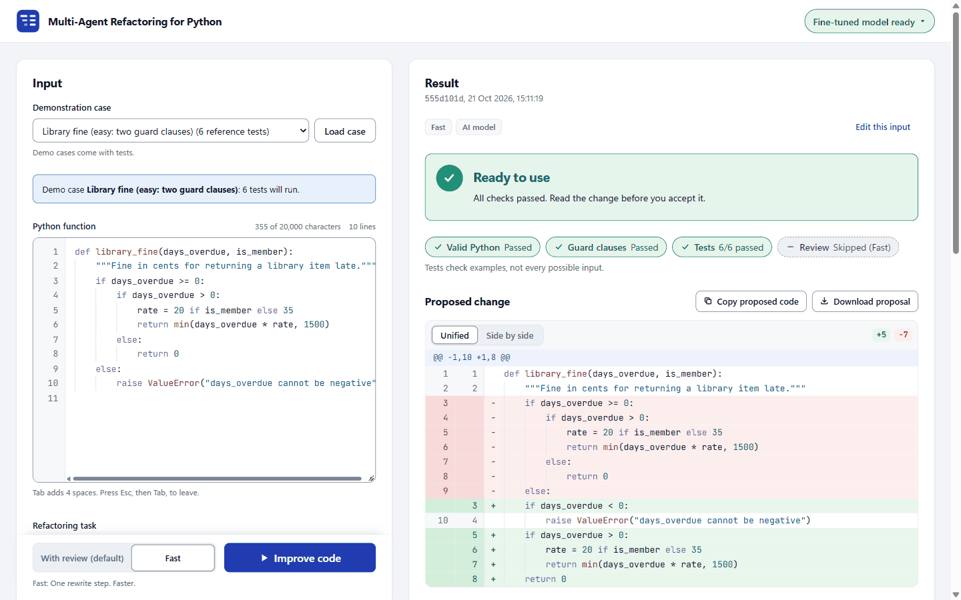
The interface
• Verdict first, in plain words
• Four check chips
• The change as a diff
• Accept or reject only records a decision
• Your files are never changed
Dania El-Walily · 0:45
14
Notes:
Screenshot docs/report/screenshots/s05-proposal-ready-light.png: one real run with the fine-tuned model (Fast, Library fine case), not a measured rate. The four results are shown separately; missing evidence is drawn as absent, never as a pass. The diff is computed by the application; decisions are records only. Demo mode carries a permanent banner. WCAG AA contrast is checked by tests in both themes (docs/report/notes/frontend.md).

Slide 15
Live demonstration
1 A success
a demo case → Ready to use
2 Out of scope
an already flat function → Nothing to change
3 A failed check
invalid syntax, and a result without trusted tests
Dania El-Walily · 9:30
15
Notes:
Follow docs/delivery/demo-script.md. Say the mode before the first run: the header pill shows "Fine-tuned model ready"; demo mode would show an amber banner. Abdullah Tarek and Abdelrahman Adel answer questions on the checks and the model.

Slide 16
Limits and next steps
Limits
Next steps
• One refactoring type, one small model
• Most data comes from templates
• Tests are examples, not proof
• The test runner is not a full sandbox
• Reproduced on one laptop only
• A reliable reviewer (tuned, or not cut off)
• A second refactoring type
• More real code in the data
• A stronger isolation layer
• Try the 1.5B model
Built with AI coding assistance; each of us owns and explains our part.
Abdelrahman Magdy · 1:30
16
Notes:
Limitations: one task; a 0.5B model; template-based data; tests that are not proof; a runner that is not a sandbox; one laptop, with training and evaluation on Kaggle in fp32 while the laptop serves in bf16. The declaration of coding-agent assistance must use the wording agreed with the supervisor (R1 question 5, ADR16); it is not written here because that meeting has not taken place. Future work: the candidates in docs/supervisor-reviews/r5-delivery.md, question 5.

Slide 17
Thank you
Questions?
17
Notes:
Likely questions with grounded answers are in docs/delivery/presentation-outline.md.

