Slide 1
Unit-2
Autoencoder, Variational Autoencoder

Slide 2
Introduction to Autoencoders
Autoencoders are neural networks designed to compress high-dimensional data into a lower-dimensional representation and then reconstruct the original data
Consist of two parts: an encoder network and a decoder network
Encoder compresses input data into lower-dimensional embedding vector
This process is called encoding
Decoder decompresses embedding back to original data domain
This process is called decoding

Slide 3
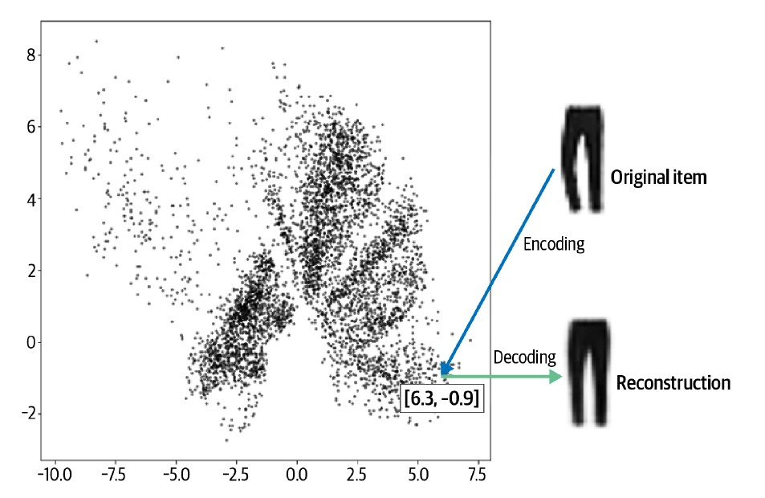
Introduction to Autoencoders
The trousers in Figure are encoded to the point [6.3, –0.9]. This vector is also known as an embedding because the encoder attempts to embed as much information into it as possible, so that the decoder can produce an accurate reconstruction.

Slide 4
Autoencoder Architecture
An autoencoder is simply a neural network that is trained to perform the task of encoding and decoding an item, such that the output from this process is as close to the original item as possible
It can be used as a generative model
We can decode any point in the 2D space that we want to produce a novel item of clothing

Slide 5
Code Example
https://github.com/davidADSP/Generative_Deep_Learning_2nd_Edition/blob/main/notebooks/03_vae/01_autoencoder/autoencoder.ipynb
Fashion MNIST Dataset

Slide 6
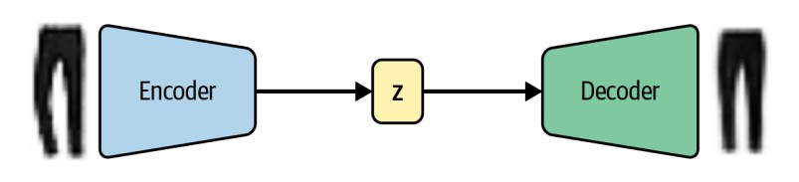

Slide 7
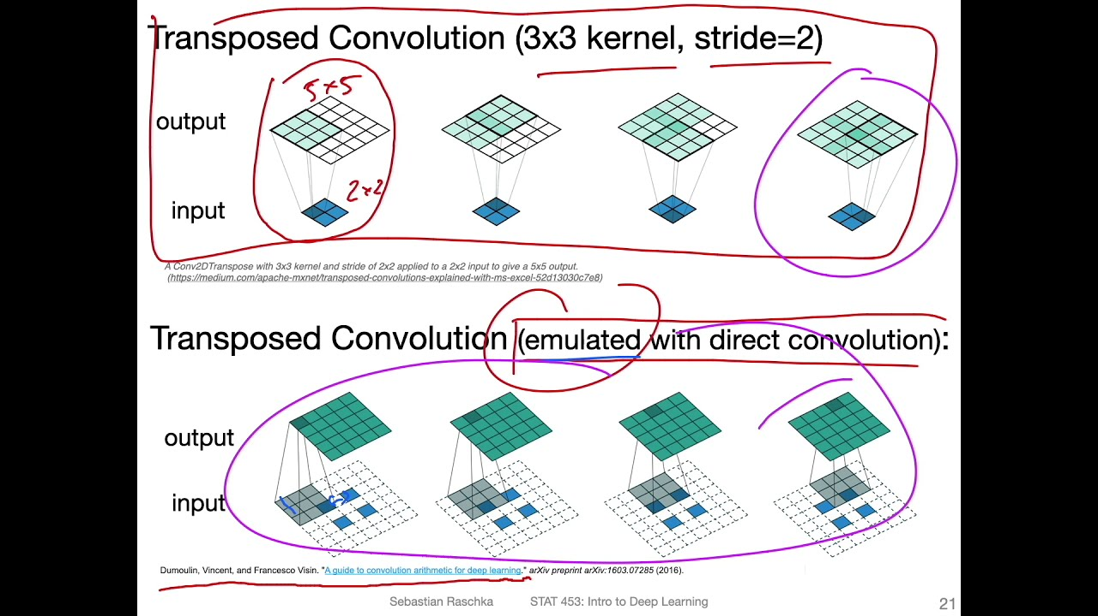
Transpose 2D Convolution

Slide 9
Visualizing the Latent Space
Notebook
https://colab.research.google.com/drive/1ilevBaYBE8NiBcYsqU3gRgU60QytM68M?usp=sharing

Slide 10
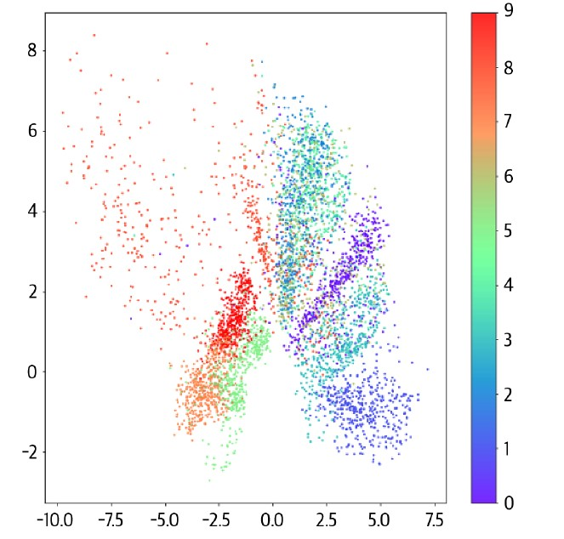
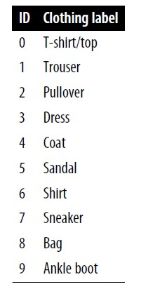
Visualizing the Latent Space – colored by clothing label

Slide 11
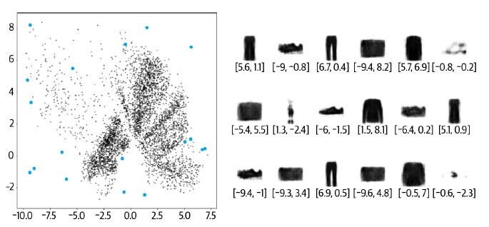
Generating New Images

Slide 12
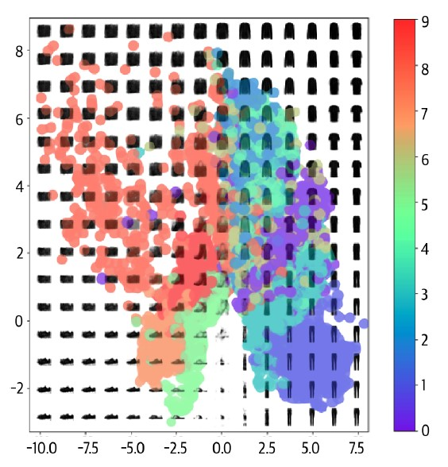
A grid of decoded embeddings

Slide 13
Problems/Disadvantages of Autoencoders
Uneven distribution: Imagine a map where different types of clothing are represented by different areas. Some clothes, like t-shirts, might take up more space on this map than others, like hats.
Sampling bias: If you were to randomly drop a pin on this map, you're more likely to hit the bigger areas. So you'd be more likely to "create" a t-shirt than a hat, simply because t-shirts take up more space on the map.

Slide 14
Problems/Disadvantages of Autoencoders
Undefined sampling method: There's no clear rule about how to choose a spot on this map to create a new piece of clothing. It's like being told to pick a random spot on a blank page without any guidelines.
Unbounded latent space: The "map" of clothing doesn't have clear boundaries. You could technically choose any point, even very far from where most clothes are usually found on the map.

Slide 15
Problems/Disadvantages of Autoencoders
Lack of centering: Unlike a traditional map where important things are often in the middle, this clothing map doesn't have a clear center. The clothing items might be scattered all over without a particular focal point.
Empty regions: There are blank areas on the map where no real clothing items exist. If you try to create a piece of clothing from these areas, you might get something that doesn't look like real clothing at all.

Slide 16
Problems/Disadvantages of Autoencoders
Central points may not decode well: Imagine a map where the middle is usually the "best" area. In this case, even the middle might give you odd results. It's like expecting the center of a city to always be nice, but sometimes finding it's not what you expected.
Lack of continuity: If you're walking from one spot to another very close by, you might suddenly see a big change. It's like taking one step in a neighborhood and finding yourself in a completely different place.

Slide 17
Problems/Disadvantages of Autoencoders
Dimensional constraints: When working with a small map (2D), everything gets squished together. It's like trying to organize all your clothes in a tiny closet - things end up close to each other even if they're different.
Complexity increases with dimensions: When we make the "map" bigger (more dimensions), it's like moving from a small closet to a huge warehouse. There's more space, but it becomes harder to organize things neatly.

Slide 18
Problems/Disadvantages of Autoencoders
Gaps between similar points: In this big warehouse, you might find all the shirts in one corner and all the pants in another far corner, with a lot of empty space in between. It's not efficiently organized.
No incentive for well-formed intermediates: The system doesn't try to put "normal-looking" clothes in the empty spaces. It's like having sections for red and blue shirts, but no effort to put purple shirts in between - the middle area might be empty or filled with odd-looking items.

Slide 19
What is the solution then?

Slide 20
Analogy for Variational Autoencoder
New placement strategy: Instead of putting each piece of clothing in one exact spot, they now give each item a general area. This is like saying, "T-shirts are around this area" rather than "This exact T-shirt goes in this exact spot." This helps solve the problem of sudden changes between nearby locations.
Rules for organization: They set two main rules: a) Try to keep the center of each clothing area close to the middle of the wardrobe. b) Items should typically be about one meter away from their area's center - not too close, not too far. If they break these rules, they have to pay Brian (the stylist) more money. This encourages them to stick to the rules.

Slide 21
Analogy for Variational Autoencoder
Improved results: After using this new system for a while, they see much better results:
There's a good variety of clothing items.
No more poorly made or weird-looking clothes.
The two new rules seem to have solved their previous problems.
In the context of machine learning, this is explaining how changing the way a model organizes information (the "wardrobe layout") and adding some constraints (the "rules") can lead to better and more consistent outputs (the "generated clothing items").

Slide 22
Analogy for Variational Autoencoder
The key takeaway is that by allowing some flexibility in how things are organized, but still maintaining some structure and rules, they've created a system that produces better and more diverse results without the weird glitches they had before.

Slide 23
What do we need to change?
The two parts that we need to change are the encoder and the loss function.

Slide 24
The Encoder
In an autoencoder, each image is mapped directly to one point in the latent space.
In a variational autoencoder, each image is instead mapped to a multivariate normal distribution around a point in the latent space

Slide 25
Single point (like in a regular autoencoder): This would be like always trying to hit the exact center of the dartboard. Each throw should ideally land on that one specific spot.
Multivariate normal distribution (like in a variational autoencoder): This is more like aiming for a general area around the center. Your throws are likely to land close to the center, but they're spread out in a pattern around it.

Slide 26
Key points about multivariate distribution:
It's "normal" or "bell-shaped": Most throws will be near the center, with fewer throws landing farther away.
It's "multivariate": This means it spreads out in multiple directions.
It has a center: There's still a central point you're aiming for, but you're okay with landing near it, not just exactly on it.
It has a spread: This determines how far from the center your throws typically land.

Slide 27
The Encoder
Encoder maps to mean and variance vectors: The encoder in a variational autoencoder maps each input to two vectors - a mean vector and a variance vector.
No covariance consideration: The encoder doesn't need to worry about covariance between dimensions in the latent space.
The machine doesn't worry about how changing one aspect of the photo might affect other aspects. It treats each characteristic independently.

Slide 28
The Encoder
The encoder will take each input image and encode it to two vectors that together define a multivariate normal distribution in the latent space:
z_mean: The mean point of the distribution
z_log_var: The logarithm of the variance of each dimension
Think of this as a special metal detector. When you scan an area, it doesn't just give you one spot, but instead it gives you two pieces of information: A "best guess" location (z_mean), A "how sure we are" measure (z_log_var)
We can sample a point z from the distribution defined by these values using the following equation:
z = z_mean + z_sigma * epsilon
where:
z_sigma = exp(z_log_var * 0.5)
epsilon ~ N(0,I)

Slide 29
The Decoder
The decoder of a variational autoencoder is identical to the decoder of a plain autoencoder

Slide 30
Overall Architecture

Slide 31
Why does this small change to the encoder help?
Previous lack of continuity: In earlier models, nearby points in the latent space didn't necessarily produce similar images.
Example of discontinuity: Points like (-2, 2) and (-2.1, 2.1) could decode to very different images.
New sampling method: The model now samples random points from an area around the mean (z_mean).
Continuity requirement: The decoder must now ensure that nearby points produce similar images.
Benefit of continuity: Even unseen points in the latent space are likely to produce well-formed images.

Slide 32
The Loss Function
The Kullback–Leibler (KL) divergence
KL divergence is a way of measuring how much one probability distribution differs from another.
In a VAE, we want to measure how much our normal distribution with parameters z_mean and z_log_var differs from a standard normal distribution.
kl_loss = -0.5 * sum(1 + z_log_var - z_mean ^ 2 - exp(z_log_var))

Slide 33
Generative Adversarial Networks

Slide 34
GAN
GAN Architecture: Two Adversarial Components
Generator: Creates synthetic data
Discriminator: Evaluates data authenticity
These components engage in a competitive learning process
Generator's Role
Random noise
Transform noise into convincing fake data
Produce outputs indistinguishable from real dataset samples
Discriminator's Role
Mix of real and generated data
Classify inputs as real or fake
Accurately distinguish between authentic and synthetic samples
Adversarial Training Process
Generator aims to fool the discriminator
Discriminator strives to improve detection accuracy
Continuous improvement loop: As one component improves, the other must adapt

Slide 35
GAN
Initial State of GAN Components
Generator Produces low-quality, noisy images. Discriminator Makes random predictions. Both networks start from a state of low performance
Alternating Training Mechanism
Training process switches between generator and discriminator. Each network improves incrementally in turns. This alternation is crucial for balanced development of both components
Adaptive Learning Process
As generator improves, it creates more convincing fake images. Discriminator must then enhance its detection capabilities. This creates a dynamic, competitive learning environment.
Continuous Improvement Cycle

Slide 36
Deep Convolutional GAN (DCGAN)
Paper: Unsupervised Representation Learning with Deep Convolutional Generative Adversarial Network (Alec Radford et al., January 7 – 2016, https://arxiv.org/abs/1511.06434)
Bricks Dataset
https://www.kaggle.com/datasets/joosthazelzet/lego-brick-images
1.1 GB, 40,000 LEGO Bricks, 50 different toy bricks

Slide 37
Deep Convolutional GAN (DCGAN)
Preprocessing
Image Size = 64*64
Color Mode = Gray Scale
When training GANs we rescale the data to the range [–1, 1] so that we can use the tanh activation function on the final layer of the generator, which tends to provide stronger gradients than the sigmoid function.

Slide 38
Upsampling Versus Conv2DTranspose
An alternative to using Conv2DTranspose layers is to instead use an UpSampling2D layer followed by a normal Conv2D layer with stride 1
x = layers.UpSampling2D(size = 2)(x)
x = layers.Conv2D(256, kernel_size=4, strides=1, padding="same")(x)
It has been shown that the Conv2DTranspose method can lead to artifacts, or small checkerboard patterns in the output image.

Slide 40
DCGAN Training Process
Training the DCGAN—gray boxes indicate that the weights are frozen during
training

Slide 41
Analysis of DCGAN

Slide 42
Wasserstein GAN (WGAN)
Imagine two people playing a game. One person (the generator) tries to create fake paintings, while the other person (the discriminator) tries to spot the fakes. As they keep playing, the faker gets better at creating convincing fakes, and the spotter gets better at detecting them. This back-and-forth process is how GANs work to generate realistic data.
Problem with traditional GANs: Sometimes, this game doesn't work well. The faker might give up too easily, or the spotter might become too good too quickly. This leads to unstable training and poor results.

Slide 43
WGAN
Wasserstein GAN (WGAN): WGAN changes the rules of the game to make it fairer and more stable. Instead of just saying "real" or "fake," the spotter (now called a critic) gives a score on how realistic the fake looks. This score is based on a special mathematical measure called the Wasserstein distance.

Slide 44
Advantages
More stable training: The game is less likely to break down, so the faker (generator) can keep improving.
Better feedback: The faker gets more useful information on how to improve, rather than just "you failed.”
Easier to tell if it's working: The scores given by the critic directly relate to the quality of the generated fakes, making it easier to track progress.
Better quality: The generated samples tend to be of higher quality.

Slide 45
Wasserstein distance
The Wasserstein distance is a way to measure how different two probability distributions are.
In the context of GANs, it's used to compare the distribution of real data with the distribution of generated (fake) data.
Goal: Make the generated distribution as similar as possible to the real distribution

Slide 46
Conditional GAN (CGAN)

Slide 47
CGAN

