Slide 1
Computer Case Types
Prof. Abdul Samad

Slide 2
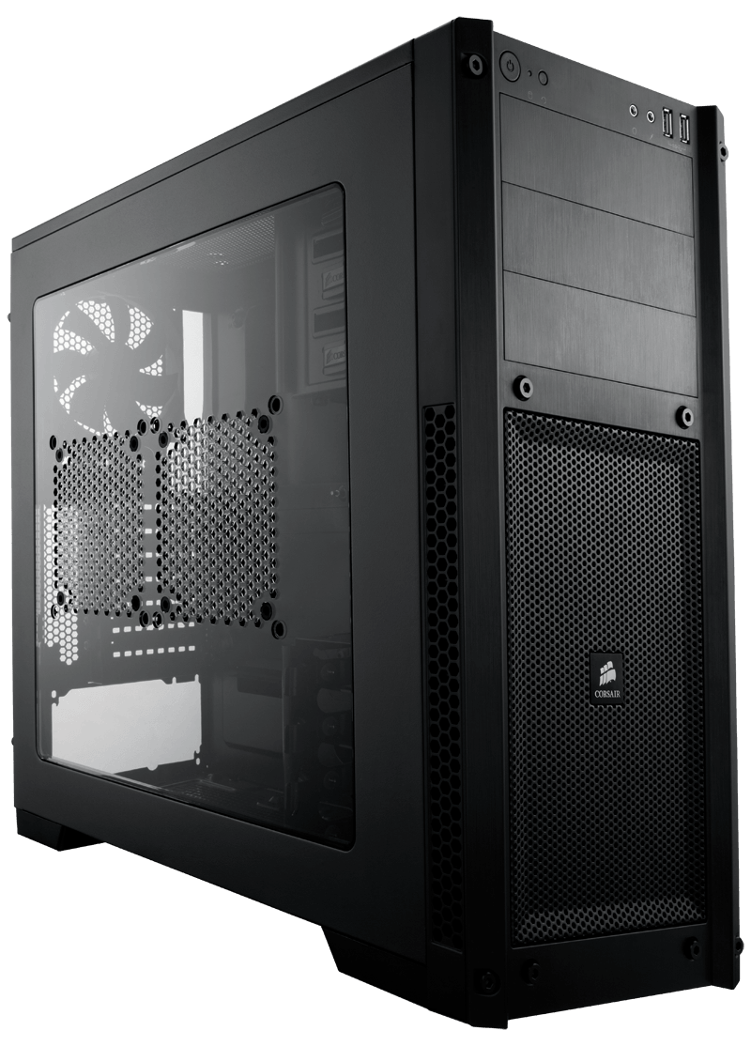
What is computer case ?
A computer case is the outer cover of a computer that holds and protects all the inside parts.
This Photo by Unknown Author is licensed under CC BY-NC

Slide 3
Types Of Computer Cases
Desktop Case
Tower Case
Mini PC Case
Laptop Case
Rackmount Case

Slide 4
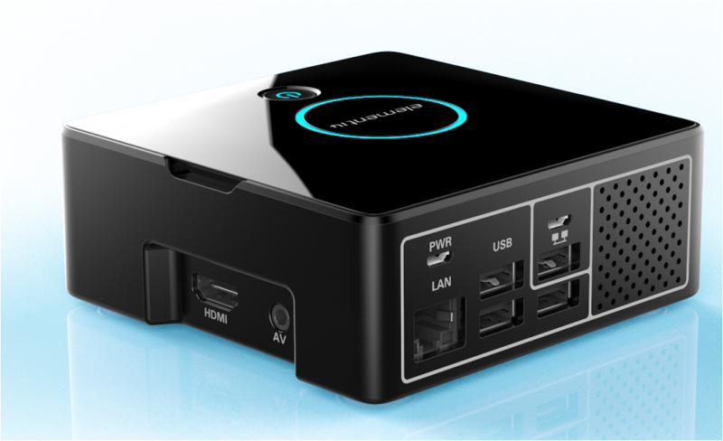
Desktop Case
A desktop case is a flat, box-shaped shell that holds all of a computer's main components, including the motherboard, CPU, and storage.
It usually lie on top of a desk sometimes has a monitor lying on it.
The cover protects the computer's components and helps them stay cool.

Slide 5
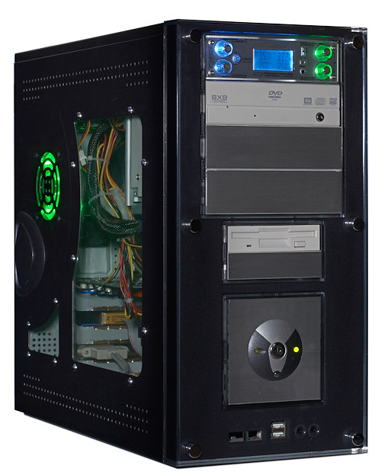
Tower Case
A tower case is a type of desktop computer in which the case is vertically oriented like a tower.
This form allows greater component area and better cooling than smaller, horizontal cases.
This Photo by Unknown Author is licensed under CC BY-SA-NC

Slide 6
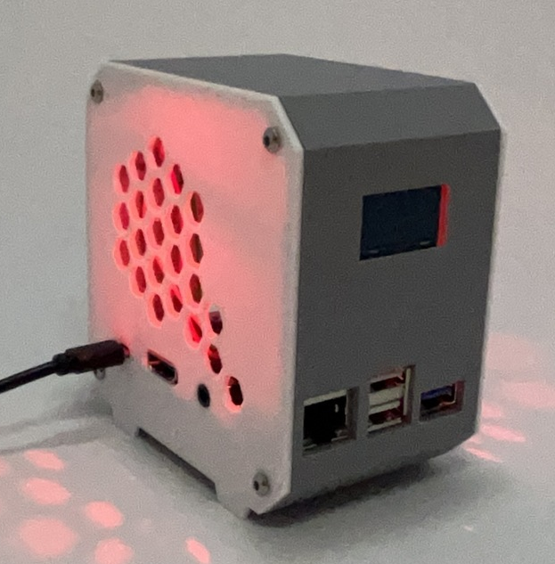
Mini PC Case
A Mini PC case is a small case for storing all the parts of a small form-factor personal computer.
It's suitable to save space while still providing sufficient protection and cooling for the PC's internal parts.

Slide 7
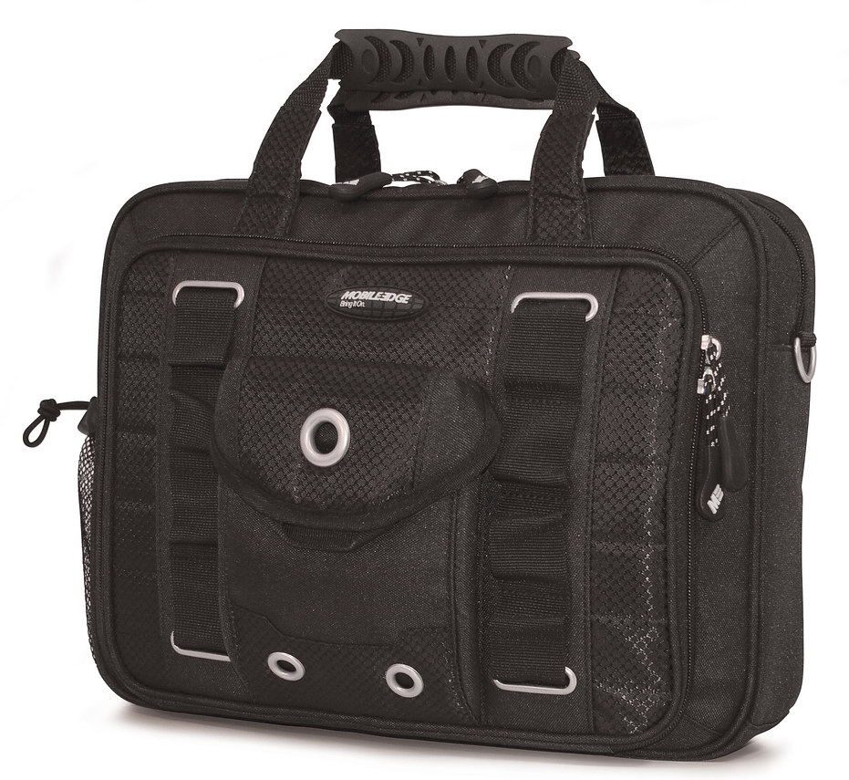
Laptop Case
A laptop case is a protective cover for laptops. It protects the laptop from shocks, scratches, and dust while also making it easier to carry around.
A laptop case often includes drawers or compartments for equipment such as chargers, cables, and documents, making it perfect for travel and daily use.

Slide 8
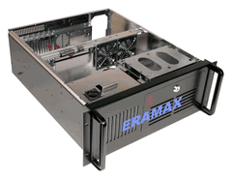
Rackmount Case
Rackmount cases also called rackmount enclosures, rackmount chassis.
Rackmount cases are a special type of enclosure used for the protection of equipment when being mounted into standard 19" racking.
They are designed to house devices such as routers, UPS power supplies, computers, switches, and audio equipment.

