Slide 1
Deep Learning Approach for Automated Climate Change Fact-Checking
Group Members:
Bushraa Yousuf
Hijab Fatima
Zainab Haider

Slide 2
01
Research Question
Given a claim about climate change, assess its factual accuracy and determine whether it is true or false.

Slide 3
Motivation
Combating Widespread Climate Misinformation
Improved Climate Literacy
Supporting Climate Policy and Advocacy

Slide 4
02
Models & Experimentation

Slide 5
Dataset
No | Topic | Scientific Papers Abstracts
1 | Greening | 188
2 | CO2 Emissions | 189
3 | Extreme Weather | 177
4 | Global Warming | 167
Claims | 770

Slide 6
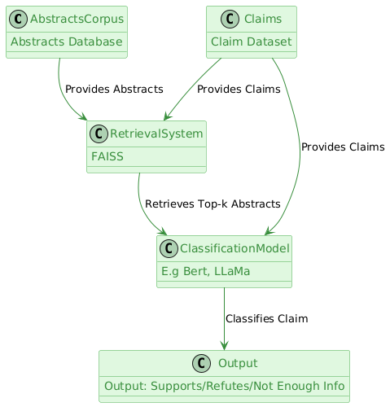
Model Diagram

Slide 7
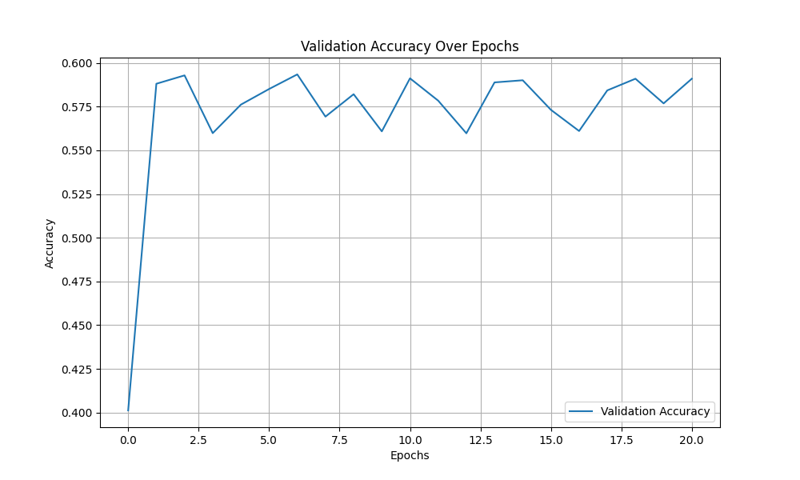
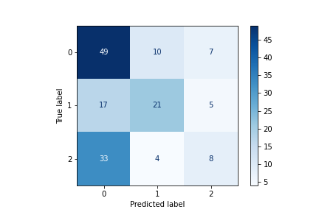
Initial Experiments
Results using LLaMa 3.2 1b

Slide 8
Data Augmentation
To enhance dataset diversity and size, improve model generalization, and address biases or underrepresentation in the dataset
Used the Gemini API for Synonym Replacement (SR) to augment claims by replacing key words with synonyms while preserving semantic meaning.
Dataset size was doubled
Label | Count
0 | 344
1 | 220
2 | 206
Total | 770
Label | Count
0 | 686
1 | 439
2 | 412
Total | 1537
Original Claims Dataset
Augmented Claims Dataset

Slide 9
Hyperparameters for LLaMa 3.2
Hyperparameter | Value
Epochs | 20
Batch Size | 4
Learning rate | 2e-5
Weight Decay | 0.01
Optimizer | AdamW
Loss Function | Cross Entropy Loss

Slide 10
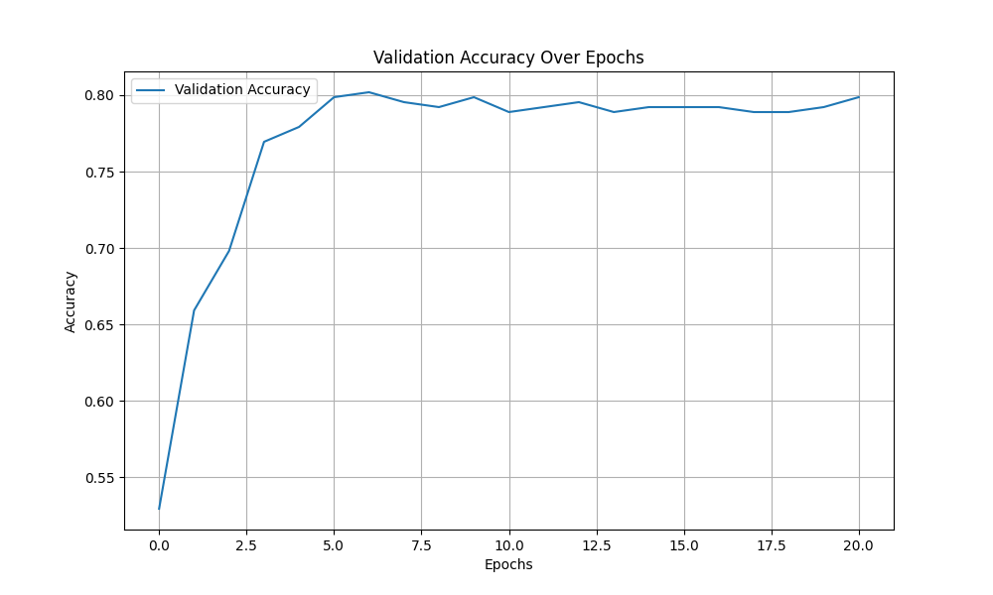
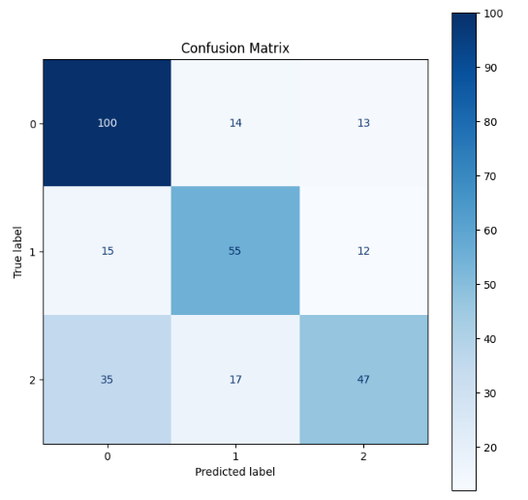
LLaMa 3.2 1B - 80.19%

Slide 11
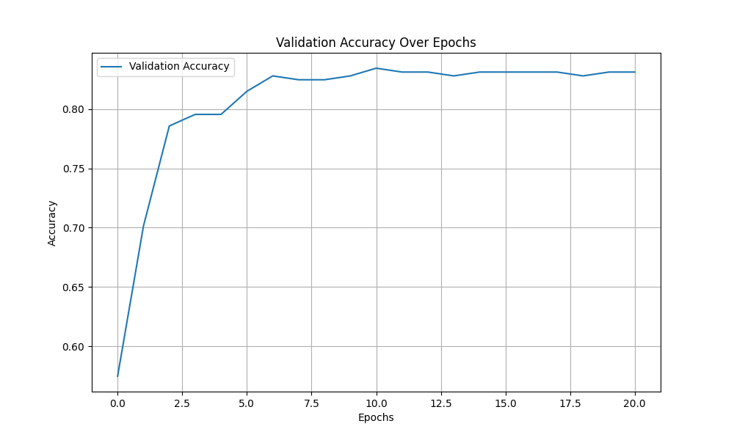
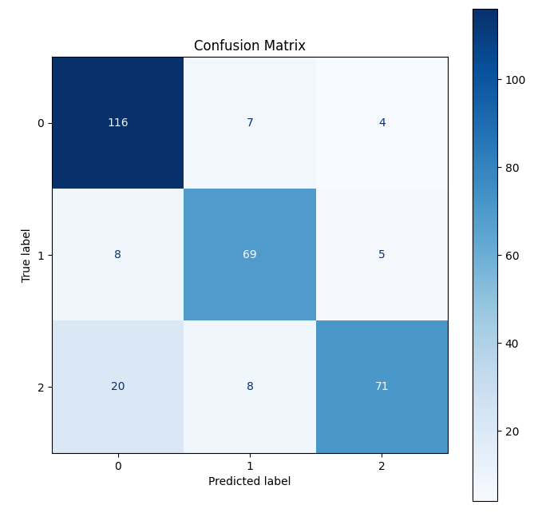
LLaMa 3.2 3B - 83.44%

Slide 12
Hyperparameters for BERT models
Hyperparameter | Value
Epochs | 100
Batch Size | 4
Learning rate | 1e-5
Optimizer | Adam
Loss Function | Sparse Categorical Cross entropy

Slide 13
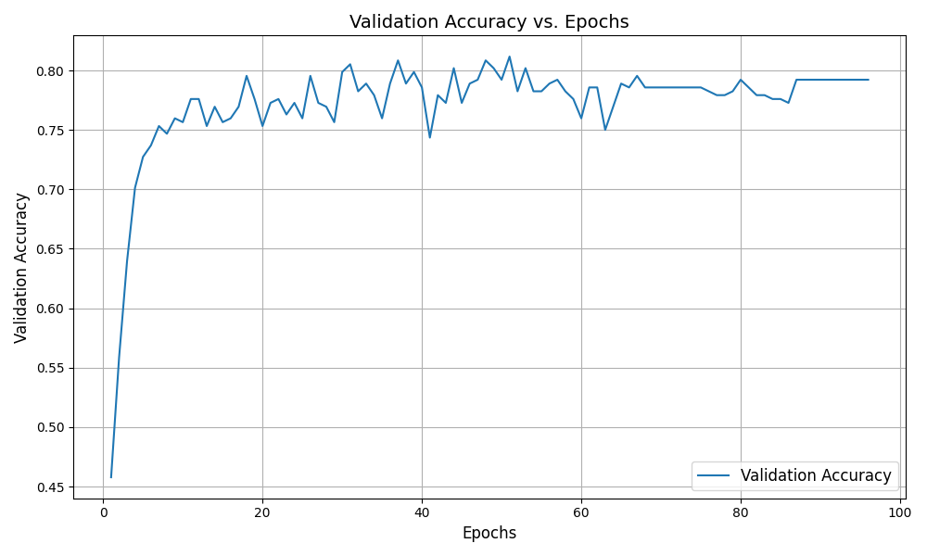
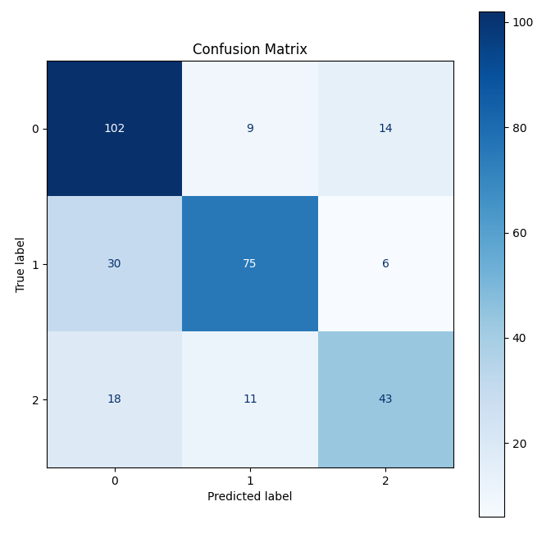
SciBERT - 81.17%

Slide 14
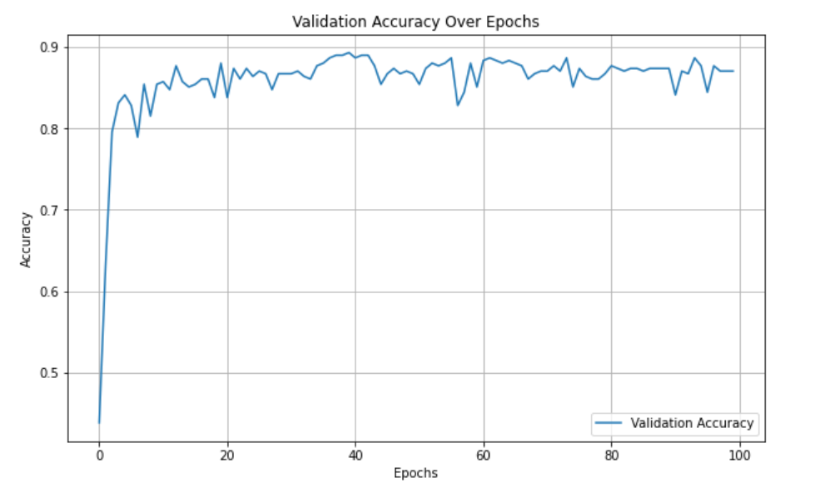
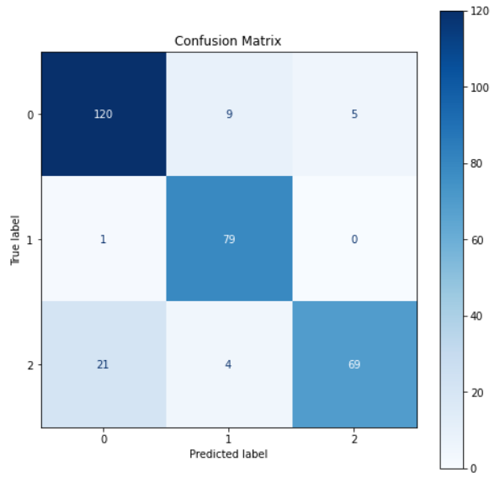
DeBERTa - 89.29%

Slide 15
Summary
Model | Accuracy | Dataset Type
LLaMa 3.2 1B | 0.5901 | Original Claims Dataset
LLaMa 3.2 1B | 0.8019 | Augmented Claims Dataset
LLaMa 3.2 3B | 0.8344 | Augmented Claims Dataset
SciBERT | 0.8117 | Augmented Claims Dataset
DeBERTa | 0.8929 | Augmented Claims Dataset

Slide 16
03
Results & Discussion

Slide 17
Year | Data Type | Model | Accuracy
2024 [2] | False Claims for Covid-19 through Google Fact Check Tools and PolitiFact Synthetic Data set using GPT-4, GPT-3.5-Turbo, and Llama-2-70b-chat-hf Coronavirus Twitter Dataset | BERT-base GPT-4 GPT-3.5-turbo LLaMa-2-13B LLaMa-2-7B | 46% 63% 73% 71% 73%
2021 [1] | Climate Fever Claims Dataset (multi class classification) | RoBERTa | F1 score of 0.718
2022 [3] | Climate Fever Claims Dataset (multi class classification) | climateGPT-2 GPT-2 | F1 score of 0.72 F1 score of 0.67
2024 [4] | Scientific Abstracts and Claims | Climinator (GPT-4-based Model) | 7 classes: 62.72 5 classes: 64.4 2 classes: 97.04

Slide 18
Comparison
Most existing work relies on claim-based datasets.
Our model achieved higher accuracy than existing models for multi-class classification tasks.
Despite using open-source models, our approach demonstrated strong performance.
We curated a publicly available dataset of scientific literature abstracts to support future research.
By augmenting the Climate Fever Claims dataset, we expanded it from 770 to 1537 claims, enriching its diversity.

Slide 19
Future Improvement
1.
2.
3.
Claims Dataset
Abstracts Dataset
Different Models
Leveraging large language models, curate a more comprehensive and intensive claims dataset, building upon the existing claims dataset
Collecting additional scientific literature on existing climate issues from diverse resources beyond Google Scholar
Experimenting with advanced models like GPT-4, and leveraging techniques like ensemble learning and domain-specific pretraining for enhanced accuracy

Slide 20
References
Wang, G., Chillrud, L., & McKeown, K. (2021). Evidence-Based Automatic Fact-Checking for Climate Change Misinformation. In Proceedings of the Fifteenth International AAAI Conference on Web and Social Media (ICWSM-2021). Retrieved from https://workshop-proceedings.icwsm.org/pdf/2021_39.pdf
E. C. Choi and E. Ferrara, “FACT-GPT: Fact-Checking Augmentation via Claim Matching with LLMs,” arXiv (Cornell University), Feb. 2024, doi: 10.48550/arxiv.2402.05904.
S. Vaghefi, V. Muccione, C. Huggel, H. Khashehchi, and M. Leippold, "Deep Climate Change: A Dataset and Adaptive Domain Pre-trained Language Models for Climate Change Related Tasks," in *NeurIPS 2022 Workshop on Tackling Climate Change with Machine Learning*, 2022. [Online]. Available: https://s3.us-east-1.amazonaws.com/climate-change-ai/papers/neurips2022/27/paper.pdf
M. Leippold et al., “Automated Fact-Checking of Climate Change Claims with Large Language Models,” arXiv (Cornell University), Jan. 2024, doi: 10.48550/arxiv.2401.12566.

Slide 21
Thank You!

