Slide 1
Transformers
Abdul Samad
Adapted from Prof. Simon Prince

Slide 2
Natural language processing (NLP)
Translation
Question answering
Summarizing
Generating new text
Correcting spelling and grammar
Finding entities
Classifying bodies of text
Changing style etc.

Slide 3
Transformers
Motivation
Dot-product self-attention
Matrix form
The transformer
NLP pipeline
Decoders
Large Language models

Slide 4
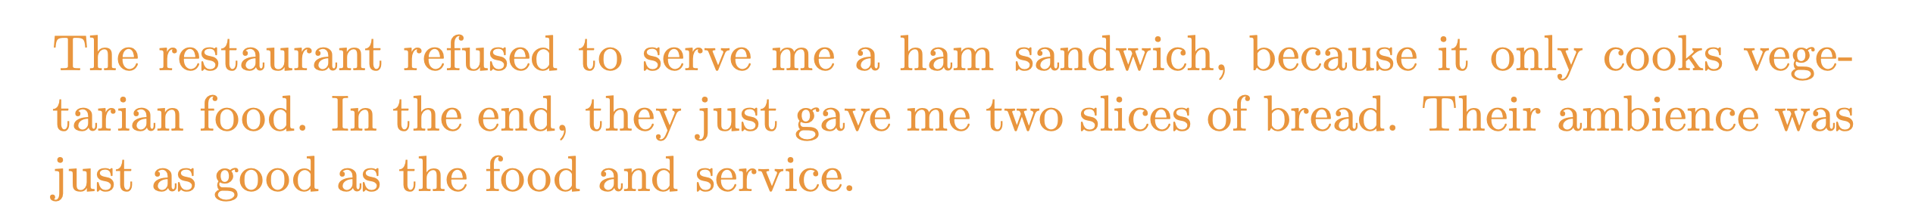
Motivation
Design neural network to encode and process text:
Notes:
The goal is to design a network to process this text into a representation suitable for downstream tasks. For example, it might be used to classify the review as positive or negative or to answer questions such as “Does the restaurant serve steak?”

Slide 5

Motivation
Design neural network to encode and process text:

Slide 6

Motivation
Design neural network to encode and process text:
x N

Slide 7
Standard fully-connected layer
Notes:
The encoded input can be surprisingly large. In this case, each of the 37 words might be represented by an embedding vector of length 1024, so the encoded input would be of length 37 × 1024 = 37888 even for this small passage. A more realistically sized body of text might have hundreds or even thousands of words, so fully connected neural networks are impractical.

Slide 8
Standard fully-connected layer

Slide 9
Standard fully-connected layer
Problem:
A very large number of parameters
Can’t cope with text of different lengths
Conclusion:
We need a model where parameters don’t increase with input length

Slide 10
Motivation
Design neural network to encode and process text:
The word their must “attend to” the word restaurant.

Slide 11
Motivation
Design neural network to encode and process text:
The word their must “attend to” the word restaurant.
Conclusions:
There must be connections between the words.
The strength of these connections will depend on the words themselves.

Slide 12
Transformers
Motivation
Dot-product self-attention
Matrix form
The transformer
NLP pipeline
Decoders
Large Language models

Slide 13



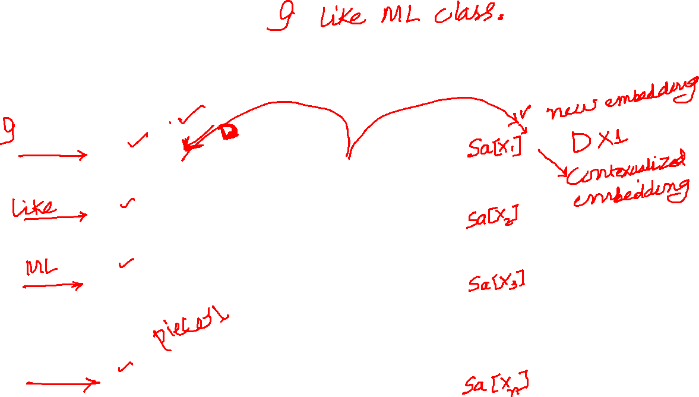





Self-Attention Block
$D×1$ contexual embeddings
$n$ words as input
$D×1$ embedding of words
word1
$$x_{1}$$
Self Attention Block
word2
$$x_{2}$$
word3
$$x_{3}$$
Word $n$
$$x_{n}$$
Notes:
self-attention block sa[•] takes N inputs x1, . . . , xN , each of dimension D × 1, and returns N output vectors of the same size. In the context of NLP, each input represents a word or word fragment.

Slide 14
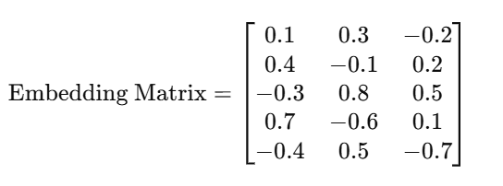
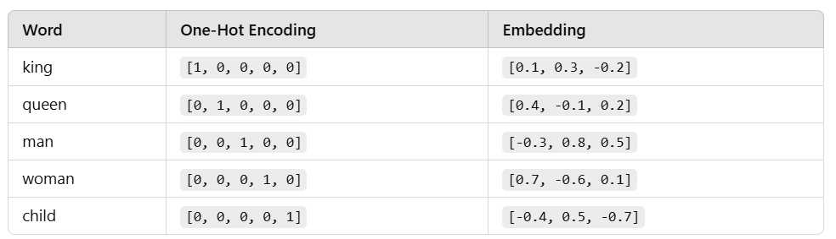
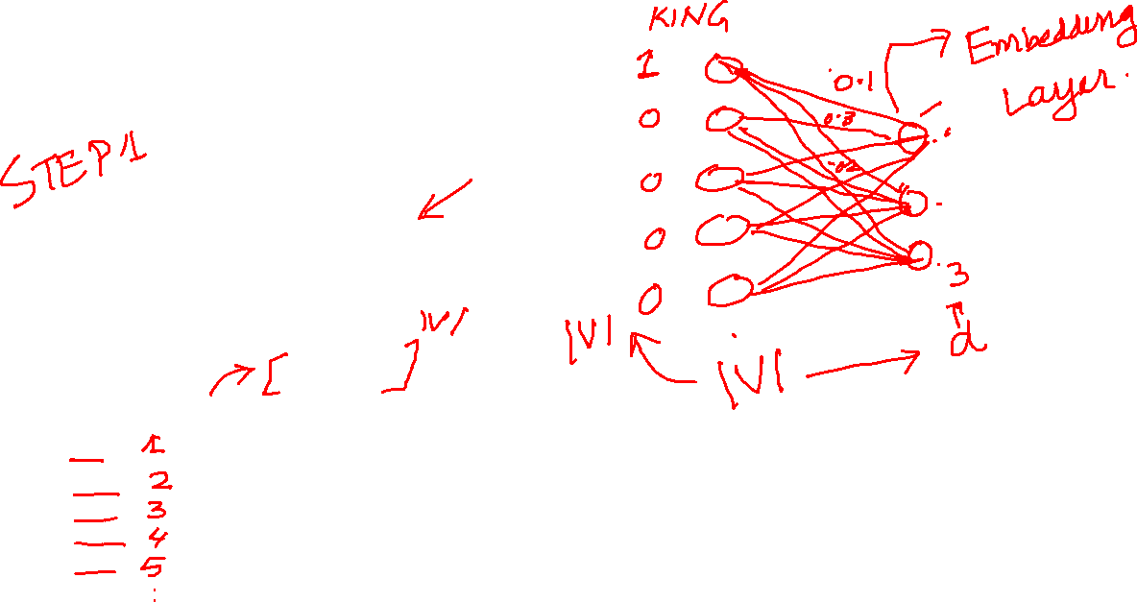
Word Embedding

Slide 15

Dot-product self attention
Takes N inputs of size Dx1 and returns N inputs of size Dx1
Computes N values (no ReLU)
N outputs are weighted sums of these values
Weights depend on the inputs themselves

Slide 16
Dot-product self attention
Takes N inputs of size Dx1 and returns N inputs of size Dx1
Computes N values (no ReLU)
N outputs are weighted sums of these values
Weights depend on the inputs themselves

Slide 17
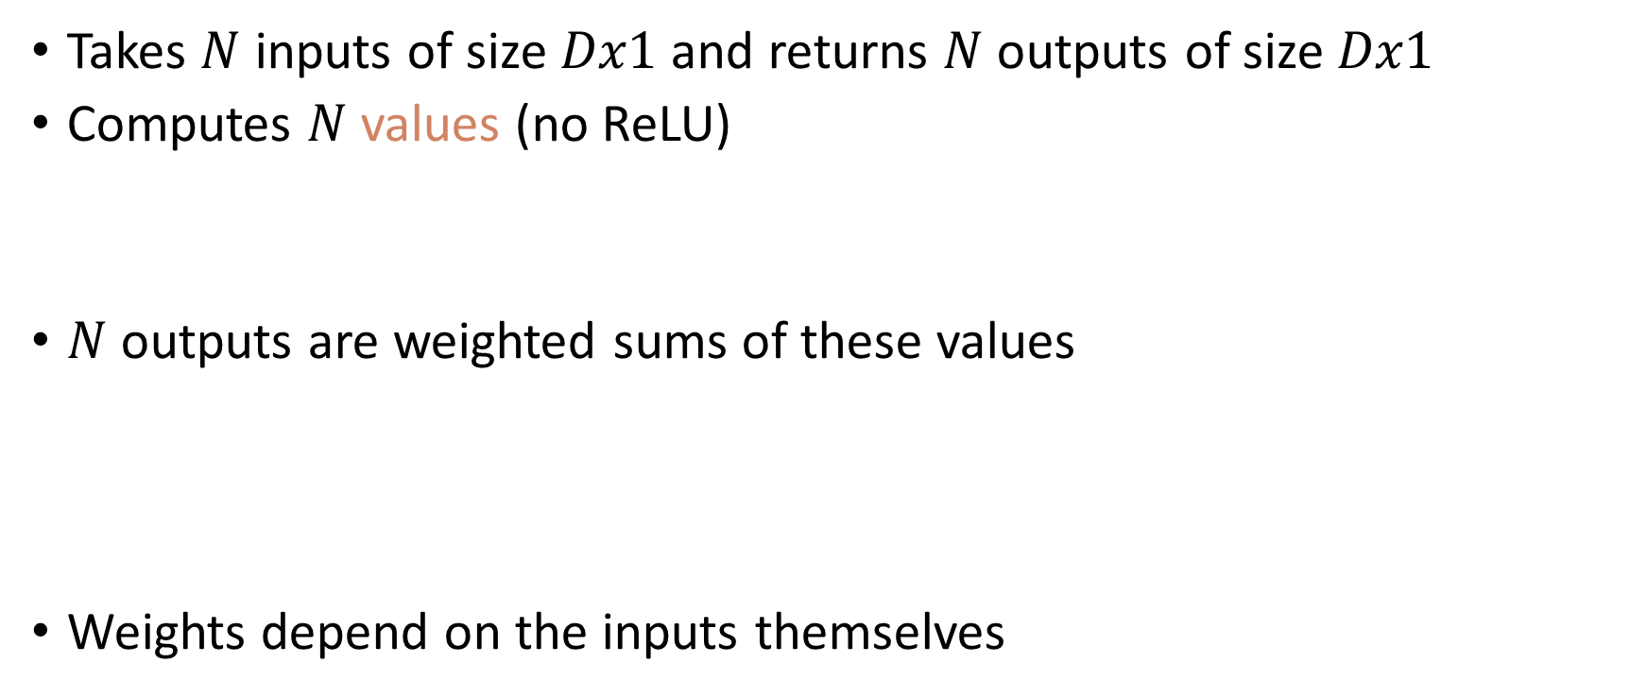
Dot-product self attention
Takes $N$ inputs of size $Dx1$ and returns $N$ outputs of size $Dx1$
Computes $N$ values (no ReLU)
$N$ outputs are weighted sums of these values
Weights depend on the inputs themselves

Slide 18
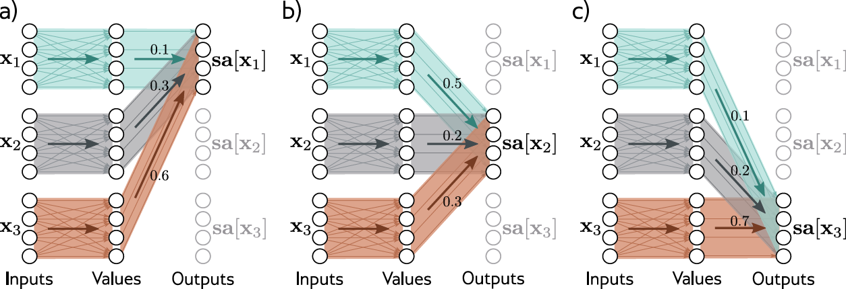
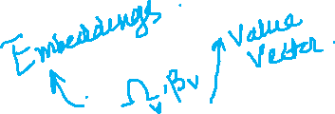
Attention as routing

Slide 19
Attention as routing

Slide 20
Attention as routing

Slide 21
Attention weights
Compute N “queries” and N “keys” from input
Calculate similarity and pass through softmax:
Weights depend on the inputs themselves

Slide 22
Attention weights
Compute N “queries” and N “keys” from input
Take dot products and pass through softmax:
Weights depend on the inputs themselves

Slide 23
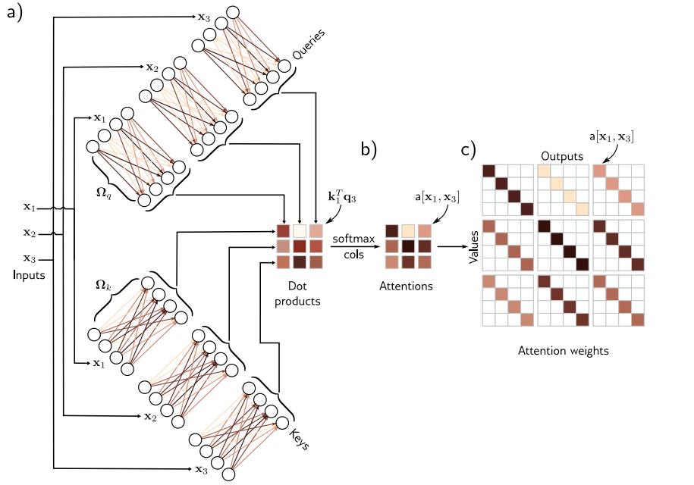
Attention Weights

Slide 24
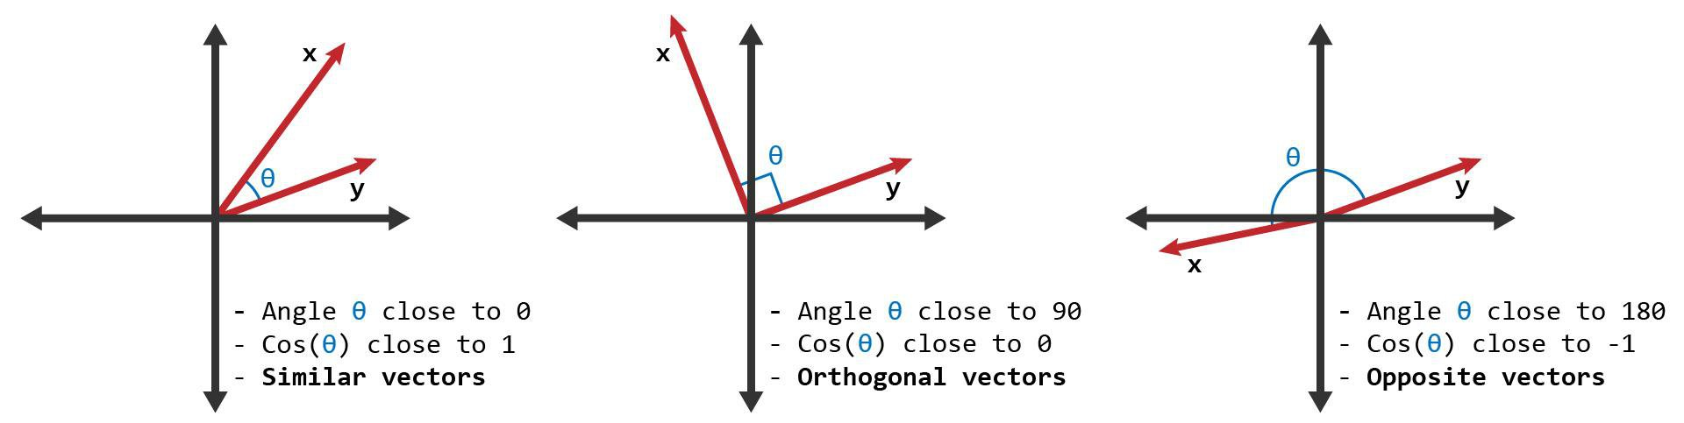
Dot product = measure of similarity

Slide 25
Motivation
Design neural network to encode and process text:
Conclusions:
We need a model where parameters don’t increase with input length
There must be connections between the words.
The strength of these connections will depend on the words themselves.

Slide 26
Transformers
Motivation
Dot-product self-attention
Matrix form
The transformer
NLP pipeline
Decoders
Large Language models

Slide 27
Matrix form
Store N input vectors in matrix X
Compute values, queries and keys:
Combine self-attentions

Slide 28
Matrix form

Slide 29
Position encoding
Self-attention is equivariant to permuting word order
But word order is important in language:
The man ate the fish
vs.
The fish ate the man

Slide 30
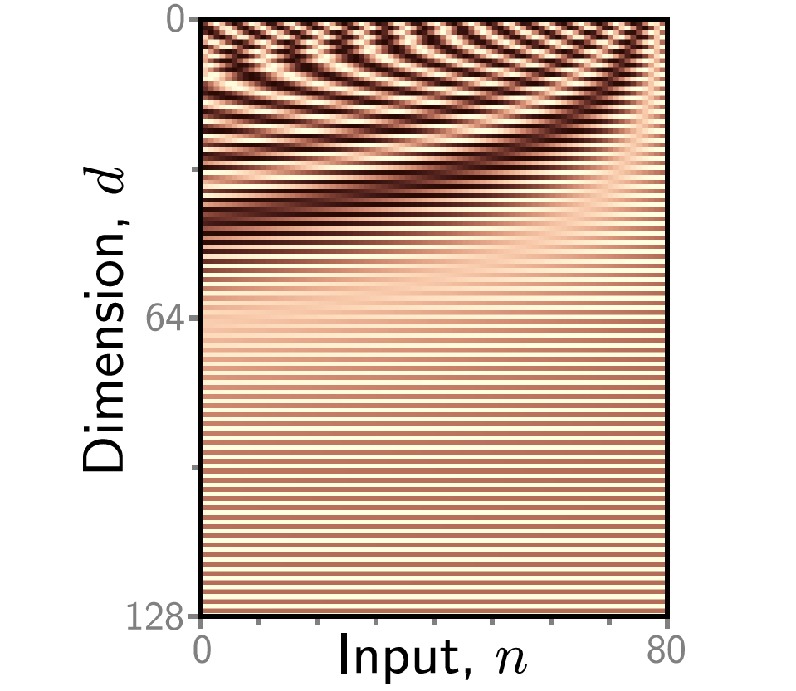
What is Positional Encoding?
Positional encoding is a technique used in Transformer models to provide information about the position of tokens in a sequence.

Slide 31
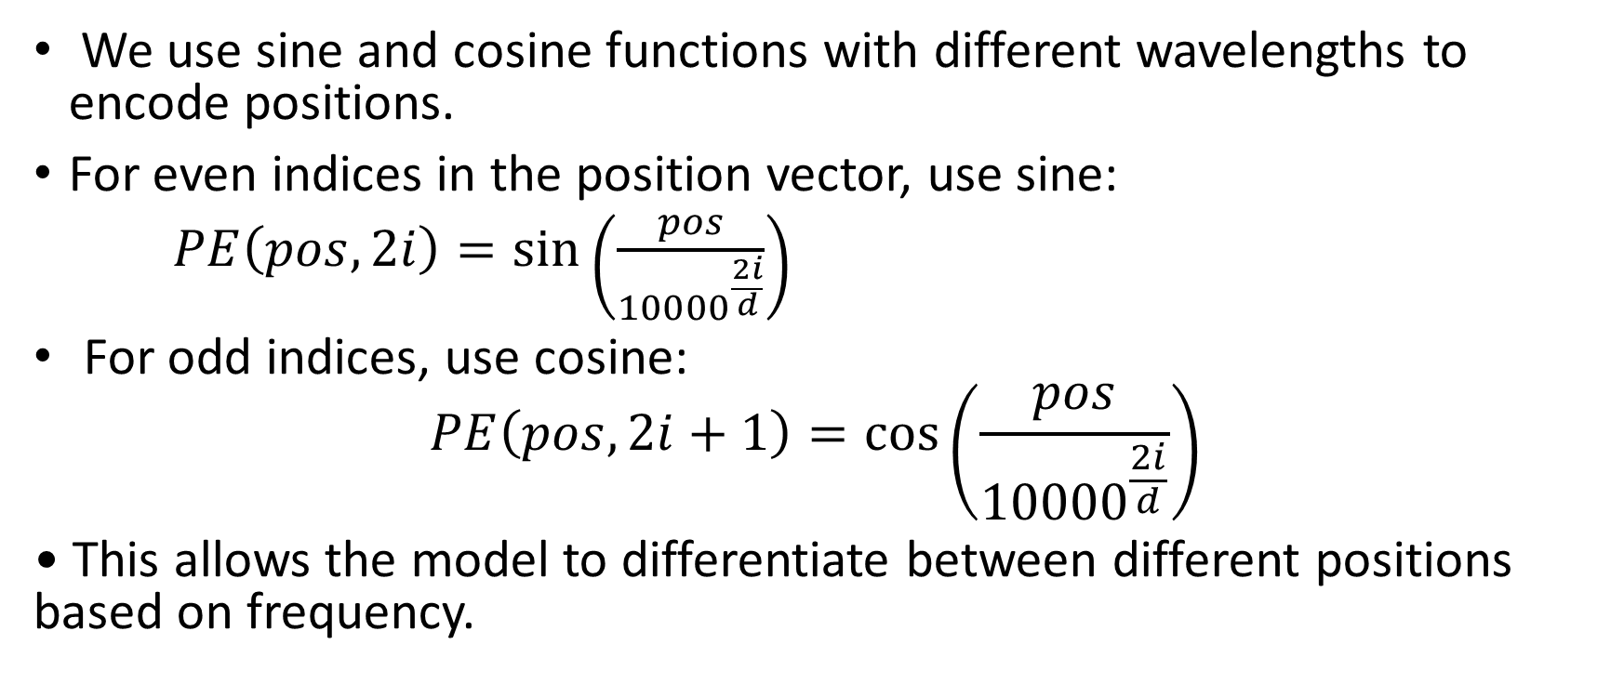
How Does It Work?
We use sine and cosine functions with different wavelengths to encode positions.
For even indices in the position vector, use sine:
$PE\left(pos, 2i\right)=\sin\left(\frac{pos}{{10000}^{\frac{2i}{d}}}\right)$
For odd indices, use cosine:
$$PE\left(pos, 2i+1\right)=\cos\left(\frac{pos}{{10000}^{\frac{2i}{d}}}\right)$$
• This allows the model to differentiate between different positions based on frequency.

Slide 32
Example: Simple Sequence
Let's take a simple example:
Sequence: ['I', 'am', 'learning', 'NLP']
Each word has an embedding in a 4-dimensional space (d=4).
We will calculate positional encodings for positions 0, 1, 2, and 3.

Slide 33
Calculating Position 0 Encoding
For position 0 (assuming d=4):
• PE(0,0) = sin(0 / 10000^(0/4)) = sin(0) = 0
• PE(0,1) = cos(0 / 10000^(0/4)) = cos(0) = 1
• PE(0,2) = sin(0 / 10000^(2/4)) = sin(0) = 0
• PE(0,3) = cos(0 / 10000^(2/4)) = cos(0) = 1
Position Encoding: [0, 1, 0, 1]

Slide 34
Calculating Position 1 Encoding
For position 1 (d=4):
• PE(1,0) = sin(1 / 10000^(0/4)) = sin(1) ≈ 0.8415
• PE(1,1) = cos(1 / 10000^(0/4)) = cos(1) ≈ 0.5403
• PE(1,2) = sin(1 / 10000^(2/4)) ≈ 0.0785
• PE(1,3) = cos(1 / 10000^(2/4)) ≈ 0.9969
• Position Encoding: [0.8415, 0.5403, 0.0785, 0.9969]

Slide 35
Final Encodings for Sequence
Position encodings for the sequence:
• Position 0: [0, 1, 0, 1]
• Position 1: [0.8415, 0.5403, 0.0785, 0.9969]
• Position 2: [0.9093, 0.4161, 0.1564, 0.9877]
• Position 3: [0.1411, -0.9899, 0.2330, 0.9724]

Slide 36
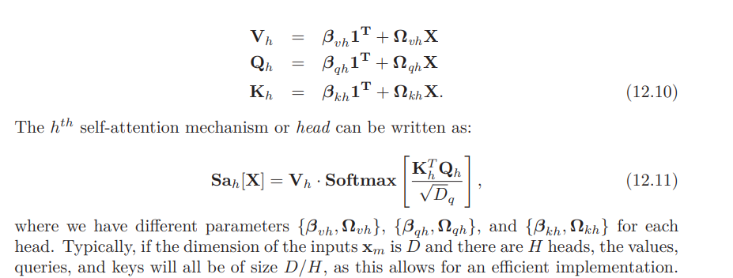
Multiple heads

Slide 37
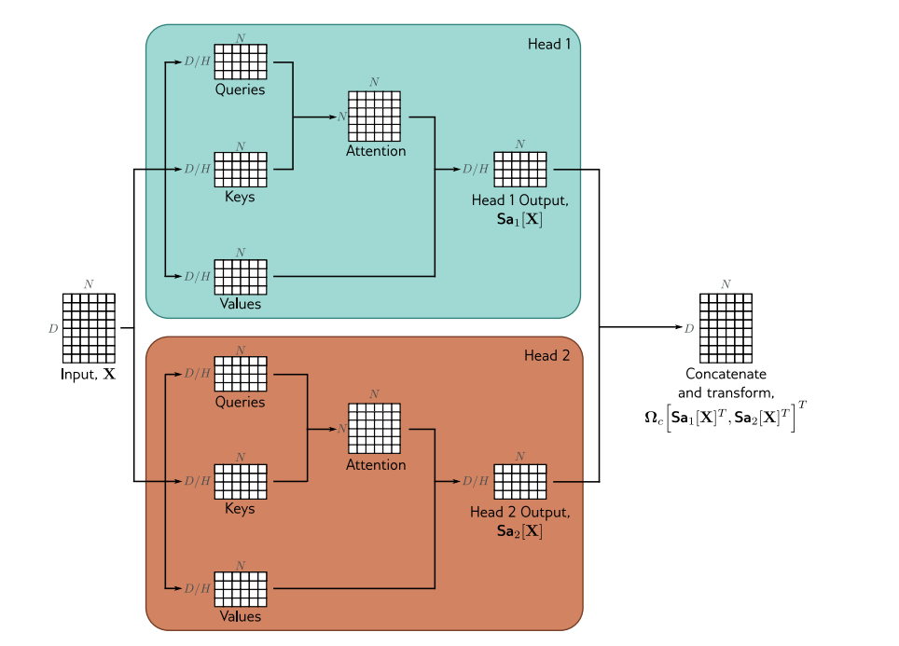

Multiple heads

Slide 38
Transformers
Motivation
Dot-product self-attention
Matrix form
The transformer
NLP pipeline
Encoders, decoders, and encoder-decoders
Transformers for vision

Slide 39
Transformers
Motivation
Dot-product self-attention
Matrix form
The transformer
NLP pipeline
Decoders
Large Language models

Slide 40
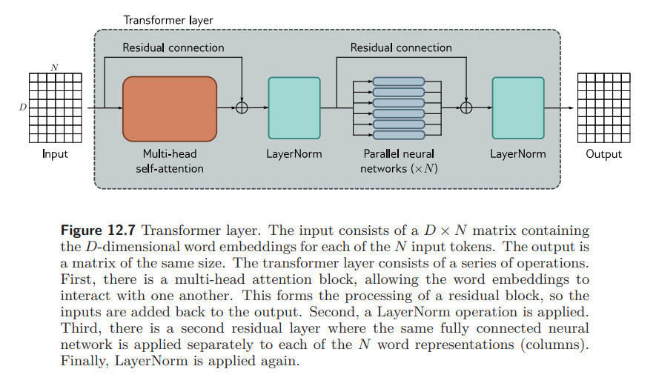
The transformer
https://poloclub.github.io/transformer-explainer/?fbclid=IwY2xjawGNndNleHRuA2FlbQIxMQABHZ7Qn4O499hmrFMO5eDLdbqRp-Y3F64d0eLlZ4zH6pq2EfwvPQZ0FLI0EQ_aem_DqjO_heFYGfUb1lijlsgyA

Slide 41
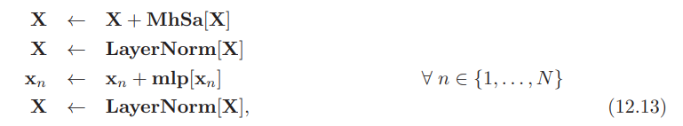
The transformer
https://poloclub.github.io/transformer-explainer/?fbclid=IwY2xjawGNndNleHRuA2FlbQIxMQABHZ7Qn4O499hmrFMO5eDLdbqRp-Y3F64d0eLlZ4zH6pq2EfwvPQZ0FLI0EQ_aem_DqjO_heFYGfUb1lijlsgyA

Slide 42
Transformers
Motivation
Dot-product self-attention
Matrix form
The transformer
NLP pipeline
Decoders
Large Language models

Slide 43
Tokenizer
Goal: Tokenizer chooses input “units”
Inevitably, some words (e.g., names) will not be in the vocabulary.
It’s not clear how to handle punctuation
The vocabulary would need different tokens for versions of the same word with different suﬀixes (e.g., walk, walks, walked, walking) and there is no way to clarify that these variations are related
Solution: Sub-word tokenization
Notes:
we have implied that these tokens represent words, but there are several difficulties. • Inevitably, some words (e.g., names) will not be in the vocabulary. • It’s unclear how to handle punctuation, but this is important. If a sentence ends in a question mark, we must encode this information. • The vocabulary would need different tokens for versions of the same word with different suffixes (e.g., walk, walks, walked, walking), and there is no way to clarify that these variations are related.

Slide 44
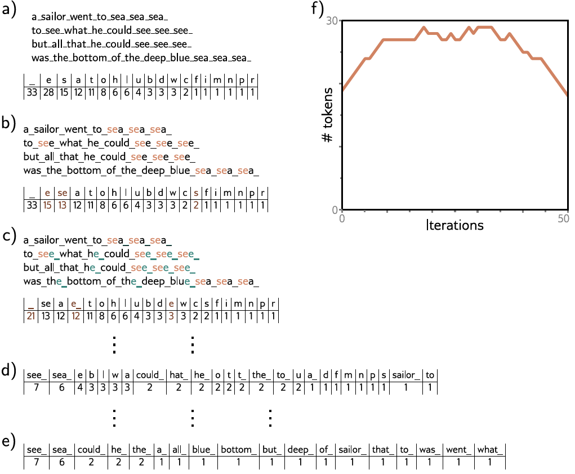
Notes:
8 Sub-word tokenization. a) A passage of text from a nursery rhyme. The tokens are initially just the characters and whitespace (represented by an underscore), and their frequencies are displayed in the table. b) At each iteration, the sub-word tokenizer looks for the most commonly occurring adjacent pair of tokens (in this case, se) and merges them. This creates a new token and decreases the counts for the original tokens s and e. c) At the second iteration, the algorithm merges e and the whitespace character_. Note that the last character of the first token to be merged cannot be whitespace, which prevents merging across words. d) After 22 iterations, the tokens consist of a mix of letters, word fragments, and commonly occurring words. e) If we continue this process indefinitely, the tokens eventually represent the full words. f) Over time, the number of tokens increases as we add word fragments to the letters and then decreases again as we merge these fragments. In a real situation, there would be a very large number of words, and the algorithm would terminate when the vocabulary size (number of tokens) reached a predetermined value. Punctuation and capital letters would also be treated as separate input characters.

Slide 45
Notes:
8 Sub-word tokenization. a) A passage of text from a nursery rhyme. The tokens are initially just the characters and whitespace (represented by an underscore), and their frequencies are displayed in the table. b) At each iteration, the sub-word tokenizer looks for the most commonly occurring adjacent pair of tokens (in this case, se) and merges them. This creates a new token and decreases the counts for the original tokens s and e. c) At the second iteration, the algorithm merges e and the whitespace character_. Note that the last character of the first token to be merged cannot be whitespace, which prevents merging across words. d) After 22 iterations, the tokens consist of a mix of letters, word fragments, and commonly occurring words. e) If we continue this process indefinitely, the tokens eventually represent the full words. f) Over time, the number of tokens increases as we add word fragments to the letters and then decreases again as we merge these fragments. In a real situation, there would be a very large number of words, and the algorithm would terminate when the vocabulary size (number of tokens) reached a predetermined value. Punctuation and capital letters would also be treated as separate input characters.

Slide 46
Notes:
8 Sub-word tokenization. a) A passage of text from a nursery rhyme. The tokens are initially just the characters and whitespace (represented by an underscore), and their frequencies are displayed in the table. b) At each iteration, the sub-word tokenizer looks for the most commonly occurring adjacent pair of tokens (in this case, se) and merges them. This creates a new token and decreases the counts for the original tokens s and e. c) At the second iteration, the algorithm merges e and the whitespace character_. Note that the last character of the first token to be merged cannot be whitespace, which prevents merging across words. d) After 22 iterations, the tokens consist of a mix of letters, word fragments, and commonly occurring words. e) If we continue this process indefinitely, the tokens eventually represent the full words. f) Over time, the number of tokens increases as we add word fragments to the letters and then decreases again as we merge these fragments. In a real situation, there would be a very large number of words, and the algorithm would terminate when the vocabulary size (number of tokens) reached a predetermined value. Punctuation and capital letters would also be treated as separate input characters.

Slide 47
Notes:
8 Sub-word tokenization. a) A passage of text from a nursery rhyme. The tokens are initially just the characters and whitespace (represented by an underscore), and their frequencies are displayed in the table. b) At each iteration, the sub-word tokenizer looks for the most commonly occurring adjacent pair of tokens (in this case, se) and merges them. This creates a new token and decreases the counts for the original tokens s and e. c) At the second iteration, the algorithm merges e and the whitespace character_. Note that the last character of the first token to be merged cannot be whitespace, which prevents merging across words. d) After 22 iterations, the tokens consist of a mix of letters, word fragments, and commonly occurring words. e) If we continue this process indefinitely, the tokens eventually represent the full words. f) Over time, the number of tokens increases as we add word fragments to the letters and then decreases again as we merge these fragments. In a real situation, there would be a very large number of words, and the algorithm would terminate when the vocabulary size (number of tokens) reached a predetermined value. Punctuation and capital letters would also be treated as separate input characters.

Slide 48
Notes:
8 Sub-word tokenization. a) A passage of text from a nursery rhyme. The tokens are initially just the characters and whitespace (represented by an underscore), and their frequencies are displayed in the table. b) At each iteration, the sub-word tokenizer looks for the most commonly occurring adjacent pair of tokens (in this case, se) and merges them. This creates a new token and decreases the counts for the original tokens s and e. c) At the second iteration, the algorithm merges e and the whitespace character_. Note that the last character of the first token to be merged cannot be whitespace, which prevents merging across words. d) After 22 iterations, the tokens consist of a mix of letters, word fragments, and commonly occurring words. e) If we continue this process indefinitely, the tokens eventually represent the full words. f) Over time, the number of tokens increases as we add word fragments to the letters and then decreases again as we merge these fragments. In a real situation, there would be a very large number of words, and the algorithm would terminate when the vocabulary size (number of tokens) reached a predetermined value. Punctuation and capital letters would also be treated as separate input characters.

Slide 49
Notes:
8 Sub-word tokenization. a) A passage of text from a nursery rhyme. The tokens are initially just the characters and whitespace (represented by an underscore), and their frequencies are displayed in the table. b) At each iteration, the sub-word tokenizer looks for the most commonly occurring adjacent pair of tokens (in this case, se) and merges them. This creates a new token and decreases the counts for the original tokens s and e. c) At the second iteration, the algorithm merges e and the whitespace character_. Note that the last character of the first token to be merged cannot be whitespace, which prevents merging across words. d) After 22 iterations, the tokens consist of a mix of letters, word fragments, and commonly occurring words. e) If we continue this process indefinitely, the tokens eventually represent the full words. f) Over time, the number of tokens increases as we add word fragments to the letters and then decreases again as we merge these fragments. In a real situation, there would be a very large number of words, and the algorithm would terminate when the vocabulary size (number of tokens) reached a predetermined value. Punctuation and capital letters would also be treated as separate input characters.

Slide 50
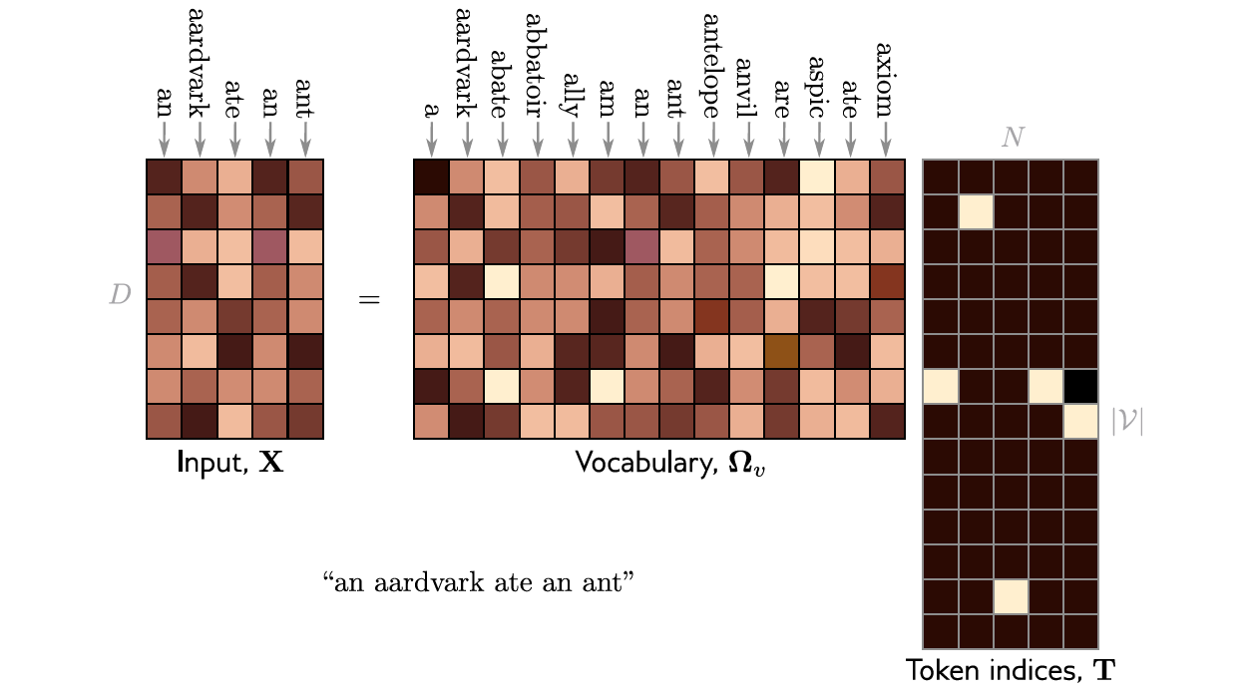
Learning vocabulary
”One hot encoding”

Slide 51
Transformers
Motivation
Dot-product self-attention
Matrix form
The transformer
NLP pipeline
Decoders
Large Language models

Slide 52
Three types of transformer layer
Encoder (BERT)
Decoder (GPT3)
Encoder-decoder (Translation)

Slide 53
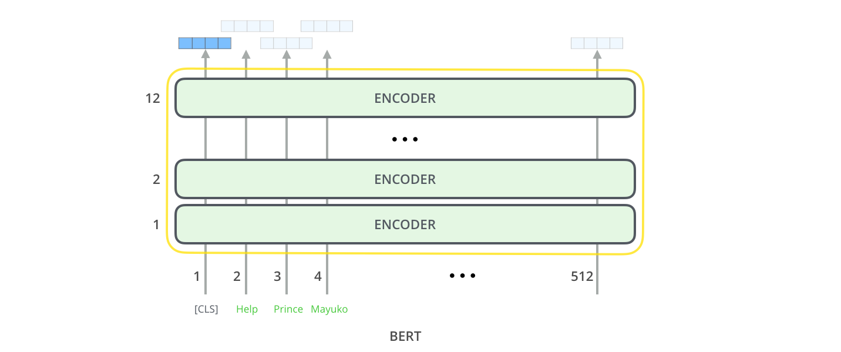
Encoder (BERT)
Transformer
Transformer
Transformer

Slide 54
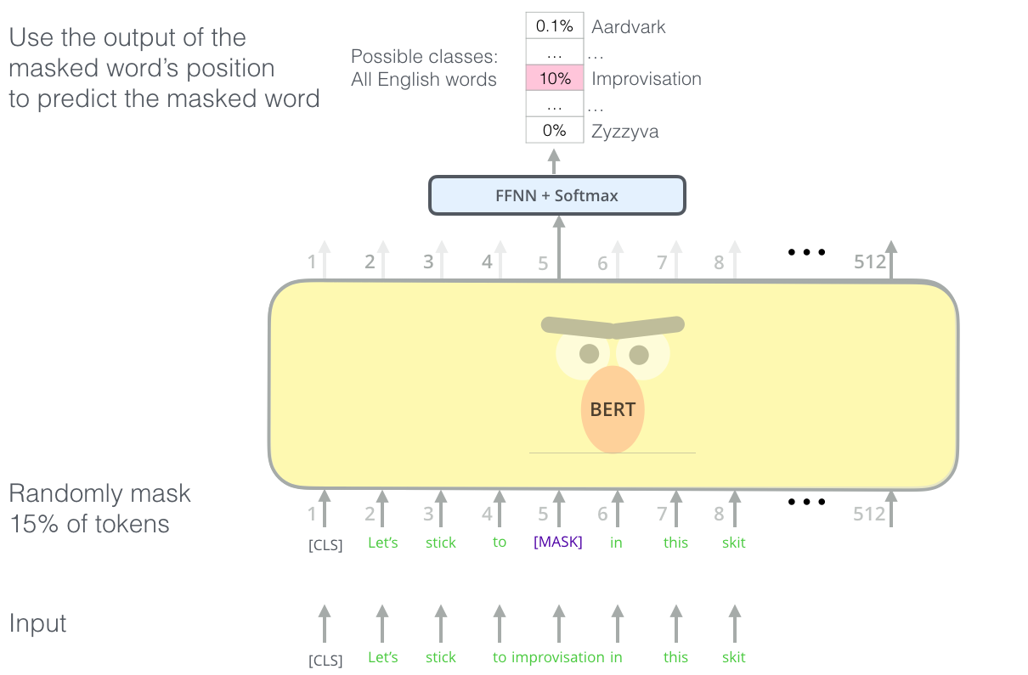
BERT-Pretraining

Slide 55
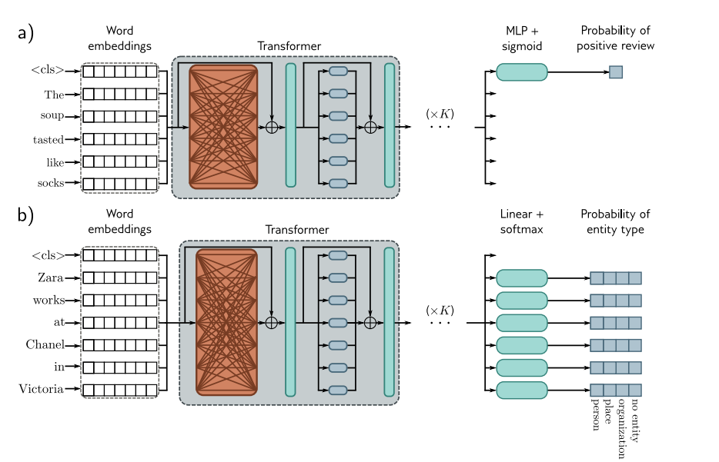
Encoder (BERT) finetuning

Slide 56
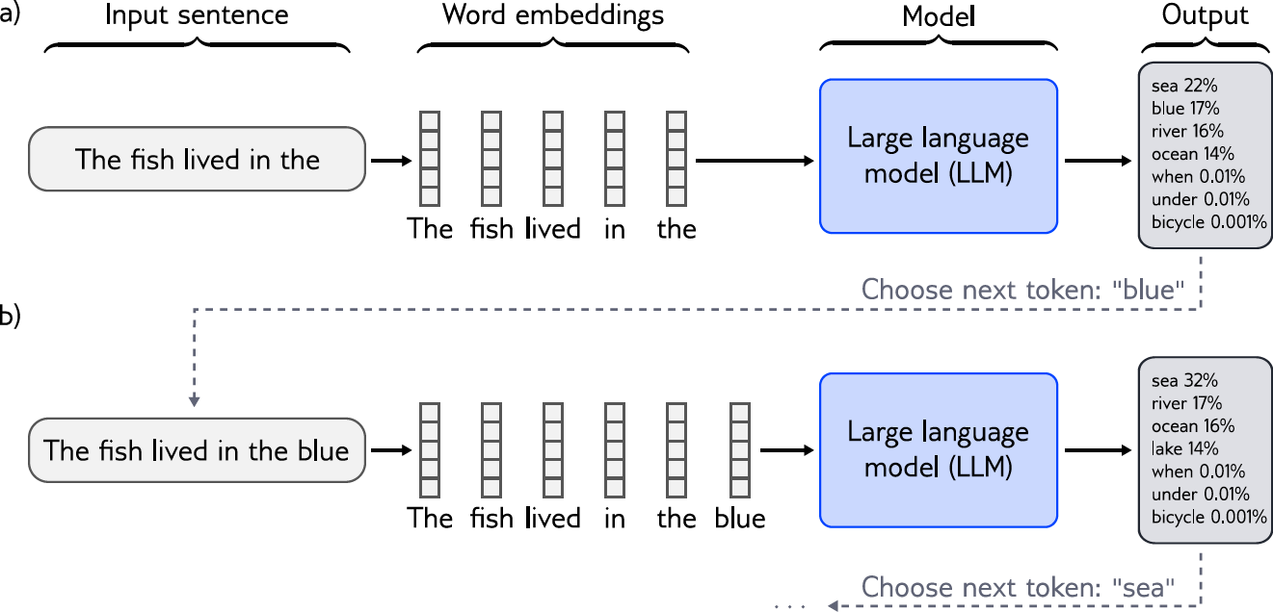
Decoder model

Slide 57
Decoder model: GPT3
One job: predict the next word in a sequence
More formally builds an autoregressive probability model

Slide 58
Decoder model: GPT3
Builds autoregressive probability model
E.g. “It takes great courage to let yourself appear weak”
Notes:
Autoregressive vs. Non-Autoregressive
Autoregressive models rely on sequential token-by-token predictions and are slower in generating long sequences.
Non-autoregressive models (e.g., BERT) predict all tokens at once, typically used in tasks where the model needs to understand the entire context simultaneously (like masked token prediction).

Slide 59
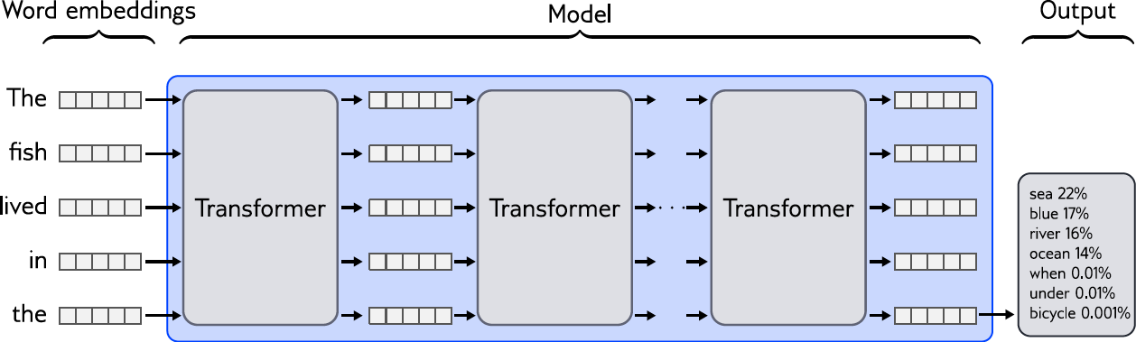
Predicting next

Slide 60
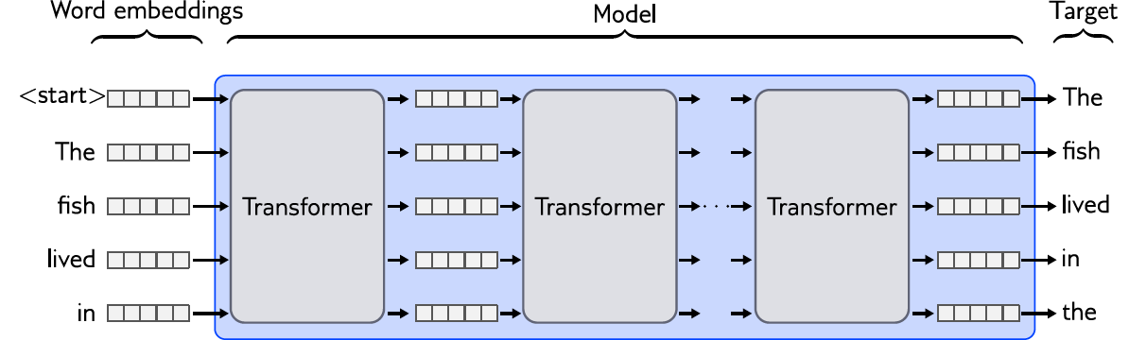
Predicting all next words simultaneously

Slide 61
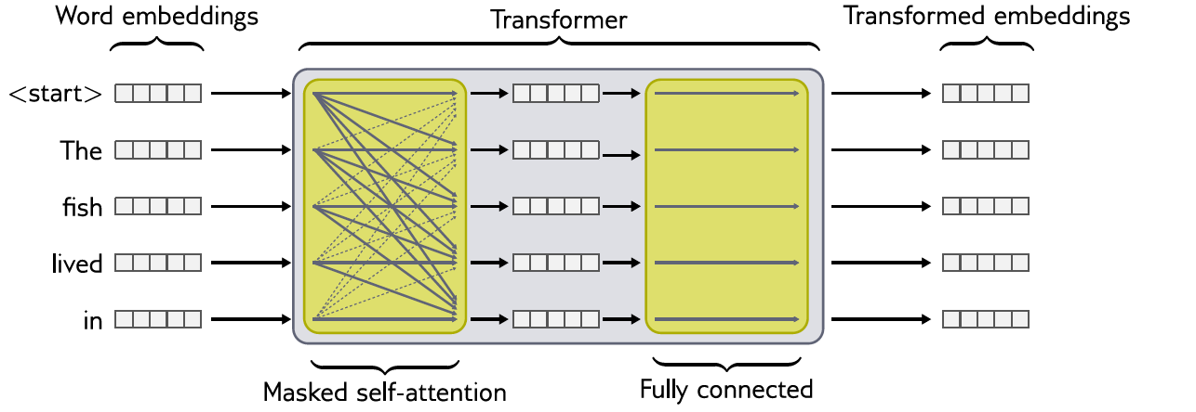
Masked self-attention

Slide 62
Transformers
Motivation
Dot-product self-attention
Matrix form
The transformer
NLP pipeline
Decoders
Large Language models

Slide 63
GPT3 (Brown et al. 2020)
Sequence lengths are 2048 tokens long
Batch size is 3.2 million tokens.
96 transformer layers (some of which implement a sparse version of attention), each of which processes a word embedding of size 12288.
96 heads in the self-attention layers and the value, query, and key dimension is 128.
300 billion tokens
175 billion parameters

Slide 64
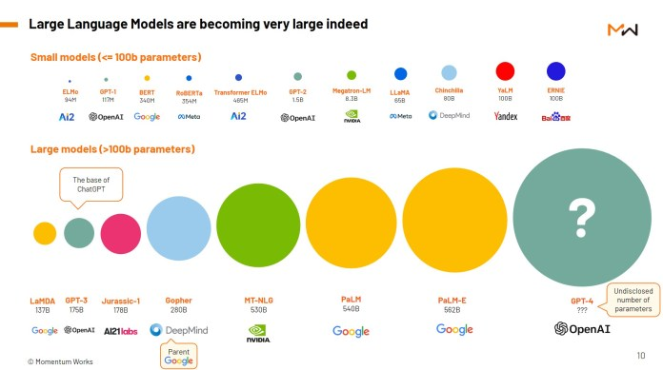

Slide 65
What does it learn?
Syntax
“Tomorrow, let’s…”
General knowledge:
“The train pulled into the…”

Slide 66
Text completion
Understanding Deep Learning is a new textbook from MIT Press by Simon Prince that's designed to offer an accessible, broad introduction to the field. Deep learning is a branch of machine learning that is concerned with algorithms that learn from data that is unstructured or unlabeled. The book is divided into four sections:
Introduction to deep learning
Deep learning architecture
Deep learning algorithms
Applications of deep learning
The first section offers an introduction to deep learning, including its history and origins. The second section covers deep learning architecture, discussing various types of neural networks and their applications. The third section dives into deep learning algorithms, including supervised and unsupervised learning, reinforcement learning, and more. The fourth section applies deep learning to various domains, such as computer vision, natural language processing, and robotics.

Slide 67
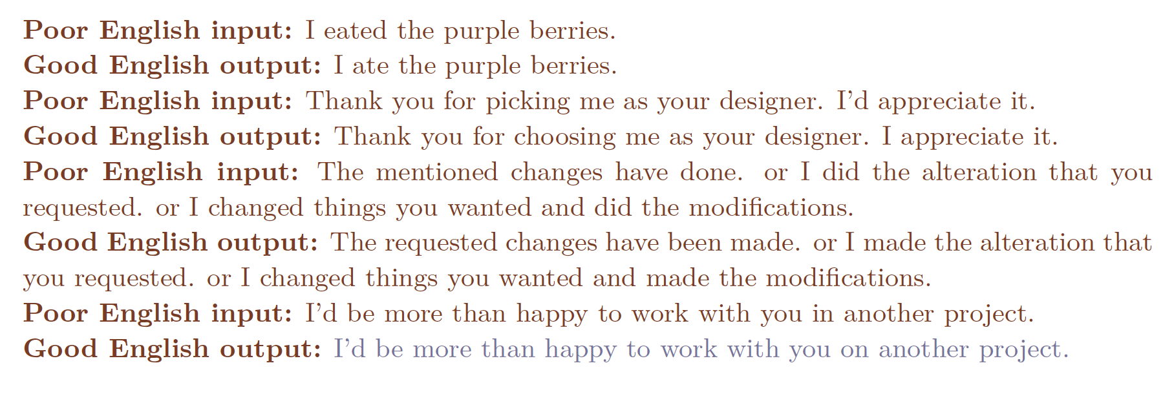
Few shot learning:

Slide 68
Who was the first man on the moon?...
…Neil Armstrong.
…What is the largest lake in the world? What is the capital of Canada?
…was the first question on the exam. I knew the answer but I couldn’t bring it to mind and I panicked.
…This is a trick question. The moon landing was staged.

Slide 69
Who was the first man on the moon?...
…Neil Armstrong.
…What is the largest lake in the world? What is the capital of Canada?
…was the first question on the exam. I knew the answer but I couldn’t bring it to mind and I panicked.
…This is a trick question. The moon landing was staged.

Slide 70
Who was the first man on the moon?...
…Neil Armstrong.
…What is the largest lake in the world? What is the capital of Canada?
…was the first question on the exam. I knew the answer but I couldn’t bring it to mind and I panicked.
…This is a trick question. The moon landing was staged.

Slide 71
Who was the first man on the moon?...
…Neil Armstrong.
…What is the largest lake in the world? What is the capital of Canada?
…was the first question on the exam. I knew the answer but I couldn’t bring it to mind and I panicked.
…This is a trick question. The moon landing was staged.

Slide 72
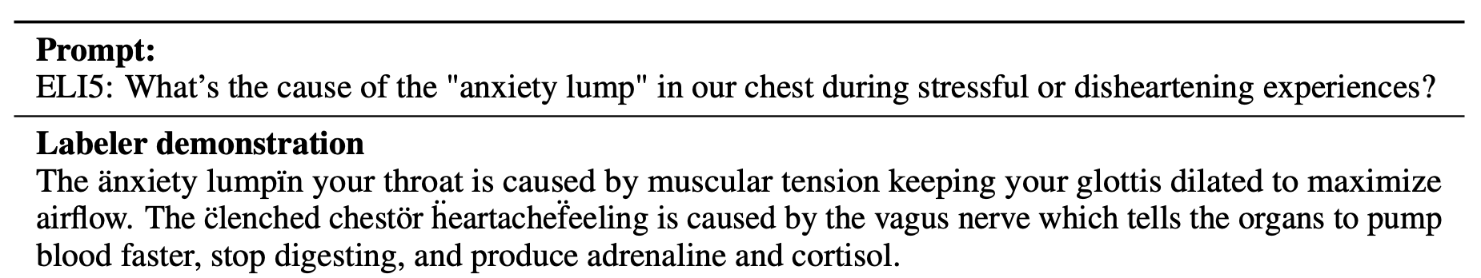
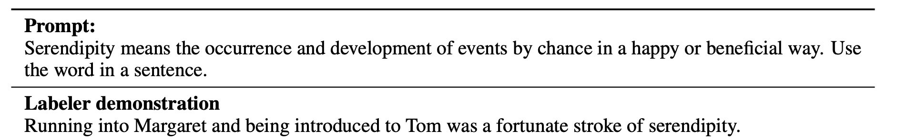
ChatGPT
GPT3.5 fine-tuned with human annotations
Trained to predict the next word + be “helpful, honest, harmless”

Slide 73
ChatGPT
GPT3.5 fine-tuned with human annotations
Trained to predict the next word + be “helpful, honest, harmless”

Slide 74
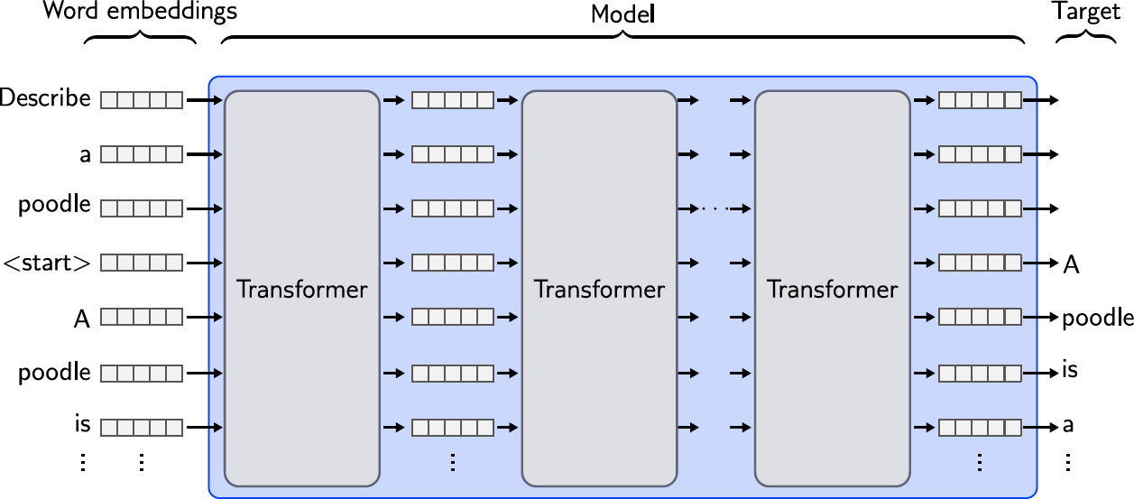
Instruction tuning

