Slide 1
CE103 - Algorithms And Programming I
Sample Course Module Name Author: Asst. Prof. Dr. Uğur CORUH

Slide 2
CE103 Algorithms and Programming I
Week-1 (Database Systems)
Spring Semester, 2022-2023
Download DOC, SLIDE, PPTX

Slide 3
Outline
Understanding The Concept of Database and Relational Database
Database Design

Slide 4
Database

Slide 5
Database
What is Database?
1-) Database is a regular collection of information.
2-) Database is regular data stored in a computer environment.
3-) Systematic access in computer terminology capable, manageable, updateable, portable, defined relationships between each other is a set of available information.
4-) Systematically stored on the computer, It is a chunk of data that can be processed in programs.

Slide 6
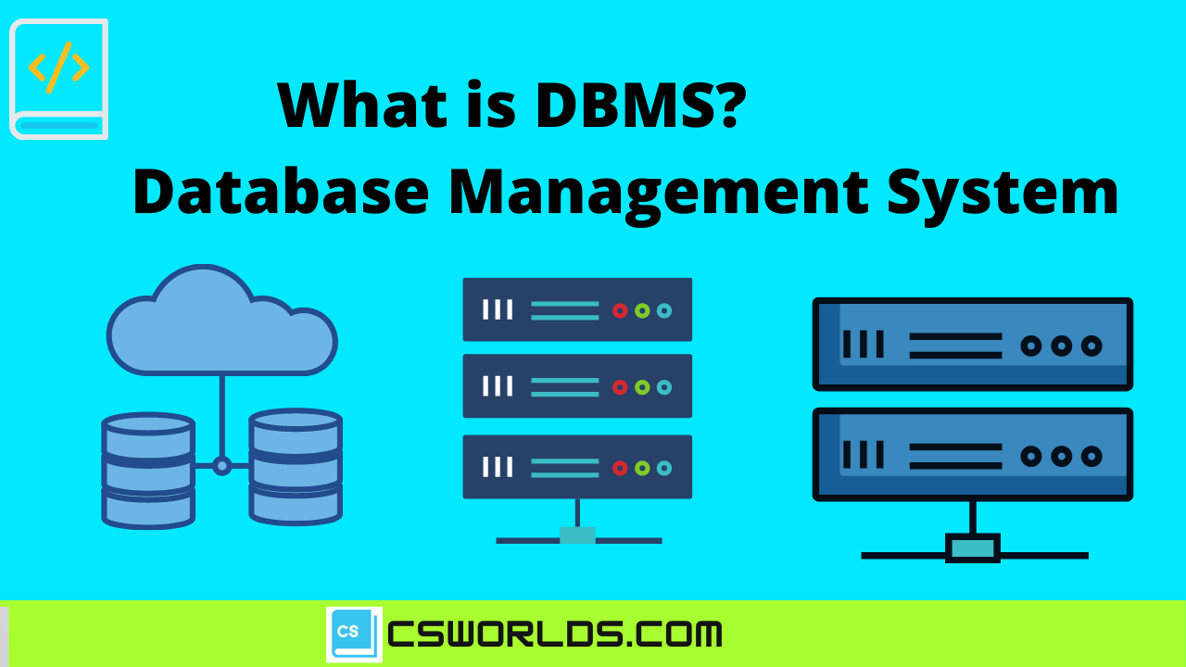
DBMS
What is the Database Management System-DBMS
Defining and creating a database, to keep alive and audited to the database used to gain access software system.

Slide 7
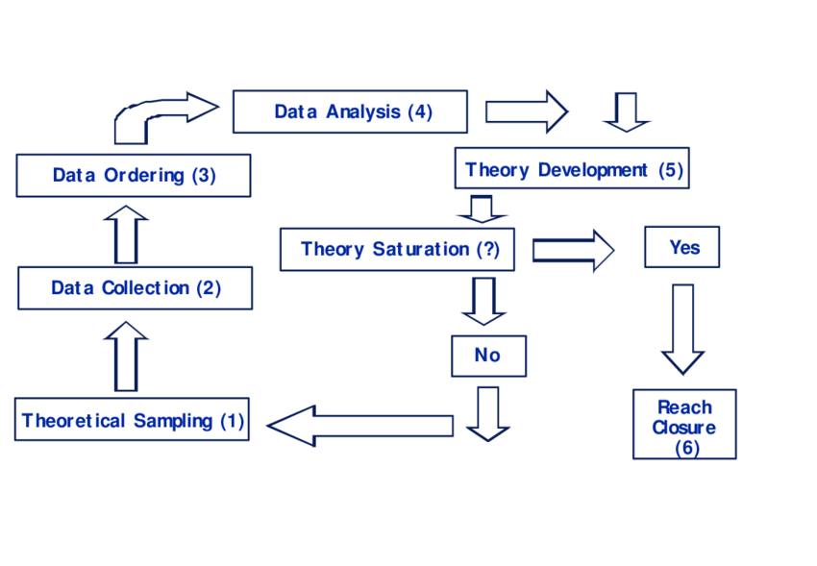
DBMS
Database systems contain the following information
Collection of interrelated data The set of software required to access the data

Slide 8
DBMS
Advantages of Database Systems Database Systems prevents duplication of data. Establishing relationships between database systems and subsystems and many In practice, it requires data to be designed jointly within the same database.

Slide 9
DBSM
Advantages of Database Systems Database Systems ensures that the data is consistent. Data integrity, the accuracy and consistency of the data means. By placing constraints on data entries, only the desired range can be entered.

Slide 10
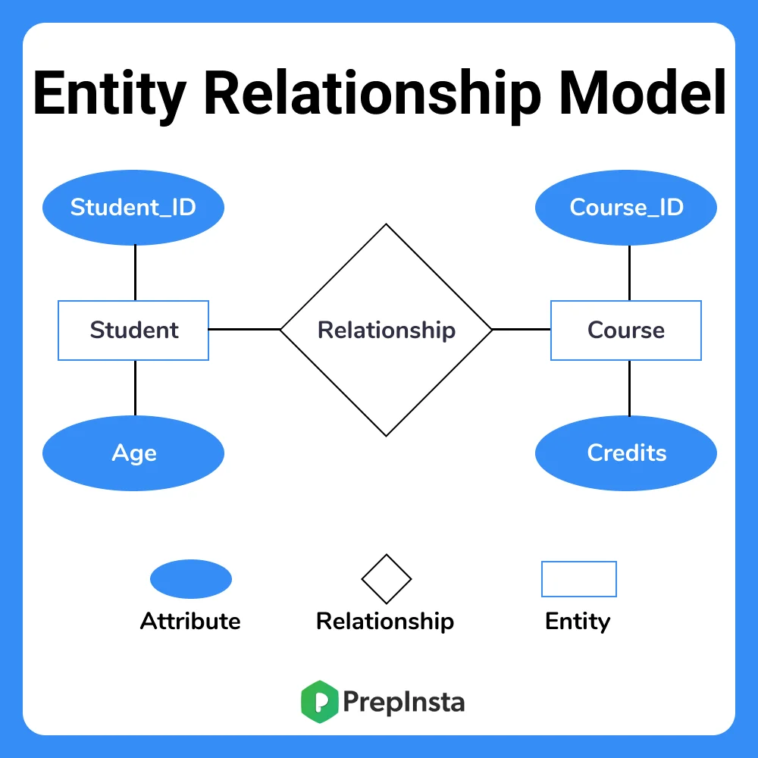
The Entity-Relationship Model
Revealing relationships in data analysis and modeling. It is the tool used to put it on. Entity: Distinguish from other objects in a field. “thing” or “object”. By set of attributes is defined. Relationship: The relationship between more than one entity.

Slide 11
Relationship and Relationship Sets
The link between entities is called a relationship. For example, with the entity “Burak”, “Lessons” There is a relationship between existence. Relationship set is the set of relationships of the same type, this set of relations is denoted by R.

Slide 12
References
https://avesis.erdogan.edu.tr/ugur.coruh
https://www.linkedin.com/in/ugurcoruh/
https://csworlds.com/what-is-dbms-database-management-system/
https://prepinsta.com/dbms/entity-relationship-model-er-model/

Slide 13

$$End−Of−Week−1−Module$$

