Slide 1

SAP UI5/Fiori DEVELOPMENT
UI5 / Fiori — MCP
AI Assisted Frontend
Development
Model Context Protocol accelerates how developers build SAP applications
and deliver intelligent outcomes through LLMs.
UI5 MCP — Developer Speed

Slide 2

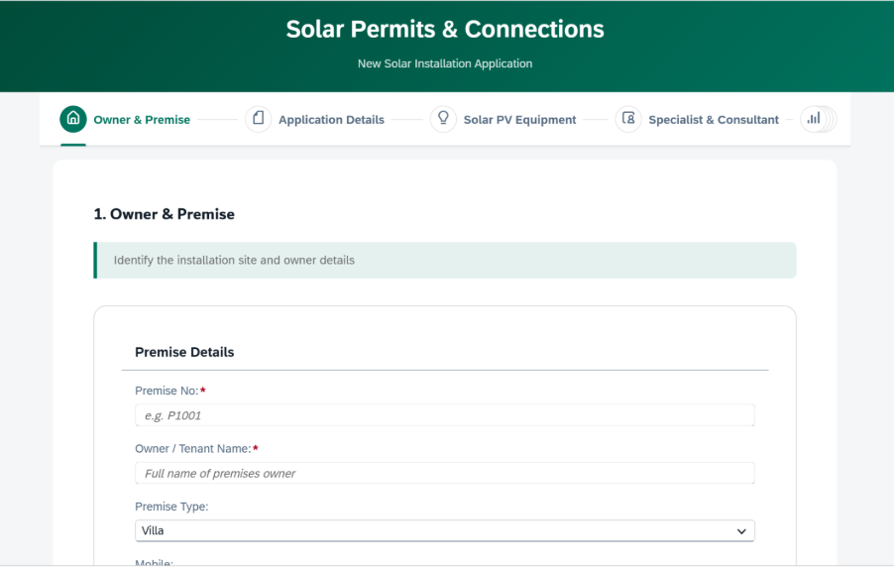
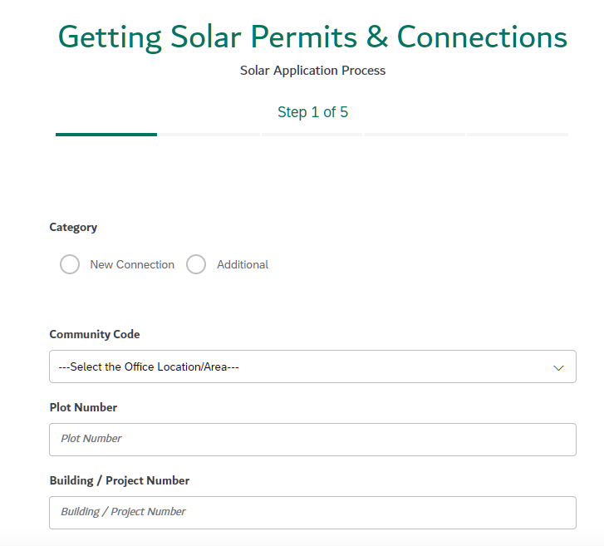
UI5 / FIORI MCP · PHASE 1
02
Development Speed Comparison
UI5 using BAS (Cloud)
GitHub Copilot in Visual Studio
55 – 60 hrs
Complex UI5/Fiori
Front Application
7 – 8 hrs
Any UI5/Fiori
Front Application
Manual component wiring & OData binding
Natural language prompt → production code
Repetitive boilerplate across views
MCP injects SAP-compliant UI5 patterns
VS
Context switching between docs & IDE
OData metadata parsed automatically
Long review cycles for SAP Fiori compliance
Fiori design principles enforced by MCP

Slide 3
UI5 / FIORI MCP · PHASE 1
03
GitHub Copilot / Claude + SAP UI5 MCP — Prompting Scenarios
SCENARIO 1 — With OData Metadata
SCENARIO 2 — Business Requirement + Figma Design
You are a SAP UI5 expert with access to UI5 MCP tools. Your task is to create a production-ready SAP UI5 application that follows SAP Fiori design principles, clean architecture, and enterprise UI/UX standards.
Create freestyle SAP UI5 application from scratch based on a plain-language business requirement — no OData metadata needed. Simply describe what the app should do.
<<< ODATA $metadata >>>
<<< Figma Design >>>
WHEN TO USE
WHEN TO USE
Use when OData service metadata is available. MCP interprets entity sets, nav properties and binding patterns to scaffold the UI automatically.
Ideal for greenfield apps. Describe the business flow in plain language; MCP generates Fiori-compliant views, routing and controllers without requiring metadata.
MCP-Optimized
SAP-Compliant
Enforces DESIGN.md
Works with Copilot
WHY THESE PROMPTS WORK:
MCP-optimized
SAP-compliant
Enforces DESIGN.md
Works with Copilot + UI5 MCP

Slide 4





UI5 / FIORI MCP · PHASE 1
04
How the AI Development Flow Works
Developer
KEY PRINCIPLE
Types a natural language prompt
UI5 MCP is a NPM local package maintained as open source by SAP.
The MCP Server acts as a structured knowledge layer — it never reads business data, never executes code, and never makes service calls. It only returns SAP-compliant patterns and context.
Natural language prompt
VS Code (IDE)
Forwards prompt to GitHub Copilot
Forwards prompt
GitHub Copilot / Claude / Cline
Requests SAP-specific context from MCP
Requests SAP context
KEY POINTS
UI5 MCP Server (local Node.js)
Copilot (GitHub) stays in the cloud (the model)
Returns UI5 + OData patterns — no business data, no exec
SAP-aligned code generated
UI5 MCP server runs locally via Node.js / npx
SAP-Aligned UI5 Code
Generated UI5 artifact
VS Code acts as the bridge — lets Copilot call MCP tools

Slide 5

UI5 / FIORI MCP · PHASE 1
05
Prerequisites & Setup
REQUIREMENTS
SETUP STEPS
VS Code IDE
1
Install VS Code, Node.js, GitHub Copilot
Free, no subscription required
Node.js ≥ v20.x
2
Enable MCP in Copilot settings
MCP servers run as local Node processes — Free
npm v8.0.0+
3
MCP: Add server
Terminal access required
GitHub Copilot
4
Add @ui5/mcp-server and @sap-ux/fiori-mcp-server
Subscription + Copilot Chat extension — GitHub License
GitHub settings
5
Enable tools in Copilot Chat
Enable "MCP Servers in Copilot"
GitHub CLI & VSCode CLI
6
Create UI5 App through prompts
Execution permissions required

Slide 6
SAP ABAP DEVELOPMENT - Q2’2026
ABAP (Custom MCP)
AI Assisted S/4HANA
Development
AI Assisted S4 HANA Development
AI-assisted ABAP development using Claude Code + Custom MCP — enforcing Clean Core compliance at every step.

Slide 7
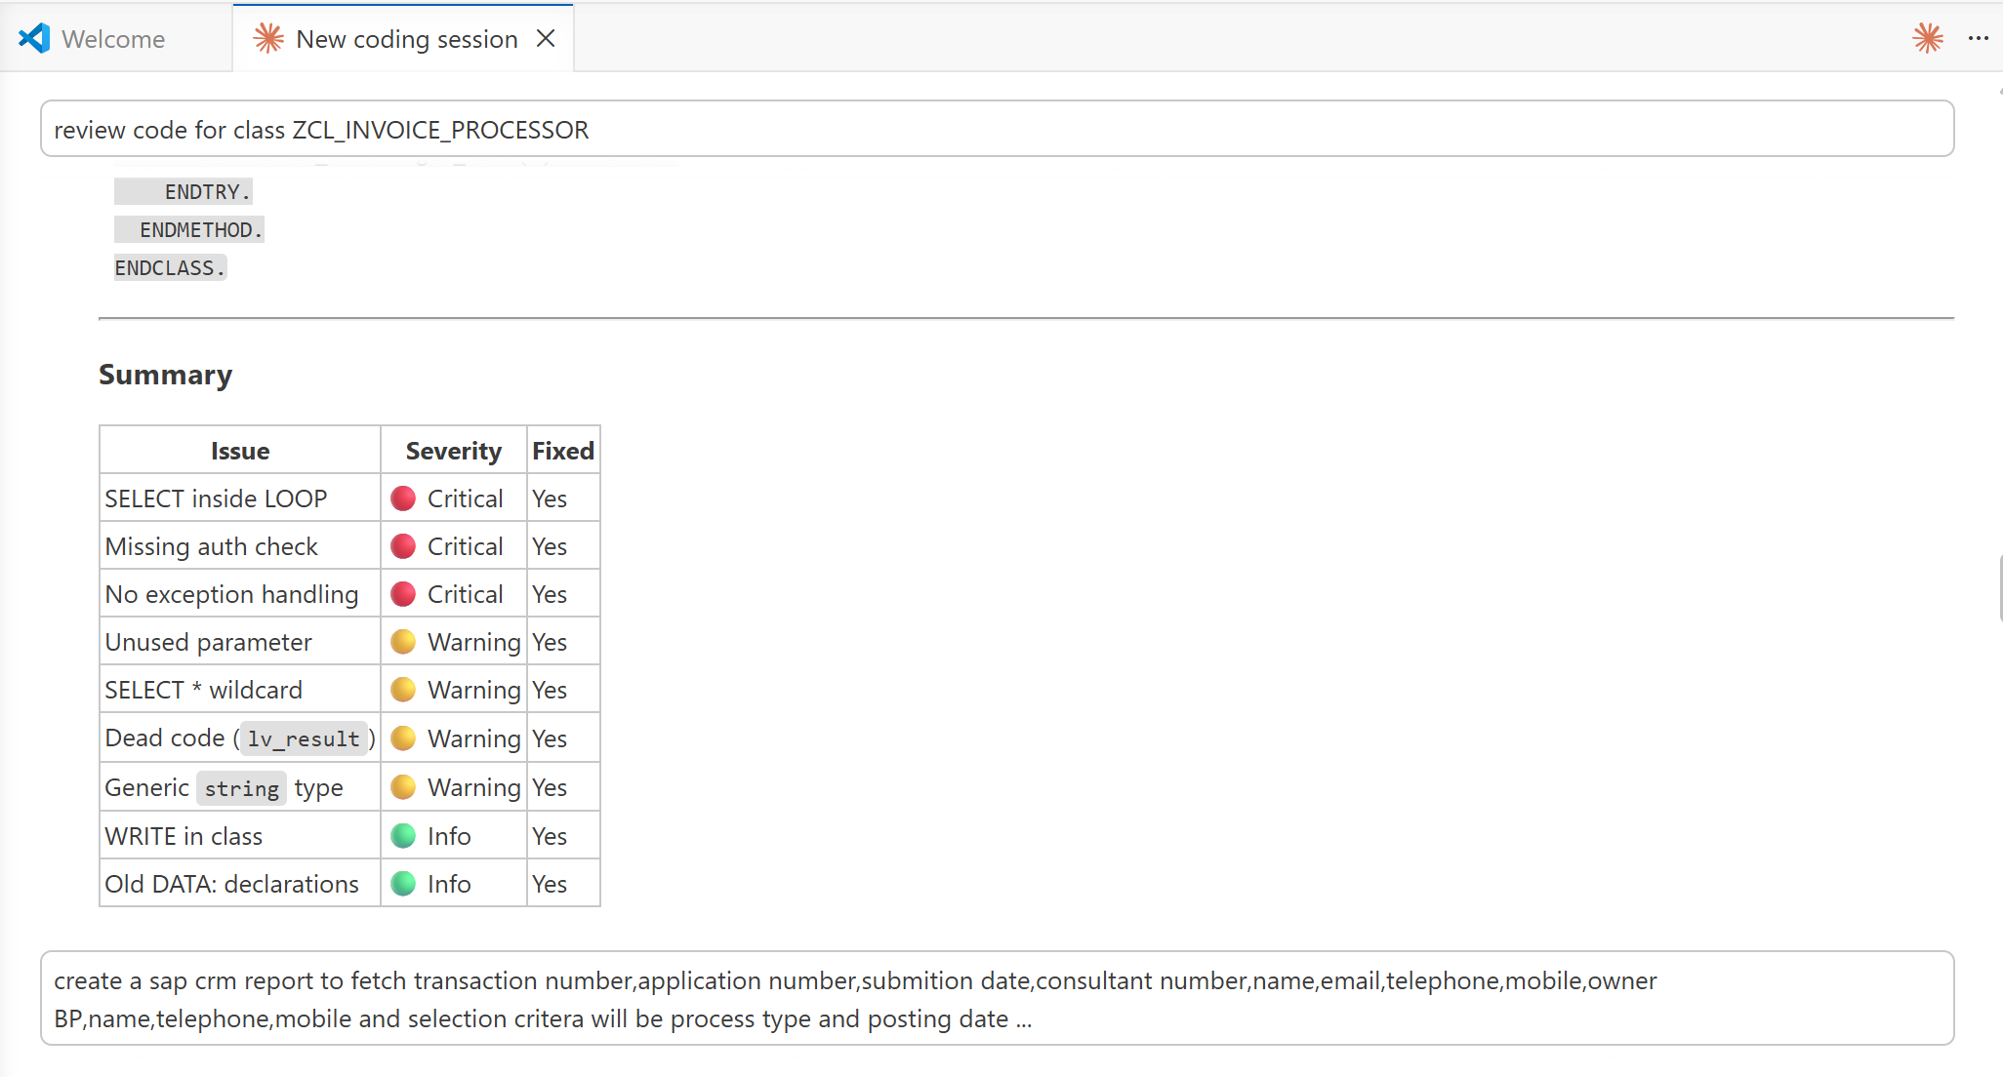
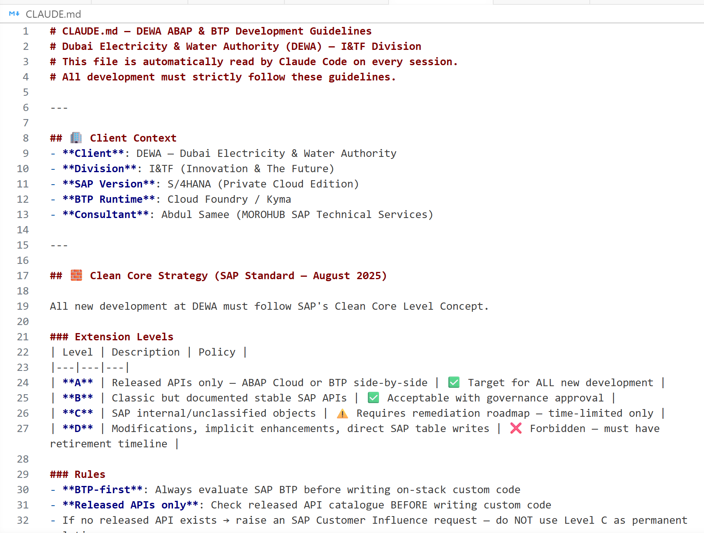
ABAP CUSTOM MCP · PHASE 2
07
AI Assisted S/4HANA Development
ABAP CODE REVIEW USING ABAP MCP→CLAUDECODE
CLAUDE.md — DEWA ABAP & BTP DEVELOPMENT GUIDELINES
EXAMPLE PROMPTS
review code for class ZCL_INVOICE_PROCESSOR
create a ABAP report to fetch transaction number,
application number, consultant name, BP, telephone, mobile

Slide 8
SAP DEVELOPMENT AI – Q3’2026
BTP Integration Suite
AI Assisted Integration
Design
AI Assisted Integration Design (Build Time Pattern)
AI at design-time in SAP Integration Suite — accelerate CPI development without affecting runtime determinism.

Slide 9
BTP INTEGRATION SUITE · PHASE 3
09
SAP GenAI Integration Patterns
SAP GenAI service embedded in Cloud Integration (Design-time) · Generative AI – Integration Flow Generation · No custom model required
WHERE AI IS USED
USE WHEN
WHAT THE LLM INTERPRETS
SAP GenAI service embedded in Cloud Integration (Design-time)
Integration design intent and interface standardization only — not executable logic
Source system & target system identification
Generative AI drives Integration Flow Generation
Accelerating CPI development cycles
Message direction and sync vs async assumption
No custom model required — uses SAP's embedded LLM
PI/PO → Integration Suite modernization
Integration pattern selection and flow scaffolding
Build-time only — AI assists in design; it never affects runtime execution or message determinism

Slide 10
THANK YOU

