Slide 1
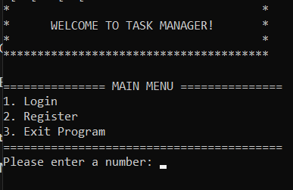
Task Manager: User Authentication
Login: The login feature provides a secure authentication process that ensures only authorized users can access their personal tasks and data. By entering their unique credentials, users can securely log into the system and continue managing their tasks seamlessly from where they left off. This functionality ensures data privacy and prevents unauthorized access.
Register: The registration process allows new users to create their personalized accounts, enabling them to access task management features tailored to their needs. During registration, users can set up their credentials and preferences, ensuring a smooth and customized experience from the very beginning. This functionality also supports user-specific task organization and notification settings.
These features collectively ensure a secure, user-friendly environment where tasks can be managed efficiently while maintaining the confidentiality and integrity of user data.

Slide 2
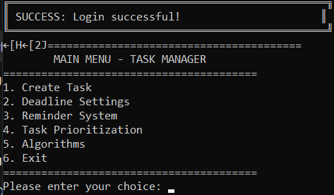
Task Manager: Main Menu
- Create Task: Users can add and manage tasks efficiently with categorized details.
- Deadline Settings: Set specific due dates for tasks to ensure timely completion.
- Reminder System: Receive notifications about upcoming deadlines via email, SMS, or in-app alerts.
- Task Prioritization: Organize tasks by priority levels (High, Medium, Low).
- Algorithms: Leverage advanced hashing algorithms to manage users and tasks efficiently.

Slide 3
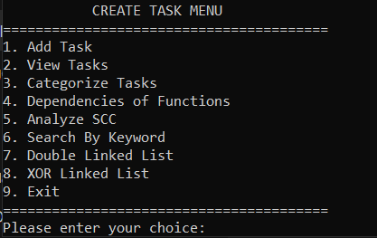
Task Manager: Create Task Menu
- Add Task: Create new tasks with detailed descriptions and deadlines.
- View Tasks: Display all tasks with filtering options.
- Categorize Tasks: Organize tasks into specific categories (e.g., Work, Personal).
- Dependencies of Functions: Analyze task dependencies for efficient workflow.
- Analyze SCC: Identify strongly connected components in task dependencies.
- Search By Keyword: Quickly find tasks using keywords.
- Double Linked List: Efficiently manage and navigate tasks.
- XOR Linked List: Optimize memory usage while handling task pointers.

Slide 4
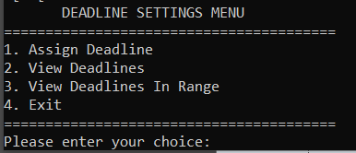
Task Manager: Deadline Settings Menu
- Assign Deadline: Set deadlines for specific tasks to ensure timely completion.
- View Deadlines: Display a list of all upcoming task deadlines.
- View Deadlines In Range: Filter and display deadlines within a specific date range.

Slide 5
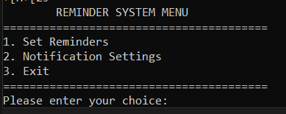
Task Manager: Reminder System Menu
- Set Reminders: Schedule reminders for tasks to ensure timely notifications.
- Notification Settings: Customize notification preferences (Email, SMS, In-app).

Slide 6
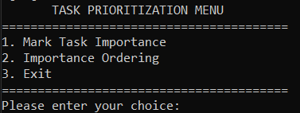
Task Manager: Task Prioritization Menu
- Mark Task Importance: Assign priority levels (High, Medium, Low) to tasks.
- Importance Ordering: Automatically reorder tasks based on their priority levels.

Slide 7
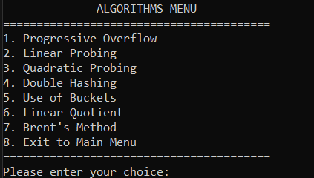
Task Manager: Algorithms Menu
- Progressive Overflow: Manage hash collisions with dynamic overflow handling.
- Linear Probing: Resolve hash collisions using sequential searching.
- Quadratic Probing: Handle collisions with quadratic intervals.
- Double Hashing: Use a secondary hash function for collision resolution.
- Use of Buckets: Group data efficiently into logical divisions.
- Linear Quotient: Optimize memory usage during collision handling.
- Brent's Method: Minimize probe sequence length during collisions.

Slide 8
Why Choose Task Manager?
- Efficient Task Management: Easily create, organize, and track tasks with intuitive menus.
- Deadline Control: Stay on top of deadlines with reminders and date range filtering.
- Customizable Reminders: Get notified through email, SMS, or in-app alerts.
- Task Prioritization: Focus on what matters most with priority-based task sorting.
- Algorithm Efficiency: Advanced algorithms ensure optimal performance and resource management.
- User-Friendly Interface: Simple, clear, and easy-to-navigate interface for all users.
- Enhanced Productivity: Streamline your workflow and reduce task management stress.

