Slide 1
MINI PROJECT PRESENTATION
Taste Embedding Learning for Recipes
Balancing Food Categorization and Intuitive Dish Identity with Hybrid Neural Embeddings
Project Team & Academic Information
• Submitted By: P. Thrivikram (23BCS100) & S. Abdul Sami (23BCS119)
• Under the Guidance of: Dr. Krishnendu Ghosh
• Institution: Indian Institute of Information Technology Dharwad
• Academic Year: 2026–2027

Slide 2
PROJECT CONTEXT
Motivation: Why Food Similarity is Unique
1. Words vs. Culinary Reality
2. The Danger of Tag-Only Training
• Standard text models (BERT, MiniLM) group sentences based on shared vocabulary and grammar.
• In Food, text similarity can be misleading:
- 'Beef burger' and 'Chicken burger' have different meat words, but they are conceptually the same dish.
- General language models do not natively know dish roles (e.g., appetizer vs. dessert vs. main course).
• Need: We need vector embeddings that capture 'Taste & Meal Category'.
• What happens if we train heavily on recipe tags?
• 'Semantic Collapse': The model groups recipes purely by coarse tags (e.g., 'quick', 'lunch', 'finger-food').
• The Dosa vs. Burger Paradox:
A Burger and a South Indian Dosa are completely different foods. But because both have tags like 'lunch' and 'vegetarian/snack', a naive tag model ranks Dosa closer to a burger than a pizza!
• Key Question: How do we improve category retrieval while keeping true dish identity intact?

Slide 3
GOALS & ROADMAP
Problem Statement & Project Objectives
Problem Statement
To design, train, and deploy an AI representation learning pipeline that maps recipes into 'taste embeddings' such that similar meal categories cluster together, semantic collapse is prevented, and intuitive dish identities are preserved across nearest-neighbor searches.
Key Objectives
• 1. Data Pipeline: Curate and clean 10,000 recipes from Food.com; extract structured titles, ingredients, and 51 high-frequency culinary tags.
• 2. Baseline Vectorization: Encode recipe texts using frozen all-MiniLM-L6-v2 to obtain 384-dimensional dense vectors.
• 3. Metric Learning: Train a lightweight 2-layer neural projector with Soft Contrastive Loss using continuous Jaccard tag overlaps.
• 4. Convex Blending: Implement an exact 50/50 convex vector blend combining raw text semantics with learned category embeddings.
• 5. Rigorous Evaluation: Benchmark 10-Nearest Neighbor retrieval on 2,000 held-out test recipes against an 8,000-recipe training gallery.
• 6. Production Deployment: Build an asynchronous FastAPI web service and Claude LLM chat agent for real-time recipe recommendation.

Slide 4
DATA PIPELINE
Dataset & Recipe Text Formulation
Dataset Overview (Food.com)
Label Space Curation
• Source: Food.com Recipes with Search Terms & Tags
• Total Dataset: 494,963 recipes across 10 attributes.
• Sample: 10,000 recipes sampled randomly (seed 42).
• Partition: 8,000 Train (80%) | 2,000 Held-Out Test (20%).
• Noise Removal: Filtered out uninformative administrative tags (e.g. 'time-to-make', 'equipment', 'course').
• 51 Active Tags: Kept search terms appearing >= 50 times (multi-hot binary vector Y per recipe).
• Evaluation Hierarchy: 8 mutually exclusive categories (soup, salad, dessert, dinner, casserole, breakfast, side, lunch).
Text Formulation: Text A vs. Text B Ablation
• Text A (Selected): "{Name}. Ingredients: {ingredient_list}." --> e.g. 'Chicken burger. Ingredients: chicken patty, bun, lettuce...'
• Text B (Tested): Adds filtered tags --> "{Name}. Ingredients: {...}. Tags: {tags}."
• Empirical Finding: Text A achieved 0.605 Match@10; Text B achieved 0.610 (+0.005 gain). Ingredients carry almost all the taste signal! Text A was selected to prevent tag leakage.

Slide 5
SYSTEM DESIGN
End-to-End System Architecture
1. Encoding
2. Projection
3. Blending
4. Retrieval & UI
Pretrained Encoder
• Recipe Text A input
• all-MiniLM-L6-v2 backbone
• Frozen weights
• Yields 384-d L2-normalized vector x
Learned Head
• Linear(384 -> 512)
• ReLU + Dropout(0.1)
• Linear(512 -> 128)
• L2-normalized to S^127
• Trained with Soft Contrastive Loss
Convex Blend
• Concatenates:
[sqrt(0.5)*x, sqrt(0.5)*z]
• Total 512 dimensions
• Exact 50/50 balance of text & category semantics
Serving Layer
• In-memory dot-product index (<15ms latency)
• FastAPI async endpoints
• Claude LLM intent parsing
• Interactive web chat UI

Slide 6
METRIC LEARNING
Neural Projector & Soft Contrastive Loss
Projector MLP Architecture
Soft Contrastive Loss Objective
• Base Model: Frozen all-MiniLM-L6-v2 (d_in = 384)
• Network Layers:
1. Linear(384 -> 512)
2. ReLU Activation
3. Dropout(p = 0.1)
4. Linear(512 -> 128)
5. L2 Normalization (z / ||z||_2)
• Why Freeze Base Model? Prevents catastrophic forgetting of English grammar and ingredient names while drastically cutting training time to <2 minutes.
• Continuous Supervision via Tag Jaccard:
J(y_i, y_j) = |y_i ∩ y_j| / |y_i ∪ y_j|
• Target Probability Distribution P_ij:
P_ij = J_ij / Σ_{k ≠ i} J_ik (row-normalized overlap)
• Predicted Probability Q_ij (with temp τ = 0.1):
Q_ij = softmax( (z_i · z_j) / 0.1 )
• Loss: Cross-Entropy = -Σ P_ij · log(Q_ij)

Slide 7
THE TRADE-OFF & FIX
The 'Burger vs. Dosa' Paradox & Convex Blending
Metric Distortion & Recovery
The Mathematical Solution
Similarity of 'Burger' to other recipes:
• Convex Dimension Blending:
v_blend = [ sqrt(α)*v_raw , sqrt(1-α)*v_learned ]
• Mathematical Beauty:
||v_blend||_2 = α + (1-α) = 1 (Automatically Normalized!)
cos_sim(v_1, v_2) = α · cos_raw + (1-α) · cos_learned
• Optimal Weight α = 0.5:
- Gives highest category match (0.679)
- Retains 0.416 Jaccard label overlap
- Perfectly restores natural dish hierarchy!
Pair | Raw | Learned | Blend (0.5)
Burger vs Chicken Burger | 0.663 | 0.746 | 0.705 (Rank 1)
Burger vs Pizza | 0.560 | 0.694 | 0.627 (Rank 2)
Burger vs Dosa | 0.363 | 0.776 (!) | 0.569 (Rank 3)
Burger vs Chocolate Cake | 0.273 | 0.496 | 0.384 (Rank 4)
Correct Order? | YES | FAILED | RESTORED
• The Issue: In the learned model, Dosa (0.776) outranks Chicken Burger (0.746) because both share broad snack/lunch tags!

Slide 8
EXPERIMENTAL EVALUATION
Quantitative Results on Held-Out Test Set
Benchmark Results (2,000 Unseen Recipes)
Alpha (α) Weight Sweep
Evaluated by retrieving Top-10 neighbors from 8,000 training recipes:
How α affects performance & logic:
• α = 0.5 is the exact sweet spot: maximum retrieval accuracy while maintaining dish identity.
Model Configuration | Vector Dim | Category Match@10 | Label Jaccard@10
Random Chance Baseline | — | 0.181 (18.1%) | —
Raw Pretrained (MiniLM) | 384 | 0.599 (59.9%) | 0.359
Learned Projector | 128 | 0.676 (67.6%) | 0.419
Blended Model (α = 0.5) | 512 | 0.679 (67.9%) | 0.416
α | Match@10 | Jaccard | Order OK?
0.00 | 0.676 | 0.419 | ❌ No
0.25 | 0.683 | 0.425 | ❌ No
0.50 | 0.679 | 0.416 | ✅ YES
0.75 | 0.659 | 0.400 | ✅ YES
1.00 | 0.599 | 0.359 | ✅ YES
• Key Takeaway: The Blended Model achieves an +8.0 percentage point gain over the baseline (0.679 vs. 0.599), beating random chance by nearly 4x.

Slide 9
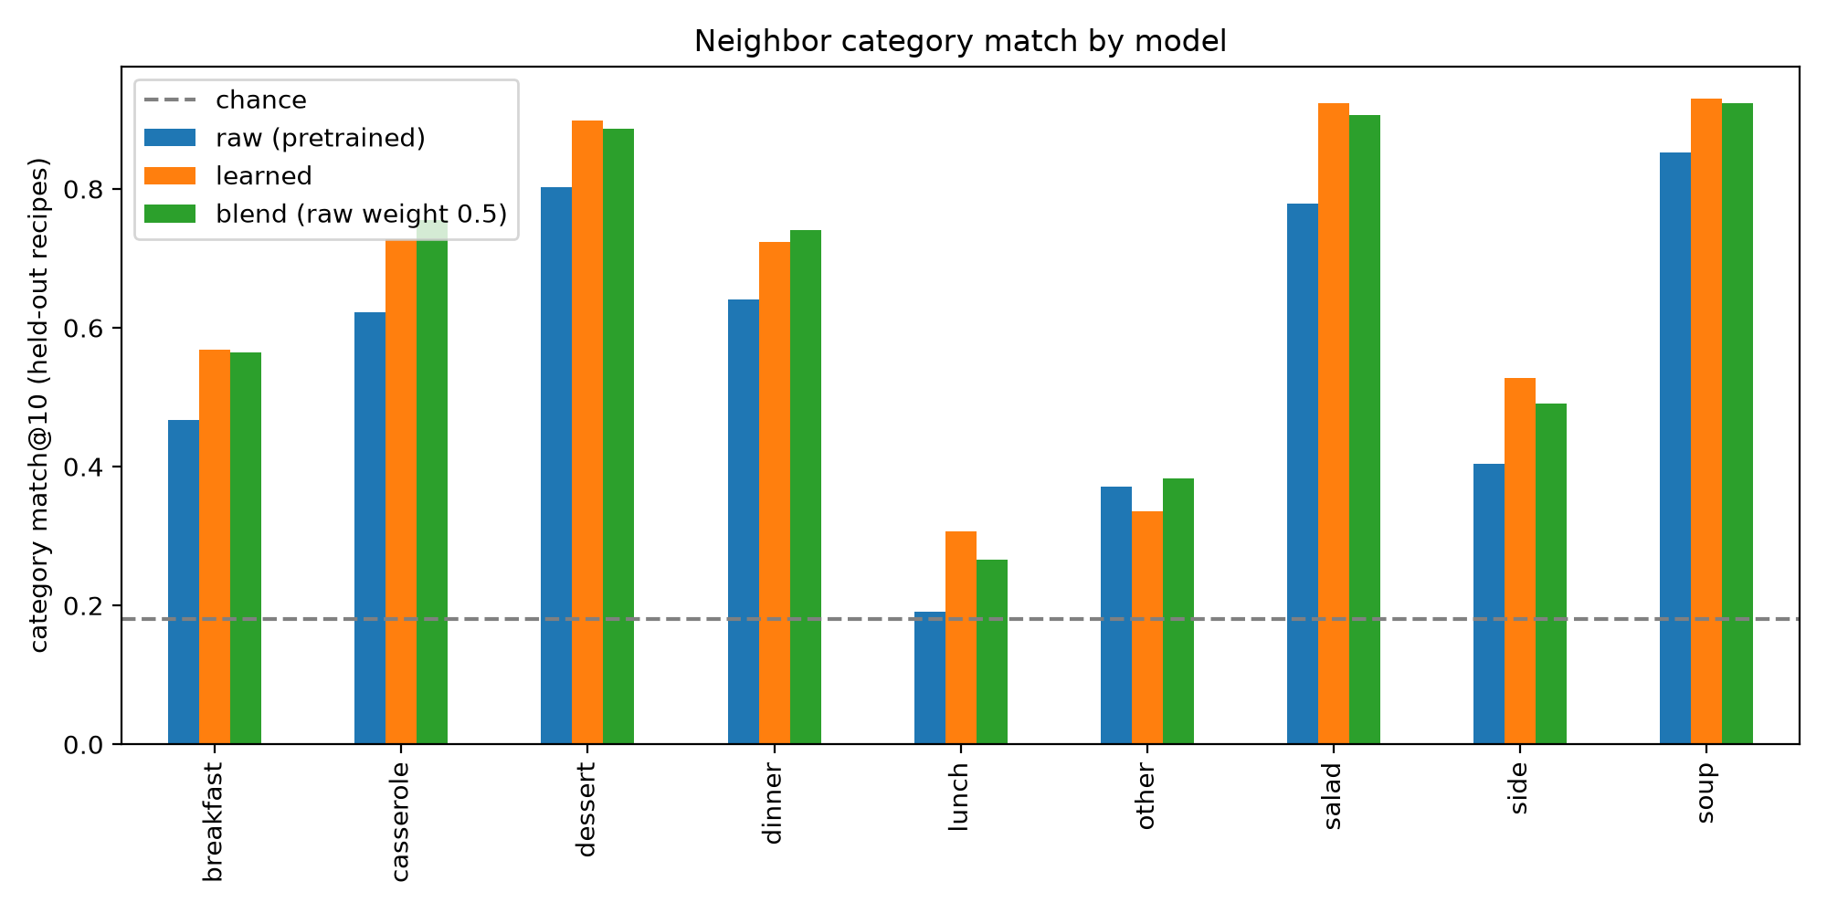
DETAILED ANALYSIS
Per-Category Retrieval Breakdown
Category Match Comparison Chart
Key Category Insights
• 🥣 Soup (92.4%) & 🥗 Salad (90.7%): Highest accuracy because ingredients (broth, greens, dressing) are distinct.
• 🍰 Dessert (88.7%): Forms an isolated cluster with sweet ingredients (sugar, vanilla, chocolate).
• 🥘 Casserole (+13.3%) & 🍽️ Dinner (+10.0%): Huge improvements from learned head recognizing structured cooking.
• 🥞 Breakfast (+9.8%): Learned model successfully connects baked & morning dishes.
• 🥪 Lunch (26.6%): Lowest across all models. Why? 'Lunch' describes when a dish is eaten, not what it tastes like!
• ❓ Other (38.3%): Learned dropped to 33.6%; Blending recovered it to 38.3% (regularization).

Slide 10
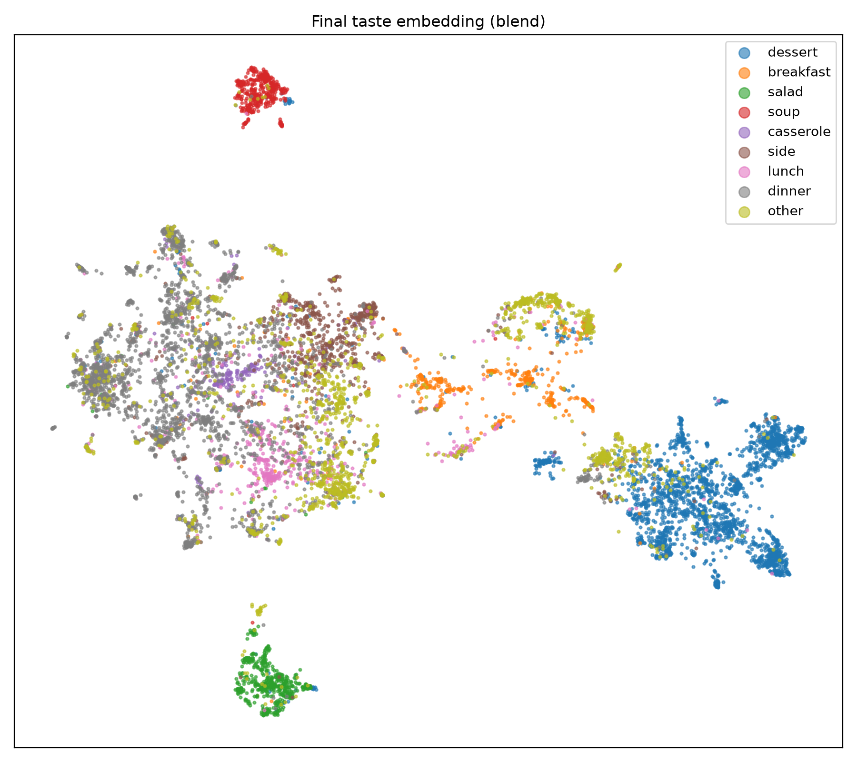
EMBEDDING TOPOLOGY
Visualizing the Embedding Space (UMAP)
2D UMAP Taste Embedding Map
Topological Manifold Insights
• Clear Isolation of Soups & Salads:
Soup and salad recipes occupy compact, isolated clusters away from heavy entrees.
• Dessert Continent:
Dessert occupies a large, continuous island on one side of the space, showing strong culinary coherence.
• Breakfast as a Natural Bridge:
Breakfast sits between desserts (pancakes, waffles, pastries) and dinner (eggs, bacon, sausages).
• Continuous Savory Spectrum:
Dinner, casseroles, sides, and lunch smoothly overlap, reflecting real-world ingredient overlap (cheese, poultry, vegetables, onions).
• High Nearest-Neighbor Density:
Neighbors within any local neighborhood share both dish identity and meal role.

Slide 11
DEPLOYMENT & DEMO
Interactive Web Application & CLI Demo
FastAPI Retrieval Engine
Conversational Claude AI Assistant
• Asynchronous Server: FastAPI backend with lifespan pre-loading.
• In-Memory Index: Matrix dot product executed in <15ms.
• Endpoints: /health (status), /similar (direct recipe vector matching), and /chat (conversational AI).
• LLM Intent Router: Anthropic Claude determines if user wants recipe search or general conversation.
• Structured Queries: Converts conversational requests into recipe vectors.
• Responsive Frontend: Modern chat UI with real-time recipe cards, similarity scores, and ingredients.
Real-World Recommendation Example (Out-of-Distribution Query)
Query: python src/recommend.py "Dosa" "rice, urad dal, fenugreek seeds, salt, oil"
Retrieved Neighbors: [0.739 Binch Akara (Bean Drops)] | [0.723 WW Rajasthani Dal Potli] | [0.719 Pumpkin Hummus] | [0.715 Hummus Bi Tahina]
• Insight: Even though the 10,000-recipe dataset had zero Indian dosa recipes, the taste embedding correctly retrieved legume/dal-based savory dishes!

Slide 12
SUMMARY
Challenges, Future Work & Conclusion
Challenges & Future Work
Project Conclusions
Key Challenges Overcome:
• Solved multi-label ambiguity using continuous Jaccard soft contrastive loss.
• Fixed categorical distortion via convex vector blending.
• Filtered noisy administrative metadata tags.
Future Directions:
• Chemical Flavor Graphs: Connect with FlavorDB for molecular pairing.
• Multimodal CLIP: Enable photo-based recipe search.
• Scalable Indexing: Integrate FAISS for searching millions of recipes.
• Dynamic Blending: Adaptive α(q) based on query type.
Summary of Achievements:
1. +8.0% Accuracy Boost: Blended embeddings achieve 67.9% Category Match@10 on held-out recipes vs. 59.9% baseline.
2. Preserved Dish Identity: Overcomes shortcut tag learning and restores proper dish similarity rankings (Chicken Burger > Pizza > Dosa > Cake).
3. Lightweight & Efficient: Trains in <2 minutes on CPU by keeping base language encoder frozen.
4. End-to-End System: Deployed with an interactive web UI and conversational agent for practical real-world use.
THANK YOU! Any Questions?

