Slide 1
Launching Managed Security Services with Check Point
Alf & Check Point MSSP Solution | Kuwait

Slide 2
Agenda
Alf Overview
Threat Landscape
What is MSSP?
Customer Benefits
Check Point Overview
Why Check Point?
Q&A
Lunch

Slide 3
Alf Overview
Trusted technology partner in Kuwait
Focused on digital transformation and managed services
Enabling secure digital growth for customers

Slide 4
Threat Landscape Overview
Threat Vectors
  Phishing
  Ransomware
  Email & Web
Emerging Cybersecurity Trends
Cybersecurity Gap
Impact of a Cyber Breach

Slide 5
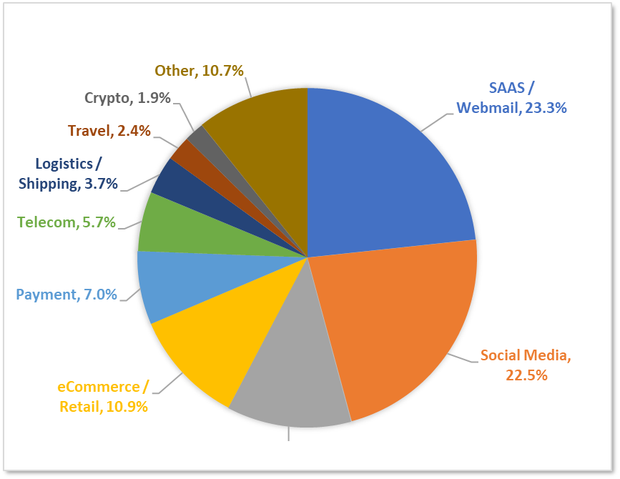
Threat vector | Phishing
Phishing trends
80-95% of cyber attacks begin with a phish. (Hoxhunt Phishing Trends Report 2025).
$4.88M is the average cost of a phishing breach.
Phishing isn’t restricted to emails. Attackers adopting new vectors like:
  SMS – Smshing
  QR – Quishing
  Voice – Vishing
  And many more.
Attackers often use new domains and websites for every phishing campaign.
Brand impersonation on a all time high.
MOST-TARGETED SECTORS, Q4 2024

Slide 6
Threat vector | Ransomware
Ransomware trends
Number of attacks ransomware actors claimed responsibility for during 2023 and 2024
2023 2024
17% percent increase in ransomware attack in 2024 (Deloitte Global CTI Report 2024).
The most common root causes for successful ransomware attacks were exploited vulnerabilities, compromised credentials, and phishing attacks.
The average cost of a ransomware data breach reached US$4.91 million.
600
500
400
300
200
100
0
Jan Feb Mar Apr May Jun Jul Aug Sep Oct Nov Dec
Top five ransomware variants observed in 2024
RaaS
185
209
516
Ransomware-as-a-Service is a business model between operators and affiliates in which affiliates pay to launch ransomware attacks developed by operators.
The prevalence of the RaaS model has significantly increased the frequency, destructiveness, and complexity of ransomware attacks.
Many politically-motivated threat groups have been utilizing RaaS in their operations.
353
514

Slide 7
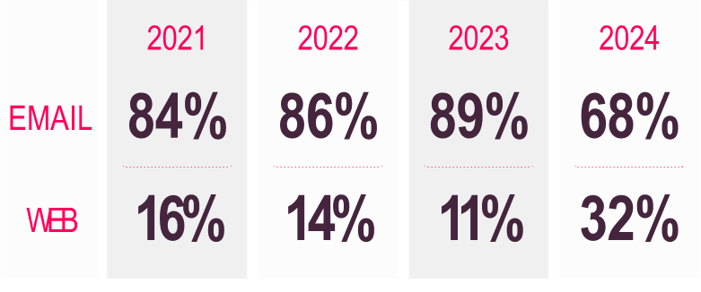
Threat vector | Email & Web
Email trends
Email-based attacks remain the dominant initial attack vector, with 68% of attacks originating from email. (Check Point Cyber Security Report 2025).
Attackers attach malicious HTML& PDF files which are then used to carry-out phishing, credential theft, and HTML smuggling.
68%
OF ATTACKS ORIGINATE
FROM EMAIL
Web trends
32% rise in web-delivered attacks.
Most common attack types include drive-by downloads & fake updates.
61%
OF EMAIL-DELIVERED MALICIOUS FILES INCLUDE HTML ATTACHMENTS

Slide 8
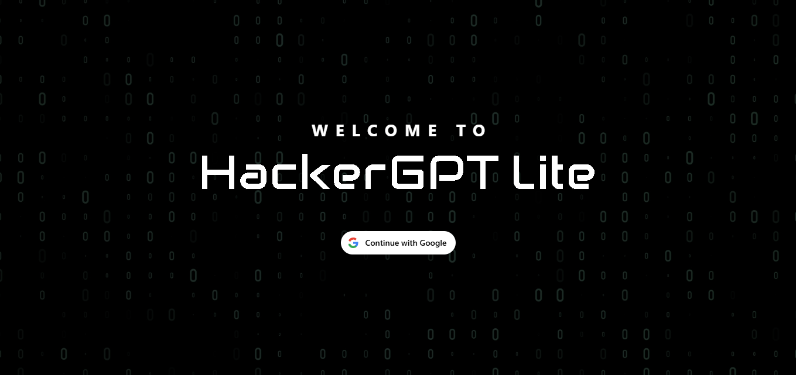
Emerging Threat | AI
AI for Malware
Cyber attackers are weaponizing AI to automate every stage of the attack chain — from writing malware code, phishing kits to generating deepfakes and data-stealing tools. (Check Point AI Security Report 2025).
Emerging groups like FunkSec are leading this trend, using AI to enhance ransomware precision and speed.
AI Models used by Cyber Criminals
Malicious AI models such as WormGPT are now being sold on underground forums, capable of writing malware and social-engineering scripts without ethical limits.

Slide 9
Cyber Security Gap
Lack of Skills & Training
58% of security breaches stem from insufficient cybersecurity skills or training among IT staff (Fortinet Cybersecurity Skills Gap Report 2025).
Hiring skilled cybersecurity professionals remains a major challenge.
Low Cybersecurity Awareness
56% of breaches are attributed to poor security awareness among employees.
Lack of Necessary Cybersecurity Tools
54% of organizations attribute breaches to lack of essential cybersecurity solutions.
It’s expensive to build everything in-house.
Misconfigurations: The Hidden Weakness in Cyber Defense
Over 80% of successful breaches involve misconfigurations or human error.
Very difficult for MSME organizations of effectively deploy, manage & optimize their security solutions.

Slide 10
Impact of a Cyber Breach
Tangible
  Regulatory fines & penalties
  Loss of Revenue
  Data loss / theft
Intangible
  Loss of customer trust
  Loss of Reputation
  Loss of Market Share

Slide 11
What is MSSP?
MSSP is an acronym for Managed Security Services Provider.
It’s is a company that manages, monitors and protects your organization’s IT infrastructure & data from cyber threats 24/7.
What does it mean for you?
You get to work with trained & certified team of security experts who manages and monitors your network 24*7*365 so you can focus on your business.
You get complete end-to-end security offering from Alf ME covering all aspects of cybersecurity.
Dedicated team support engineers to assist you with day-to-day issues and troubleshooting.
Best in-class incident response team responsible for managing and responding to cybersecurity incidents.
Complete peace of mind!!!

Slide 12
Customer Benefits
Security Without the Complexity
Enterprise-grade cybersecurity without needing to hire, train, or manage a security team. All the operational burden is handled by experts.
24*7 Monitoring & Protection
Customers get round-the-clock surveillance, real-time alerts, and rapid response to incidents.
Cost Effective Security
Instead of buying expensive tools, hardware, and licenses, customers simply pay a predictable monthly subscription.No CapEx. No surprise upgrades
Always Up to Date
All security products i.e. firewalls, endpoint agents, email security, SIEM rules — are patched, updated, and optimally configured. Customers never fall behind on updates.

Slide 13
Access to Skilled Cyber Experts
Instant access to certified experts, threat analysts, and SOC professionals.
Faster Response to Threats
MSSP detects and responds immediately threats & incidents, dramatically reducing the impact of attacks.
Better Visibility & Reporting
Daily/Weekly/Monthly security reports, and insights that show exactly what’s happening and how they’re being protected.
Improved Compliance & Reporting
MSSP ensures security controls align with standards like ISO, PCI-DSS, GDPR, NCA ECC, SAMA, etc. This helps customers maintain compliance effortlessly.

Slide 14
How does a MSSP differ from a MSP?
Core Focus
MSPs provides generic managed IT services whereas MSSPs solely focus on providing managed cybersecurity services.
Tools & Technology
MSSPs rely on specialized cybersecurity tools like SIEM & SOAR whereas MSP may rely on standard IT tools.
Outcome
MSP may help in achieving higher availability and minimizing IT downtime. However, MSSP helps in reducing cybersecurity risk & enhance security posture.

Slide 15
Alf MSSP Offering
Managed Next-Gen Firewall
Managed Email Security
Managed End Point Protection
Managed SIEM / SOC Monitoring

Slide 16
Managed Next-Gen Firewall
Cloud-delivered managed firewall solution that provides advanced network security which is divided into 3 bundles as shown below.
Security Bundle
Basic | Intermediate | Advanced
Firewall IPS | Firewall IPS URL Filtering App Control Anti-bot Anti-virus DNS Security | Firewall IPS URL Filtering App Control Anti-bot Anti-virus DNS Security Threat Emulation (Sandboxing) Threat Extraction (CDR) Zero Phishing

Slide 17
What do you get with Managed Firewall?
SIEM: Daily / Weekly / Monthly Access-Control & Threat Prevention reports. Email based alerts. Daily utilization reports. Miscellaneous Capabilities: Third-party IoC feed integration. Supports custom threat indicators. Forwarding logs to third-party SIEM / SYSLOG. Supports SNORT signatures. - 24*7 Support
Add-ons
Log Retention up to 3/6/12 months. Regulatory Compliance.

Slide 18
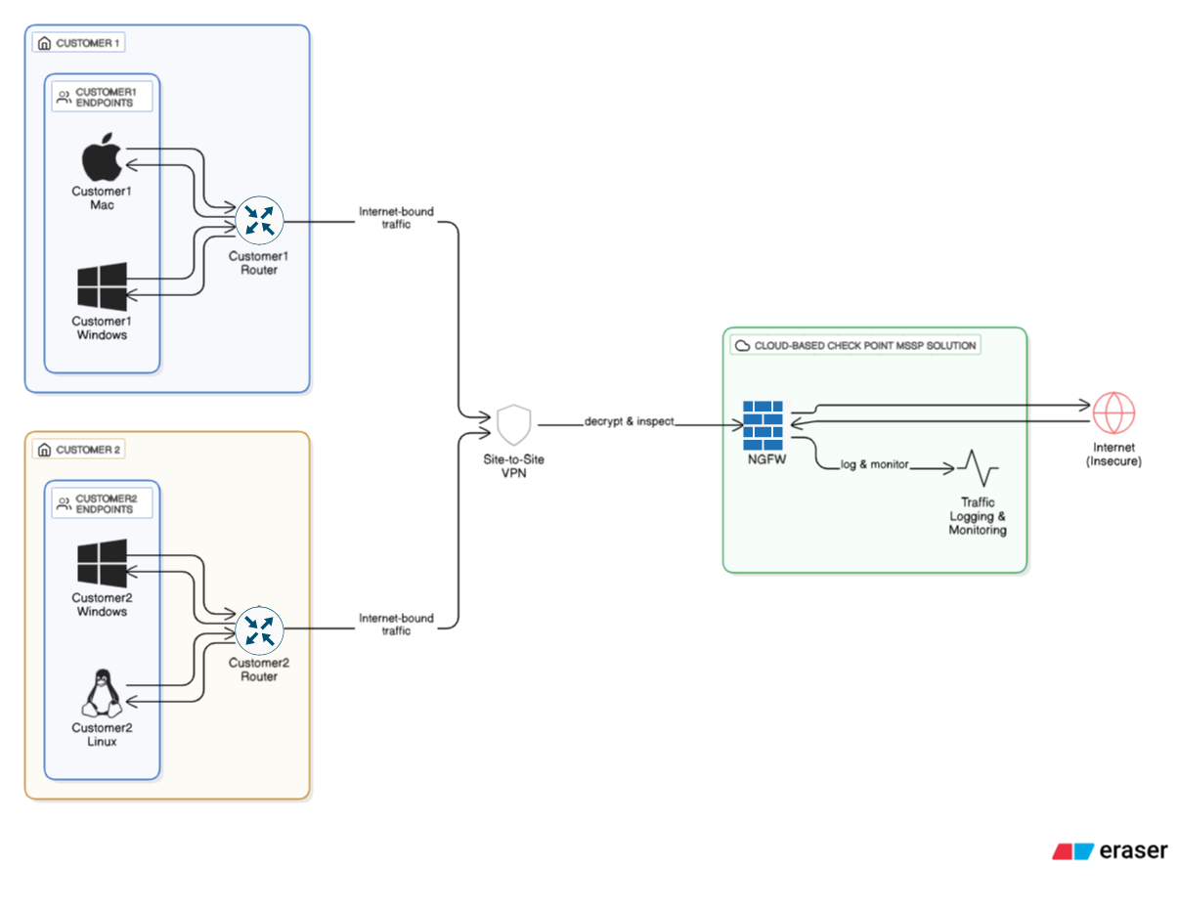
Managed Firewall Traffic Flow

Slide 19
Managed Email Security
A cloud-native email security platform that seamlessly integrates with Microsoft 365, Google Workspace, and even on-premises mail servers, ensuring complete protection wherever your email lives.
What it Means for you?
Complete Email Security
Protect your mail servers against zero-day threats, spams and malicious attachments.
Protection Against Phishing
Delivers exceptional protection against generic & targeted phishing campaigns.
Protection Against DLP
Gain visibility and control of sensitive data flowing in and out of your organization.

